Slide 1
Computer network HW2 -Retransmission + Congest control
DATE : 2018/11/28

Slide 2
Introduction

Slide 3
Introduction
Target
Application layer reliable transfer / congestion control
Implement TCP by UDP
Socket Programming
UDP | TCP
Unreliable Unordered delivery | Reliable In-order Delivery Congestion Control

Slide 4
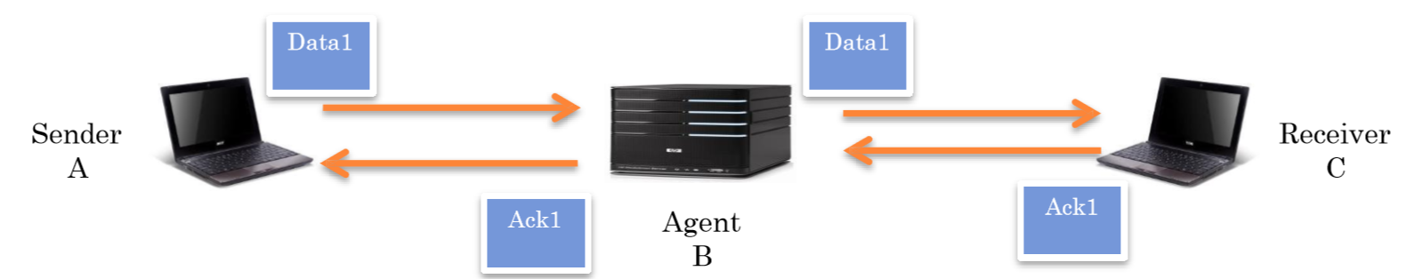
Introduction
You need to implement three components : the sender,
receiver and agent.

Slide 5
Introduction
Sender / Receiver
Send / receive file by UDP
Provide reliable transmission
Congestion control
Agent
Forward Data & ACK packets
Randomly drop data packet
Compute loss rate

Slide 6
Requirement

Slide 7
Requirement
Reliable Transmission
Data & ACK
Time out & Retransmission(Go-Back-N)
Sequence number
Completeness and correctness of transmitted file

Slide 8
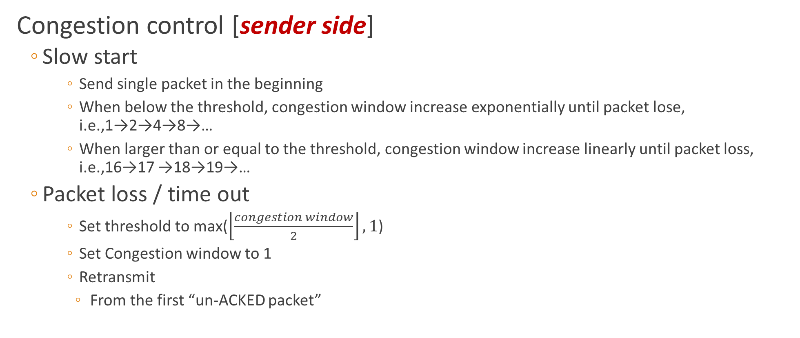
Requirement

Slide 9
Requirement
Buffer handling [receiver side]
Buffer Overflow
Drop packet if “out of range” of buffer
Flush (write) to the file
Only when both buffer overflows and all packets in range are received.

Slide 10
What is Go-Back-N(GBN)?

Slide 11
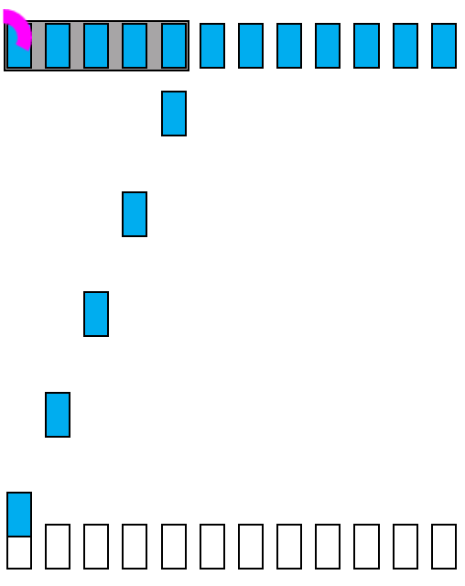


Go-Back-N case 1 (working normally)
Window size
Sender
Time
Packet
Ack
Receiver

Slide 12
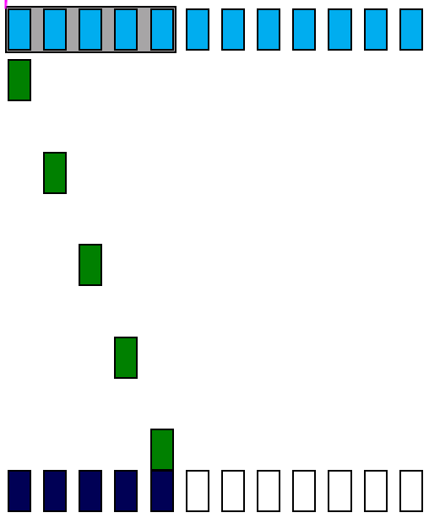
Go-Back-N case 1 (working normally)
Window size
Sender
Time
Packet
Ack
Receiver

Slide 13
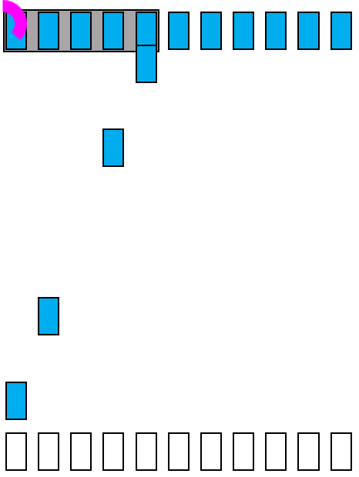
Go-Back-N case 2 (packet loss)
1 2 3 4 5 6 7
Sender
5
4
Packet loss
Time
2
Packet
1
Ack
Receiver

Slide 14
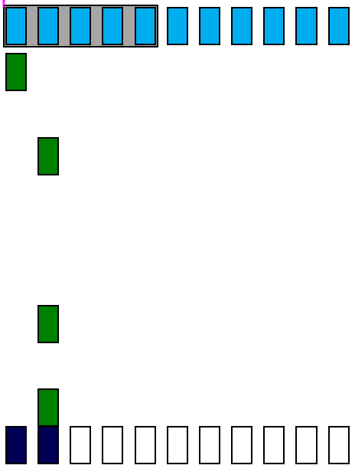
Go-Back-N case 2 (packet loss)
1 2 3 4 5 6 7
Sender
1
ACK-2 triggered by packet-2
2
ACK-2 triggered by packet-4
Time
2
ACK-2 triggered by packet-5
Packet
2
Ack
Receiver

Slide 15
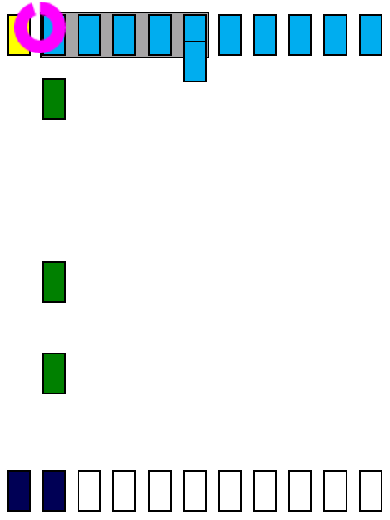
Go-Back-N case 2 (packet loss)
1 2 3 4 5 6 7
Sender
6
2
ACK-2 triggered by packet-2
ACK-2 triggered by packet-4
2
Time
2
Packet
ACK-2 triggered by packet-5
Ack
Receiver

Slide 16
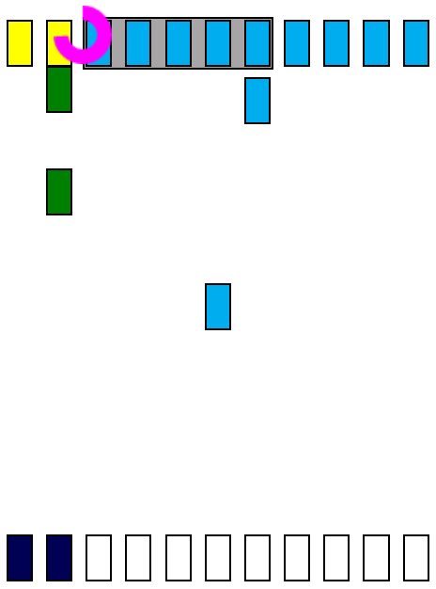
Go-Back-N case 2 (packet loss)
1 2 3 4 5 6 7
Sender
2
7
ACK-2 triggered by packet-4
2
ACK-2 triggered by packet-5
6
Time
Packet
Ack
Receiver

Slide 17
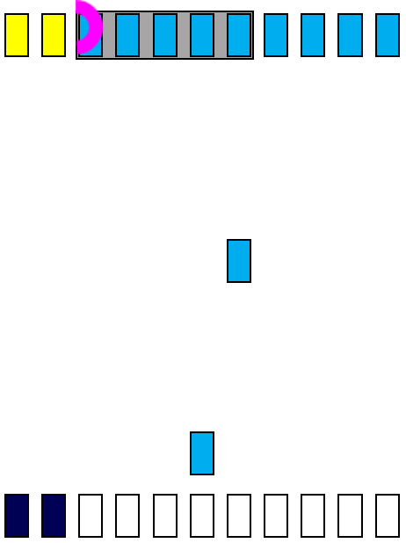
Go-Back-N case 2 (packet loss)
1 2 3 4 5 6 7
Sender
7
Time
Packet
6
Ack
Receiver

Slide 18
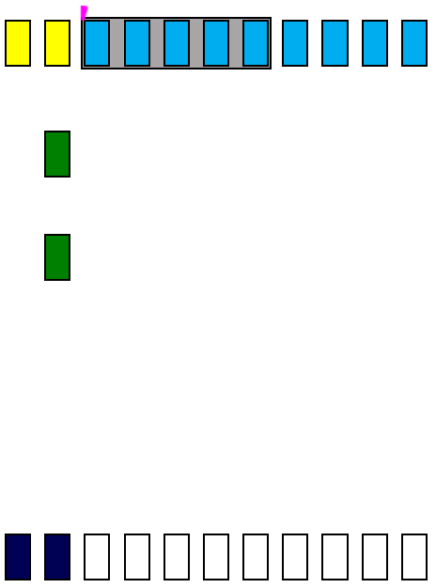
Go-Back-N case 2 (packet loss)
1 2 3 4 5 6 7
Sender
Time out
2
ACK-2 triggered by packet-6
2
ACK-2 triggered by packet-7
Time
Packet
Ack
Receiver

Slide 19
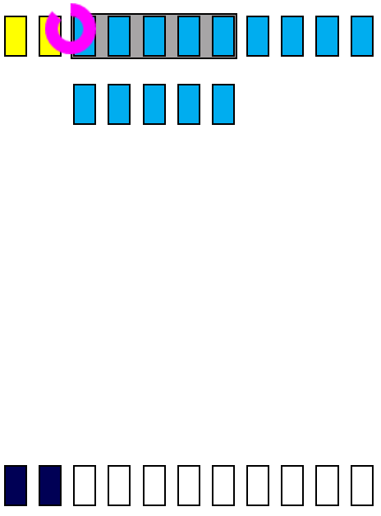
Go-Back-N case 2 (packet loss)
1 2 3 4 5 6 7
Sender
3 4 5 6 7
Time
Packet
Receiver
Ack

Slide 20
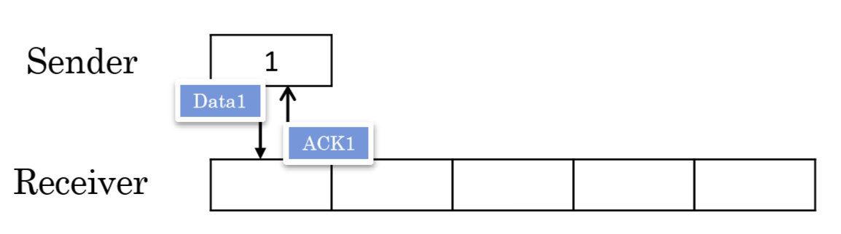
Example (GBN + Congestion control)
Sender sends Data 1
Congestion window = 1. Threshold = 2
Receiver sends ACK 1

Slide 21
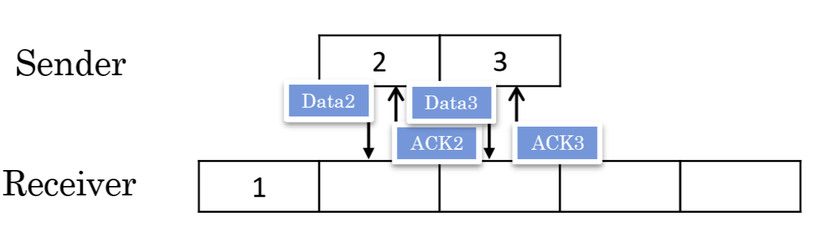
Example (GBN + Congestion control)
Sender sends Data 2,3
Congestion window =2, Threshold =2;
Receiver sends ACK 2,3

Slide 22
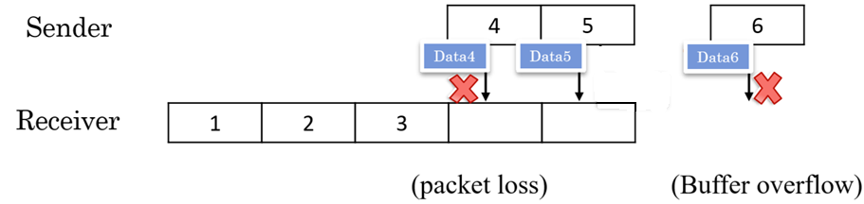

Example (GBN + Congestion control)
Sender sends Data 4,5,6
Congestion window =3; Threshold =2;
Receiver drops Data 5, sends ACK 3, drops Data 6, sends ACK 3
Drop
(Drop)

Slide 23
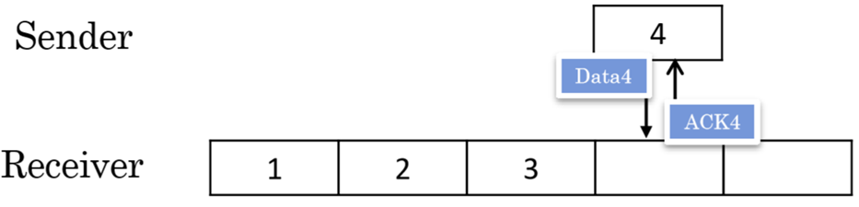
Example (GBN + Congestion control)
Sender sends Data 4
Congestion window = 1, Threshold = 1
Receiver sends ACK 4

Slide 24
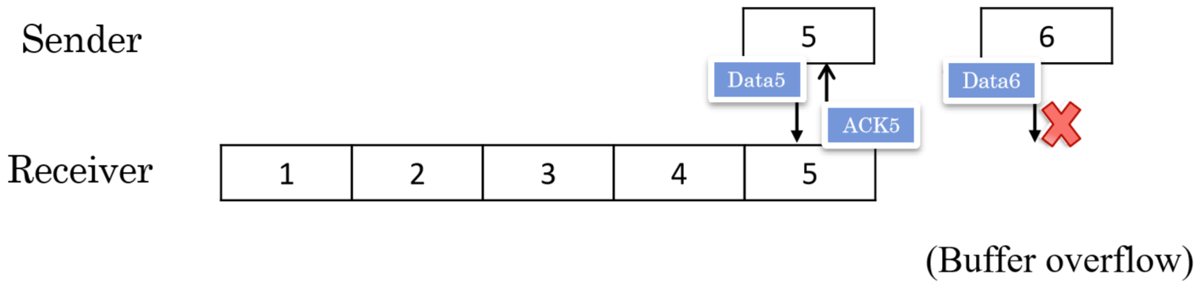

Example (GBN + Congestion control)
Sender sends Data 5,6
Congestion window = 2, Threshold =1;
Receiver sends ACK 5, drops Data 6, sends ACK 5, flush buffer ()

Slide 25
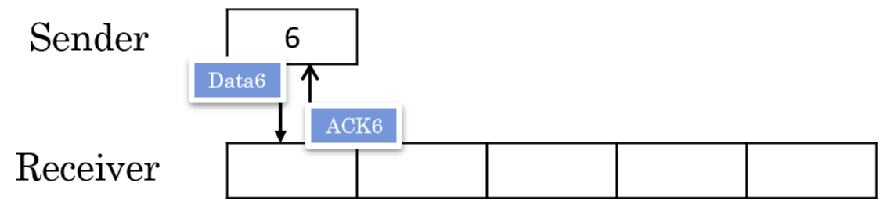
Example (GBN + Congestion control)
Sender sends Data 6
Congestion Window =1; Threshold =1
Receiver sends ACK 6
And so on…

Slide 26
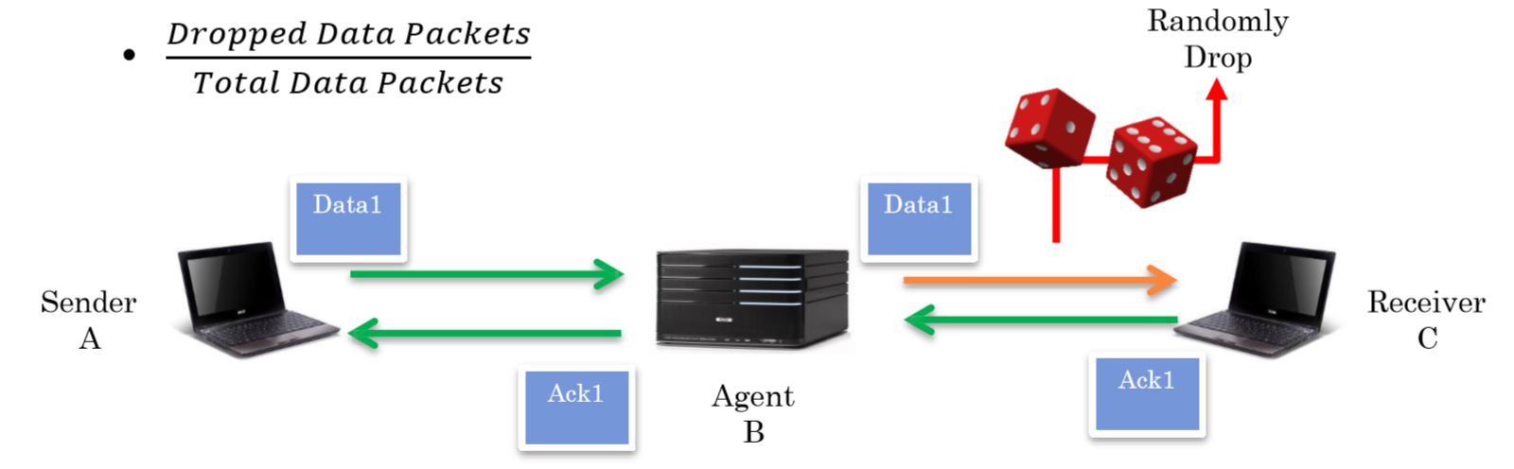
Requirement
Agent
Forward data and ACK packets
Randomly drop data packet [DO NOT DROP ACK PACKETS]
Compute loss rate

Slide 27
Requirement
Show Message
Sender
send, recv, data, ack, fin, finack, sequence number, time out, resnd, winSize, threshold
Receiver
send, recv, data, ack, fin, finack, sequence number, drop, flush
Agent
get, fwd, data, ack, fin, finack, sequence number, drop, loss rate

Slide 28
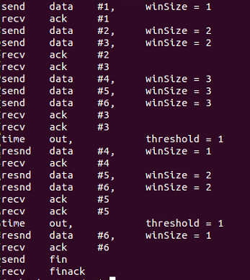
Requirement
Sender

Slide 29
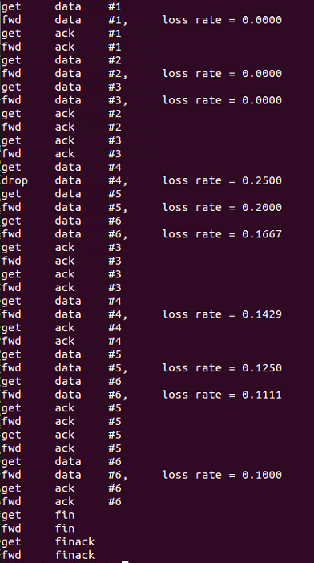
Requirement
Agent

Slide 30
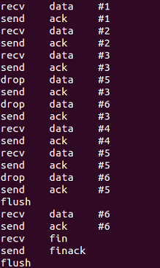
Requirement
Receiver

Slide 31
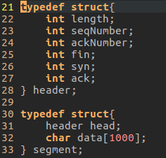
Requirement
The format used for transmission should be the same as fallow:
fin: 0 or 1
syn: 0 or 1 (just make it 0)
ack: 0 or 1

Slide 32
Requirement
Settings
Sender
Arguments: IP, Port, path of source file,… etc.
Default threshold:16
Input file may include media file or text file, etc.(e.g. ./sender text.txt)
Receiver
Arguments: IP, port ,path of destination file, … etc.
Default buffer size: 32 segments
Output file name: result.?? (Filename Extension is the same as the input file)
Agent
Arguments: IP, port, loss rate, … etc.

Slide 33
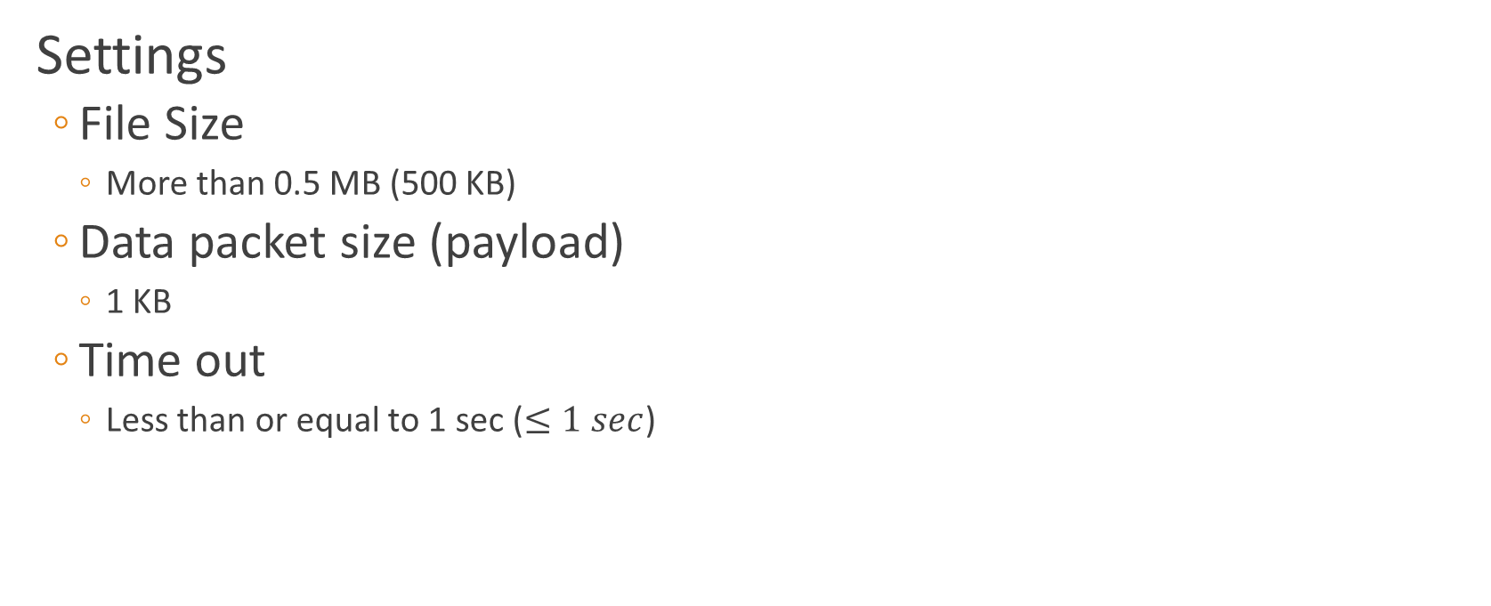
Requirement

Slide 34
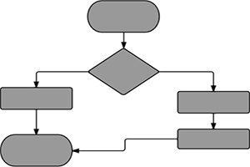
Requirement
Document
Format
A4, at most 2 pages
Digital PDF file only, “HW2-Report.pdf”
Content
How to execute your program
Explain your program structure(including 3 flow charts for sender, agent, and receiver)
Difficulties and Solutions

Slide 35
Grading and Submission

Slide 36
Grading and Submission
Grading (100%)
Basic requirement (10%)
Socket programming with UDP
Language: No restriction
Without crash
Reliable transmission (20%) (page 7)
Congestion control (25%) (page 8)
Buffer handling (15%) (page 9)
Agent (10%) (page 26)
Message format (5%) (page 27)
Document (5%) (page 33)
Demo (10%) (page36)

Slide 37
Grading and Submission
Demo (10%)
Please fill the demo form (will be announced on course website)
Come to demo on time
Discount for those are not on time
You will get ZERO for this homework if you don’t demo.

Slide 38
Grading and Submission
Submission Deadline
2018/12/26 (Wed.) 23:59 (UTC+8)
Late submission: 20% off per day
NOT accept after 23:59, 12/28, 2018.
Naming
[Student ID].zip Ex: r069xxxxx.zip
Email subject: [CN2018] Homework2_studentID
Email: ntu.cnta@gmail.com

