Slide 1
Household Electric Power Prediction
A ML Project

Slide 2

Hello!
I am Ahmed Abdalrahiem
This presentation is intended to discuss the outcomes of the project

Slide 3
Content
Business KPIs
Problem Statement
Key Findings
Model Performance
Recommendations

Slide 4
Business KPIs
1

Slide 5
Potential for KPIs
While machine learning projects are challenging and complex, it’s always advisable to start them by identifying the goal of the project and the way it serves the business container in which it lives.
One of the ways is defining the business goals along with the Key Performance Indicators (KPI).

Slide 6
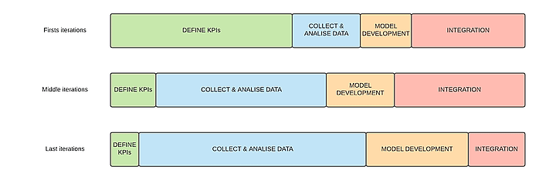

Slide 7
Identified KPIs
Customer Acquisition Cost (CAC): Tracks the cost of acquiring a new customer (marketing, sales efforts).
Customer Lifetime Value (CLTV): Estimates the total revenue a customer generates over their relationship with the company.
Average Daily/Monthly Consumption (kWh): Tracks average electricity used per day or month across the customer base.
Average Reduction in Consumption after Efficiency Initiatives: Analyzes the effectiveness of programs in reducing household electricity usage.

Slide 8
Problem Statement and Methodology
2

Slide 9
Problem Statement
In order to achieve a high value in the predefined KPIs for the Energy Company, we have to come up with a solution that can improve most of them.
The most valuable solution is to design a data-driven model that can predict the electrical consumption for the next 7 days.

Slide 10
Key Findings
3

Slide 11
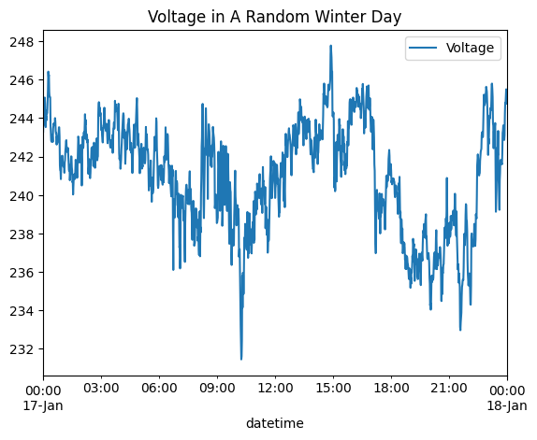
Key Findings
The voltage received by the customer fluctuates and has a standard deviation ranging from 2 to 3. The company may be interested in studying and verifying this phenomenon.

Slide 12
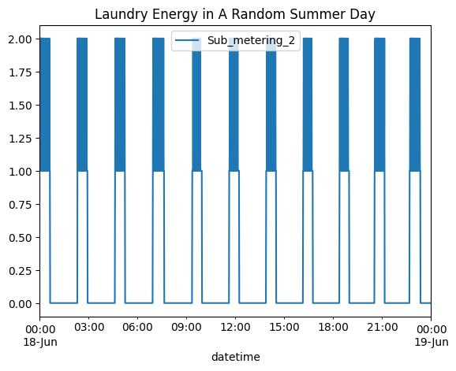
Key Findings
The laundry activities are performed all over the day. The company may give incentives to people who disregard laundry during peak hours.

Slide 13
Key Findings
The laundry activities are performed all over the day. The company may give incentives to people who disregard laundry during peak hours.

Slide 14
Model Performance
4

Slide 15
Model Performance
An LSTM-based sequence-to-sequence model has been developed.
This type of a model has been used instead of traditional models to avoid dynamic model training for each prediction. Also to avoid complexity while considering multivariate time series prediction.
The problem has been identified to be a multivariate multi-step time-series problem.
The model achieved 98% accuracy on test data(The model has seen the data only once)

Slide 16
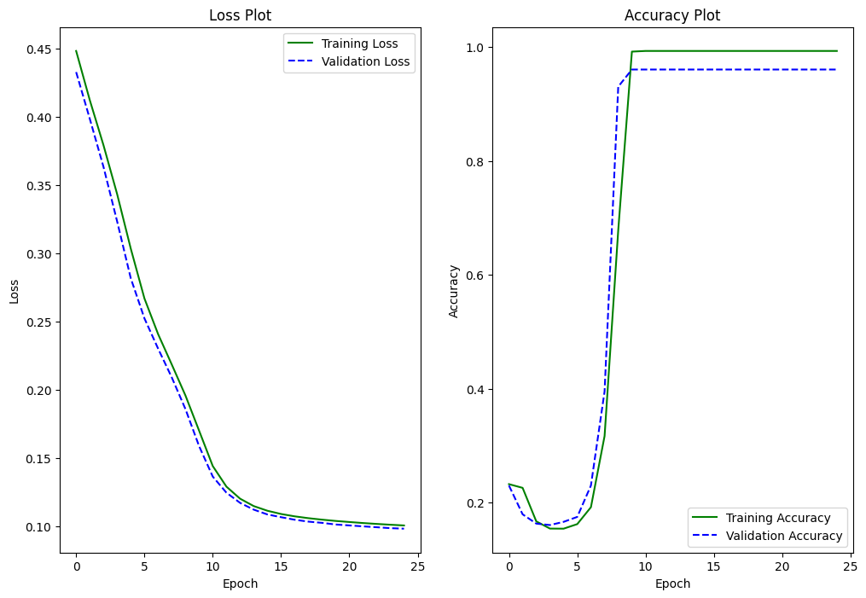
Learning Curves

Slide 17
Recommendations
5

Slide 18
Recommendations
1. Targeted Customer Acquisition:
Analyze customer data to identify segments with high consumption patterns or potential for energy efficiency improvements.
2. Smart Meter Rollout and Incentives:
Implement a program to encourage smart meter adoption. This provides valuable data for consumption analysis and personalized energy-saving recommendations.
Offer incentives like discounts or rebates for customers who switch to smart meters.

Slide 19
Recommendations
3. Develop and Promote Energy Efficiency Programs:
Design programs that educate customers about energy-saving practices and recommend efficient appliances/technologies.
Track the impact of these programs using the "Average Reduction in Consumption" KPI and refine them for better results.
4. Leverage Predictive Modeling:
Utilize consumption data and customer information to build accurate models that forecast electricity usage.
Develop personalized recommendations and targeted interventions (e.g., peak-hour usage reduction plans) based on predicted consumption patterns.

Slide 20
Reccomendations
6. Continuously Monitor and Adapt:
Regularly analyze KPIs to assess the effectiveness of your strategies and identify areas for improvement.
Adapt your plans based on the insights gained from data analysis and customer feedback.

Slide 21
Thanks!
Any questions?
You can find me at:
a.abdalrahiem@gmail.com

