Slide 1

Alfy
A generative AI companion that lives on the Alif Ensemble E8
Every frame drawn live by a neural network on the Ethos-U85. No cloud.
Abdul Mohammed · Awab Ibrahim · Arm + Meta ExecuTorch Edge AI Challenge 2026
Notes:
This is Alfy. Every frame of him is generated live by a neural network on the Ethos-U85, from 32 pose parameters, about 20 times a second. Nothing leaves the board.

Slide 2



From virtual pets to generative pets
1990s
2010s
2026
Pocket virtual pets
Cloud assistants
Alfy on the Alif E8
Tamagotchi: care for a creature on a tiny screen
Smart, but your voice and camera go online
Generative, sees and hears, 100% on-device
The brief imagined: “speaking to a device and watching it generate images” entirely at the edge. That is Alfy.
Notes:
Inspiration: the 90s virtual pet. Alfy keeps the care and personality, but adds generative AI, vision and voice, all on a microcontroller. The organisers' brief described exactly this.

Slide 3





Meet Alfy
Sees you
Feels you
Face tracking, rides your shoulder
Pet him, push him, shake him
Hears you
Reads drawings
Push-to-talk voice, any voice
Draw a fish, he eats it
Needs, moods and learning: pet him after a trick and he does it more
Notes:
Alfy has four senses, each powered by a model or a sensor, plus a personality engine with needs, moods and learning from petting.

Slide 4
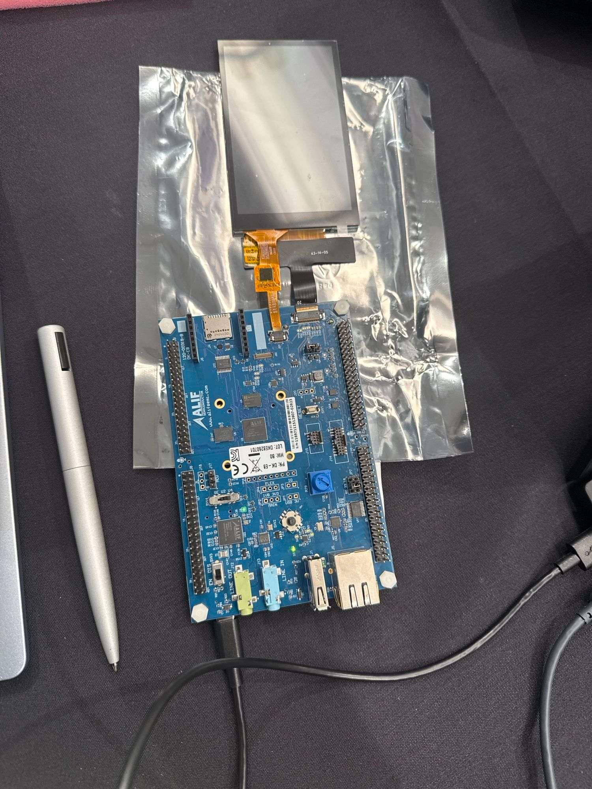



What we built on
Alif Ensemble E8
480×800 touchscreen
2× Cortex-M55, Ethos-U85, 2× Ethos-U55
MIPI DSI panel + GT911 touch
MT9M114 camera
PDM microphones
MIPI CSI, 640×480
8 kHz voice capture
IMU
Joystick + RGB LEDs
accelerometer + gyroscope
push-to-talk, mood light
Notes:
This is the kit: the Alif Ensemble E8 DevKit with its touchscreen. Every input Alfy uses is on this board.

Slide 5









One network, every mood
idle
wave
hop
run
shaken
sleep
sad
yawn
love
angry
Touch
Motion (IMU)
Voice
Camera
Time and needs
Real poses from the generator’s training set. Sensors and moods turn 32 dials; the NPU draws the in-betweens.
Notes:
Each mood is a combination of the 32 pose dials. In-between settings blend smoothly, so the network draws poses it never saw exactly in training.

Slide 6

The hardware: Alif Ensemble E8 DevKit
Ensemble E8 chip
Ethos-U85 NPU
all 4 models
MT9M114 camera
480×800 touch display
Cortex-M55 HP
400 MHz · brain + render
Cortex-M55 HE
160 MHz
PDM microphones
Joystick
2× Ethos-U55
tested, not used
2× Cortex-A32
unused
IMU motion sensor
8 MB SRAM
7.86 MB used
RGB LEDs
Bright = used by Alfy
Notes:
Bright blocks are what Alfy uses: the Ethos-U85 NPU for all four models and the high-performance Cortex-M55 for everything else. Six on-board peripherals feed him.

Slide 7
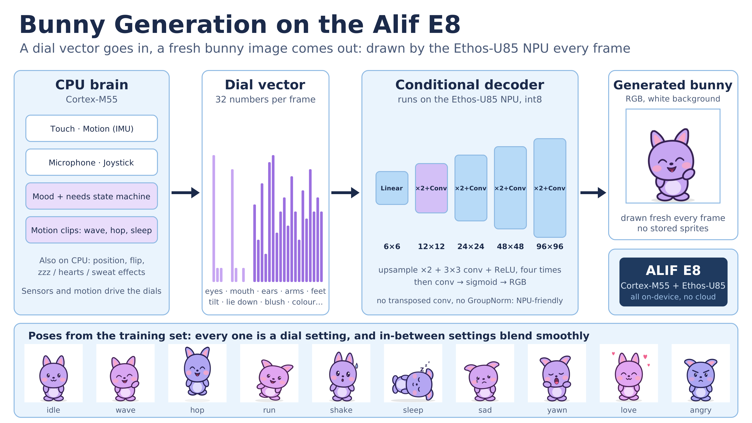
Notes:
The bunny is not pre-drawn. The CPU sets 32 pose dials, and a conditional decoder on the Ethos-U85 turns them into a 96x96 RGB image in 9.4 ms. NPU-friendly layers only: upsample plus 3x3 conv, no transposed conv, no GroupNorm. 16-bit activations (a16w8) because colours collapsed in plain int8. The bottom row is real training poses; in-between dial settings blend smoothly.

Slide 8

Four models, one NPU
Bunny generator
Face detector
Keyword spotter
Doodle reader
Conditional decoder
BlazeFace
DS-CNN
CNN
32 dials → 96×96 RGB
128×128 camera
49×40 log-mel → 11 words
28×28 → 8 drawings
9.4 ms
10.3 ms
0.65 ms
0.23 ms
every frame
every 2nd frame
per command
per drawing
100% NPU
100% NPU
100% NPU
100% NPU
Notes:
All four models run 100% on the Ethos-U85, int8 or int16, with only float-int conversion at the edges on the CPU. The NPU is busy about a quarter of each frame.

Slide 9

Performance on the board
20 fps
home world
~25%
12–15 fps
camera world
NPU duty per frame
~29 ms
voice compute after you speak
45-minute soak test: 0 reboots, 0 faults, 0 NPU errors. 3 s hardware watchdog. Doodles 12/12 recognised.
Notes:
Latencies from the board's NPU counters. Home world runs at 20 fps, camera world 12 to 15. The NPU is only busy about 25% of a frame: the bottleneck is CPU rendering, not AI. Soak test: 45 minutes, no faults.

Slide 10


Fitting it all in 8 MB
7.86 MB
One NPU scratch pool shared by all 4 models
Models copied to SRAM at boot (fixed NPU bus abort)
MRAM: 2.25 MB of 5.5 MB
of 8 MB on-chip SRAM used (98%)
Notes:
Four models plus two frame buffers fit in 8 MB of on-chip SRAM because all models share one NPU scratch pool. The NPU could not read weights from upper flash, so models are copied into SRAM at boot.

Slide 11
What runs where
Ethos-U85 NPU
Bunny generator
Face detector
Keyword spotter
Doodle reader
Cortex-M55 HP · 400 MHz
Personality engine
96→448 px upscale + outline
Audio front end (FFT, log-mel)
UI, motion clips
Dedicated hardware
Camera: CPI + DMA, async
Display: CDC200, vsync swap
Touch, IMU, LEDs
Design choice: we tested the Ethos-U55 (385 µs vs 249 µs on U85) but kept one NPU: it is only ~25% busy, and a second core would cost 1.3 MB we don't have.
Notes:
Workload placement. The rubric rewards good decisions rather than maximum NPU use: we tested the U55, it works, but adding it needs a second firmware on the other M55 and 1.3 MB more SRAM, for a few fps. We chose a stable single-core, single-NPU design.

Slide 12
Sense → AI → reaction
Hold joystick, say “happy”
Keyword spotter
dances
Face in camera + “up”
BlazeFace + voice
jumps on your shoulder
Draw a fish
Doodle reader
eats it, food meter fills
Shake the board
IMU on the CPU
gets dizzy
Touch Alfy
Personality engine
hearts, LED pink
Notes:
Every input goes through AI or the personality engine and comes out as an animated reaction, all on the board.

Slide 13
Training the models
Bunny generator
Keyword spotter
1.63 MB
91.1%
Trained by us on images rendered from a vector rig of Alfy
Google Speech Commands, resampled to 8 kHz + noise
Doodle reader
Face detector
96.4%
10.3 ms
Google Quick, Draw!, 8 classes
Google BlazeFace, exported + quantised for the U85
PyTorch → ExecuTorch → Vela → Ethos-U85
Notes:
We trained three of the four models. The bunny generator was trained on a dataset rendered from a vector rig of the character. Keyword spotter: 91.1% on Speech Commands test clips with noise. Doodle classifier: 96.4%. BlazeFace was exported and quantised for the U85.

Slide 14
Hard problems we solved
Problem
Problem
Problem
Problem
Colours collapsed in int8
NPU bus abort reading flash
4 models in 8 MB
Voice v1 only knew one person
Fix
Fix
Fix
Fix
16-bit activations (a16w8) + clamp head
Copy models to SRAM at boot
One shared NPU scratch pool
Trained a real keyword model
Notes:
The four hardest problems and how we solved them.

Slide 15
All on the board. No cloud.
4
100%
20 fps
0
AI models
on the NPU
generated live
bytes sent off-device
Code: https://github.com/aabdurmohammed-source/CMSIS-Executorch· branch Alfy · tag v1.0-demo
Built with: PyTorch, ExecuTorch, Vela, CMSIS-Toolbox, Arm CMSIS-Executorch example, Alif Ensemble E8
Data and models: Google Speech Commands, Quick, Draw! (CC BY 4.0), BlazeFace
Inspiration: 1990s virtual pets (Tamagotchi)
Abdul Mohammed · Awab Ibrahim · all-student team
Notes:
Close: four models, all on the NPU, Alfy generated live at 20 fps, nothing leaves the device. Code, numbers and design decisions are in the README. Thank you, happy to take questions.

