Slide 1
Oil Price Prediction
Aktan Abdygaziev
2019

Slide 2
Introduction
Client: Oil & Gas Investor
Dataset: Weekly WTI Crude Oil Price, 1986-2019
WTI – West Texas Intermediate – oil price benchmark
Source: https://fred.stlouisfed.org/series/WCOILWTICO
Size: 2 features, 1754 observations
Goal:
Predict the WTI crude oil price for the next 5 years
Method: Time Series Analysis

Slide 3
Time Series Analysis
Time Series (TS) is a set observation taken at specified times at equal intervals
It’s time dependent. Assumption that observations are independent does not hold.
Along with increasing/decreasing trend, most of TS data have some form of seasonality
Limitations:
Very sensitive to recent past events
Can not predict or take into account irregular events (random adversities)

Slide 4
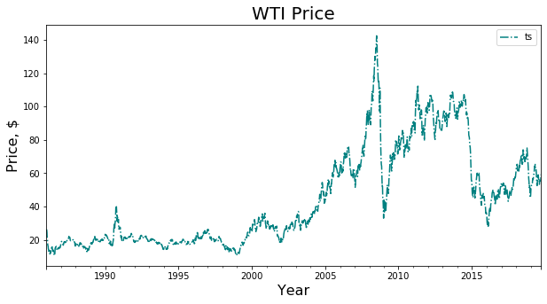
Initial Look of the Data
Financial Crisis 2008
Drone Attack
Recession & 9/11
QE Policy
$59.33
09-20-2019
Notes:
Drone Attack event , Sep 14,2019. This Attack cut Saudi Arabian Oil Production by half – which is 5% of global oil supply. This destabilized financial markets.

Slide 5
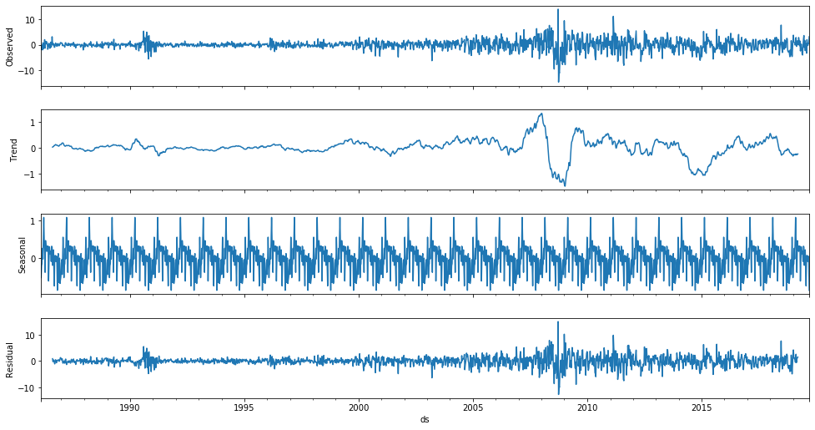
Decomposed Data

Slide 6
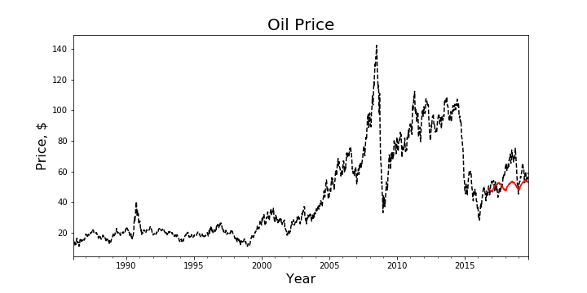
Modelling
Train Data
Test Data

Slide 7
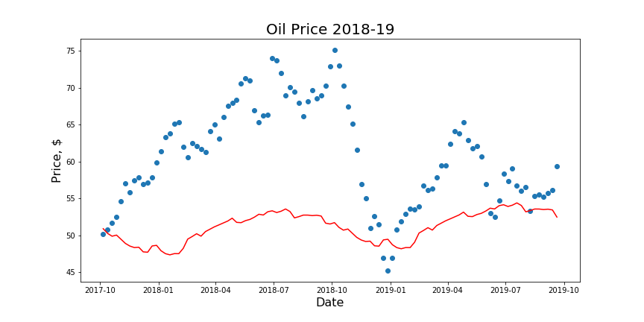
Modelling

Slide 8
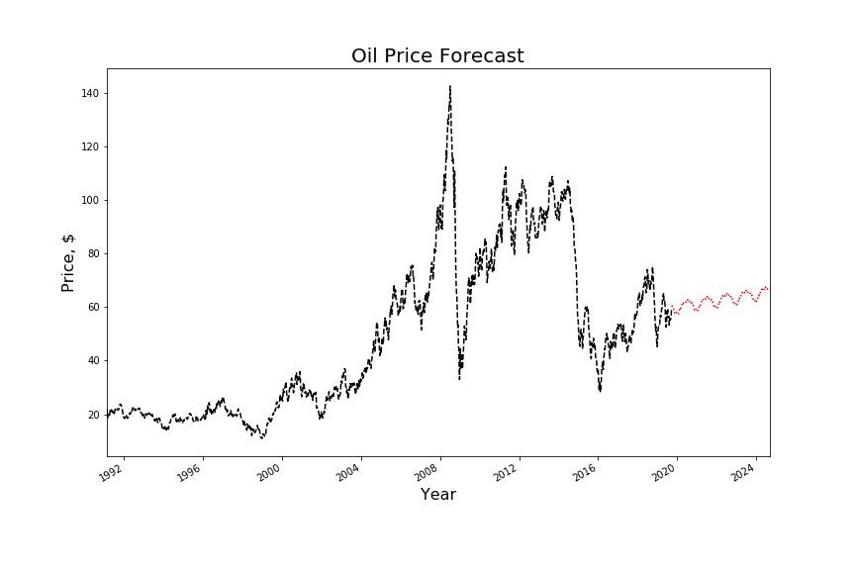
Prediction 2019-2025

Slide 9
Recommendations
Do not invest in current market situation:
Late stage of the economy, recent irregular events
Safer to invest in government bonds or in golds
Wait for the big drop and then buy

