Slide 1
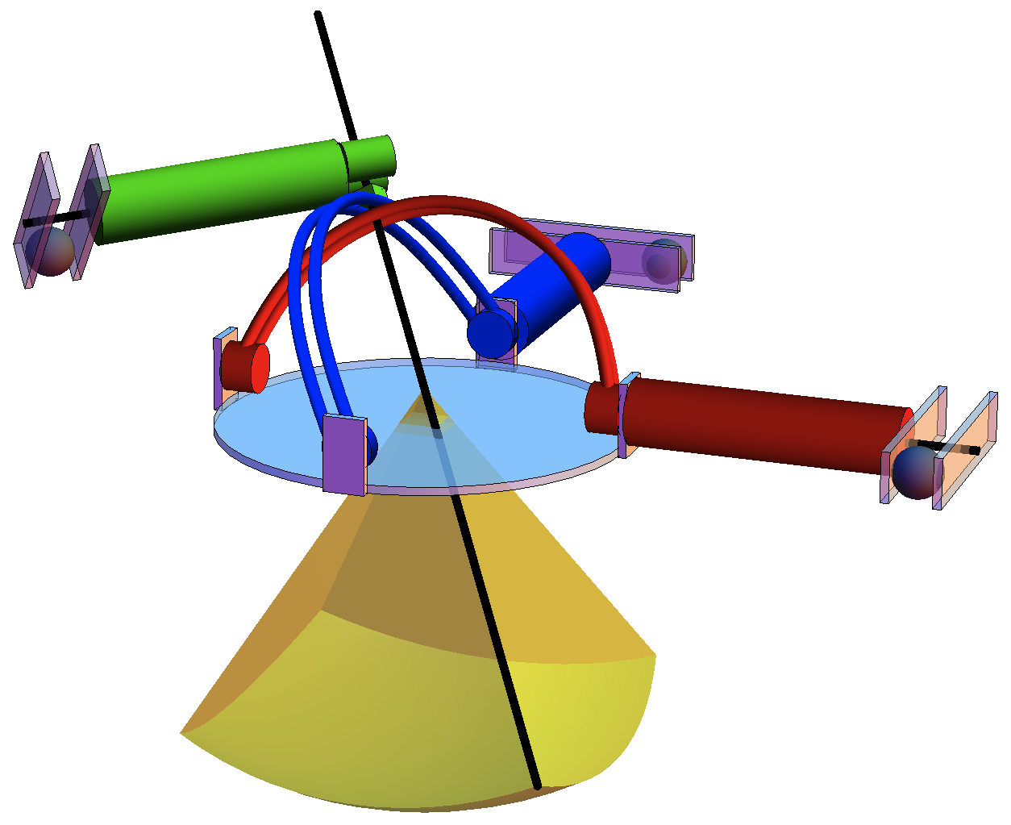
Simultaneously Power & Control Many Actuators With a Clinical MRI Scanner
Aaron Becker, Ouajdi Felfoul, & Pierre E. Dupont
Boston Children’s Hospital &
Harvard Medical School, USA
Uses MRI to power & image multiple actuators
Relies on inhomogeneities e.g. no parallel rotors
Easily implemented position & velocity controllers—global asymptotic convergence
All code online (MATLAB)
ferrous spheres
actuator
needle
robot
workspace
3 Actuators

