Slide 1
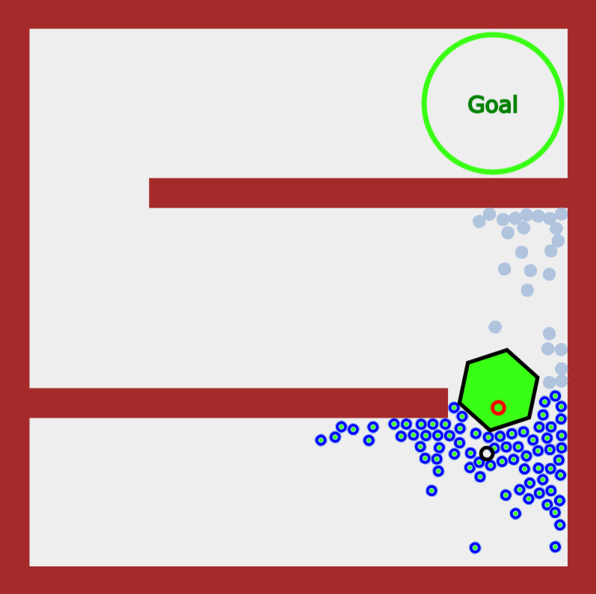
Main Region 3
Main Region 2
Main Region 1
Goal With Regions
Goal Without Regions
Object
Robots in Region
Robots out of Region

