Slide 1
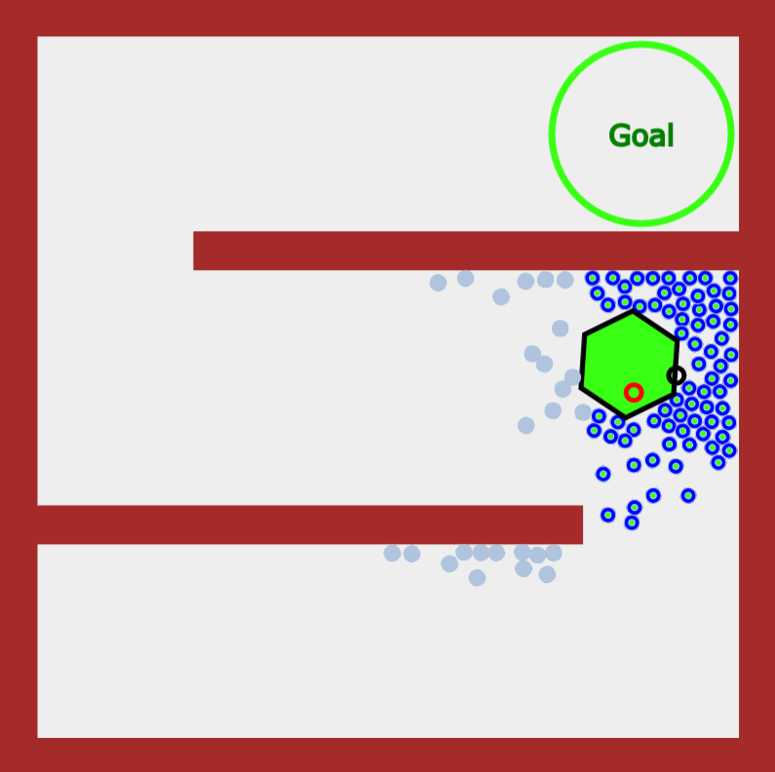
Transfer Region 2
Transfer Region 1
2
1

