Slide 1
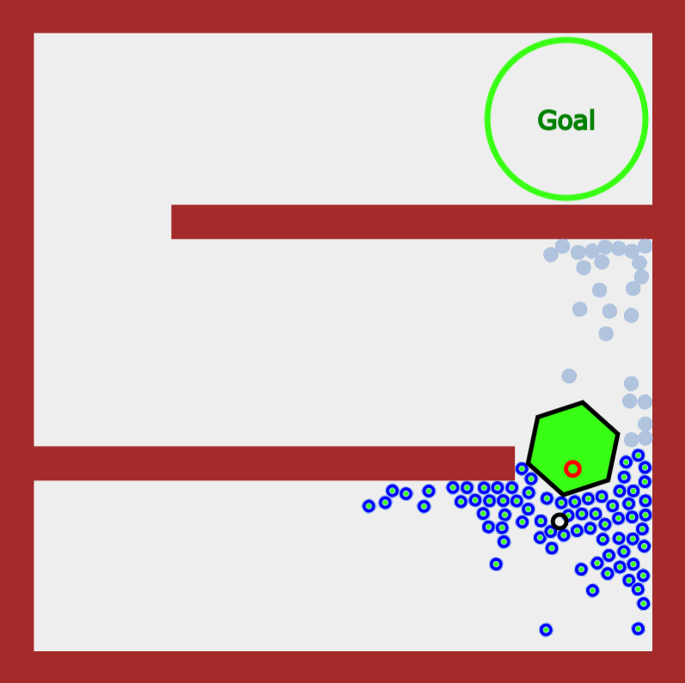
Main Region 3
Main Region 2
Main Region 1
Filtered Mean
Mean
Object
Robots in Region
Robots not in Region

