Slide 1
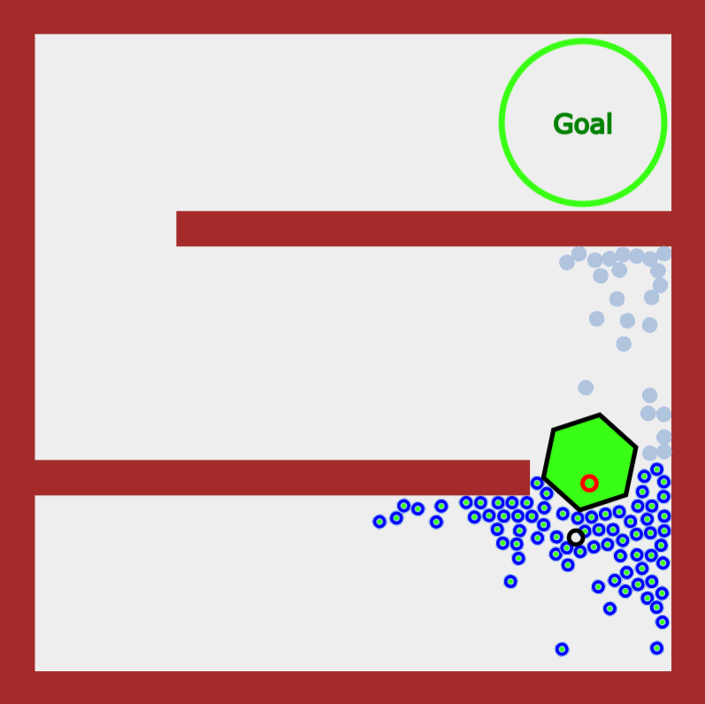
Main Region 2
Main Region 1
Main Region 0
Goal With Regions
Goal Without Regions
Object
Robots in Region
Robots out of Region

