Slide 1
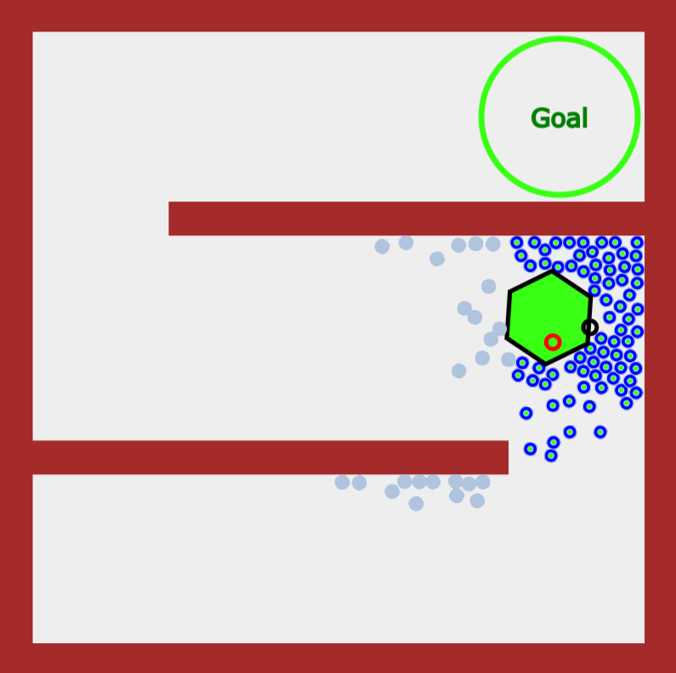
Transfer Region 1
Transfer Region 2
1
Goal With Regions
Goal Without Regions
Object
Robots in Region
Robots out of Region
2

