Slide 1
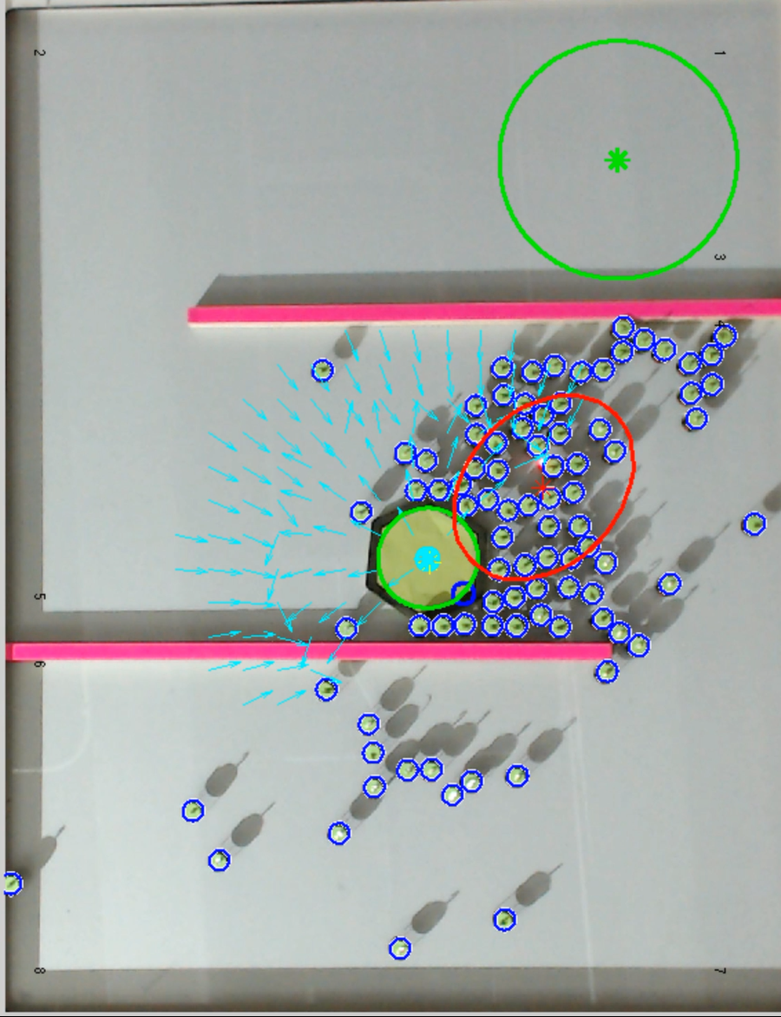
End Goal
Mean of Robots
Object Centroid / Repulsive Point
Object
95% Confidence Ellipse
Force Vectors
Attractive Point
Robots

