Slide 1
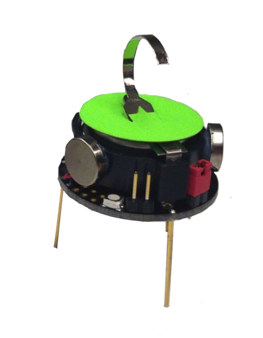
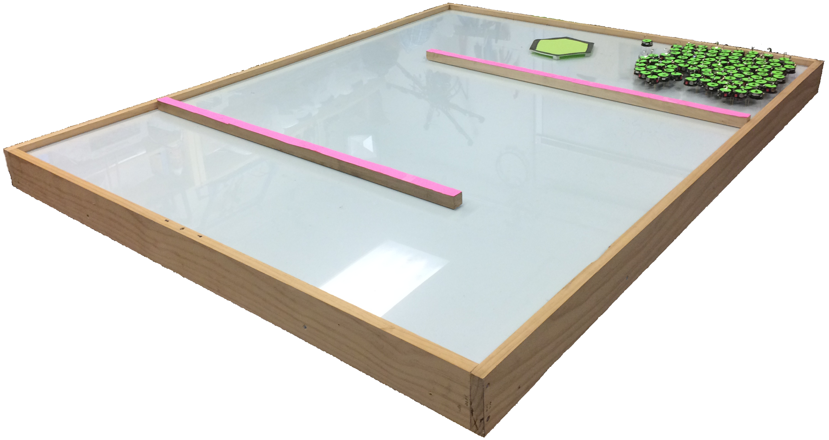
Vision System
30W LED Lights
30W LED Lights
1.5 m
1.2 m
1.5 m
Robots
Object
3 cm
Table of the Robots
Obstacle

