Slide 1
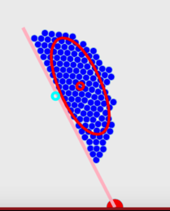
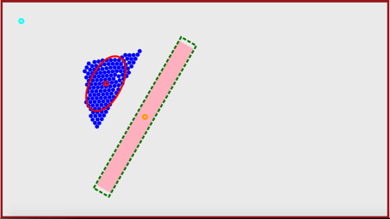
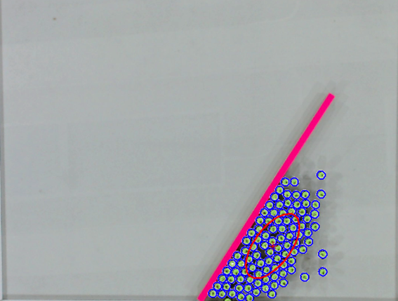
goal
position
robots
object
mean
position
COM
r
object goal pose
a)
b)
c)
Light Direction
Detected Robots
Mean Position +
Covariance Ellipse
Object
Goal
Pivot
θ

Slide 2
robots
mean
position
object
r
pivot
c)
Light Direction
Detected Robots
Mean Position +
Covariance Ellipse
Object
Goal
Pivot
θ

