Slide 1
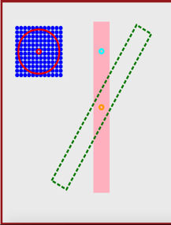
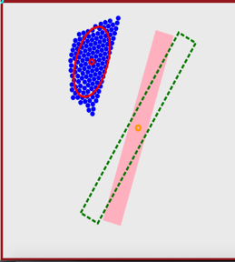
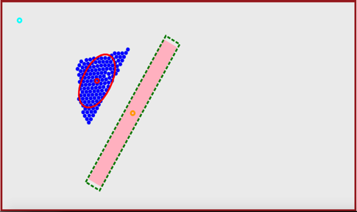
t= 0
t= 5s
t= 15
Robots
COM
Mean Position
Goal Position
Block
Goal Angle
12m
13m
15m

