Slide 1
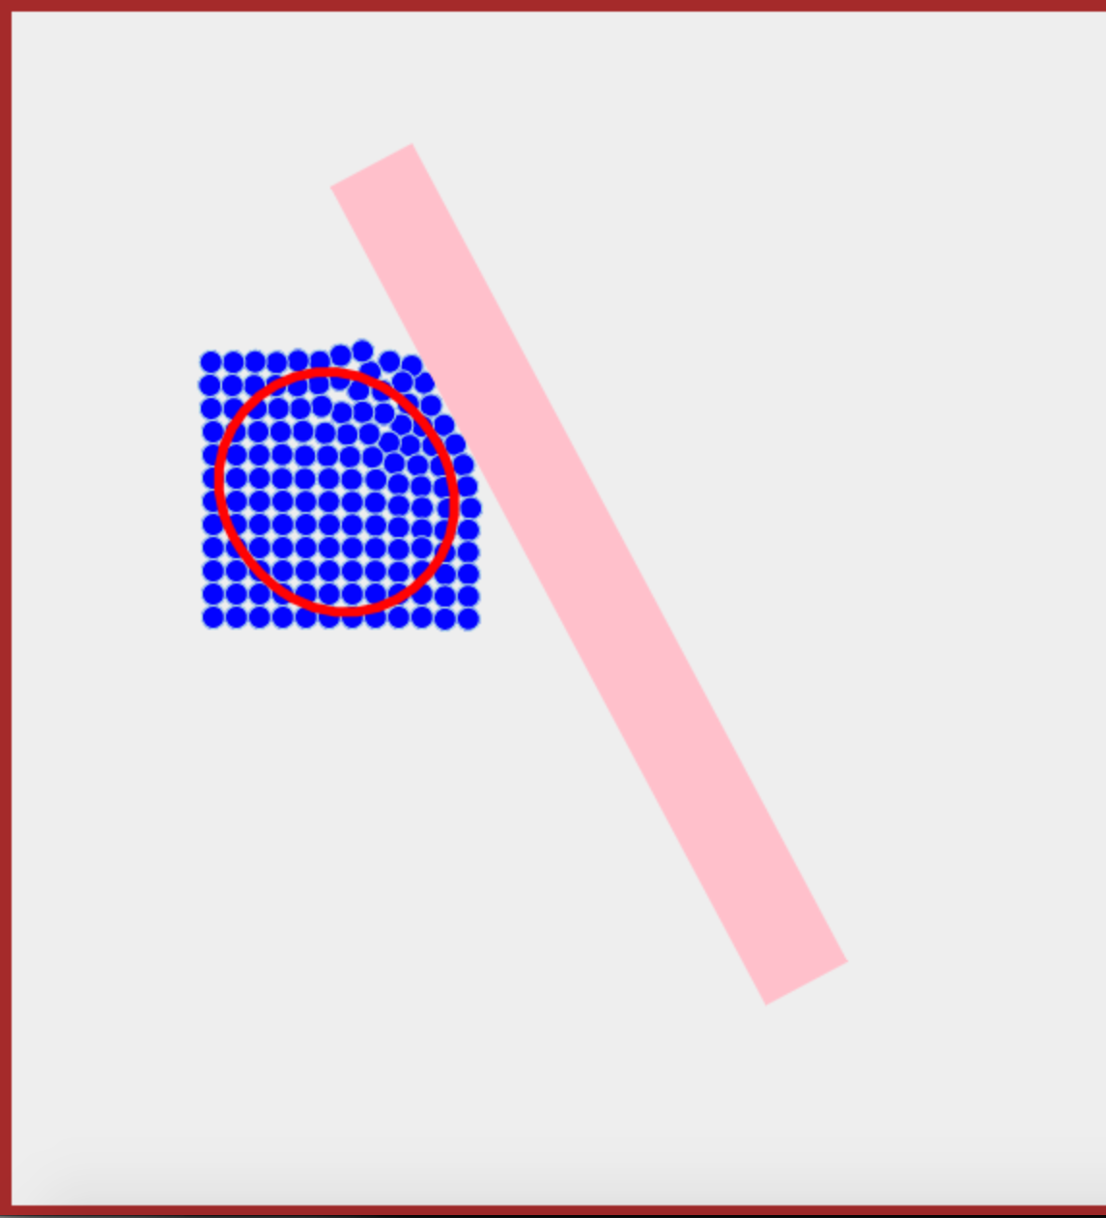
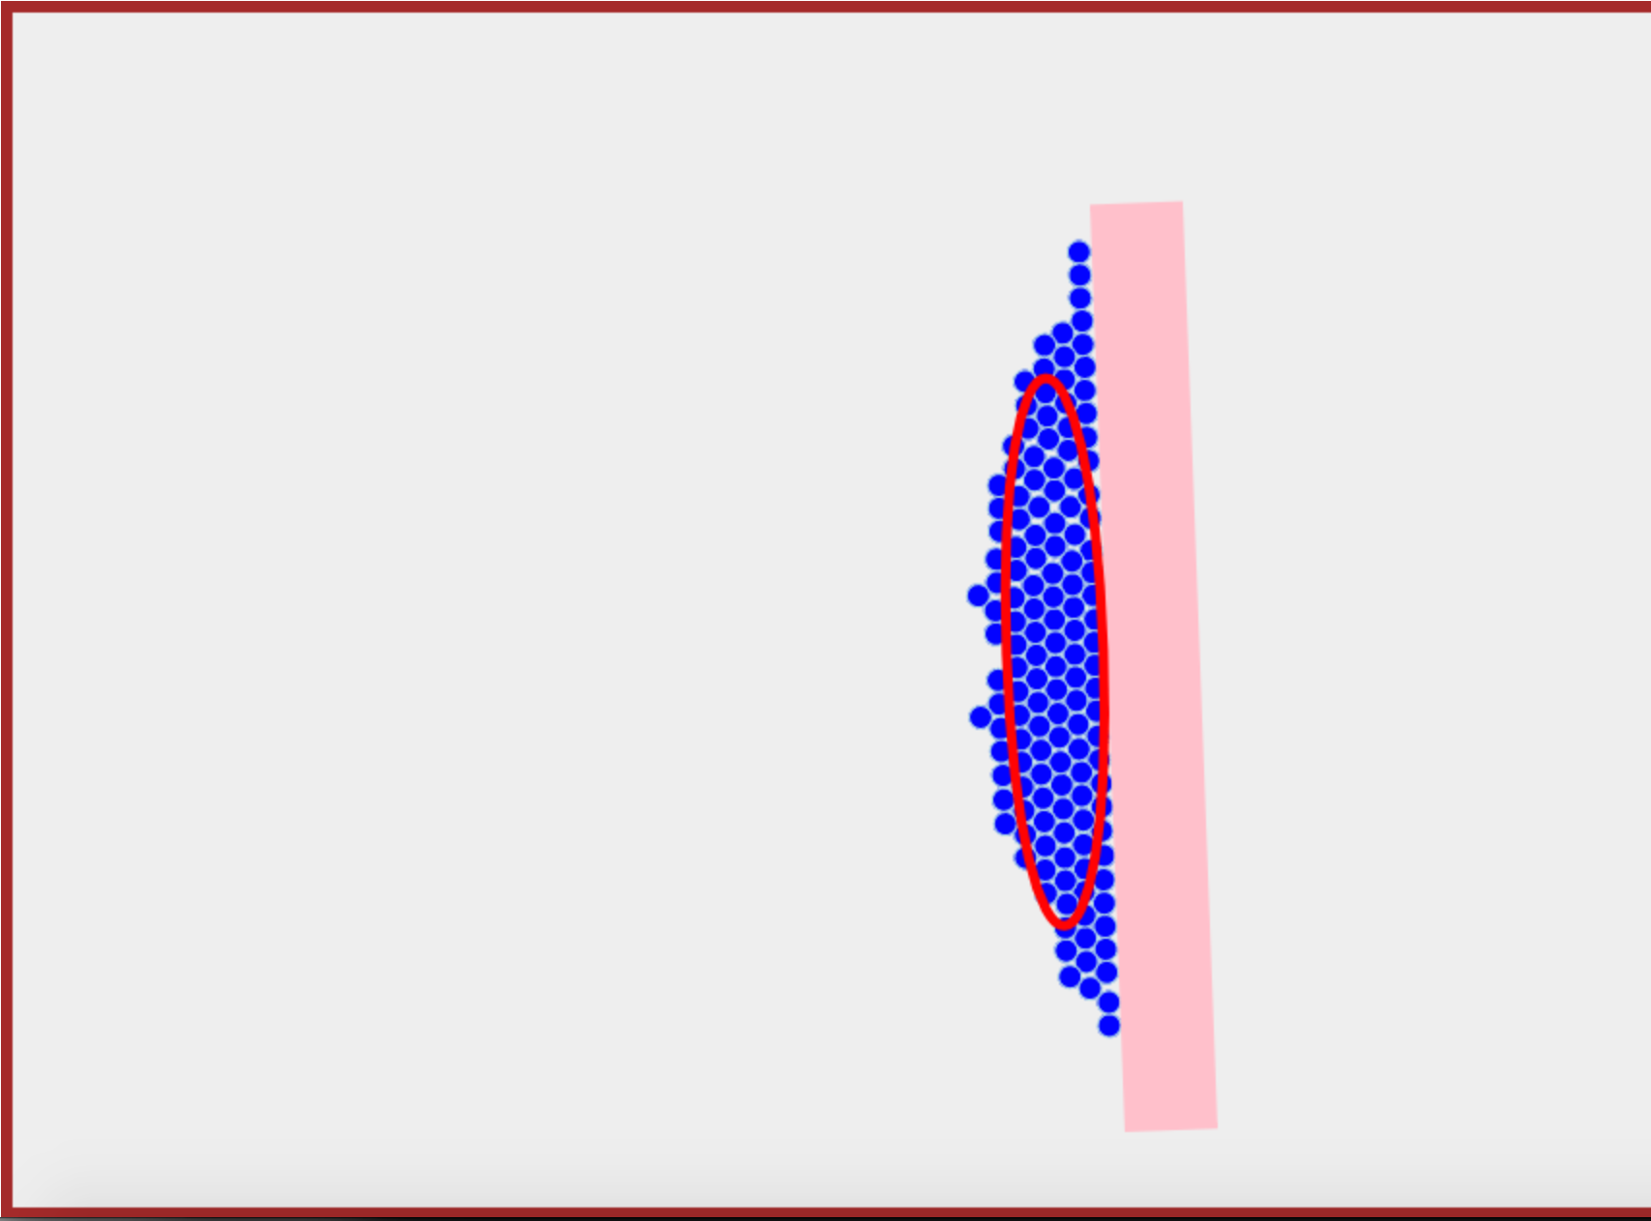
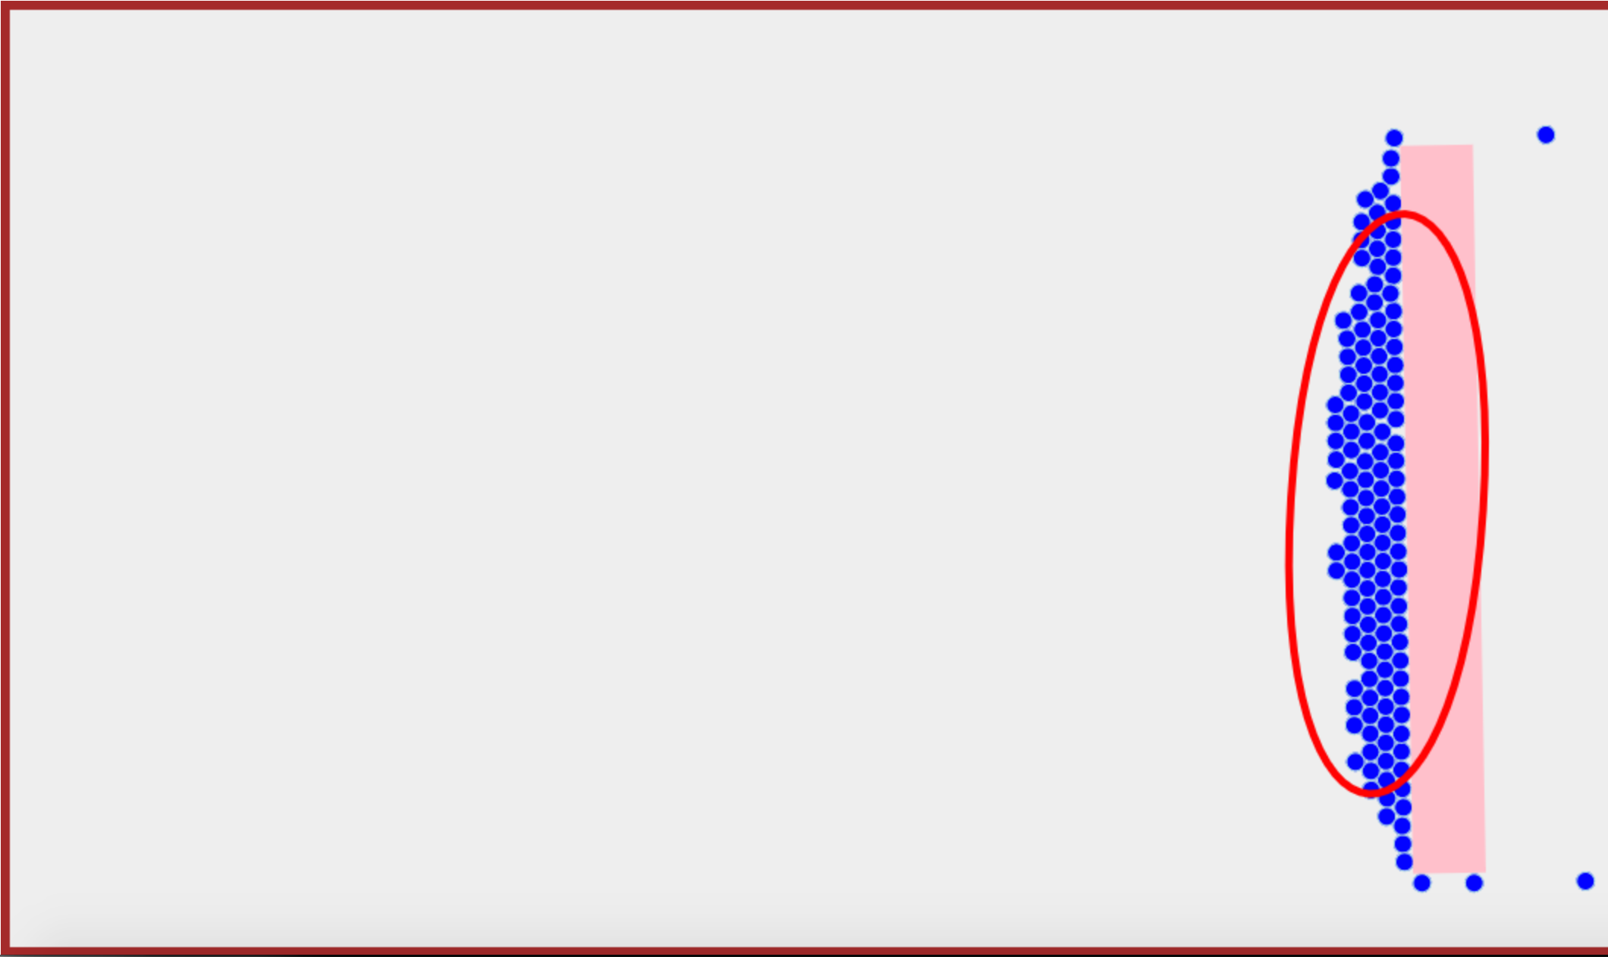
t = 5 s
θ
t = 15 s
t = 25 s
11m
18m
25m
Initial θ

