Slide 1
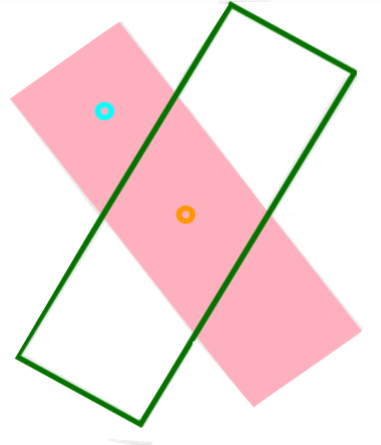
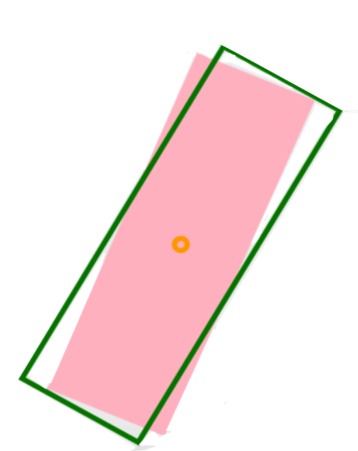
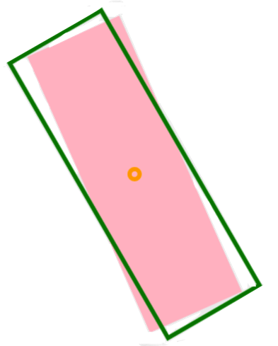
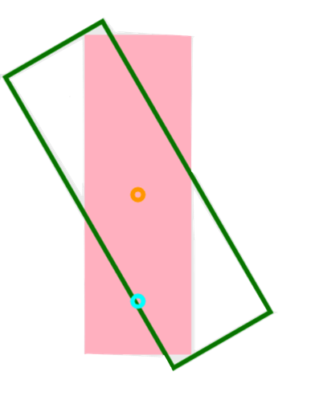
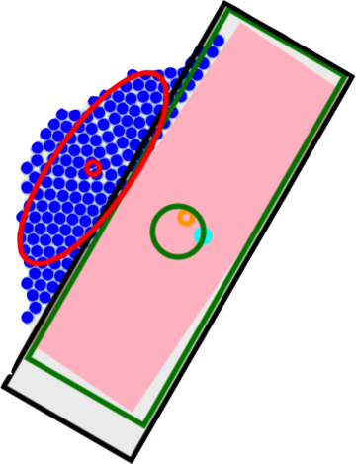
Robots
COM
Mean Position
Goal Position
Block
Current Goal Angle
Final Goal Angle
t = 0
t = 30
t = 60
t = 120
t = 150
Goal Distance

