Slide 1
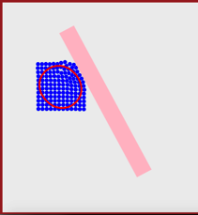
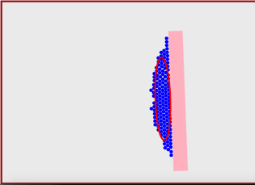
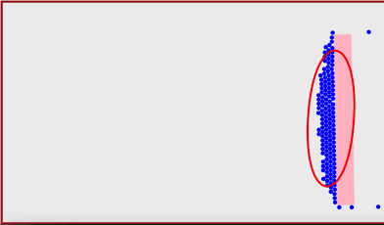
t = 5
Δθ
t = 15
t = 25
Robots
Covariance Ellipse
Block
11m
18m
25m

