Slide 1

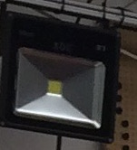
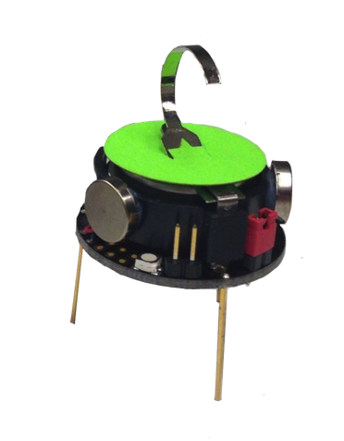
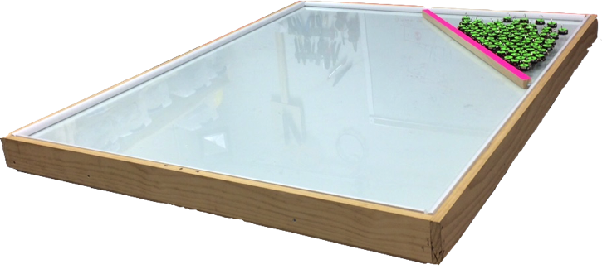
Vision System
30W LED Light
1.5 m
Table of the robots
1.2 m
Robots
1.5 m
Pivot
Large-aspect-ratio rectangle

