Slide 1
Main Region 2
Main Region 1
Main Region 0
Goal Without Regions
Goal With Regions
Object
Robots in Region
Robots out of Region
GOAL
Notes:
Figure: The blue rectangles represent the main regions. The main regions are bounded by the blue dashed lines, which are extensions from the pink obstacles to another obstacle or a size of the maze.

Slide 2
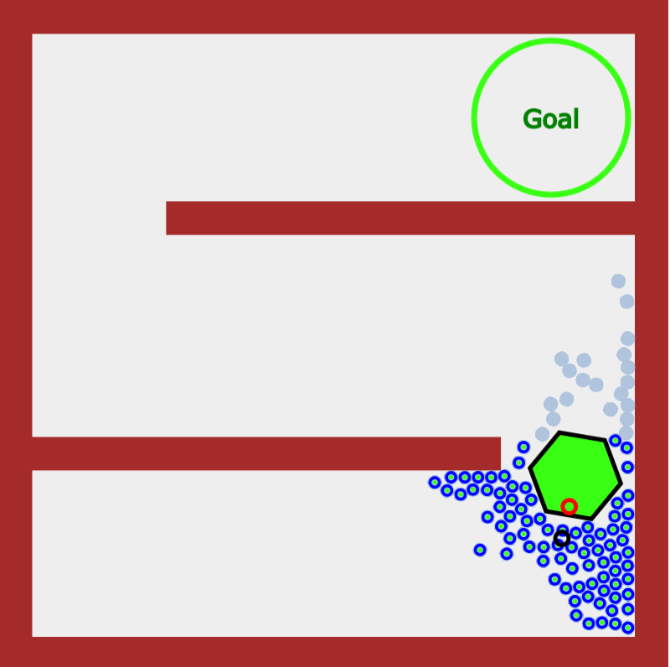
Main Region 2
Main Region 1
Main Region 0
Goal Without Regions
Goal With Regions
Object
Robots in Region
Robots out of Region

