Slide 1
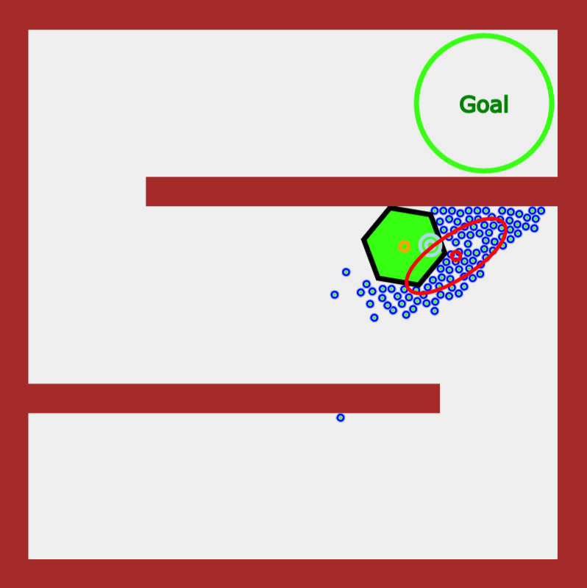
Intermediate Goal
Mean Position
Covariance
Min Variance
Max Variance
Object
Robot

