Slide 1
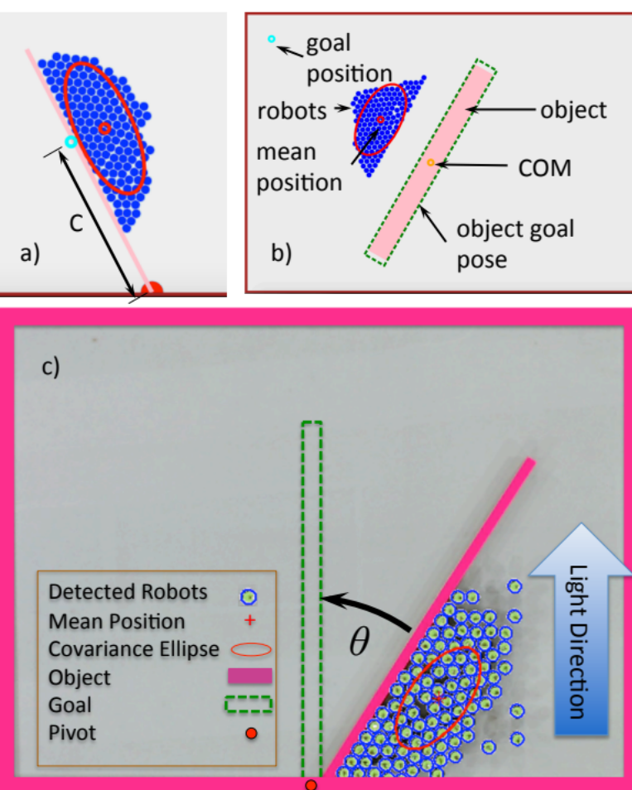
Object Manipulation and Position Control Using a Swarm with Global Inputs
Shiva Shahrokhi, Aaron T. Becker
University of Houston, TX, USA
Regulates object’s orientation and position using a swarm of robots with global inputs—all robots get the same global input
We determine the best point to apply torque
We make the object’s orientation and keep it in any arbitrary line
We push the object to its goal position while it has its goal orientation

