Slide 1
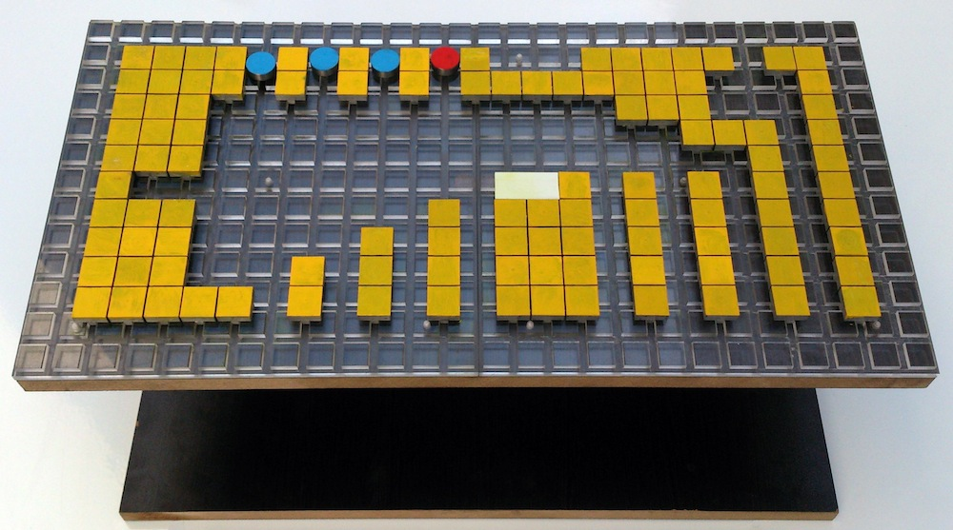
Particle Computation:
Device Fan-out and Binary Memory
Hamed Mohtasham Shad, Rose Morris-Wright, Erik Demaine, Sándor Fekete, Aaron Becker¹,
¹MIT, ²TU Braunschweig, ³University of Houston
•2D workspace •global inputs •particles move till hit obstacle or robot
Full computational universality with 2x1 sliders
Gates & wiring for arbitrary computation
Large scale hardware prototype
http://youtu.be/EJSv8ny31r8

