Slide 1
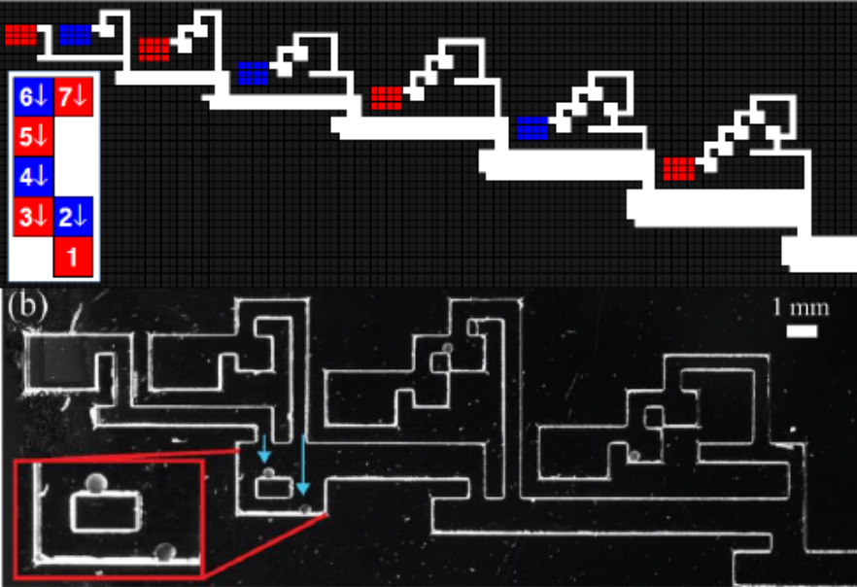
Parallel Self-Assembly of Polyominoes Under Uniform Control Inputs
Sheryl Manzoor¹, Samuel Sheckman², Jarrett Lonsford¹,
Hoyeon Kim², Min Jun Kim², and Aaron T. Becker¹
Electrical and Computer Engineering Department, University of Houston, USA¹
Lyle School of Engineering, Southern Methodist University, USA²
Algorithms to produce a factory that uses global inputs to assemble arbitrary polyominoes.
A polyomino is a 2D geometric figure formed by joining equal squares edge to edge.
Built and tested two prototypes:
Macro-scale gravity based &
Micro-scale magnetically actuated.
Top: Factory schematics for a seven tile polyomino.
Bottom: Micro-scale implementation using alginate micro-robots

