Slide 1
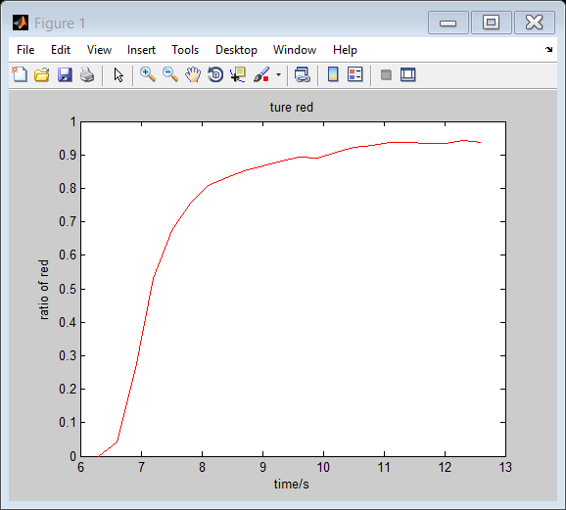
The time constant of the human swarm for a command "everyone turn red"
Image from video
Image from video t = t2
Fig. 1: Plot showing human response to vocal command “copy this from transcript“. The command was announced at 0s. This was the first such command, and had a time constant of τ = XX. everyone turns to red, so it takes about 7 seconds.
THIS MAKES YOUR BACKGROUND WHITE
figure(2); set(gcf,'color','w');
Add the other colors

Slide 2
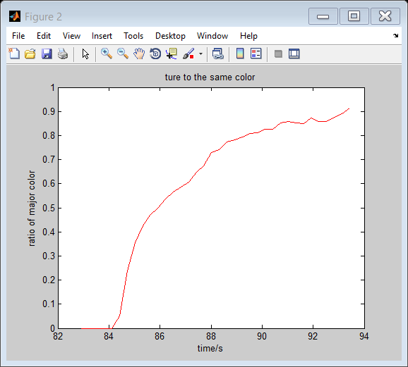
The time constant for the human swarm for a harder question "everyone turn to the same color"
Fig. 2. Response time for command “everyone turns to same color”, people start to move in the video around 82s, and till 94s, all people turn to same color, it takes about 12 seconds
PUT A DOTTED LINE AT 0.63%
Xlabel = “time (s)”
No titles
Can you add an exponential fit?
http://www.mathworks.com/examples/curvefitting/2782-fit-exponential-models-using-the-fit-function

Slide 3
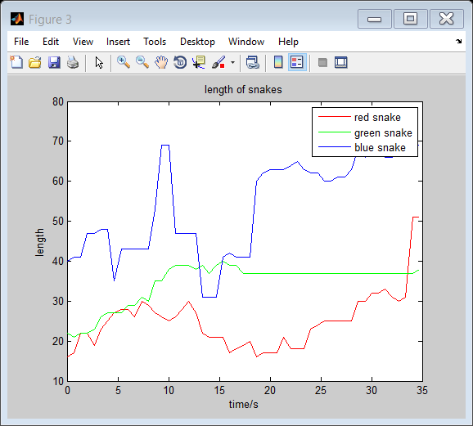
How long did it take to form snakes? How long where the snakes as a function of time?
This plot shows how long it takes to form snakes, x axis shows the time it takes, and y axis shows how long the snake is, which is how many umbrellas are there in the snake, and we have three different color snakes in the video
What constitutes a snake? (maybe, if the break is more than 4 umbrella radius, this is not a snake)

