Slide 1

MODULE 4 PROJECT – ROLES WITHIN DATA ANALYTICS
ALY 6000
DATA ANALYST
BY: AABHAS MARU

Slide 2

ROLES AS A DATA ANALYST
A Data Analyst converts the raw data into systematic understandable format and transfer this data to senior management to draw a decision from it.
Analyzing the data with the help of statistical tools and techniques.
Acquiring the data from their primary & secondary sources
A data analyst identifies, analyzes and interpret the pattern or trends of the complex data set.

Slide 3
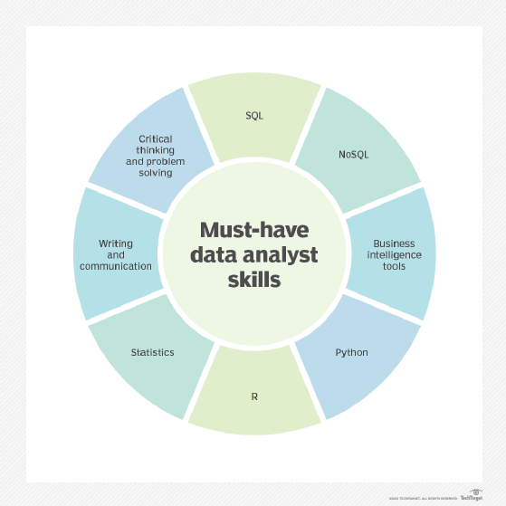
Skills Required for Data Analyst Job
Probability and Mathematics
Structured Query Language (SQL)
Microsoft Excel
Critical Thinking
Problem-solving skills
R / Python programming language
Data visualization
Machine Learning
Presentation skills

Slide 4
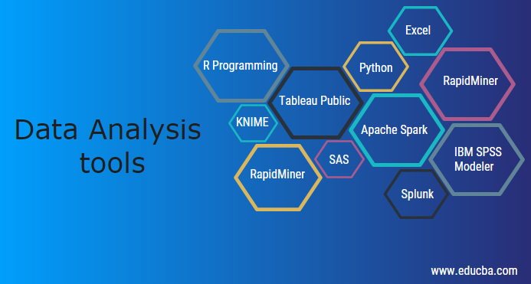
Data Analysis Tools
A data analyst uses a wide variety of tools to make their data more accurate and understandable. Some of the most common tools used by data analysts are:
R Programming
Python
Tableau / Power BI
SAS
MS Excel
SQL

Slide 5
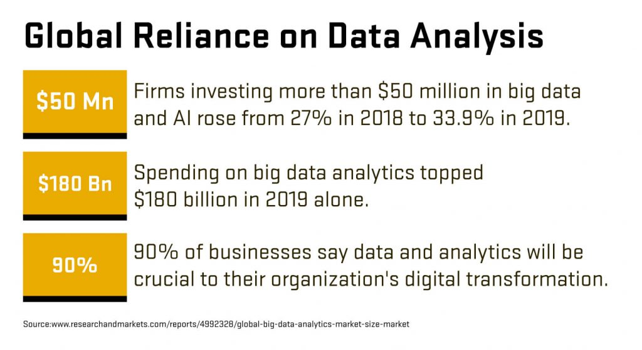
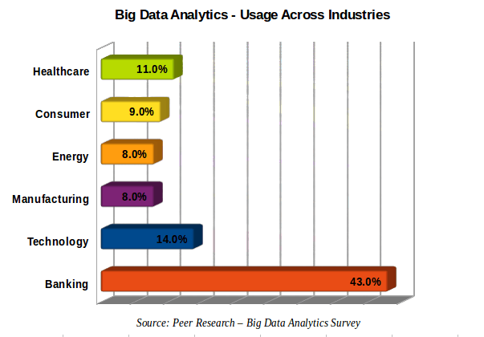
Future Prospect as a Data Analyst
With a Degree in Data Analytics, a person has more than 60 options to work in different industry. Here are some data of industries that hires the most data analyst.

Slide 6
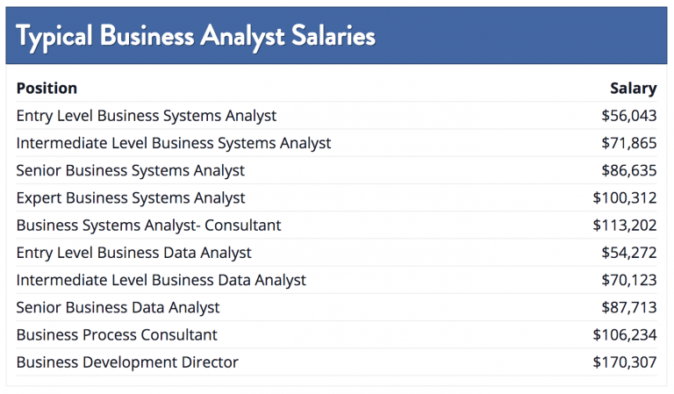
Average Salary, Job Forecast & Industry Demand for Data Analyst
The average salary for the Data Analyst as of January 24, 2022 is $65,074. Though this average always keeps on shifting. The salary increases as your experience in the given field.
According to BLS, the demand for the job role of data analyst is going to increase at a rate of whooping 25% from 2019 to 2029.

Slide 7
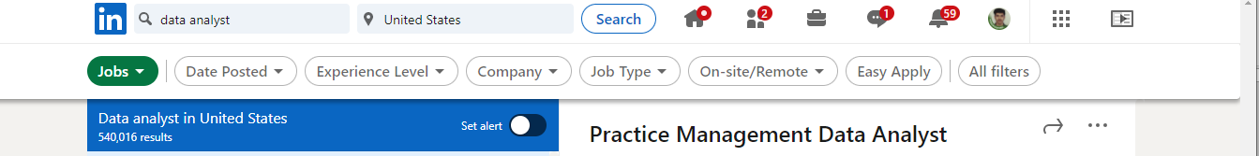
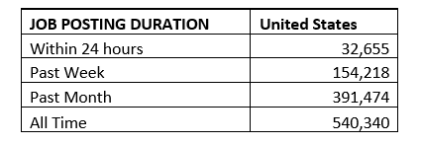
Job Posting on LinkedIn

Slide 8
References
1. What is a data analyst? A key role for data driven business decisions, by Thor Olavsrud, December 23, 2020
https://www.cio.com/article/217583/what-is-a-data-analyst-a-key-role-for-data-driven-business decisions.html#:~:text=Developing%20and%20implementing%20databases%20and,Filtering%20and%20cleaning%20data
2. 7 – Must have skills for data analysts, By Scott W. O’Connor, January 23, 2020
https://www.northeastern.edu/graduate/blog/data-analyst-skills/
3. Data Analysis Tools, By Swati Tawde
https://www.educba.com/data-analysis-tools/

Slide 9
References
4. How to become a data analyst
https://www.discoverdatascience.org/career-information/data-analyst/#:~:text=Data%20analyst%20job%20outlook,the%20average%20for%20all%20occupations
5. Data analyst salary is US
https://www.indeed.com/career/data-analyst/salaries
6. Popular career path of a data analyst
https://bootcamp.pe.gatech.edu/blog/data-analyst-career-path/

