Slide 1

MODULE 5 PROJECT – INDUSTRY ANALYSIS
ALY 6000
Aabhas Maru
002955865
maru.a@northeastern.edu
February 16, 2022

Slide 2
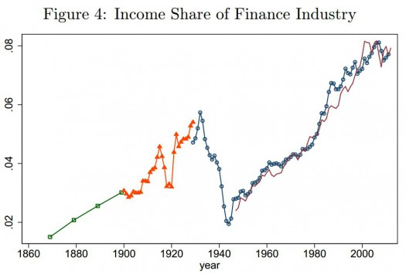
FINANCE INDUSTRY
Provides financial services to commercial and retail customers.
Sectors like: Banks, NBFC’s, Insurance companies, Fintech, Investments firms.
24% of world’s GDP.
$22.5 trillion dollars of market size.
Growth rate 9.90% YoY.

Slide 3
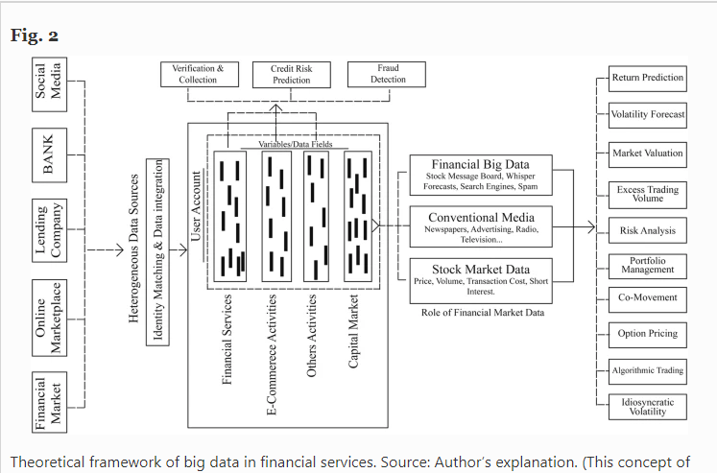
How Data Analytics has Evolved Specifically in the Industry
Algorithmic Trading.
Reduction of bad loans for lending sector.
Increase in profitability.
Better success rate while launching new product.
Provides competitive edge in the market.
Risk Analysis.

Slide 4
Ways in which Big Data has Disrupted the Industry
Mobile banking and payments, instant peer-to-peer money transfers via SMS, online peer-to-peer lending, robo-advice, AI-driven chatbots, and blockchain-based interbank payments – to name a few – are all financial innovations that have emerged in the last decade.
The key element that has enabled these technological disruption is the incorporation of big data analytics by financial services companies.
These big data cannot be processed using traditional database management applications. New predictive analytics tools need to be used to gain valuable insights of user behavior from these large datasets.

Slide 5
How Do You See Analytics Changing the Industry in Future ?
Making the industry fully autonomous.
Fraud detection and prevention.
Gaining in-depth customer knowledge.
Risk management.
AI and data science powered personalized banking.
Playing vital roles in decreasing operational cost & increases productivity.

Slide 6
Organizational Roles Associated with Data Analytics and Unique Roles as per the Industry
This industry provides jobs which are commonly referred to as; ‘Data Analyst, Data Scientist or Data Engineer’.
There are some unique job roles named; ‘Financial Data Analyst, Equity Analyst, Business Intelligence Analyst, Fraud Analyst, Investment Data Analyst’.
Average salary in this Industry in Boston is $88,894.
Average salary in US is $64,375.
Unique job average salary in US is $72,598.

Slide 7
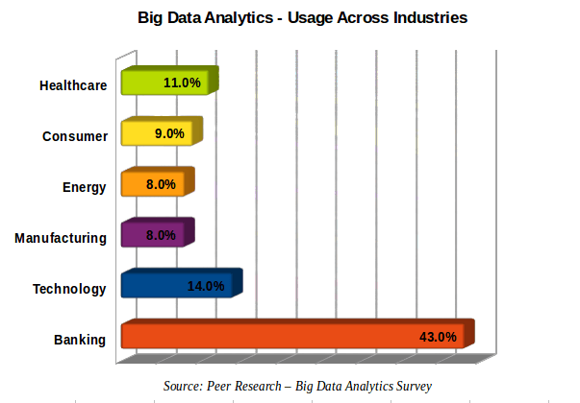
Current Demand for Data Analytics in the Industry
According to U.S. Bureau of Labor Statistics (BLS), the job growth predicted in this industry is 11% annually till 2026, which is 7% more than other industries.
53,252 job posted on LinkedIn for the role of ‘Financial Data Analyst’.

Slide 8
What Make it my Ideal Industry? Specific Role I would like to Play
My previous educational background makes it an ideal industry for me. Plus, my interest and passion towards this industry.
I would like to play the role of either ‘Financial Analyst or Equity Analyst’.
The reason behind this is because of my understanding of this business, like I know how banking, investment, insurance or equity market works.
I have the knowledge of how they make money out of this business.
I want to analyze this industry more closely.
Want to understand more about how data plays a vital role and what new decision to be made with the help of these data’s.
Another reason is, with experience the money you make is also a reason to go for this industry.

Slide 9
REFERENCES
1. Financial Services: Sizing the Sector in the Global Economy, By Sean Ross (September 30, 2021) https://www.investopedia.com/ask/answers/030515/what-percentage-global-economy-comprised-financial-services-sector.asp
2. Current Landscape and Influence of Big Data on Finance, By Hasan et. al., Popp & Olah (March 12, 2020) https://journalofbigdata.springeropen.com/articles/10.1186/s40537-020-00291-z
3. How Big Data is Disrupting the Financial Industry, By John DeCleene (March 28, 2018) https://www.datadriveninvestor.com/2018/03/28/how-big-data-is-disrupting-the-financial-industry/#:~:text=Mobile%20banking%20and%20payments%2C%20instant,emerged%20in%20the%20last%20decade.
4. 5 Ways Data Science and Analytics has Changed the Financial Services Industry, By Institute of Data (September 22, 2020) https://www.institutedata.com/blog/5-ways-data-science-and-analytics-has-changed-the-financial-services-industry/
5. How much Does a Finance Data Analyst Make? https://www.glassdoor.com/Salaries/finance-data-analyst-salary-SRCH_KO0,20.htm
6. Data Analyst Salary in Boston https://www.builtinboston.com/salaries/data-analytics/data-analyst/boston
7. Career Advice: Financial Analyst vs Data Analyst, By Greg Depersio (August 22, 2019) https://www.investopedia.com/articles/professionals/120315/career-advice-financial-analyst-vsdata-analyst.asp#:~:text=The%20BLS%20did%20not%20break,occupations%20in%20the%20United%20States
8. 10 Reason Why Big Data Analytics is the Best Career Move https://www.edureka.co/blog/10-reasons-why-big-data-analytics-is-the-best-career-move

