Slide 1
AI-Assisted Inventory Insights for HimShakti
Business Problem
Inventory losses due to expiry and poor monitoring.
Need data-driven inventory decisions.
AI + BI used to identify actionable insights.

Slide 2
Dataset Overview
Source: HimShakti Inventory Dataset
Records: 1000
Columns: Batch_ID, Raw_Material, Entry_Date, Expiry_Date, Quantity_KG, Remaining_Quantity_KG, Production_Date, Finished_Good, Shelf_Life_Days
Objective: Reduce inventory waste and improve planning.

Slide 3
Key Finding
Finding:
Some raw materials have much higher remaining inventory, indicating uneven utilization and possible expiry risk.

Slide 4
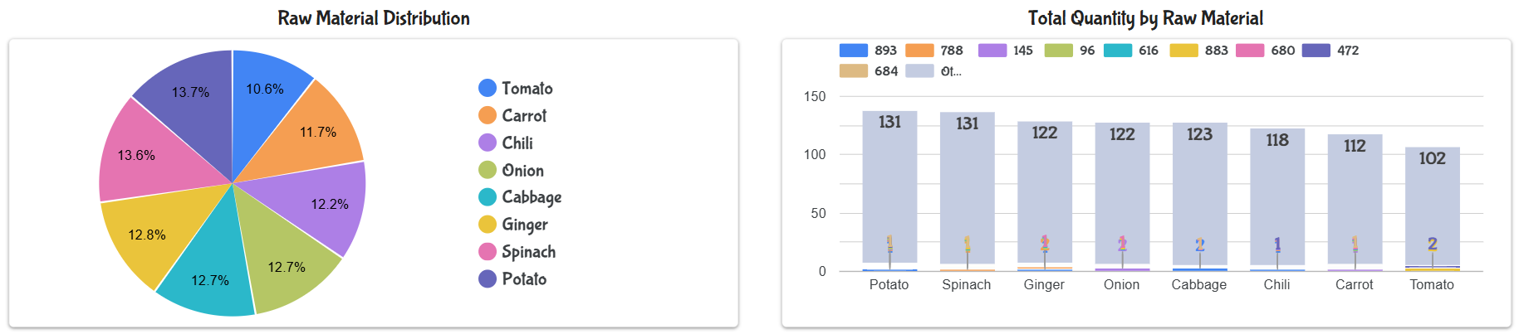
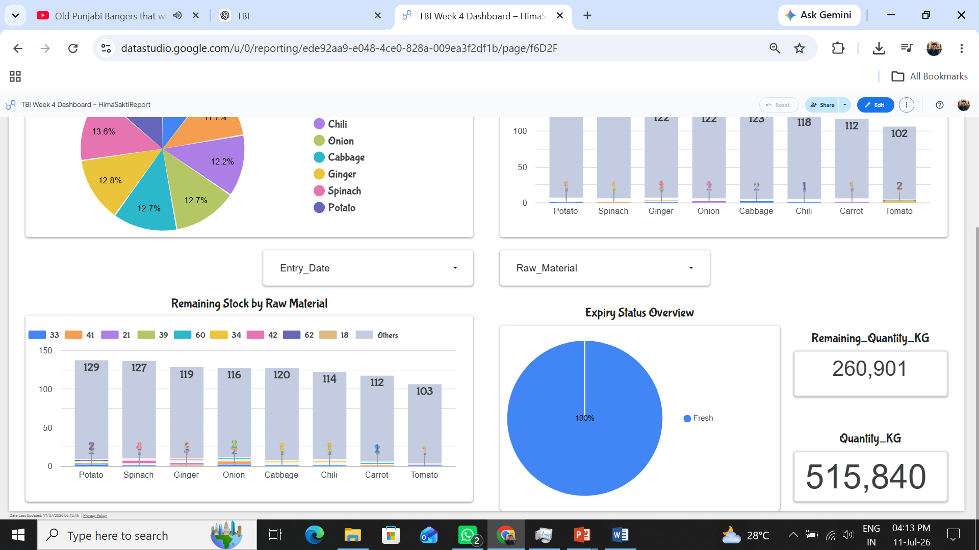
So What?
Excess stock increases expiry risk and storage cost. Monitoring inventory levels helps improve procurement, production planning, and operational efficiency.

Slide 5
Recommendations
1. Enable expiry alerts.
2. Review inventory weekly.
3. Monitor KPIs using BI dashboards.
4. Optimize procurement based on inventory consumption.

