Slide 1
India Tour and Travels

Slide 2
INTRODUCTION AND OBJECTIVE OF THE PROJECT
As the population of the city is increasing day by day , the city is getting congested .As of that to travel from one place to another it’s in the city is being a humongous task . Just take an example of our own city ,Bengaluru .To travel from,Say whitefield to RR nagar it takes more than 2 hours , and the distance we cover during this journey is just around 30 km . Due to the traffic we could not travel quicker .
So to overcome this problem , and by keeping a traveller in mind we come up to the solution that gives the traveller info about what time it gonna take to travel from a to b and what are the possible distances to reach the same place .
The traveller can decide on the parameters of does he want to reach faster to the destination by using time component which we have incorporated in our solution .Or he wants to take shortest distance even it may cost him greater time lose .its upto him .

Slide 3
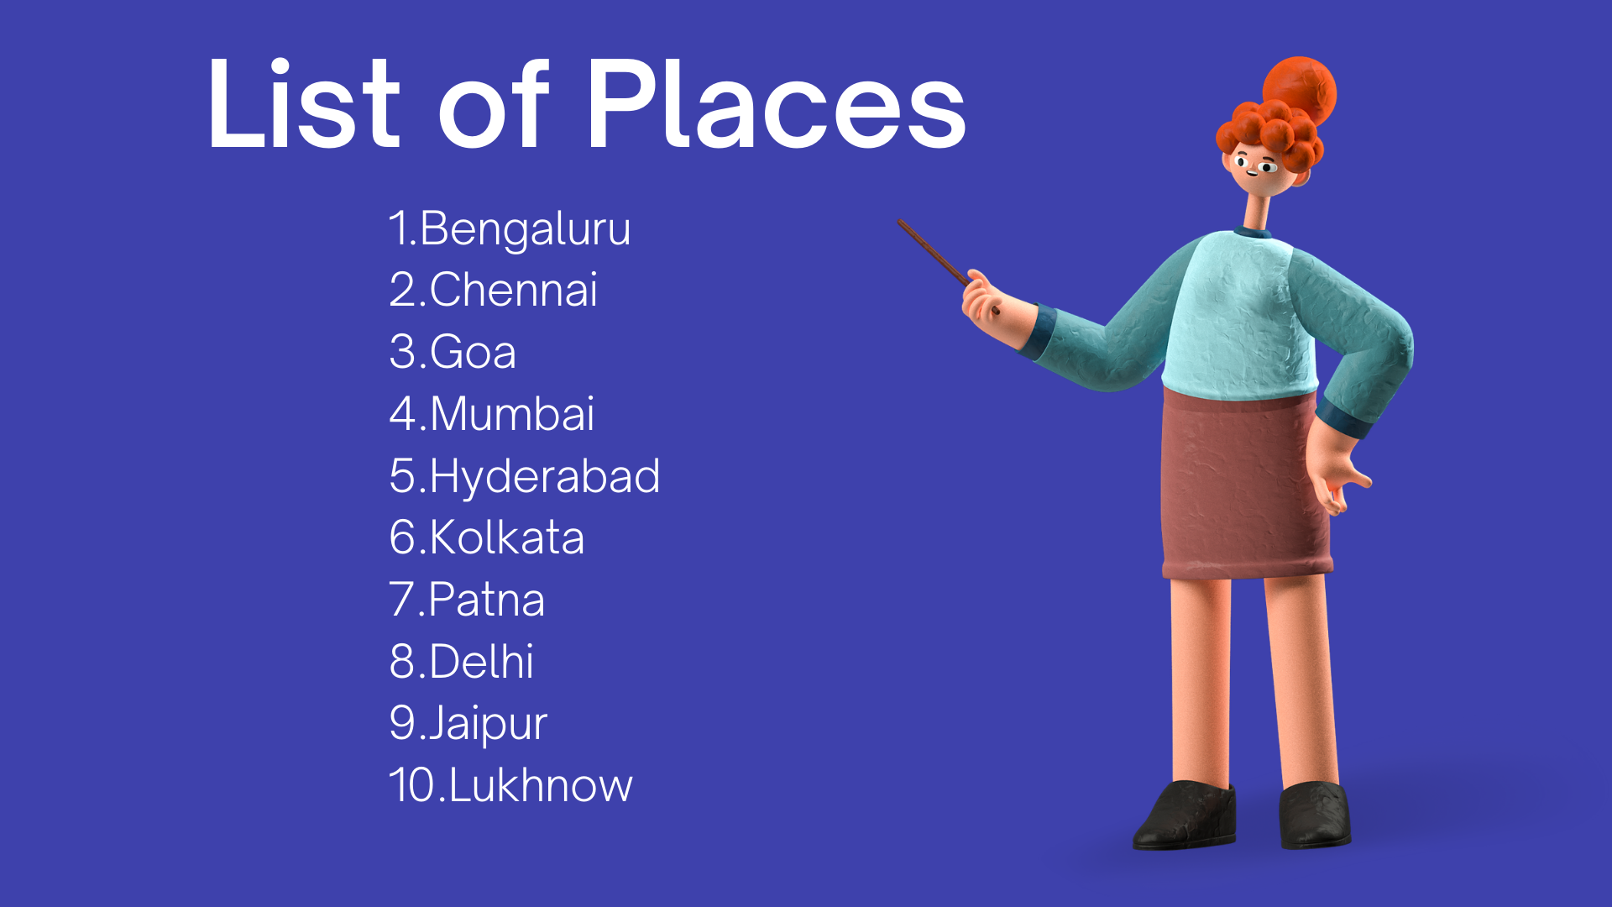

Slide 4
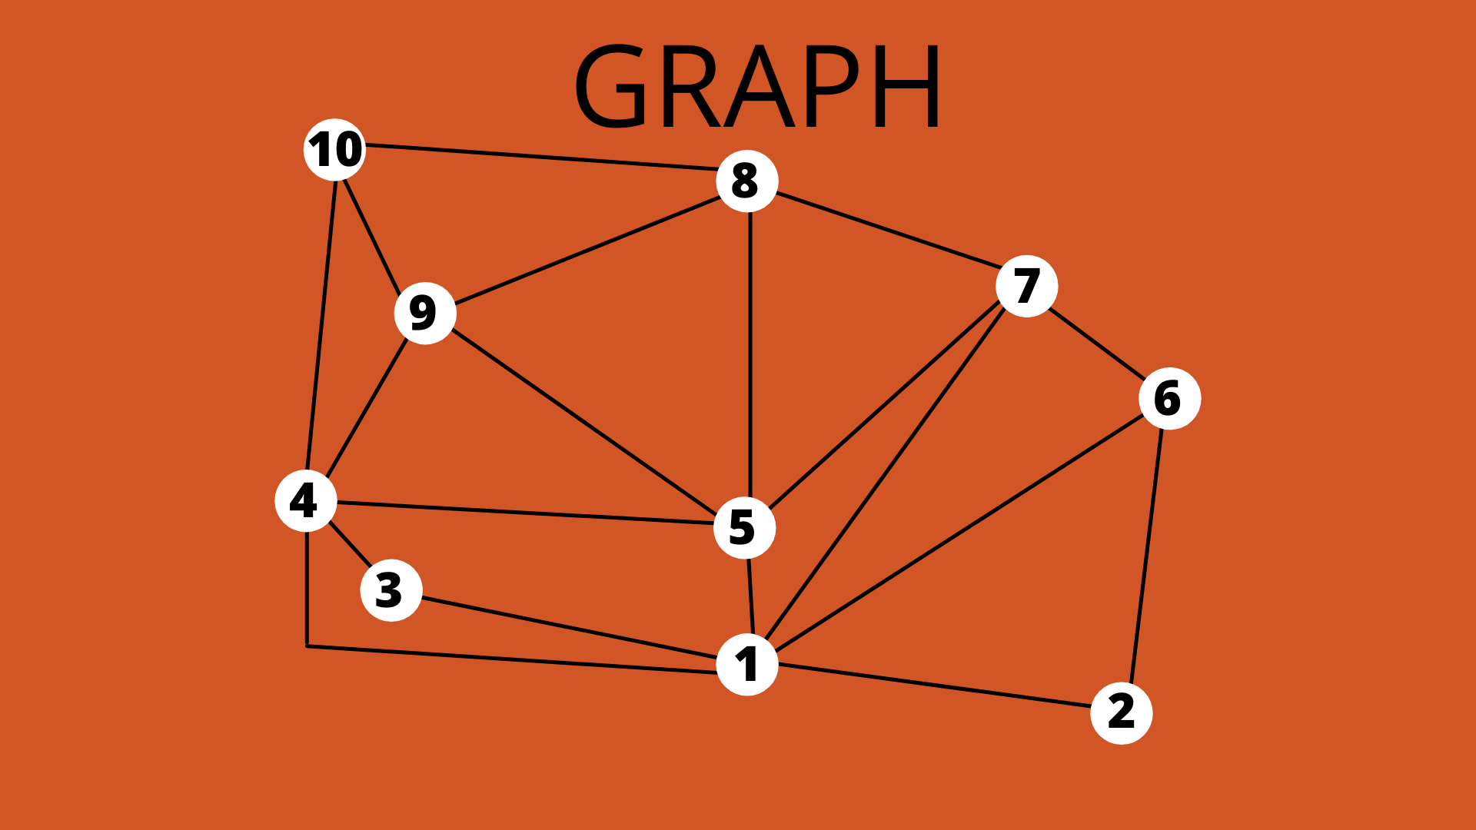

Slide 5
Algorithm design technique : Dijsktra’s algorithm & Traveling sales person algorithm
Dijkstra's Algorithm works on the basis that any subpath B -> D of the shortest path A -> D between vertices A and D is also the shortest path between vertices B and D. Each subpath is the shortest path Djikstra used this property in the opposite direction i.e we overestimate the distance of each vertex from the starting vertex.
Dijkstra’s Algo ……. https://youtu.be/bFvt1J0xtrg
Traveling Sale’s person……. https://youtu.be/4SfpvB8FT0g

Slide 6
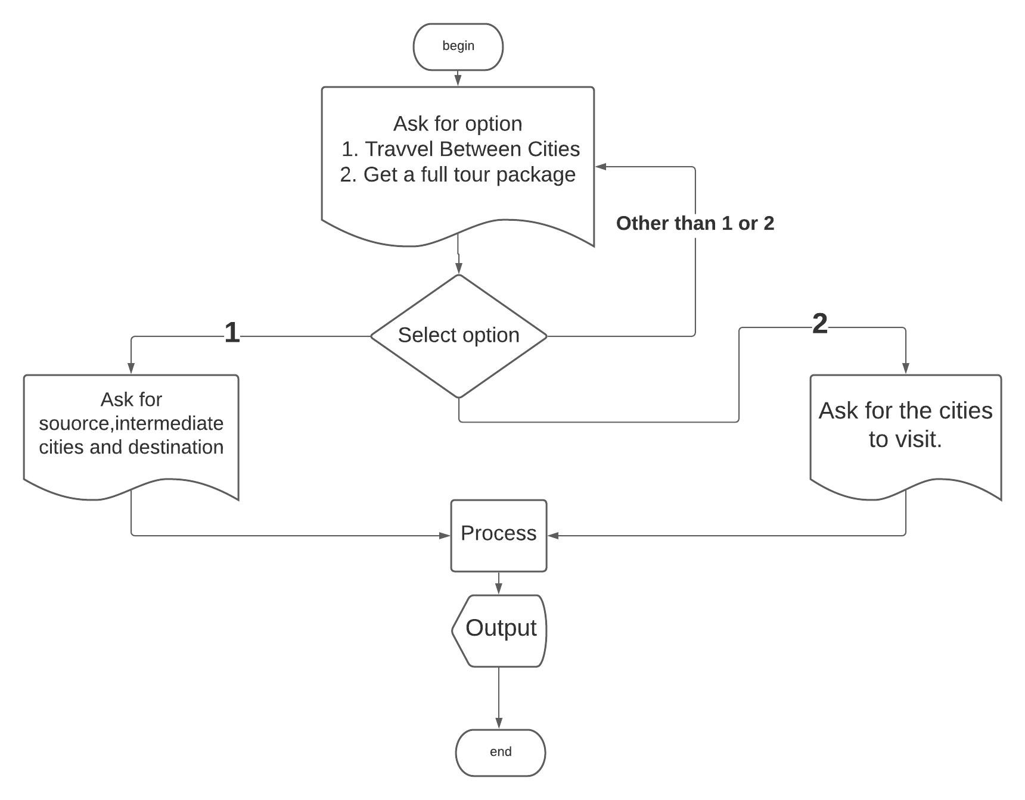
Project Architecture

Slide 7
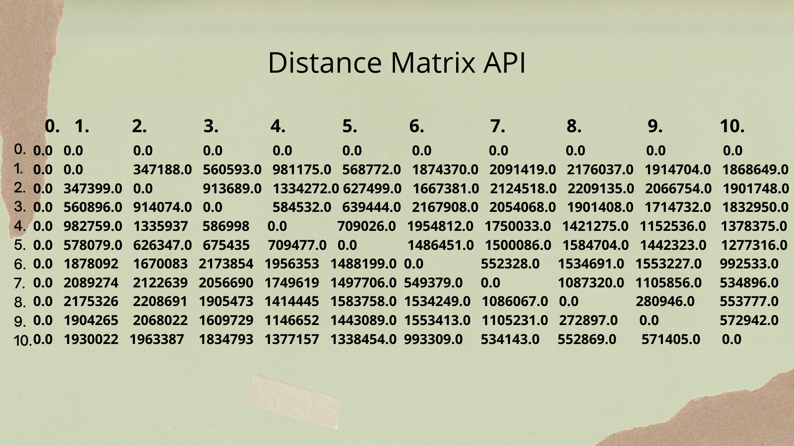
Cost Matrix

Slide 8
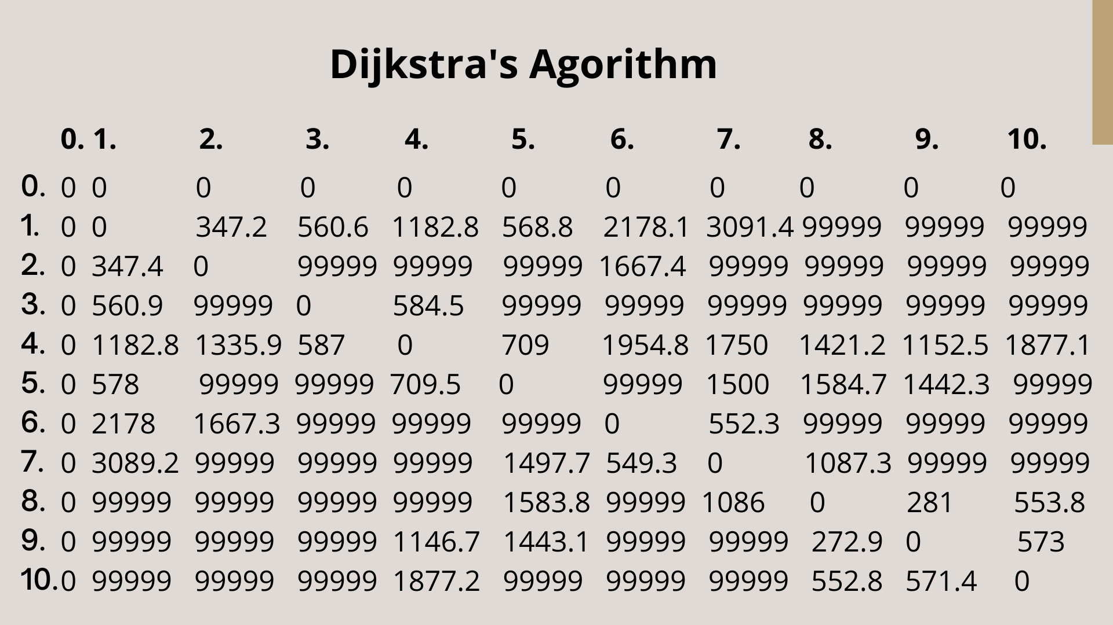
Cost Matrix

Slide 9
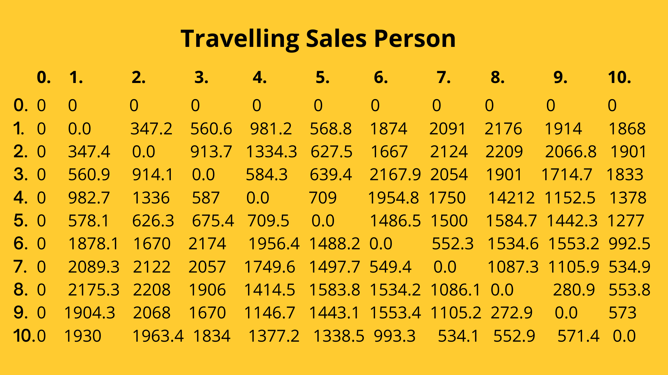
Cost Matrix

Slide 10
Application
Traveller agents can use this program to help their customers .
Navigation system of vehicles use this to check if it can reach at the destination with the amount of fuel it has .
Can be used by ambulance to escape traffic.

Slide 11
Conclusion and Future Enhancements
Alternate methods to make this project
We can also use Floyd's Algorithm or Travelling Salesperson method to make this project as it finds the minimum cost tour for a given set of places.
We can add real time traffic congestion data .
We can add the path through which we can travel.
We can add time checking for each and every path.
We can add a facility of tour in which the user have to select the places he wants to travel and the program will give the min cost tour
We can reduce time complexity by introducing min heap.

Slide 12
References:
Google.com
Class notes
Youtube.com (Abhishek singh’s youtube channel ) https://www.youtube.com/channel/UCL_yi0VM0F883QEcyESnJag
Distance Matrix API

Slide 13
THANK YOU

