Slide 1
DAA AND ANALYSIS OF ALGORITHM LABORATORY (18CSL47)
BANGLORE QUICK CONNECTIVITY
Staff in charge: Kusuma
Carried out by
Abhishek Kumar singh (1RN19IS005)
Anurag Sharma(1RN19IS032)
Chandan Parmar(1RN19IS051)

Slide 2
INTRODUCTION AND OBJECTIVE OF THE PROJECT
As the population of the city is increasing day by day , the city is getting congested .As of that to travel from one place to another it’s in the city is being a humongous task . Just take an example of our own city ,Bengaluru .To travel from,Say whitefield to RR nagar it takes more than 2 hours , and the distance we cover during this journey is just around 30 km . Due to the traffic we could not travel quicker .
So to overcome this problem , and by keeping a traveller in mind we come up to the solution that gives the traveller info about what time it gonna take to travel from a to b and what are the possible distances to reach the same place .
The traveller can decide on the parameters of does he want to reach faster to the destination by using time component which we have incorporated in our solution .Or he wants to take shortest distance even it may cost him greater time lose .its upto him .

Slide 3
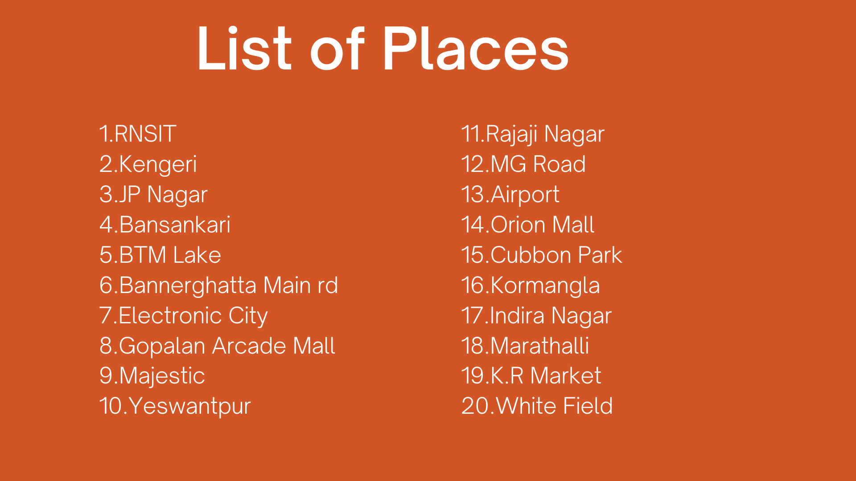

Slide 4
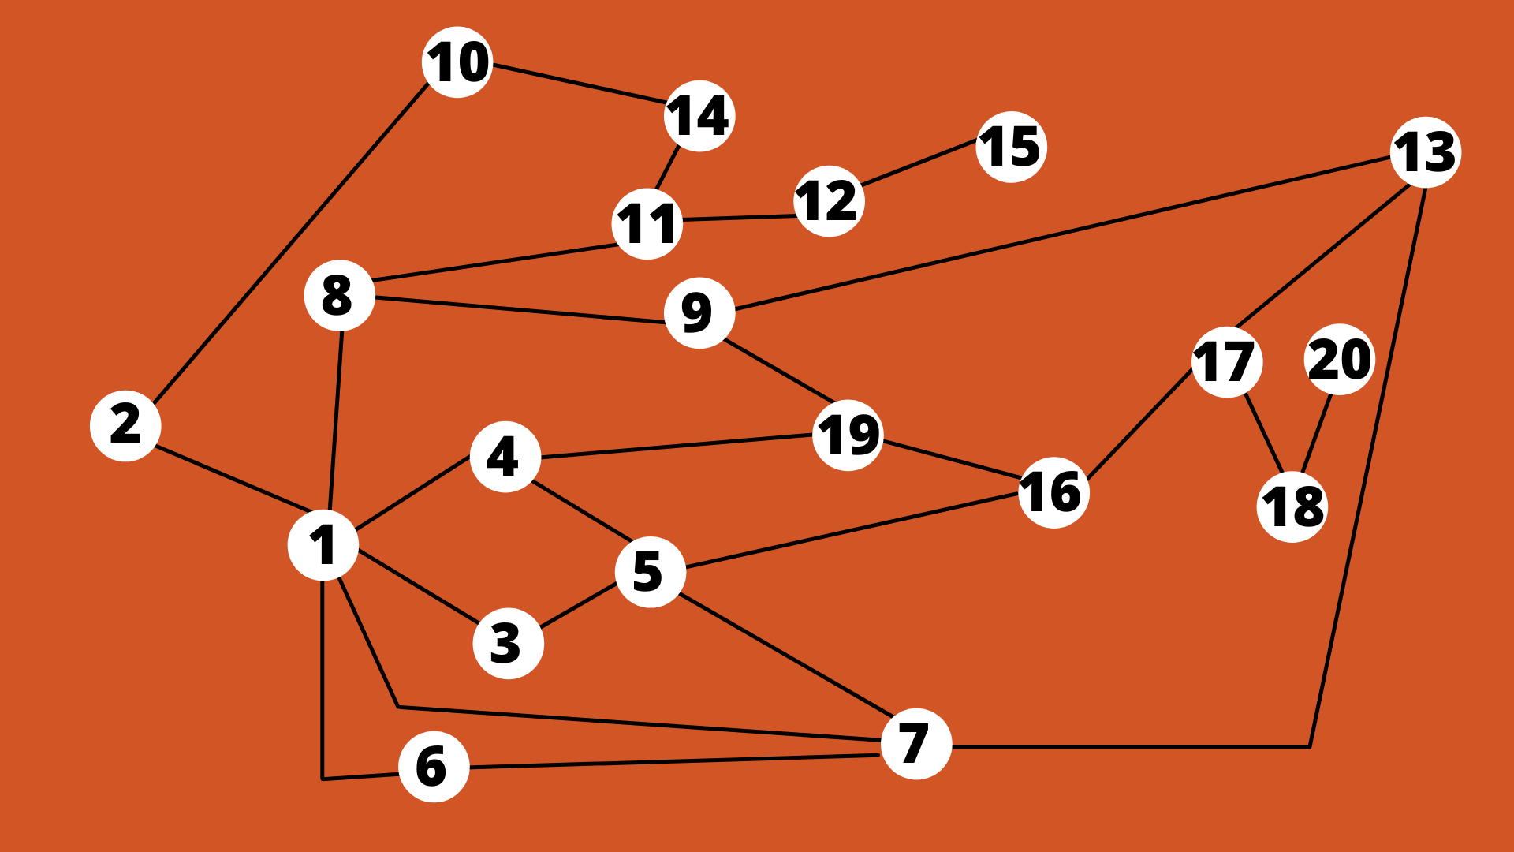

Slide 5
Algorithm design technique : Dijsktra’s algorithm
Dijkstra's Algorithm works on the basis that any subpath B -> D of the shortest path A -> D between vertices A and D is also the shortest path between vertices B and D. Each subpath is the shortest path Djikstra used this property in the opposite direction i.e we overestimate the distance of each vertex from the starting vertex.

Slide 6
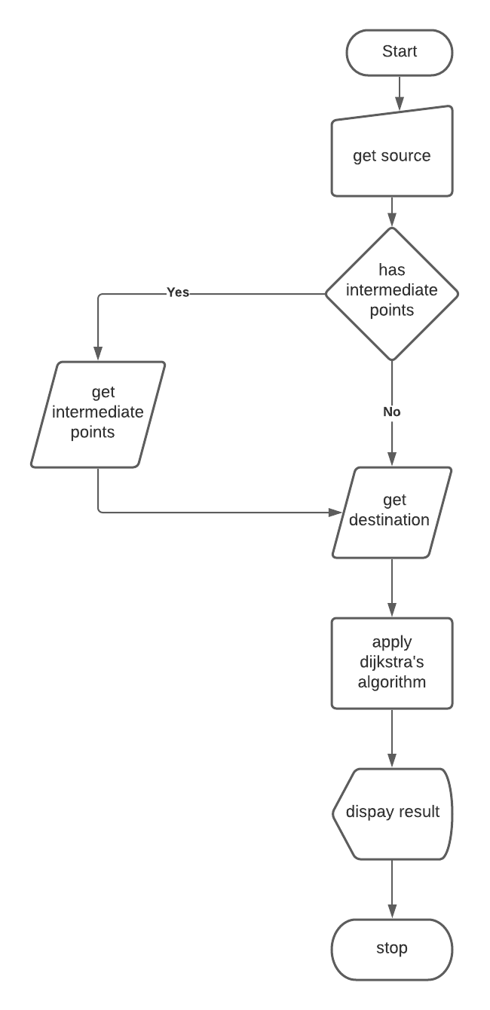
Project architecture

Slide 7
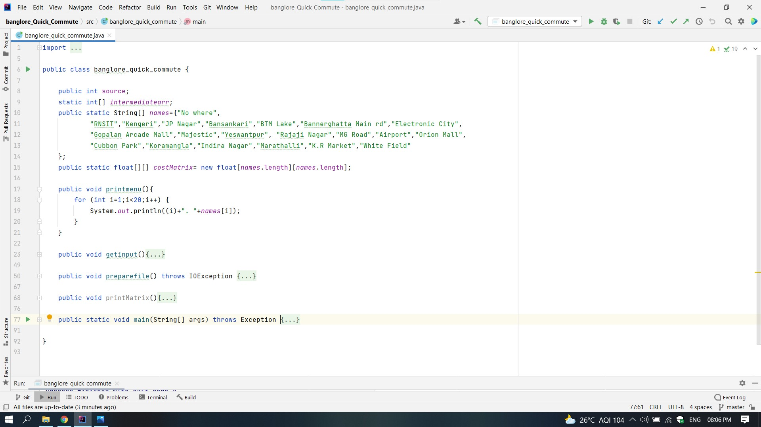
IMPLEMENTATION MODULES

Slide 8
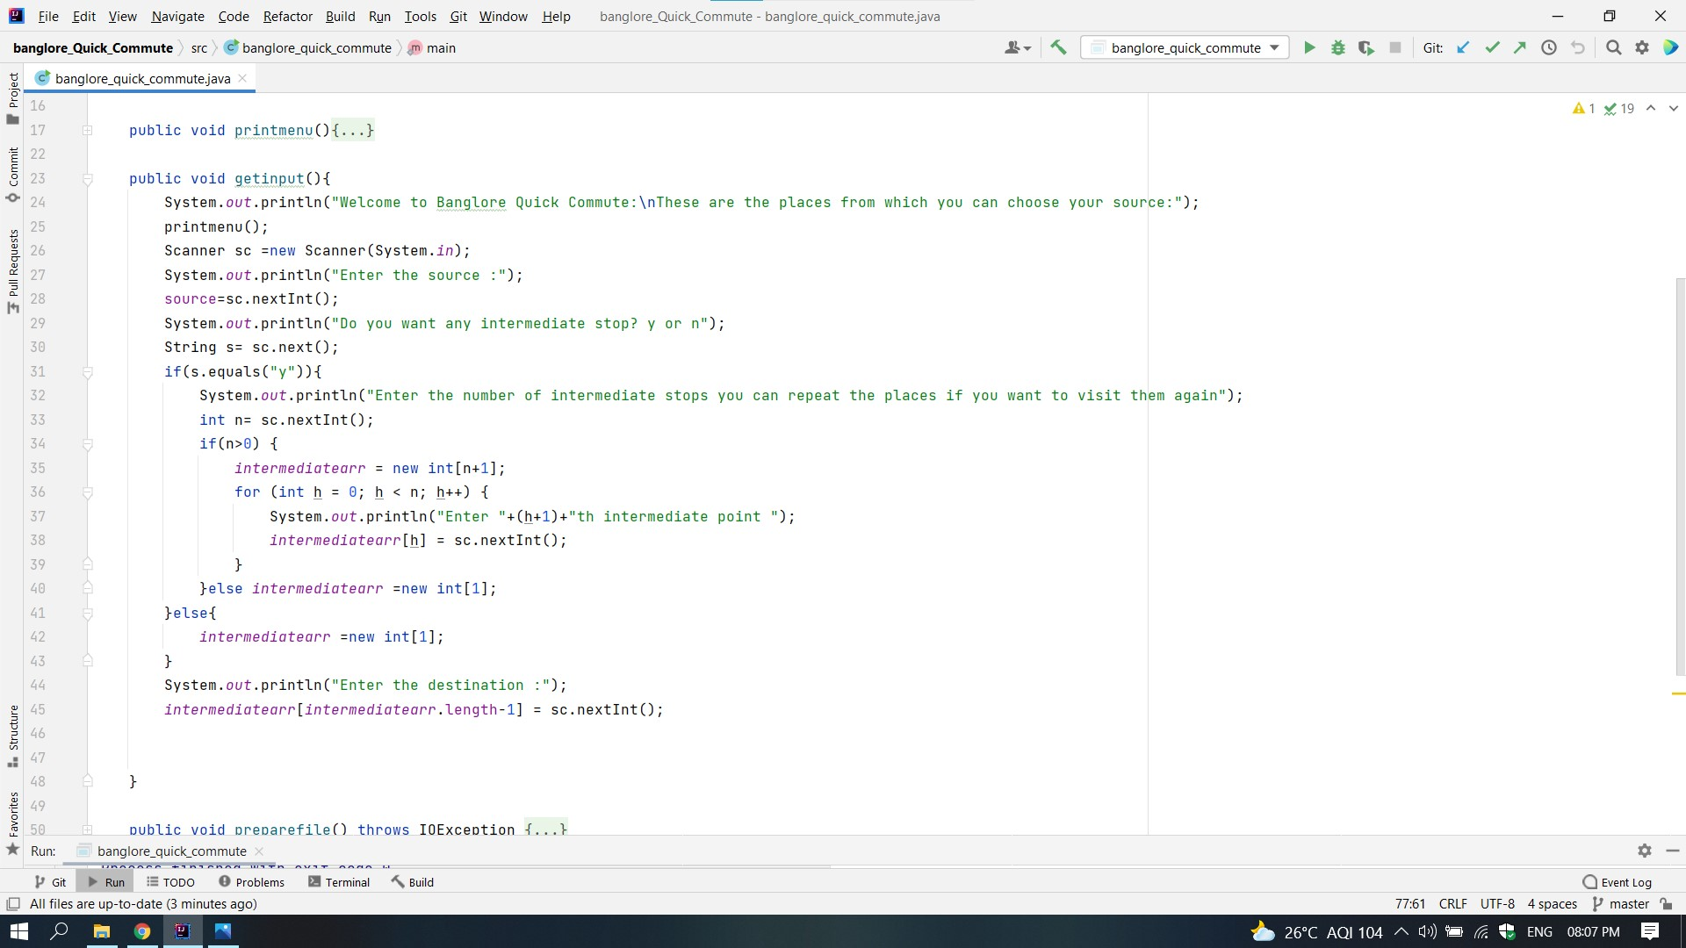

Slide 9
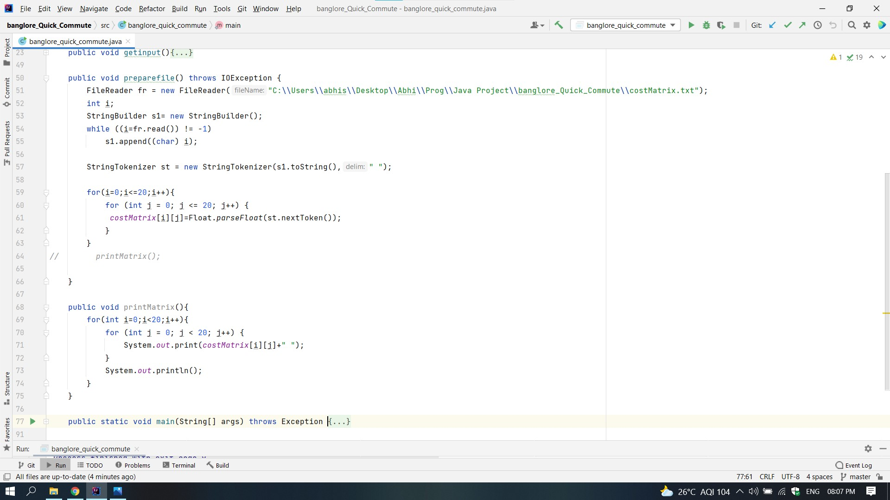

Slide 10
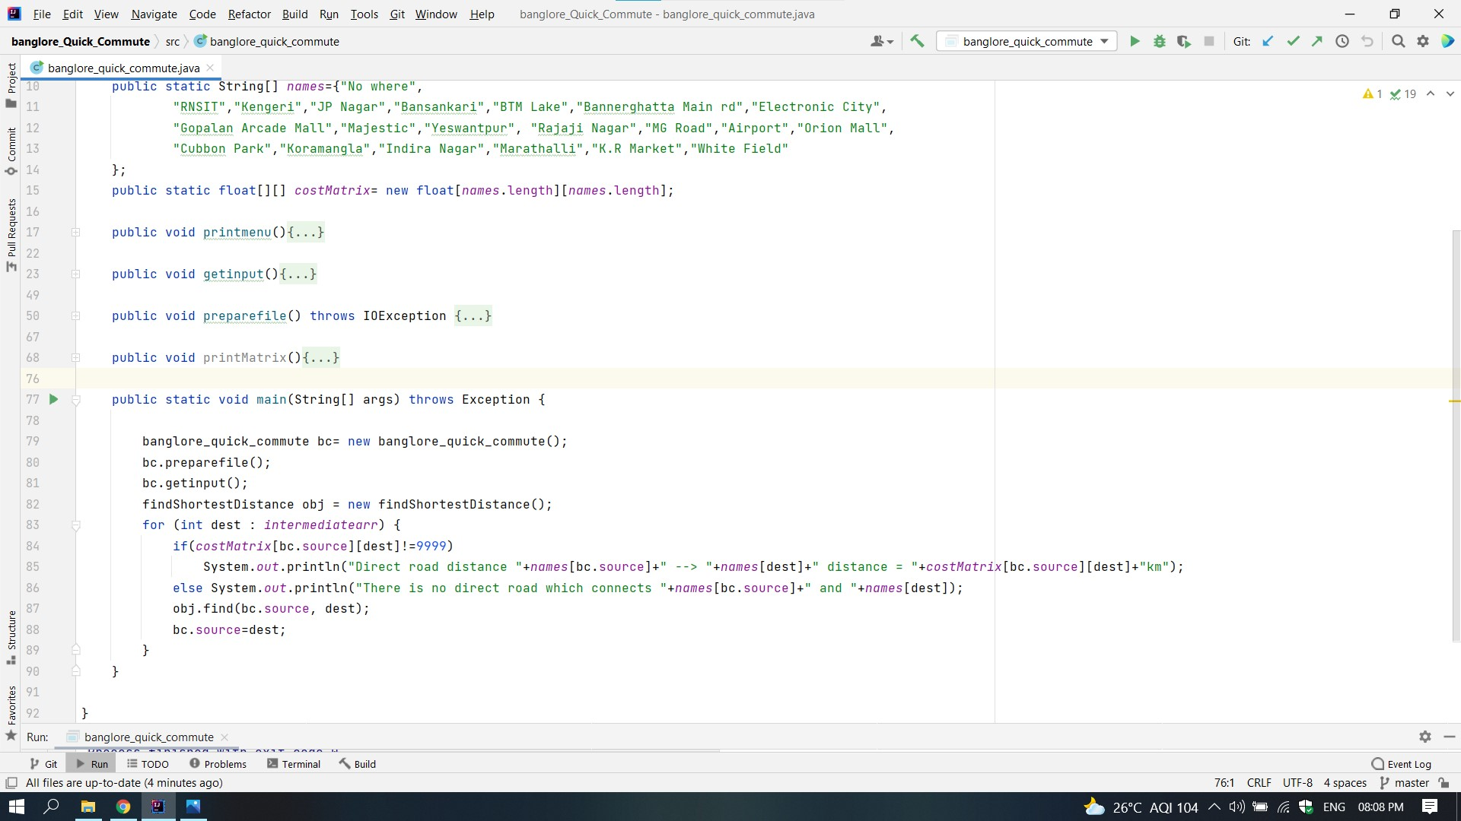

Slide 11
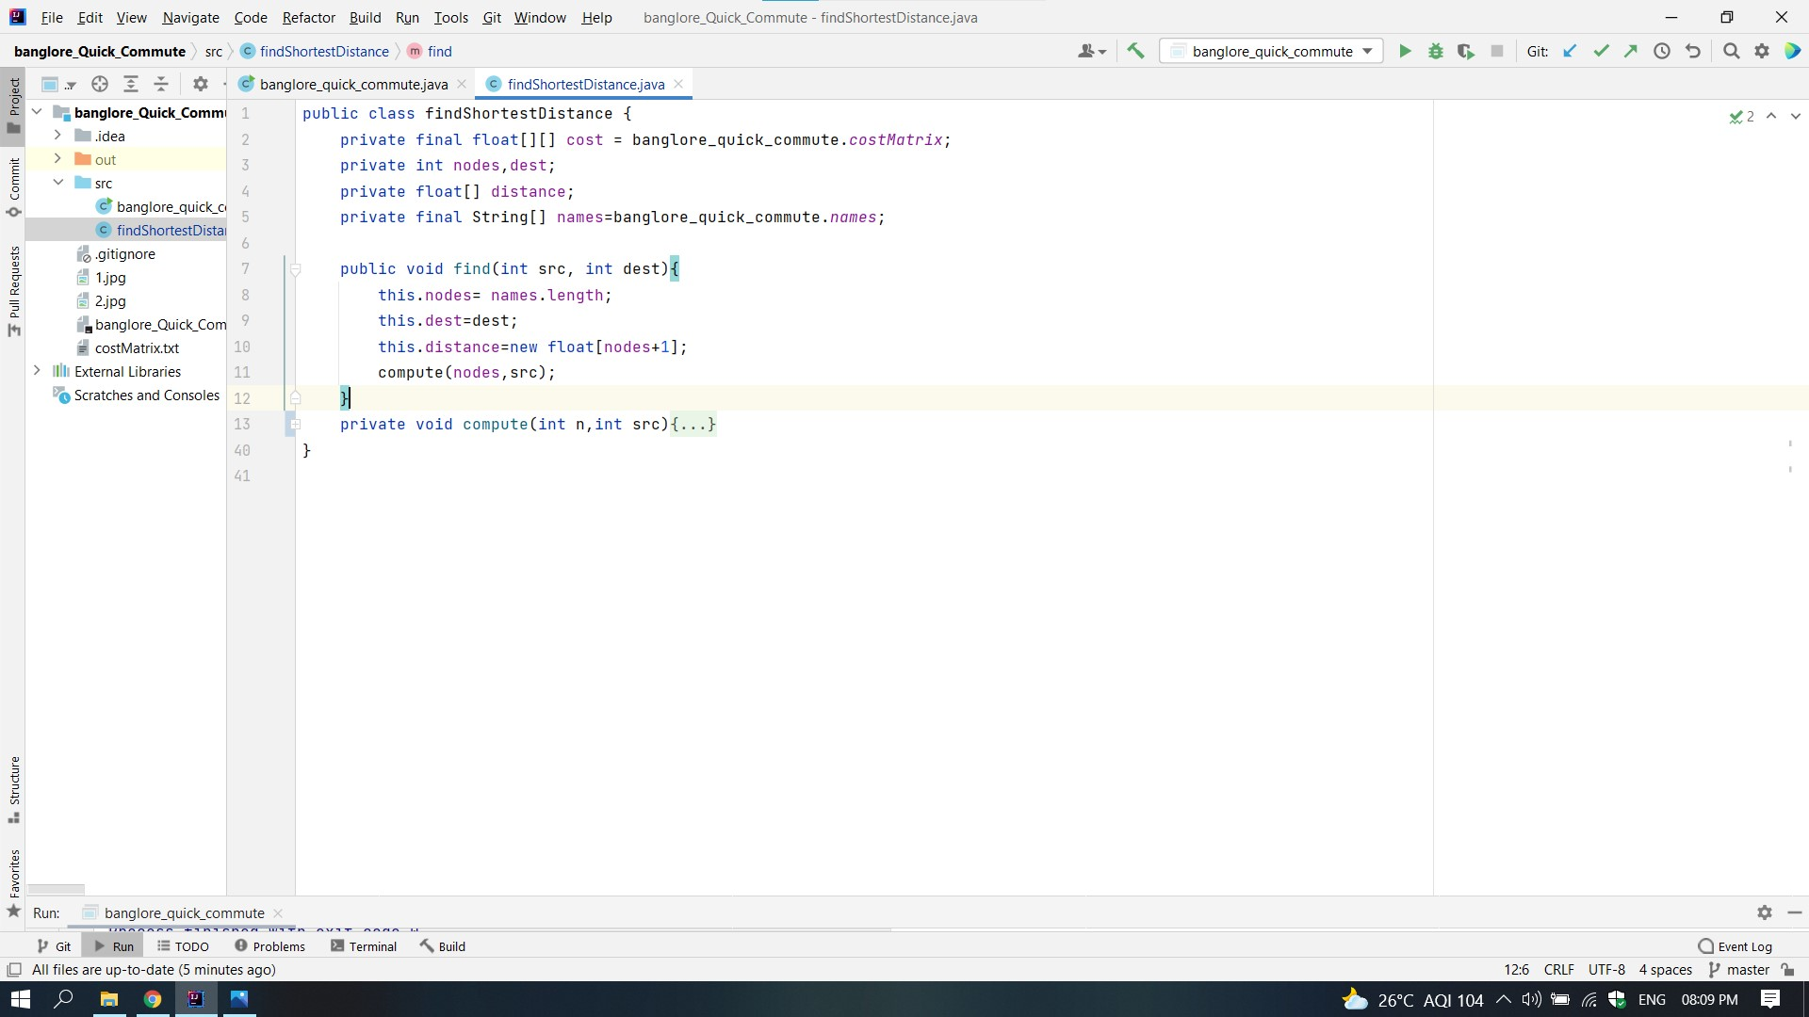

Slide 12
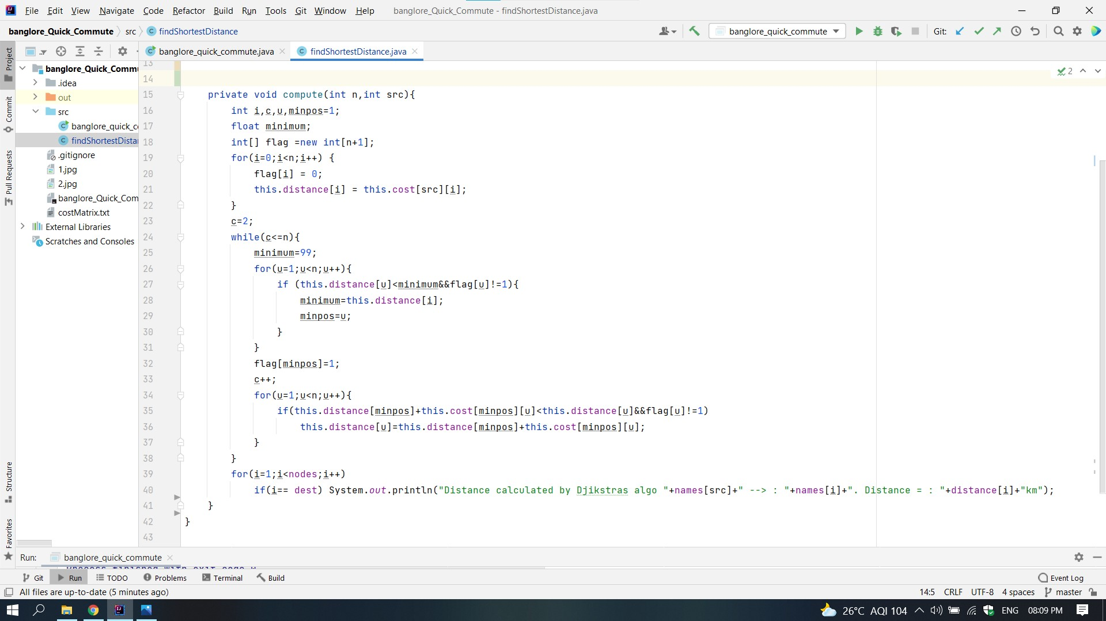

Slide 13
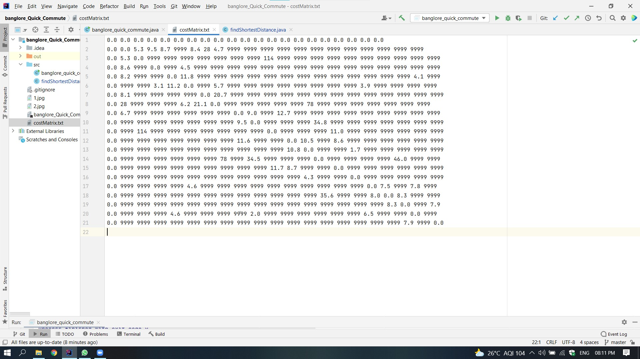
Cost Matrix

Slide 14
Result :
welcome to Banglore Quick Commute:
These are the places from which you can choose your source:
1. RNSIT
2. Kengeri
3. JP Nagar
4. Bansankari
5. BTM Lake
6. Bannerghatta Main rd

Slide 15
7. Electronic City
8. Gopalan Arcade Mall
9. Majestic
10. Yeswantpur
11. Rajaji Nagar
12. MG Road
13. Airport
14. Orion Mall
15. Cubbon Park

Slide 16
16. Koramangla
17. Indira Nagar
18. Marathalli
19. K.R Market
Enter the source :
1
Do you want any intermediate stop? y or n
y
Enter the number of intermediate stops you can repeat the places if you want to visit them again
3

Slide 17
Enter 1th intermediate point
7
Enter 2th intermediate point
13
Enter 3th intermediate point
9
Enter the destination :
8

Slide 18
Direct road distance RNSIT --> Electronic City distance = 28.0km
Distance calculated by Djikstras algo RNSIT --> : Electronic City. Distance = : 19.7km
Direct road distance Electronic City --> Airport distance = 78.0km
Distance calculated by Djikstras algo Electronic City --> : Airport. Distance = : 76.5km
Direct road distance Airport --> Majestic distance = 34.5km
Distance calculated by Djikstras algo Airport --> : Majestic. Distance = : 34.5km
Direct road distance Majestic --> Gopalan Arcade Mall distance = 9.5km
Distance calculated by Djikstras algo Majestic --> : Gopalan Arcade Mall. Distance = : 9.5km

Slide 19
Application
Traveller agents can use this program to help their customers .
Navigation system of vehicles use this to check if it can reach at the destination with the amount of fuel it has .
Can be used by ambulance to escape traffic.

Slide 20
Conclusion and Future Enhancements
Alternate methods to make this project
We can also use Floyd's Algorithm or Travelling Salesperson method to make this project as it finds the minimum cost tour for a given set of places.
We can add real time traffic congestion data .
We can add the path through which we can travel.
We can add time checking for each and every path.
We can add a facility of tour in which the user have to select the places he wants to travel and the program will give the min cost tour
We can reduce time complexity by introducing min heap.

Slide 21
References:
Google.com
Class notes
Youtube.com (Abhishek singh’s youtube channel )
Distance Matrix API

Slide 22
THANK YOU

