Slide 1
01 Design Intro Notes

Slide 2
What is a data base
→A collection of inter related data, which can be shared by many users
→ Stored data
Another Storage System is file oriented
→ Word documents, pictures and programs are examples of data stored in files
→ Each file type has a different storage format
Lead to
→ A database is another Data Storage format

Slide 3
WHAT TYPES OF DATA IS STORED
Large or small operations need to store data
Known types of data would be
- Sales and expenses
- Rent, wages and utilities
- Data about employees including pictures
- Data about customers
- Inventory or product
- Warehouses
- Accounting and banking information
- Programs to run all of this
Seneca example of the above would be?

Slide 4
SIZE OF THE DATA KEPT
Examples:
Walmart
CPP
Federal Tax

Slide 5
New Examples:
What are some of the largest data storage companies today?

Slide 6
ENTITIES
All of the “things” that an organization wants to keep details about are called ENTITIES
Example:
Pictures and Music are 2 types of entities

Slide 7
Are the entities related?
Do we have a need to “relate” the data stored in one entity to that stored in another entity?
What is the relationship between the entities?

Slide 8
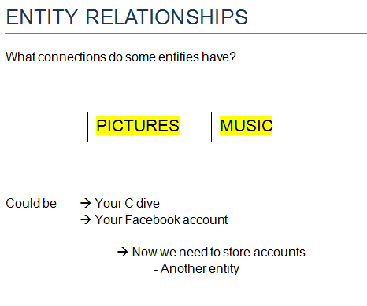

Slide 9
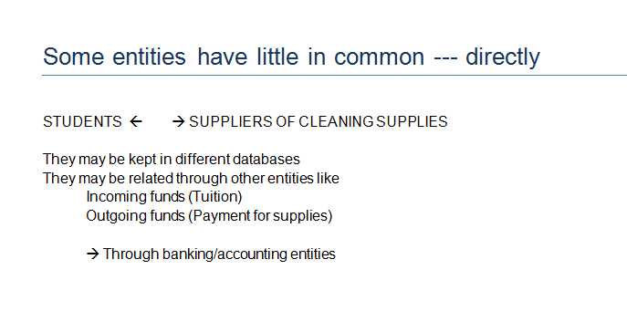

Slide 10
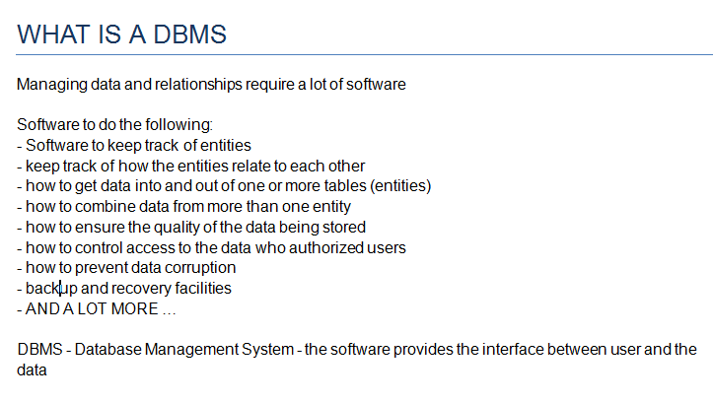

Slide 11
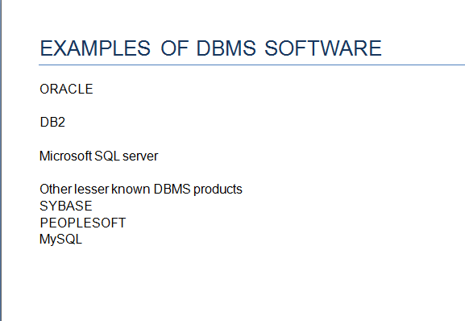

Slide 12
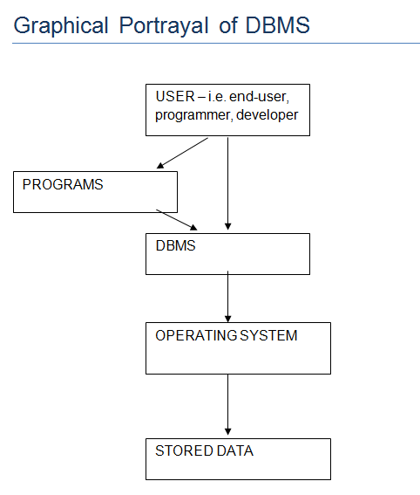

Slide 13
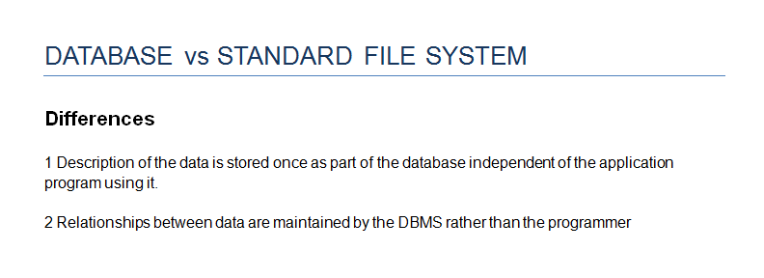

Slide 14
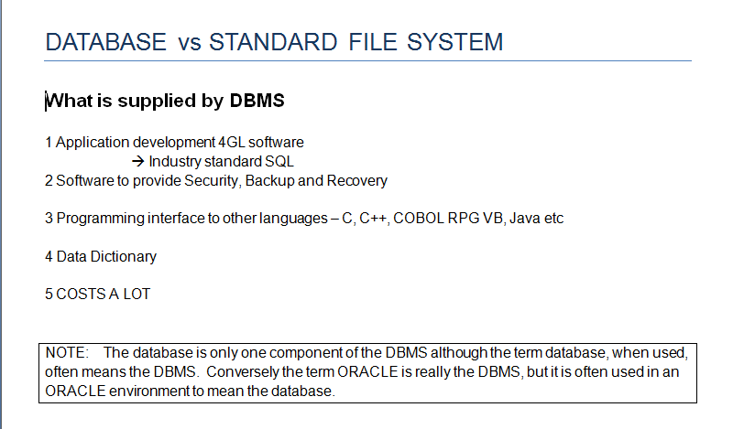

Slide 15


Slide 16
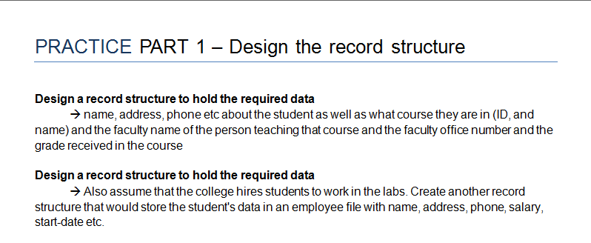

Slide 17
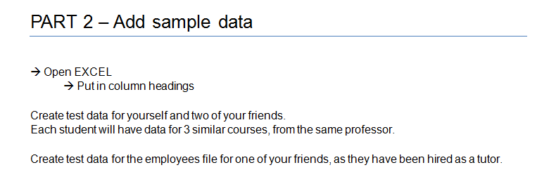

Slide 18
