Slide 1
DBS201: Introduction to Database Design and SQL
Lecture 1

Slide 2
Agenda
Introduction to the course website
Data vs. Information
File Systems
Database
Database Management System
Database Design

Slide 3
Agenda
Introduction to the course website
Data vs. Information
File Systems
Database
Database Management System
Database Design

Slide 4
Data vs. Information
Data:
Unprocessed information
i.e. customer, course, employee
Building blocks of information
Information:
Produced by processing data which is related
i.e. credit card statement, phone bill, video rental
Accurate and timely information is need for decision making
Good decision making is key to an organization’s survival

Slide 5
Agenda
Introduction to the course website
Data vs. Information
File Systems
Database
Database Management System
Database Design

Slide 6
File Systems
Using a simple business example:
A customer orders product from a Retailer
Sales Department would take the order information from the customer
Sales Department would send a request to the Shipping Department to deliver a product to a customer

Slide 7
File Systems
Using a simple business example:
The Shipping Department would enter in the information about the customer order and create a shipping document
The Shipping Department would print the shipping document and send the products to the Customer

Slide 8
File Systems
Possible files:
Sales Department:
Customer, Product, Sale
Shipping Department:
Customer, Shipping Document
Can anybody see a problem with this?
Where would you go to look up the phone number for a customer

Slide 9
Data Redundancy
Same data appears in more than one location
Results in data inconsistency
Data anomalies result when changes to redundant data are not made successfully

Slide 10
Data Anomalies
Modification anomalies
Insertion anomalies
Deletion anomalies

Slide 11
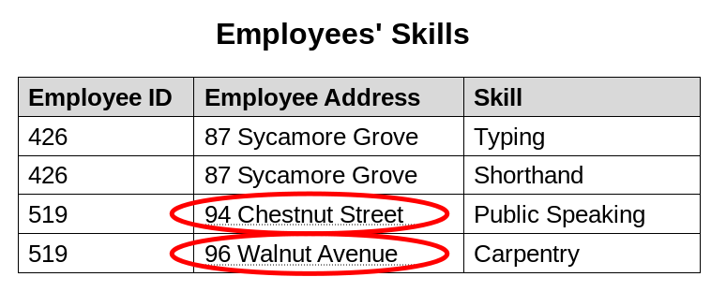
Data Anomalies
Modification anomaly
Change the address for employee 519 – has to be done for all rows
What if this employee address is in another table – has to be done for all tables

Slide 12
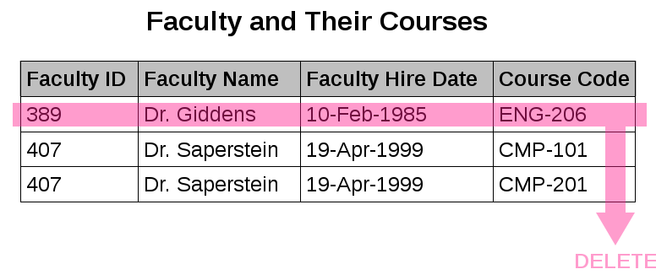
Data Anomalies
Deletion anomaly
Dr. Giddens is not teaching ENG-206 this semester
We could lose the hire date if we remove this row to reflect current faculty and their courses

Slide 13
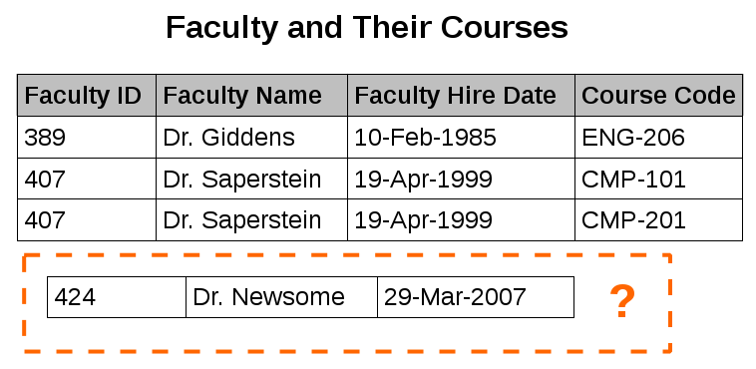
Data Anomalies
Insertion anomaly
We can record the details of any faculty member who teaches at least one course in 2007
We cannot record the details of a newly hired faculty member who has not yet been assigned to teach any courses

Slide 14
File Systems
Programs were written to access data.
i.e. to get information about a customer, a program would be written to do just that (and nothing else).
Program would go against a specific file (or files, depending on it’s purpose)
If other information was needed, another program was written
Programmer had to specify exactly how the processing of the data needed to be done

Slide 15
File Systems
What if you wanted some information from a file quickly?
Could not be done using a traditional file system.
Why? Programs specified exact structure of a file. Think of the complexity if information was required from multiples files!

Slide 16
File Systems
What if you wanted to change the structure of a file?
All the programs that used that file would have to be changed

Slide 17
Agenda
Introduction to the course website
Data vs. Information
File Systems
Database
Database Management System
Database Design

Slide 18
Database
Database
A structure that contains logically related data in a single repository
A Database contains:
End user component – data
Metadata – data about data

Slide 19
Database
Types of Databases
Centralized
Supports one or more users at a time
Database is in one physical location
Database could be on a pc, a mid-range, or a main-frame
Distributed:
Data is distributed at several physical locations
Database at each physical locations can vary (i.e. one location might have the database on a mid-range, one might have it on a pc)

Slide 20
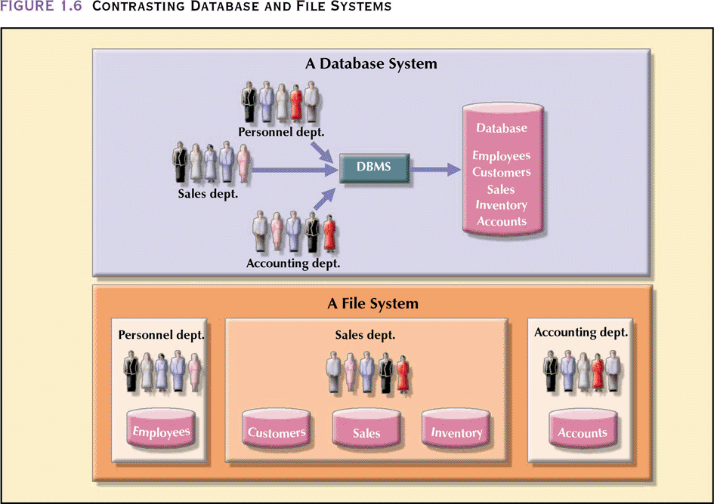
Database vs. File System

Slide 21
Database Uses
Production or Transaction
Supports day-to-day operations
Decision Support
Information for tactical or strategic decision making
Data Warehouse
Historical data

Slide 22
Advantages of Database Processing
Ability to get more information from the same amount of data
i.e. all customer related data is in one customer place
Sharing data
Data is available to be use by authorized users
Controlling Redundancy
Only a single copy of the data exists

Slide 23
Advantages of Database Processing
Balancing
Databases are structured to benefit all users in the organization, not just a single group
Expanding security
Access to data can be password protected or can restrict access to data – read only, update

Slide 24
Advantages of Database Processing
Increasing Productivity
Ability to write ad hoc queries
Users don’t have to know exact structure of the data
Provides data independence
Can change the structure of the data without having to change the programs that access it

Slide 25
Disadvantages of Database Processing
Large file size
Files now include metadata information
Increased complexity
Need to take into consideration data design, security, backup and recovery, integrity

Slide 26
Disadvantages of Database Processing
Greater impact of failure
Data is now shared, if a failure occurs, many users are impacted
More difficult recovery
If data can be updated by many users at the same time, how can it be recovered to the correct state for all users correctly

Slide 27
Agenda
Introduction to the course website
Data vs. Information
File Systems
Database
Database Management System
Database Design

Slide 28
Database Management System (DBMS)
Collection of programs that manages database structure and controls access to the database (and ultimately the data)
Manages sharing of data among multiple applications and users
Data is more consistent
Ability to do ad hoc querying

Slide 29
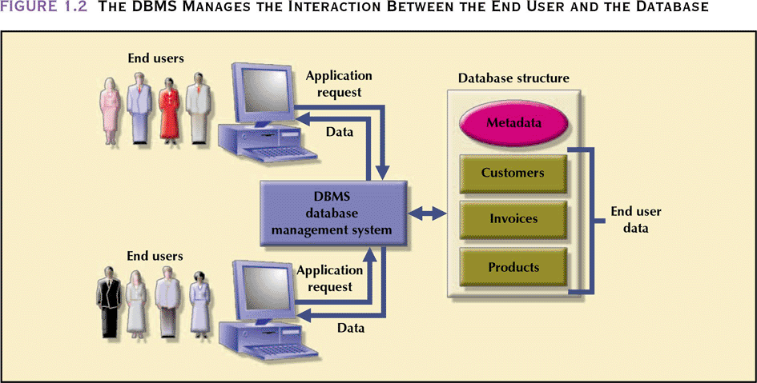
Database Management System (DBMS)

Slide 30
Importance of a DBMS
For Top Management
Provides information necessary for strategic decision making and planning
Provides access to external and internal data
Provides information on company performance and whether the company is achieving their goals (targets) or not
For Middle Management
Provides information necessary for tactical decision making planning

Slide 31
Importance of a DBMS
For Operational Management
Provides timely information
Represents and supports the company operations as closely as possible (operational data)
For Other Users
Provides timely information
Produces results within specified performance levels

Slide 32
Agenda
Introduction to the course website
Data vs. Information
File Systems
Database
Database Management System
Database Design

Slide 33
Database Design
Defines the database’s expected use
Avoids redundant data (unnecessarily duplicated)
Eliminates poorly designed databases
Done within a systems development life cycle (SDLC) framework
Database Design has it’s own framework, within the SDLC called the Database Life Cycle (DBLC)

Slide 34
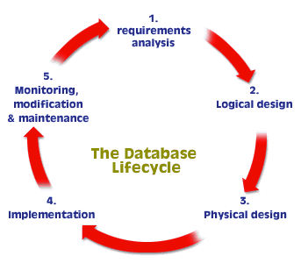
Database Design

Slide 35
Database Design
Different database design strategies exist: top-down, bottom-up, centralized and decentralized

Slide 36
DBS201: Introduction to Structured Query Language (SQL)
Lecture 1

Slide 37
Agenda
The basic commands and functions of SQL
How to use SQL to query a database to extract useful information (The SELECT statement)

Slide 38
Introduction to SQL
SQL: Structured Query Language
Designed specifically for communicating with databases
SQL functions fit into three broad categories:
Data definition language (DDL)
Data manipulation language (DML)
Transaction Control Language (TCL)

Slide 39
Introduction to SQL (continued)
Data definition language
SQL includes commands to create
Database objects such as tables
Commands to define access rights to those database objects
Data manipulation language
Includes commands to insert, update, delete, and retrieve data within the database tables objects
Transaction control language
Includes commands to ensure the integrity of the database.

Slide 40
Introduction to SQL (continued)
SQL is relatively easy to learn
Basic command set has a vocabulary of less than 100 words
Sample vocabulary:
CREATE COLLECTION
CREATE TABLE
CREATE VIEW

Slide 41
Introduction to SQL (continued)
Sample vocabulary (continued):
DROP COLLECTION
DROP TABLE
DROP VIEW
ALTER
INSERT
SELECT
DELETE

Slide 42
Introduction to SQL (continued)
American National Standards Institute (ANSI) prescribes a standard SQL
Several SQL dialects exist
DB2, Oracle, MySQL, Access etc

Slide 43
Data Manipulation Commands
SELECT attributes also called fields
FROM table(s)
WHERE condition(s)
ORDER BY attribute(s)

Slide 44
Sample Table: PART
PART NUMBER | PART DESC | ON HAND | CLASS | WAREHOUSE | PRICE
AX12 | Iron | 104 | HW | 3 | 23.95
AZ52 | Dartboard | 20 | SG | 2 | 12.95
BA74 | Basketball | 40 | SG | 1 | 29.95
BH22 | Cornpopper | 95 | HW | 3 | 24.95
BT04 | Gas Grill | 11 | AP | 2 | 149.99
BZ66 | Washer | 52 | AP | 3 | 399.99
CA14 | Griddle | 78 | HW | 3 | 39.99
CB03 | Bike | 44 | SG | 1 | 299.99
CX11 | Blender | 112 | HW | 3 | 22.95
CZ81 | Treadmill | 68 | SG | 2 | 349.99

Slide 45
Listing Table Rows
SELECT
Used to list contents of table
Syntax
SELECT Field1, Field 2,… FROM tablename
WHERE Condition 1 AND/OR Condition 2
ORDER BY Field1, Field 2,…

Slide 46
Listing Table Rows
At a minimum, must specify what you want to select and where you want to select it from
SELECT PART_NUMBER
FROM PART

Slide 47
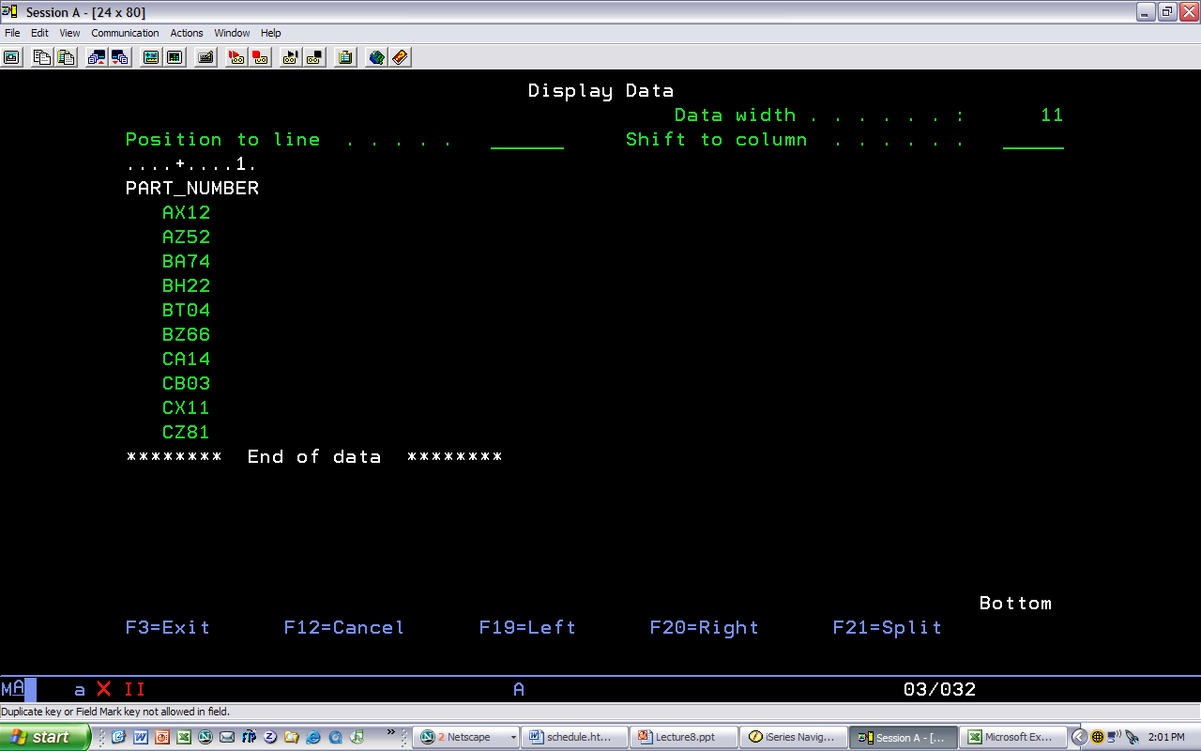
Listing Table Rows, specifying a specific field name

Slide 48
Listing All Table Rows
Asterisk can be used as wildcard character to list all attributes
SELECT *
FROM PART

Slide 49
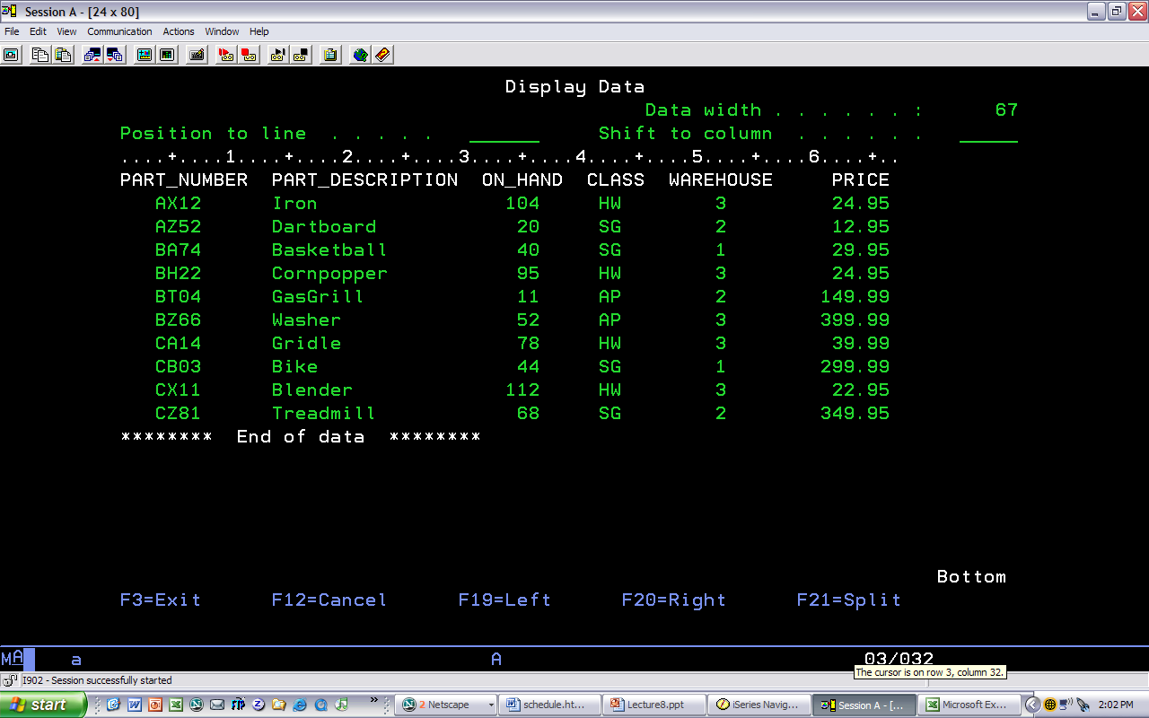
Listing Table Rows with * to represent all field names

Slide 50
Selecting Rows with Comparison Operators
Select partial table contents by placing restrictions on rows to be included in output
Add conditional restrictions to the SELECT statement, using WHERE clause
SELECT *
FROM PART
WHERE ON_HAND > 30

Slide 51
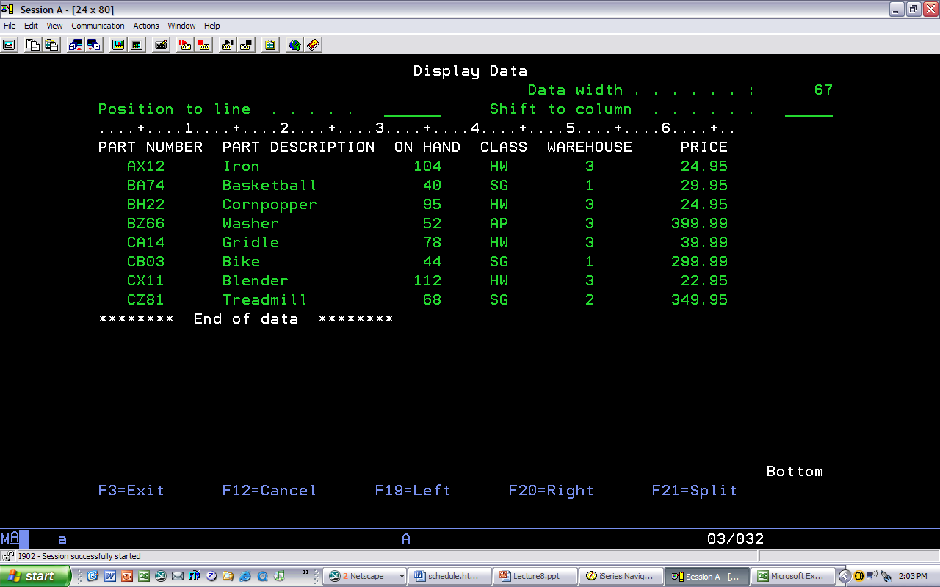
Listing Table Rows with * to represent all field names

Slide 52
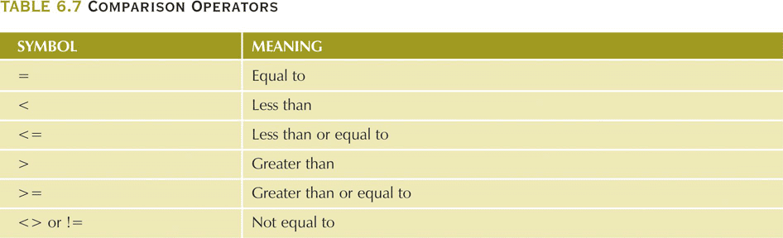
Comparison Operators

Slide 53
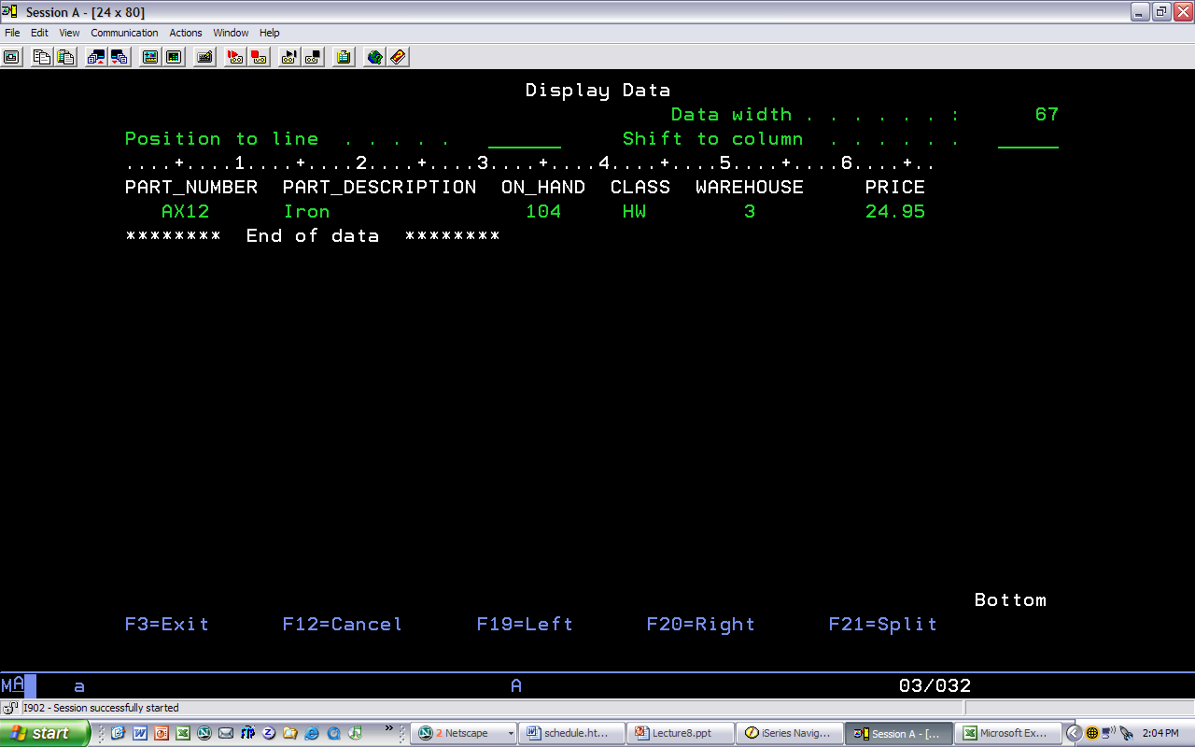
Selecting Rows with Comparison Operators
Note criteria is in
Quotes –
PART_NUMBER is a
character field
SELECT *
FROM PART
WHERE PART_NUMBER = ‘AX12’

Slide 54
Sorting Output
Data is displayed in the order which it was added to the tables initially
To change the order the data is displayed in, use the ORDER BY clause in the SELECT statement
SELECT *
FROM PART
ORDER BY ON_HAND

Slide 55
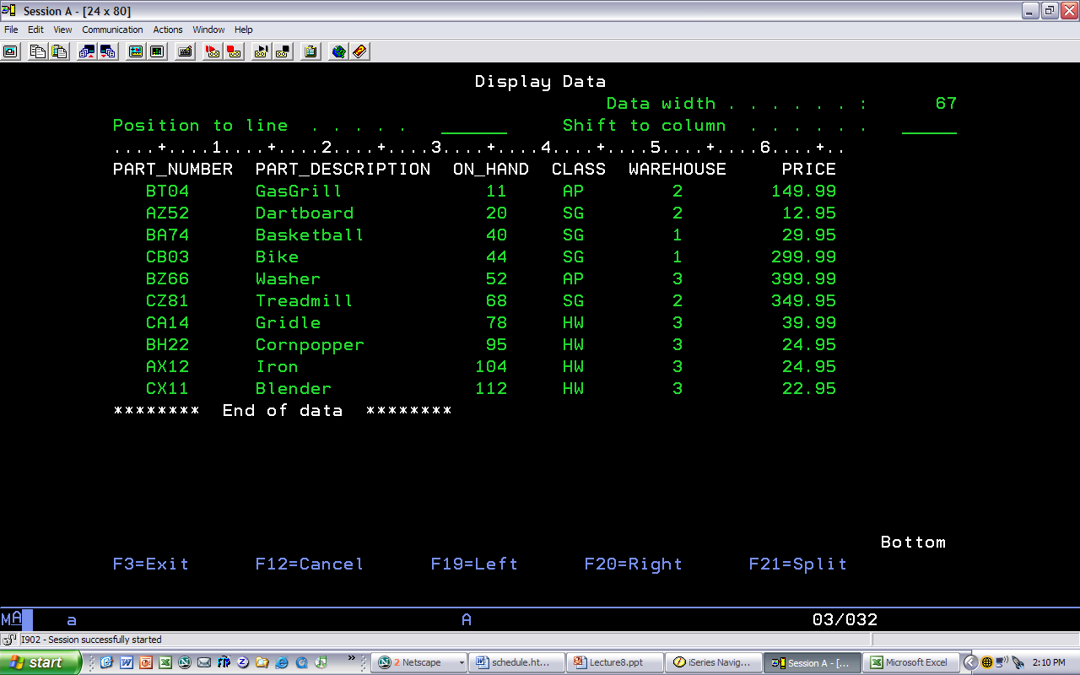
Sorting Output – Single Column
SELECT * FROM PART ORDER BY ON_HAND

Slide 56
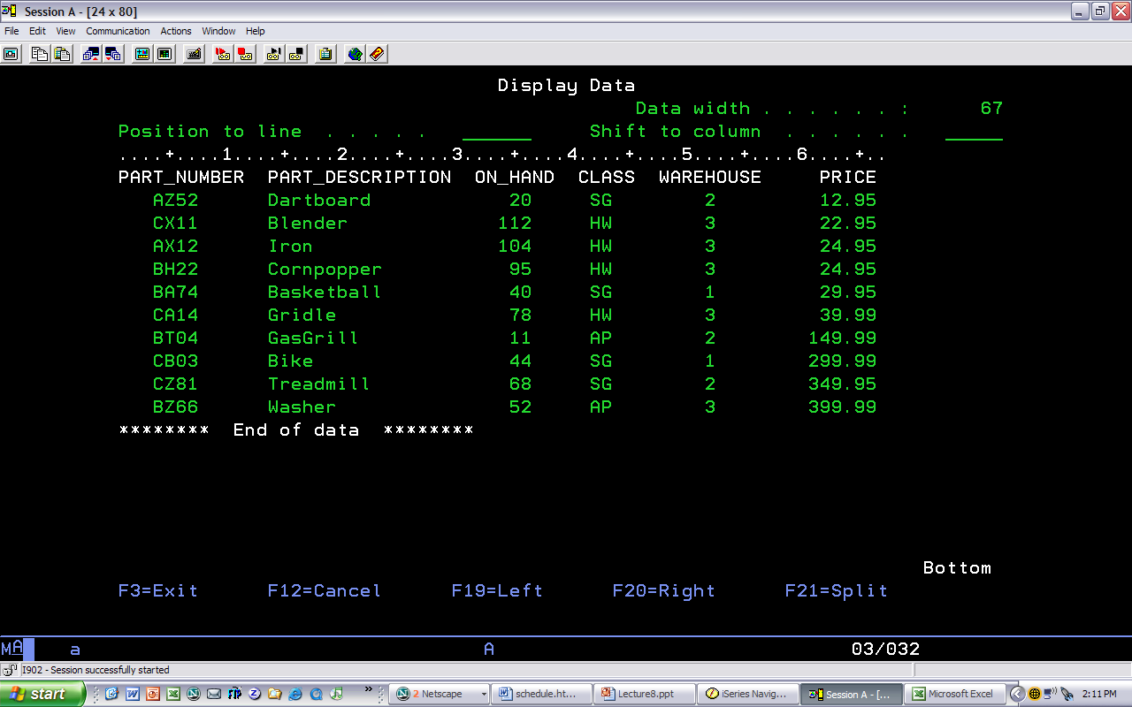
Sorting Output – Multiple Columns
Note how boat name is
sorted within owner num
SELECT * FROM PART ORDER BY PRICE, PART_NUMBER

Slide 57
Sorting Output
Data is displayed in the order which it was added to the tables initially
To sort data in descending order, use the DESC keyword after each field specified in the ORDER BY clause that is to be displayed in descending order

Slide 58
In Summary
SELECT statement
Used to list contents of table
Syntax
SELECT Field1, Field 2,… FROM tablename
WHERE Condition 1 AND/OR Condition 2
ORDER BY Field1, Field 2,…

