Slide 1
INT222
COURSE INFORMATION, INTERNET ARCHITECTURE, Web Client Programming Introduction & Lab 1 Demo
Please Note: The slides are not a substitute for the readings
https://zenit.senecac.on.ca/~emile.ohan/int222/weekly/week01/

Slide 2
Welcome! – Course Information
From the course outline:
This subject introduces students to Internet architecture and software development principles, using the World Wide Web as the system example. After successfully completing the subject, a student will be able to design and create web pages for web browsers, while applying knowledge of HTML5 technologies.
Students begin by learning JavaScript, the programming language of the Web. Then, the Document Object Model (DOM) is studied, and with it, documents that use the Hypertext Markup Language (HTML) to define its structure and content. To affect and modify the appearance and formatting of a document, students learn and apply the foundations of the Cascading Style Sheet (CSS) language. Throughout this progression of topics, JavaScript is continually used to access and modify the content and appearance of documents through the DOM interface.

Slide 3
Course Information – Format
4 hours / week (2 hours lecture, 2 hours workshop [lab]
NOTE: You are encouraged to attend all workshops periods as they may contain additional lecture material, help with assignments, labs, etc.
Grading
3 Assignments (6%, 6%, 8% respectively - 20% total)
2 Tests (17%, 18% respectively - 35% total)
1 Final Exam (30%)
6 workshops (labs) (10% total)
2 Quizzes (Unannounced) (5% total )

Slide 4
Course Information
INT222 Website walkthrough covering:
Course Standards
Course Timeline and Weekly Objectives
My.Seneca walkthrough covering:
Faculty Information
Announcements
Grades

Slide 5
Course Information / Textbook
No text book.
We will be using the “Weekly Notes” available on the website: https://zenit.senecac.on.ca/~emile.ohan/int222/weekly.php
Reference material:
Links available on the course website under “Resources”: https://zenit.senecac.on.ca/~emile.ohan/int222/resources.html

Slide 6
Grading – Labs
Labs will usually cover material from the weekly lectures
Labs are meant to reinforce the lecture material, though new material may be introduced
The tests and exam will cover lab material as well as lecture material

Slide 7
Grading – Assignment Completion
Assignments are due no later than 23:59 on the due date - See "Assignments section".
Assignments not submitted by the due date will be assessed a late penalty - See "Course Standards - Assignments Standards section".
All assignments must be submitted by the last scheduled day of classes (April 15, 2016) in order to pass this course

Slide 8
Grading – Tests
There will be two (2) term tests - worth 35%
Tests will be held on the dates shown in the "Tests section".
If you miss writing a test - See "Course Standards - Tests Standards section“
Questions on both term tests will be on material covered in class from the start of the semester as well as material on labs and assignments

Slide 9
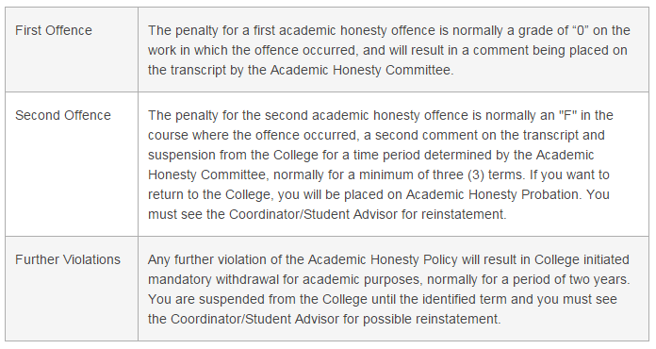
Cheating and Plagiarism
To support academic honesty at Seneca College, all work submitted by students may be reviewed for authenticity and originality, utilizing software tools and third party services. Please visit the Academic Honesty site on http://library.senecacollege.ca for further information regarding cheating and plagiarism policies and procedures.

Slide 10
In Order to Pass
To obtain a credit in this subject, you must:
Achieve a grade of 50% or better on the final exam
Satisfactorily complete all assignments
Achieve a weighted average of 50% or better for the tests and final exam
Achieve a grade of 50% or better on the overall course

Slide 11
INT222 Zenit Account – Login / Password
Each student registered in the INT222 course has an account/password on zenit.senecac.on.ca (a secure Linux server running an Apache web server).
Your account on zenit.senecac.on.ca is to be used strictly for the INT222 course and all "Seneca College Acceptable Account Use Policy" apply.
Your account on Zenit has sftp and SSH access.
The login on zenit.senecac.on.ca has the following format - e.g - int222_141a01

Slide 12
INT222 Zenit Account – Passwords
Should you forget your password, you will need to send an email to your me using your MySeneca email account. Make sure to include the following:
"INT222 - password" in the subject area
your surname followed by you first name
your student number
a brief note

Slide 13
INT222 Zenit Account – Security
All of the web content that you create in your Zenit account will be protected by a username / password. (username / password are the same as the username / password for your Zenit account)
This web server feature is implemented so that only you and myself will be able to view your work.
Test this feature using your browser by typing your URL - https://zenit.senecac.on.ca/~yourlogin/
You will be prompted for a username and a password. Type your username and password.
Your username / password will stay in effect until you exit the browser session.
Sharing your username/password with others or attempting to disable the security set for your account will be considered an act of cheating and will be treated accordingly.

Slide 14
INT222 Zenit Account – Rules
School of ICT policies include but are NOT limited to the following:
I WILL
Abide by all the rules and regulations set forth in the "Seneca College Acceptable Account Use Policy".
Practice behavior that is responsible, ethical and legal.
Limit sftp & SSH usage to a reasonable time so that others can access the server.

Slide 15
INT222 Zenit Account – Rules cont’d
I WILL NOT
Inspect, modify or copy programs or data without proper consent and respect for copyright laws.
Distribute information not intended for distribution by its owner without direct consent.
Access or read files belonging to any account other than my own without direct consent.
Use my account to place obscene or harassing materials.
Use my account to transmit or propagate chain letters or pyramid schemes; or flood user(s) with email.
Use my account to threaten, harass, or intimidate other students, faculty, or any person associated or not associated with the college.
Use my account to do network port scanning, sniffing, or other computer/network vulnerability scanning.

Slide 16
My Zenit Account - Template
Quick walkthrough of the links on the “demo account”

Slide 17
Internet Architecture
No one or organization owns the internet. The internet is a collection of networks connected to each other. The networks are connected together to form the single entity that we know as the Internet.
The name "INTERNET" comes from the two the words that describe the internet - interconnected networks.

Slide 18
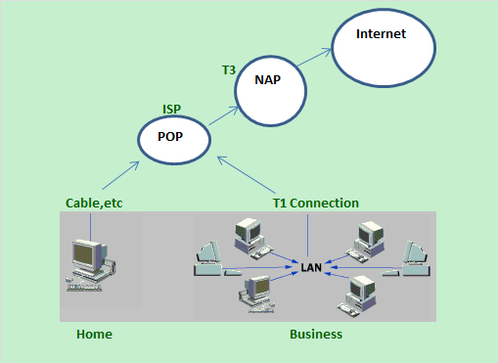
Internet Architecture – cont’d
local area network (LAN)
Internet Service Provider (ISP)
Point of Presence (POP)
Network Access Points (NAP)

Slide 19
Internet Architecture - Router
A router has two separate, but related, jobs
It ensures that information does not go where it is not needed - this is crucial for keeping large volumes of data from clogging the connections of "innocent bystanders"
It makes sure that information does make it to the intended destination.

Slide 20
History of the Web – “Internet”
1960 - computers were stand-alone
1957 - Soviet Union began launching Sputnik satellites
1958 - U.S. created two agencies to keep up with technology: NASA - National Aeronautics and Space Administration ARPA - Advanced Research Projects Agency
1960's - ARPANet created in late 1960's connected networks at universities and government agencies distributed network model had benefit that there were no central hubs that could cripple the etwork in case of nuclear attack
1970 - Telnet - TELecommunications NETwork - developed
1972 - FTP - File Transfer Protocol - developed
1973 - Email "@" standard developed
1977 - TCP/IP - Transmission Control Protocol / Internet Protocol - developed
1980's - NSFNet - National Science Foundation network created 5 supercomputers to be used for research in various parts of the U.S. NSFNet linked these computers to allow access to others this network became the first internet backbone
Late 1980's - Internet opened up to non-military organizations in late 1980's

Slide 21
History of the Web – “WWW (World Wide Web)”
Late 1980's - invented at CERN - European Council for Nuclear Research - Tim Berners-Lee document formats varied, and were difficult to find used hypertext, hyperlinks
Late 1980's - 1990 - HTTP - HyperText Transfer Protocol
1991 HTML - HyperText Markup Language created a document formatting or "markup" language, html (hypertext markup language) html was derived from SGML - Standard Generalized Markup Language (SGML) created http (hypertext transfer protocol) to transfer html documents created browser software to display html documents - all text-based
1993 - Marc Andreessen and team created Mosaic browser
1994 - HTML2 - Netscape Navigator was created - an offshoot of Mosaic
1994 - Microsoft Internet Explorer was developed
1996 CSS1 - Cascading Style Sheets
1996 JavaScript
1997 HTML4
1998 CSS2 - Cascading Style Sheets
2000 XHTML1 - Extensible HyperText Markup Language
2005 AJAX - Asynchronous JavaScript and Xml
2009 HTML5
2009 CSS3 - Cascading Style Sheets

Slide 22
Message Request & Delivery
A "message" can be one of many things
Email
Ftp request
Request for an html page
Response to a request, such as an mp3 file
etc., etc., etc.
Messages are delivered using a method called packet-switching:
Breaking up messages into “packets” using TCP (Transmission Control Protocol) and sent over a network using a destination IP address.
When received, TCP reassembles the message and ensures all packets received, otherwise requests a re-send

Slide 23
DNS (Domain Name System or Server)
DNS is used to give names to IP addresses
Zenit.senecac.on.ca is used to identify 142.204.140.203 (name gets less localized to the right – ie: hostname zenit, at Seneca, in Ontario, in Canada)
In addition to ".ca", other common domains include
.com - commercial
.edu - educational
.gov - governmental
.net - isp
.org - non-profit
and many more
ICANN - Internet Corporation for Assigned Names and Numbers- oversees assignment of names and IP addresses and certifies domain name registrars to manage the process. DNS servers (name servers) associate the domain names with the IP address

Slide 24
URL (Uniform Resource Locator)
URL is used to specify the protocol and the exact location of a desired document eg. https://scs.senecac.on.ca/~emile.ohan/index.html
Protocol = https://
Domain name = scs.senecac.on.ca
Path or URI - uniform resource indicator = ~emile.ohan/index.html

Slide 25
Client-Server model
The www uses a client-server model
client software (web browser) requests an html page
the request is sent as a message to the particular web server
requested page is sent as a message from the server to the client
the client software interprets and displays the html page
Other available services
FTP (file transfer protocol) - transfer files
SFTP (Secure file transfer protocol) - transfer files
telnet - logins to remote computers
SSH - Secure Shell - used for secure logins to remote computers
email
A port number is reserved for each the services on a server
FTP (file transfer protocol) - usually on port 21
SFTP (Secure file transfer protocol) - usually on port 22
SSH (Secure Shell) - used for secure logins - usually on port 22
telnet - usually on port 23
http - usually on port 80

Slide 26
Web Client Programming
Web development is a broad term for the work involved in developing a web site for the World Wide Web. The INT222 course deals strictly with the client side of the web development.
The INT222 covers three parts of this development
HyperText Markup Language (HTML5) The main language for creating web pages
Cascading Style Sheets (CSS) Used for describing the look and formatting of a web page
JavaScript (JS) Allows client-side scripts to interact with the user

Slide 27
Web Client Programming – Tools
Developer tools
All modern web browsers come with built in development tools – these can be accessed by pressing “F12”
HTML Validation
W3C HTML Validation Service Check the HTML, HTML5, .. of Web documents
Link Checker Check links and anchors in Web pages or full Web sites
Living Validator Check the html5 of Web documents
JavaScript Scratchpad - part of Firefox (Tools - Web Developer) To activate - Shift + F4 To Run - Ctrl + R
Online JavaScript Lint (http://www.javascriptlint.com/online_lint.php)
CSS Basics (http://csstypeset.com/)
HTML (tryit) See INT222 web site

Slide 28
Lab 1 – Run Through
Before we begin: We need to download some software:
Notepad++ https://notepad-plus-plus.org/
Filezilla https://filezilla-project.org/
Quick demonstration of how to complete “lab 1” - https://zenit.senecac.on.ca/~emile.ohan/int222/labs/lab01/

