Slide 1
INT222
Quick A2 Overview & HTML FOrms
Please Note: The slides are not a substitute for the readings
https://zenit.senecac.on.ca/~emile.ohan/int222/assignments/assignment-02/ https://zenit.senecac.on.ca/~emile.ohan/int222/weekly/week07/

Slide 2
Assignment 2 - Quick Overview
Assignment 2 is available here: https://zenit.senecac.on.ca/~emile.ohan/int222/assignments/assignment-02/
Due on: March 19, 2016 - 23:59
Pay close attention to all of the requirements, especially:
All HTML pages must pass the W3C HTML5 validation - (No errors - No warnings).
All CSS used in the assignment must be "External CSS" - CSS used in the assignment must pass the W3C CSS validation
All files related to assignment #2 must be in assign2 directory using the directory structure as illustrated on the assignment
A footer must appear on all html pages - use the JavaScript code made available to you in assignment #1 (ie: "This page was last updated on ...".)

Slide 3

Assignment 2 - “Social Media Image”
Your assignment 2 must include the following “Social Media Image” on every page (except “guestbook” & “extra”):
You will turn a minimum of 4 of these icons into links to their appropriate sites.
This can be done using “absolute positioning” – Note: a demo of Facebook is available from the assignment specification (demo)

Slide 4
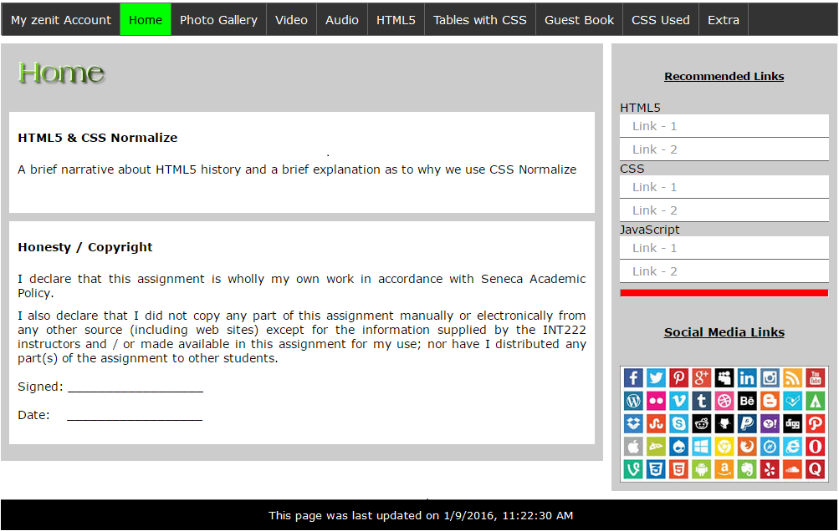
Assignment 2 – “Home” Page

Slide 5
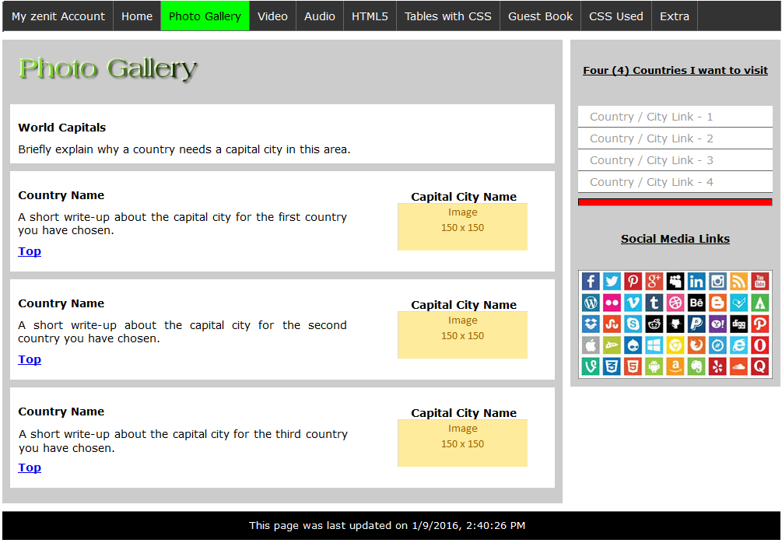
Assignment 2 – “Gallery” Page

Slide 6
Assignment 2 – “Gallery” Page

Slide 7
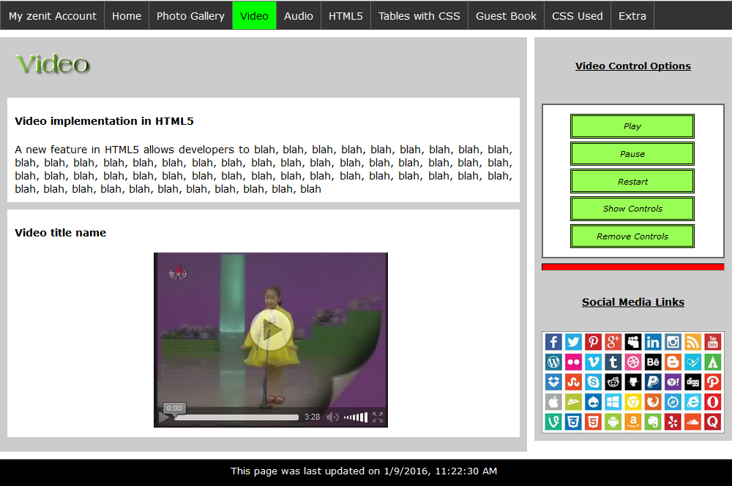
Assignment 2 – “Video” Page

Slide 8
Assignment 2 – “Video” Page

Slide 9
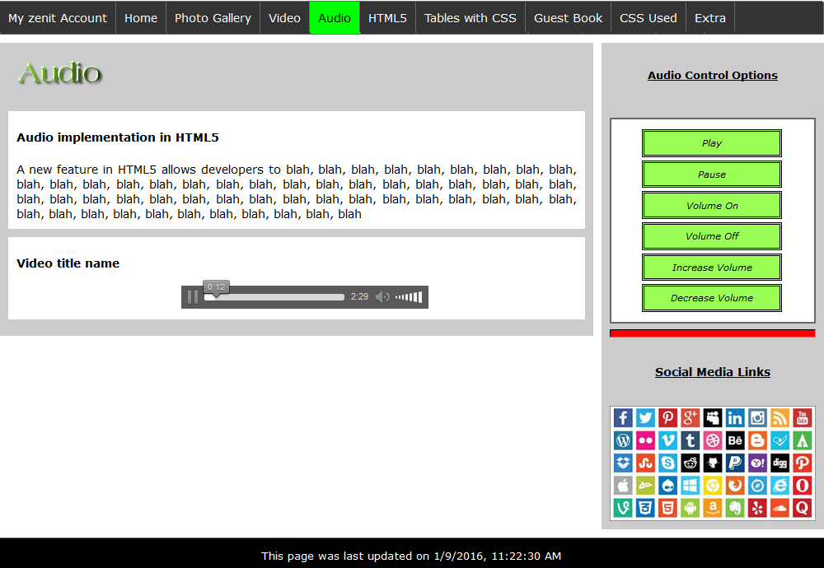
Assignment 2 – “Audio” Page

Slide 10
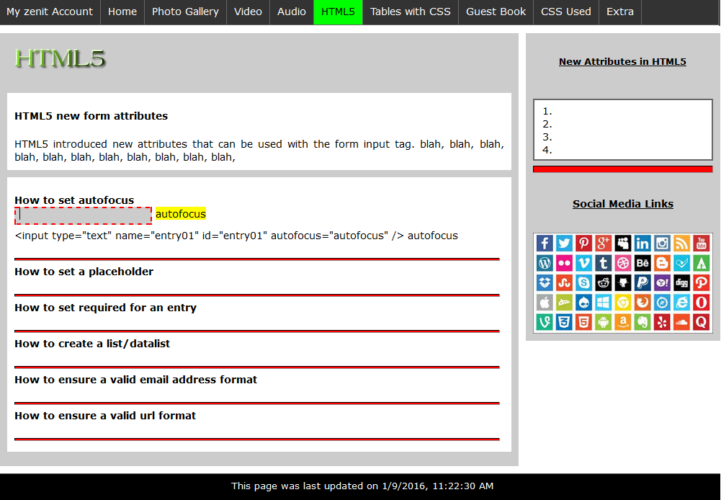
Assignment 2 – “HTML 5” Page

Slide 11
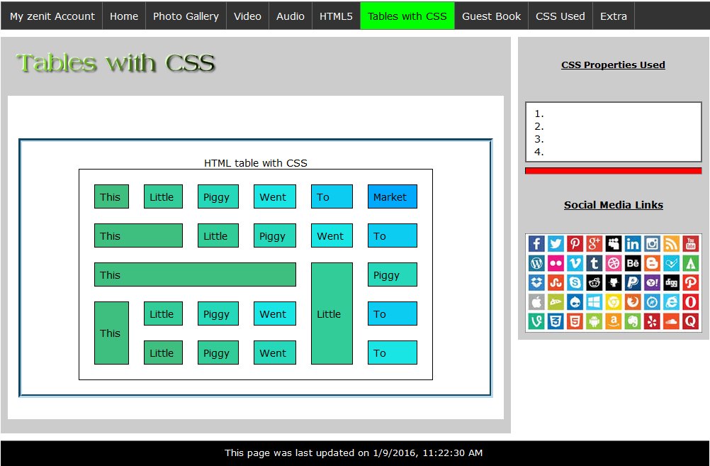
Assignment 2 – “Tables” Page

Slide 12
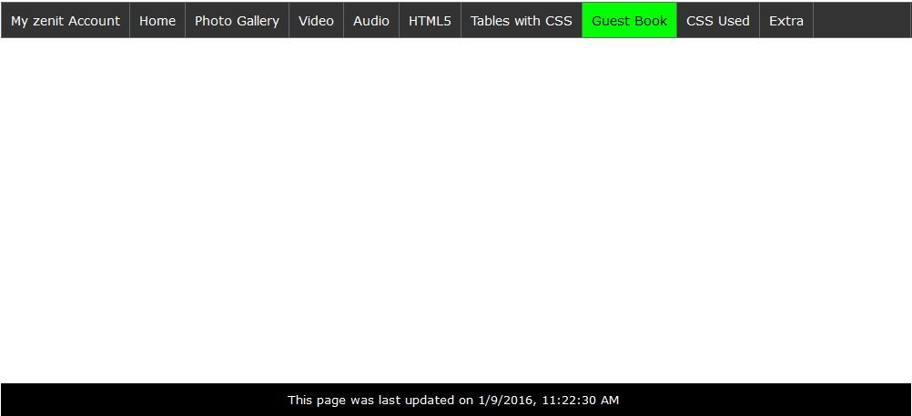
Assignment 2 – “Guest Book” Page
[ Layout / Design is up to you ]
(However, you must include the specified form elements & supplied code snippets)

Slide 13
Assignment 2 – “CSS Used” Page
This menu item is simply a link to your css/sitecss.css file

Slide 14
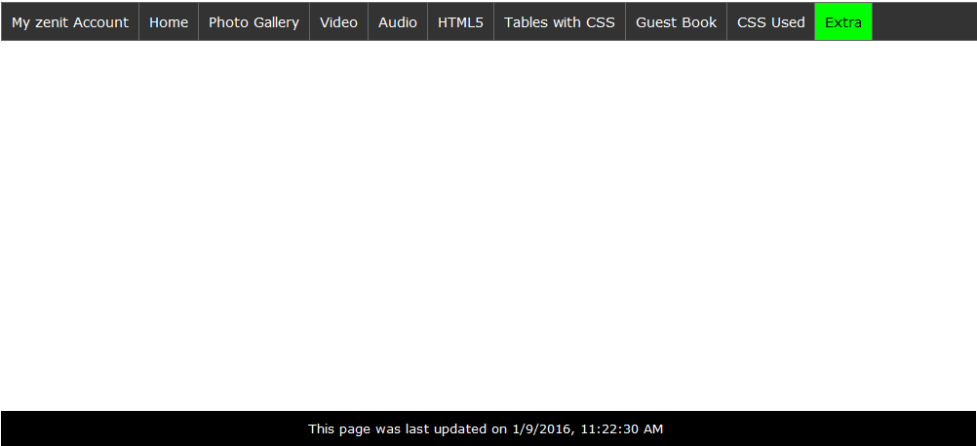
Assignment 2 – “Extra” Page
[ Layout / Design is up to you ]
Time to show off some HTML & CSS Tricks!
(Potential for Bonus Marks if all other requirements are completed successfully)

Slide 15
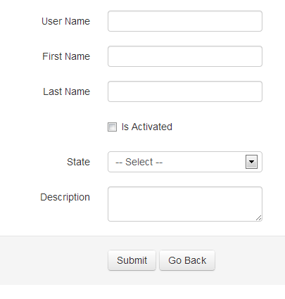
HTML Forms - Introduction
An HTML form is a section of a document containing normal content, markup, special elements called controls (checkboxes, radio buttons, menus, etc.), and labels on those controls.
Users generally "complete" a form by modifying its controls (entering text, selecting menu items, etc.), before submitting the form to an agent for processing (e.g., to a Web server, to a mail server, etc.)
https://www.w3.org/TR/html401/interact/forms.html

Slide 16
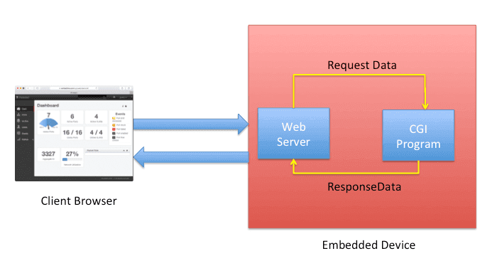
HTML Forms – Introduction & CGI
The web server can process our form data using a wide array of technologies, however in INT222 we will be concentrating primarily on sending the data to the server.
Our demo server (used for examples and A2), will process this data using the classic Common Gateway Interface (CGI) protocol
Using this protocol, the web server forwards our data to a program using Standard Input (STDIN) & Environment Variables.
The program processes our data, sends the output to Standard Output (STDOUT) which is picked up by the server and sent back to the client Browser
img src: https://embedthis.com

Slide 17
CGI Explained – Sending Data
So, how do we use CGI?
In order to send data to a program on the server to be processed, we must submit a web form to a specific url (indicated as an attribute in the form tag) using one of 2 methods:
GET: is the default method and it causes the fill-out form contents to be appended to the URL as if they were a normal query (maximum of 256 - 2048 characters).
/test/demo_form.cgi?name1=value1&name2=value2
POST: is the method that causes the fill-out form contents to be sent to the server in a data body rather than as part of the URL.
/test/demo_form.cgi

Slide 18
CGI Explained – Processing Data
Handling the GET Method:
The get method uses the QUERY_STRING environment variable to store the information being passed to the CGI Script. Any information being passed will be part of the URL and you will in fact see it as part of the URL. The part of the URL following the question mark (?) is automatically chopped and placed in the QUERY_STRING.
Handling the POST Method:
The post method uses the standard input (STDIN) stream to pass the information. The CONTENT_LENGTH environment variable is set to the number of URL-encoded bytes being sent to the STDIN.

Slide 19
CGI Explained – Processing Data (Cont’d)
Regardless of the method being used, when your CGI Script receives the data, it receives it in what is referred to as URL encoded format.
That means it's in the form of ordered pairs of information, with an equal sign (=) tying together two elements of a pair, an ampersand (&) tying pairs together, a plus (+) sign taking the place of spaces and special characters with %xx hexadecimal encoding.
This encoding will need to be decoded by the CGI in order for the CGI to use the information.
Once the information is decoded, the CGI program will carry out the function it was intended to perform
NOTE: Often this includes writing to an HTML file to generate some dynamic content

Slide 20
Setting up our <form> with Attributes
method | method="get" is the default method and it causes the fill-out form contents to be appended to the URL as if they were a normal query (maximum of 256 - 2048 characters). method="post" is the method that causes the fill-out form contents to be sent to the server in a data body rather than as part of the URL.
action | action="url" is the URL of the query server to which the form contents will be submitted. action="#" will default to the current document URL.
id or name | id="whatever" or name="whatever" are used with JavaScript - the id or name attributes allow JavaScript to make reference to any element within the form.
enctype | Specifies the encoding for the fill-out form contents. The default value is "application/x-www-form-urlencoded".

Slide 21
Form Content - <input> Tag
The input tag is used to specify a simple input element inside a form that can receive user input.
The ”type” attribute determines the specific sort of form element to be created.

Slide 22
Form Content - <input> type Attributes
type = "text" | A text element is a single line text input field in which the user can enter text (this is the default).
type = "password" | A password element is a text input field in which each character typed is displayed as a character such as * or a black dot to conceal the actual value.
type = "checkbox" | A checkbox element is a toggle that the user can select (switch on) or deselect (switch off.)
type = "radio" | A radio element is a radio button. Only one radio button in the set can be selected at one time. When the user selects a button in the set, all other buttons in the set are deselected.
type = "hidden" | A hidden input element is an invisible element whose main purpose is to contain data that the user does not enter. This data gets sent to the invoked CGI program when the form is submitted. This type="hidden" attribute value provides a way for delivering a value to the CGI program.
type = "file" | A file element allows the user to supply a file as input. When the form is submitted, the content of the specified file is sent to the server as the value portion of the name/value pair for this input element. A 'Browse' button is displayed next to the file input element that lets users select a file from their system to use as the value of the file input element. If a form contains a file input element, the value of the enctype attribute of the formtag should be 'multipart/form-data'.

Slide 23
Form Content - <input> types (Cont’d)
type = "submit" | When a user clicks a submit button, the form is submitted, which means that the actionspecified for the form is invoked.
type = "reset" | When a user clicks a reset button, all elements in the form are reset to their original default values.
type = "image" | Places an image, serving as a custom button in place of the submit button. When a user clicks the image, the form is submitted to the server.
type = "button" | Creates a "button" with no specific behavior. Typically used with JavaScript.

Slide 24
Form Content - <input> Attributes
name/id | The symbolic name (not displayed) for an input field. The name/id attribute and a value should be present for all input tags.
value | for a text or password entry field, can be used to specify the default contents of the field. for a checkbox or a radio button, value specifies the value of the button when it is checked (unchecked checkboxes are ignored when submitting the form); the default value for a checkbox or radio button is 'on'. For types submit and reset, value is used to specify the label for the push button.
checked | checked="checked" specifies that the checkbox or radio button is checked by default; this is only appropriate for a checkbox or a radio button.
size | is the physical size of the input field in characters; this is only appropriate for textentry fields and password entry fields. If this is not present, the default is 20 characters.
maxlength | is the maximum number of characters that are accepted as input; this is only appropriate for single-line text entry fields and password entry fields. If this is not present, the default will be unlimited. The text entry field will scroll appropriately if maxlength value is greater than the size value.
disabled | disabled="disabled" - When used, cannot receive user input nor will its value be submitted with the form
readonly | readonly="readonly" - When used, cannot receive user input - the value is submitted with the form
tabindex | tabindex="nn" - nn is a positive value - navigation proceeds from the element with the lowest tabindex value to the element with the highest value.

Slide 25
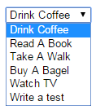
Form Content <select> Element
The select tag defines a selection list on an HTML form. A selection list displays a list of options- a menu like - from which the user can select an item(s).
For example: https://zenit.senecac.on.ca/~emile.ohan/int222/examples/forms/fms-12.html

Slide 26
Form Content <select> Attributes
name="xyz" or id="xyz" | Specifies the name/id of the select element. This value is the name/id portion of the name/value pair sent to the invoked CGI program when the form is submitted. The name is not displayed on the form.
size="n" | The SIZE attribute specifies how many options in the list are displayed at one time. For multiple-selection lists, if you do not specify the size attribute, the browser displays some, maybe all, of the options. For single-selection lists, by default, the browser displays the list as a drop-down menu that initially shows only one option. The user can click the list to display the rest of the options. If you specify the SIZE attribute, the list is displayed as a scrolling list that shows the specified number of options, regardless of whether the list allows single or multiple selection. selected="selected" when used as an attribute for the <option selected="selected"> tag indicates the option to be the default.
multiple="multiple" | Specifies that multiple items can be selected. If this attribute is omitted, only one item can be selected from the list. If multiple selection is enabled, the user usually needs to hold down the Shift key to select additional items.
<optgroup label="..."> | The <optgroup label="...."> allows for grouping options together - The grouped options in the select menu are indented. The <optgroup label="...."> requires a closing <.optgroup> after the last option being grouped. The text used for the label is in bold and is not selectable.

Slide 27

Form Content <textarea> Element
The textarea tag can be used to place a multi-line text entry field with optional default contents in a fill-out form.
Textarea fields automatically have scroll bars; any amount of text can be entered in them.
The textarea element requires both an opening and a closing tag.
For example: https://zenit.senecac.on.ca/~emile.ohan/int222/examples/forms/fms-16.html

Slide 28
Form Content <textarea> Attributes
name="..." or id="..." | The symbolic name/id of the textarea field.
rows="n" | The number of rows (vertical height) of the textarea field. NOTE: Can also be specified using CSS: height.
cols="n" | The number of columns (horizontal width in characters) of the textarea field. NOTE: Can also be specified using CSS: width.

Slide 29
Other Form Elements
If you wish to group a particular group of input fields together with a label, you can use the <fieldset> & <legend> elements:
For example: https://zenit.senecac.on.ca/~emile.ohan/int222/examples/forms/fms-17.html
Another great element used with forms is the <label> element. By using a form element’s ID, you can associate it with its associated “label”. When the user clicks on the label text, the corresponding form element is toggled on/off or focused depending on the control
This is particularly useful for checkboxes and radio buttons as it makes it easier for a user to make a selection.
For example: https://zenit.senecac.on.ca/~emile.ohan/int222/examples/forms/fms-18.html

Slide 30
Questions?
Any questions?
Would you like to see any more examples?

