Slide 1
Tribhuvan University
Institute of Science and Technology
Amrit Campus
Project Work Report on
Blockchain Based Land Registry
Under the Supervision of
Mr. Dhirendra Kumar Yadav
Department of Computer Science & Information Technology, Amrit Campus
In partial fulfillment of the requirements for the Bachelor of Science in
Computer Science and Information Technology (B.Sc. CSIT), Tribhuvan University
Submitted by: Mr. Abhishek Ojha (Roll No. 79010148 / Batch 2079)
Mr. Bivu Paudel (Roll No. 79010176 / Batch 2079)
July, 2026

Slide 2
Introduction
• Land ownership is a fundamental component of economic and social systems worldwide.
• Traditional land record systems rely on paper-based documentation and centralized databases, vulnerable to unauthorized modification, data inconsistency, and single points of failure.
• This project implements a Proof of Concept (PoC) Land Record Management System applying blockchain-inspired cryptographic techniques — SHA-256 hashing, Hash Chain, and Merkle Tree — to secure digital land records.
• Built using React (frontend), Spring Boot (backend), and PostgreSQL (database), with role-based access for Super Admin, Malpot Officer, and Citizen.

Slide 3
Problem Statement
• Centralized storage of land records creates a single point of failure — vulnerable to unauthorized modification, data loss, and security breaches.
• Maintaining a complete and verifiable history of land ownership is difficult, reducing transparency and complicating verification.
• Conventional database systems permit unaudited modification of stored data, increasing the risk of record tampering.
• Stakeholders must rely heavily on the managing authority to ensure accuracy, authenticity, and consistency of land records.
• This project addresses these gaps with cryptographic integrity mechanisms that detect unauthorized modification and maintain an auditable record history.

Slide 4
Literature Review (in short)
• Blockchain provides data integrity, transparency, and tamper resistance through cryptographic techniques — its underlying structures (hash functions, Hash Chains, Merkle Trees) can be applied without full decentralized consensus.
• Researchers have proposed blockchain-based frameworks using distributed ledgers and smart contracts to eliminate single points of failure and maintain immutable land ownership history.
• Real-world precedents: Georgia's NAPR + BitFury secured 1.5M+ land titles; Sweden's Lantmäteriet piloted with ChromaWay; Dubai Land Department and Ghana's Bitland applied blockchain for tamper-resistant registration.
• Motivated by these findings, this project applies SHA-256 hashing, Hash Chains, and Merkle Trees to strengthen integrity and traceability of digital land records.

Slide 5
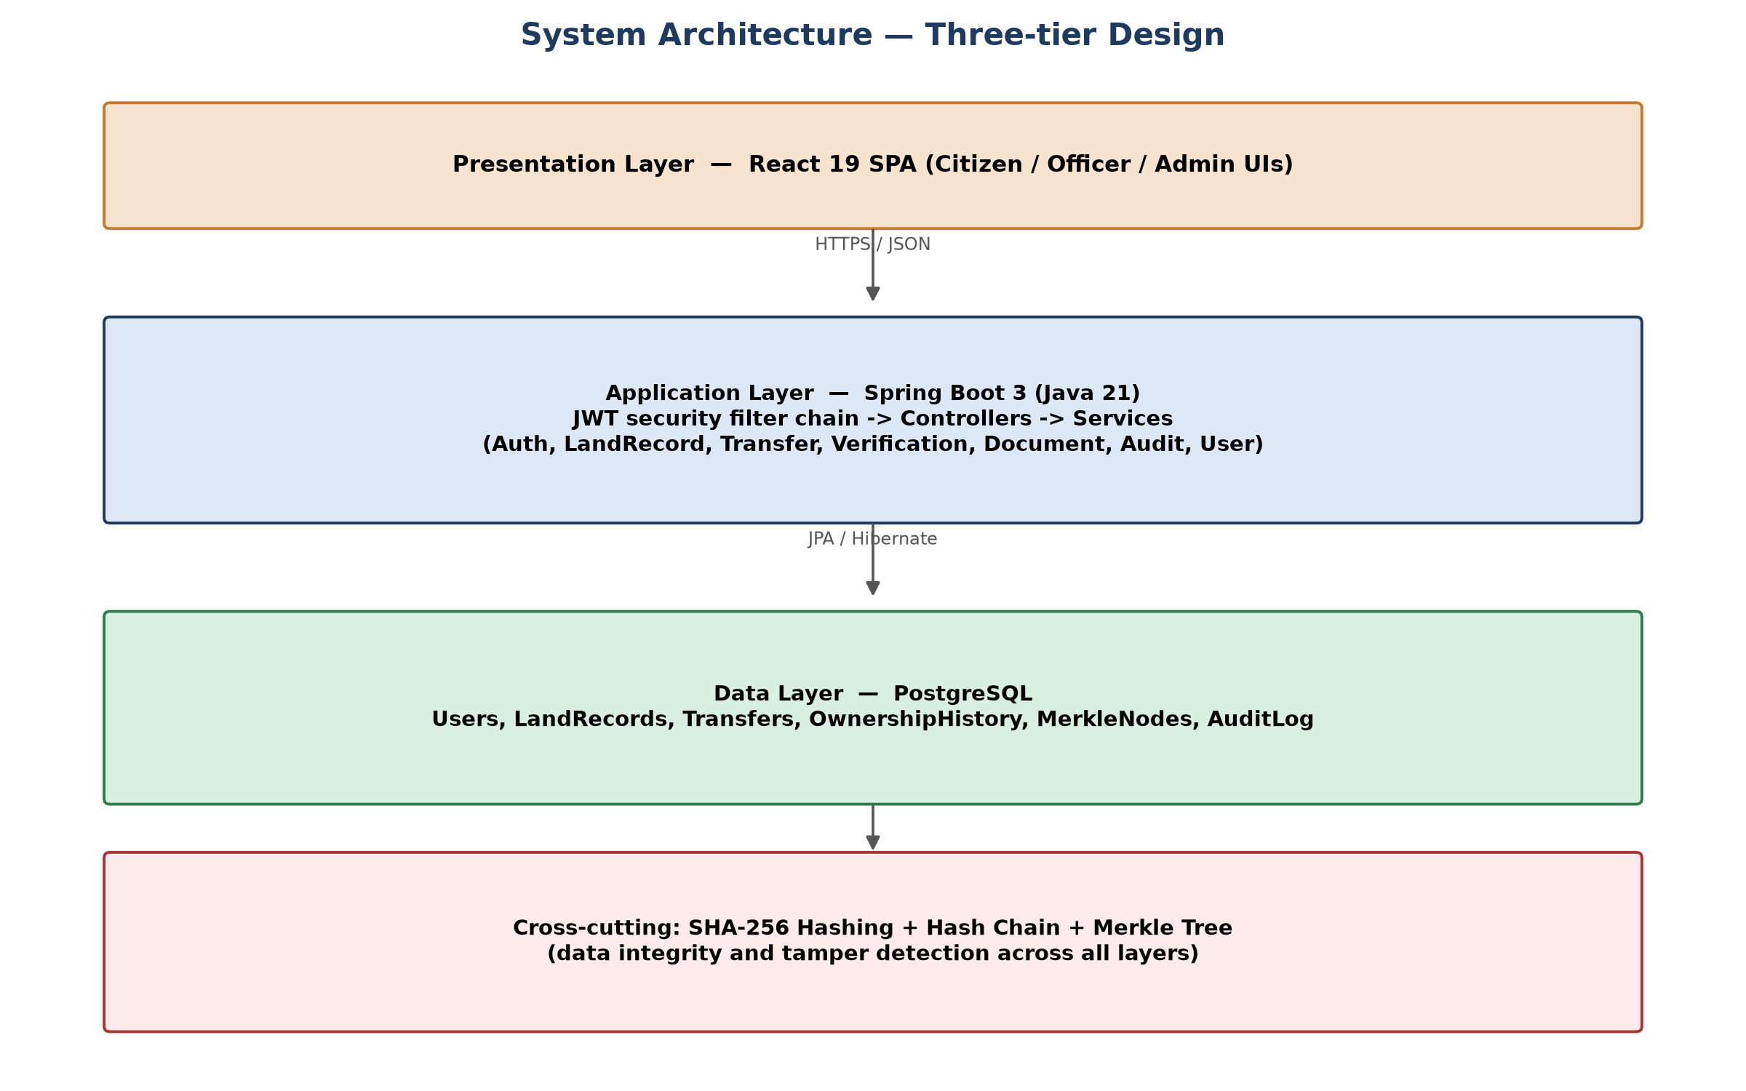
System Diagram
Three-tier architecture: Presentation (React) → Application (Spring Boot) → Data (PostgreSQL), with cryptographic integrity cross-cutting all layers.

Slide 6
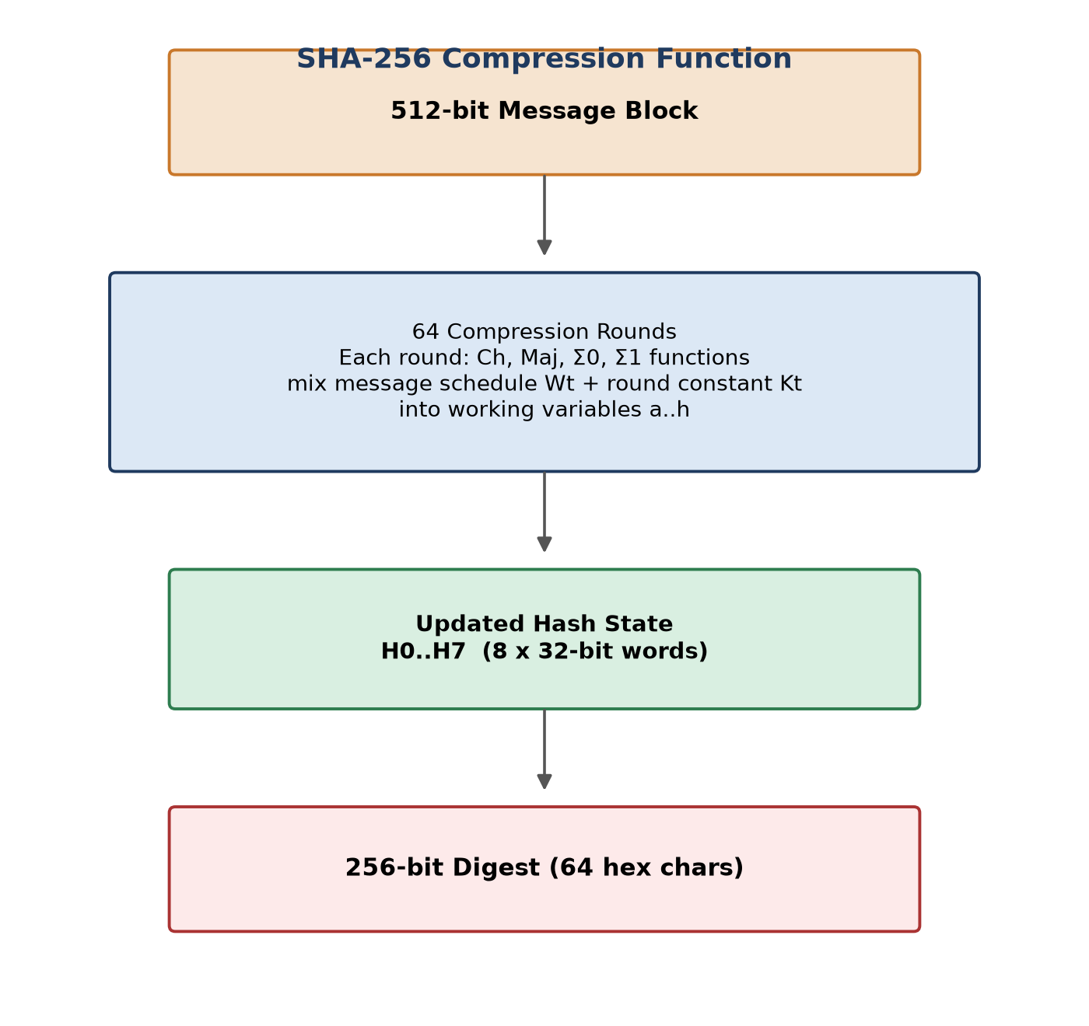
Used Algorithms — SHA-256 & Hash Chain
• SHA-256: cryptographic hash function producing a fixed 256-bit digest from input of arbitrary length.
• Compresses each 512-bit message block through 64 rounds mixing logical functions Ch, Maj, Σ0, Σ1.
• Hash Chain: each record's hash incorporates the previous record's hash, so altering history breaks the chain.

Slide 7
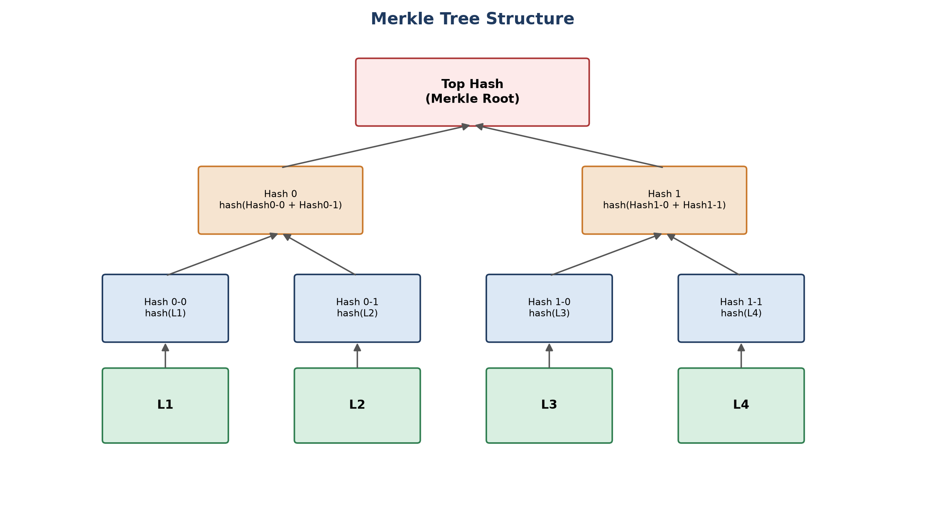
Used Algorithms — Merkle Tree
Merkle Root = recursive hash of paired child hashes; any record change alters the root, enabling O(log n) proof verification.

Slide 8
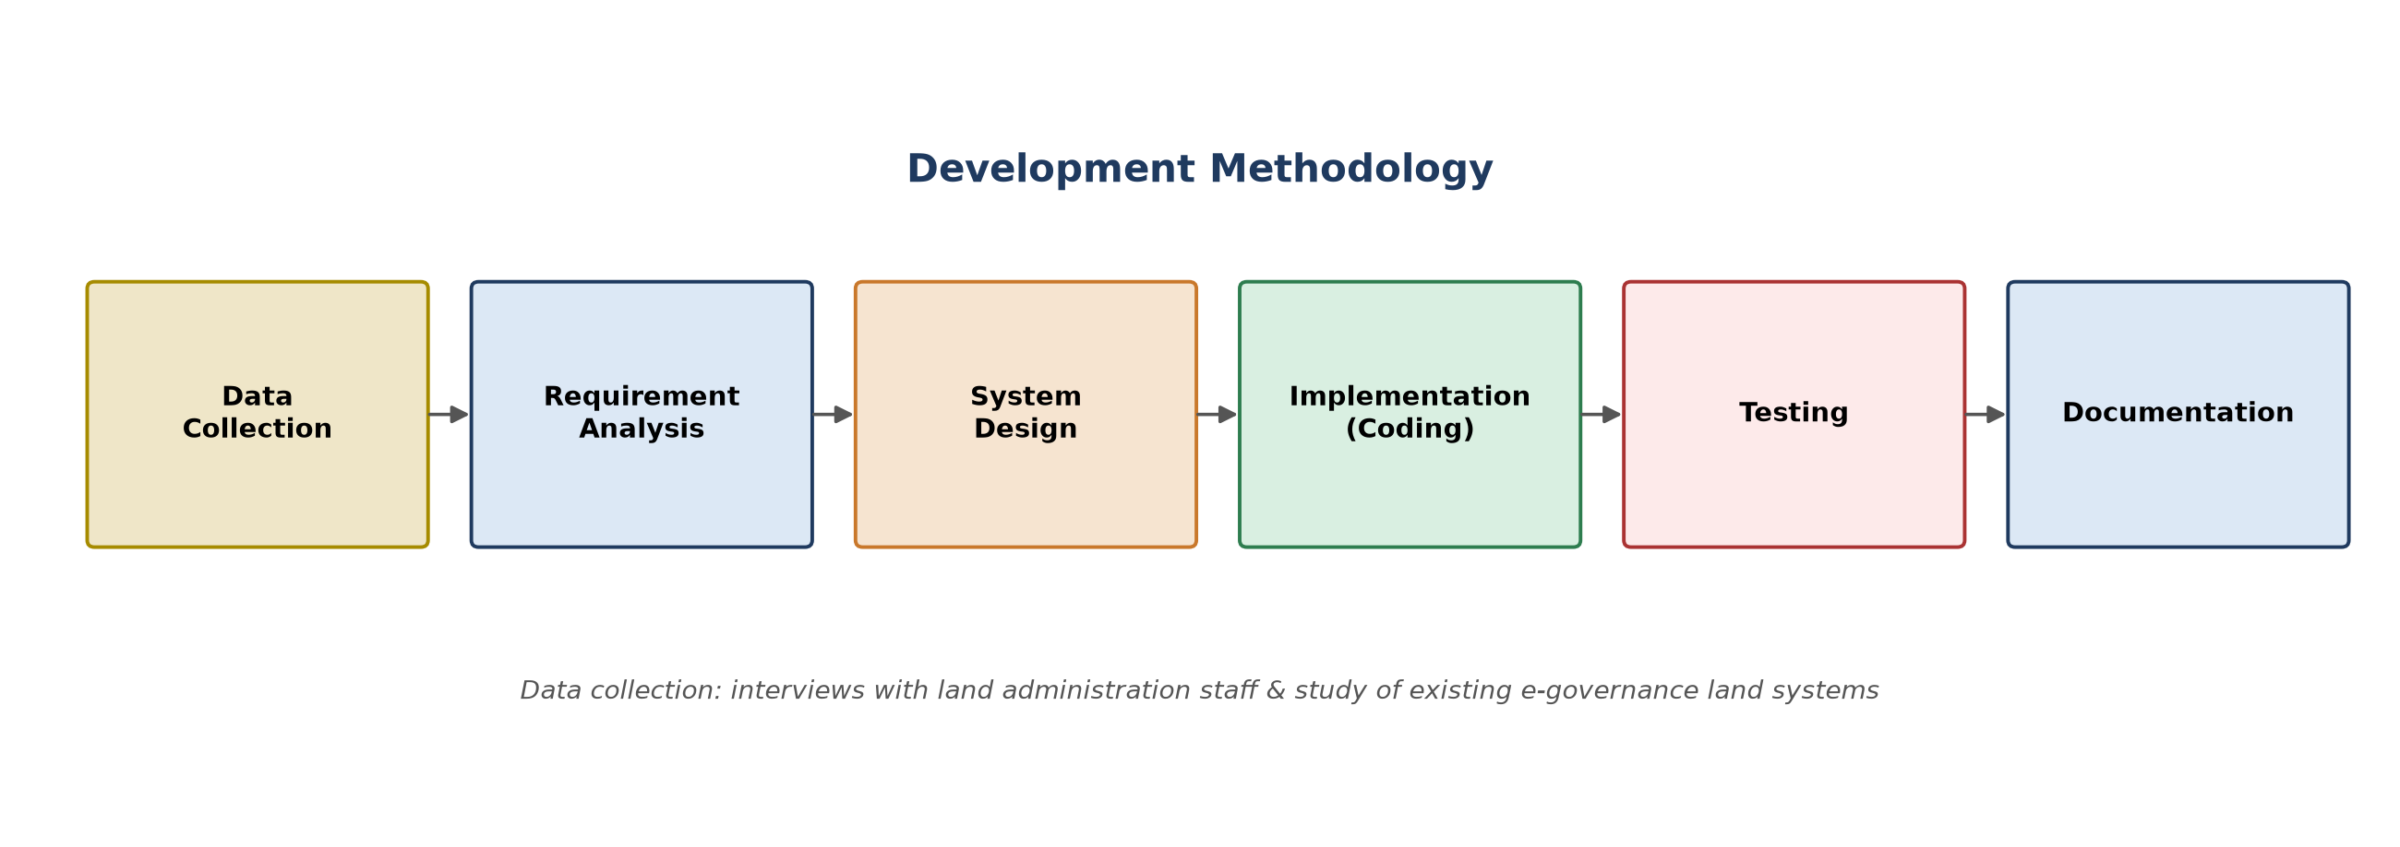
Development Methodology
Data collection (staff interviews + study of existing systems) through requirement analysis, design, implementation, testing, and documentation.

Slide 9
Chapter 6: Testing
Testing and Result Analysis — Unit Testing
ID | Test Scenario | Input Test Data | Expected Result | Result
UT-01 | User Login | Email: ram@example.com, Password: citizen123 | User authenticated and redirected to dashboard | Pass
UT-02 | User Registration | Name, Email, Password | Account should be created successfully | Pass
UT-03 | Create Land Record | Owner details, land info | Land record stored with SHA-256 hash | Pass
UT-04 | SHA-256 Hash Generation | Land record data | Unique hash should be generated | Pass
UT-05 | Document Upload | PDF / Image file | File stored with integrity hash | Pass

Slide 10
Chapter 6: Testing
Testing and Result Analysis — Integration Testing
ID | Test Scenario | Input Test Data | Expected Result | Result
IT-01 | Login to Dashboard Integration | Valid user credentials | User accesses role-based dashboard | Pass
IT-02 | Land Record Storage Flow | Land details (via frontend) | Data stored in DB with hash | Pass
IT-03 | Ownership Transfer Flow | Transfer request data | Transfer completes successfully | Pass
IT-04 | Backend–Database Integration | GET request | Data retrieved correctly | Pass
IT-05 | Document Verification Integration | File upload | File hash matches stored hash | Pass

Slide 11
Chapter 6: Testing
Testing and Result Analysis — System Testing
ID | Test Scenario | Input Test Data | Expected Result | Result
ST-01 | End-to-End User Workflow | All role users | Complete workflow executes successfully | Pass
ST-02 | Role-Based Access Control | Citizen accessing admin panel | Access correctly denied | Pass
ST-03 | Integrity Verification | Altered record | System detects tampering | Pass
ST-04 | Merkle Tree Verification | Record ID | Proof validation succeeds | Pass
ST-05 | Audit Logging System | Any CRUD operations | All actions logged correctly | Pass

Slide 12
Conclusion and Future Recommendation
• Conclusion: Successfully implemented and tested a PoC Land Record Management System — role-based access, ownership transfer workflow, and SHA-256/Hash Chain/Merkle Tree integrity verification — confirming integrity, transparency, and traceability of land records.
• Future Scope: Migrate to Hyperledger Fabric with channels / private data collections, so only the parties and offices involved in a transfer see its details.
• Future Scope: Move documents (deeds, maps, photos) to IPFS — content-addressed, tamper-evident off-chain storage, with only the hash kept on-chain.
• Future Scope: Add zero-knowledge proofs for privacy-preserving ownership verification, and smart-contract escrow for holding transaction price until approval.
• Future Scope: Integrate GIS/drone-based boundary data and ML-based anomaly detection to flag suspicious transfer patterns or forged documents.

Slide 13
Acknowledgements
Project Supervisor — Mr. Dhirendra Kumar Yadav
Department of CSIT, Amrit Campus — for continuous guidance, technical insights, and valuable feedback throughout development.
Head / Coordinator — Mr. Dabbal Singh Mahara
Department of CSIT, Amrit Campus — for constant support, coordination, and academic guidance during the project period.
Department — Department of Computer Science & Information Technology
Amrit Campus, Tribhuvan University — for providing the academic foundation and resources for this project.
Evaluating Committee — External and Internal Examiners
Institute of Science & Technology, Tribhuvan University — for their time and evaluation of this work.

