Slide 1

bb
CLIMATE CHANGE PREDICTOR USING TIME
SERIES FORECASTING
EPICS Project Review – 2
https://www.pexels.com/photo/ocean-water-wave-photo-1295138/
aa

Slide 2
Project Members
Project Guide
Uday
Agarwal
Aryan
Tandon
Parv Bhargava
Aabir Dutta
Dr. Pavan Kumar
19BAI10147
19BAI10148
19BAI10116
19BCE10062
Mriganka Das
Abdul Raziq Khan
Govit Kharsare
Vimal Tiwari
19BOE10053
19BCE10135
19MIM10094
19BCG10054

Slide 3
ABSTRACT
02
Tech Analyzing
Donec ornare rutrum neque sit amet pellentesque. Nulla eget dictum tortor.
g

Slide 4
Climate change is undoubtedly one of the biggest problems in the 21st century. And with the sudden advent and breakout of disastrous climate hazards in India and many such countries, it has become a growing public concern. Hence we take steps in understanding climate change and make certain vital predictions which are both effective and efficient. We explore the performance of a phenomenological, top-down model constructed using a neural network and big data of global mean monthly temperature. By generating graphical images using the monthly temperature data of 30 years, the neural network system successfully predicts the rise and fall of temperatures for the next 10 years. Moreover, the prediction accuracy differs among climatic zones and temporal ranges. We shall be suggesting that using artificial intelligence-based forecasting methods along with conventional physics-based models because these two approaches can work together in a complementary manner.
02
Tech Analyzing
Donec ornare rutrum neque sit amet pellentesque. Nulla eget dictum tortor.
g

Slide 5
OBJECTIVE
02
Tech Analyzing
Donec ornare rutrum neque sit amet pellentesque. Nulla eget dictum tortor.
g

Slide 6
● The latest IPCC report has devoted a separate chapter to extreme weather events, emphasizing compound events i.e. the combination of multiple drivers and/or hazards that contribute to societal or environmental risk.
● Examples are concurrent heatwaves and droughts, compound flooding (a storm surge in combination with extreme rainfall and/or river flow), compound fire weather conditions (a combination of hot, dry, and windy conditions), or concurrent extremes at different locations.
● Thus to produce a better understanding of the weather in the current scenario and also in the near future a climate change predictor shall indeed help in setting up precautionary measures allowing to have a clear picture about the depreciations.
02
Tech Analyzing
Donec ornare rutrum neque sit amet pellentesque. Nulla eget dictum tortor.
g

Slide 7
PROPOSED WORK
● The precipitation and temperatures (maximum and minimum) data are considered for the study and prepared for the analysis as monthly means.
● Once the data files are prepared, the ARIMA model needs to be identified. In this study, we have tried to fit separate SARIMA models to precipitation and temperature (minimum and maximum) time series.
● So, we have one SARIMA model that fits the precipitation time series and one that fits the temperature time series (minimum and maximum).
02
Tech Analyzing
Donec ornare rutrum neque sit amet pellentesque. Nulla eget dictum tortor.
g

Slide 8
bb
ABOUT SARIMA MODEL
https://www.pexels.com/photo/ocean-water-wave-photo-1295138/
aa

Slide 9
bb
Seasonal Autoregressive Integrated Moving Average, SARIMA or Seasonal ARIMA, is an extension of ARIMA that explicitly supports univariate time series data with a seasonal component.
It adds three new hyperparameters to specify the autoregression (AR), differencing (I) and moving average (MA) for the seasonal component of the series, as well as an additional parameter for the period of the seasonality.
The difference between ARIMA and SARIMA is about the seasonality of the dataset. If the data used is seasonal, like it happens after a certain period of time, then we will use SARIMA. Just as we know the weather datasets are seasonal in nature.
https://www.pexels.com/photo/ocean-water-wave-photo-1295138/
aa

Slide 10
METHODOLOGY
02
Tech Analyzing
Donec ornare rutrum neque sit amet pellentesque. Nulla eget dictum tortor.
g

Slide 11

1.
Setting up the environment
02
Tech Analyzing
Donec ornare rutrum neque sit amet pellentesque. Nulla eget dictum tortor.

Slide 12
01
Start Here
Donec ornare rutrum neque sit amet pellentesque. Nulla eget dictum tortor.
2.
Dataset for our model
03
Creation Process
Donec ornare rutrum neque sit amet pellentesque. Nulla eget dictum tortor.

Slide 13
02
Tech Analyzing
Donec ornare rutrum neque sit amet pellentesque. Nulla eget dictum tortor.
g
3.
Data visualization
04
Test Process
Donec ornare rutrum neque sit amet pellentesque. Nulla eget dictum tortor.

Slide 14
03
Creation Process
Donec ornare rutrum neque sit amet pellentesque. Nulla eget dictum tortor.
s
4.
Training and Validation of Dataset
05
Finish Process
Donec ornare rutrum neque sit amet pellentesque. Nulla eget dictum tortor.
D

Slide 15
04
Test Process
Donec ornare rutrum neque sit amet pellentesque. Nulla eget dictum tortor.
d
5.
Prediction
g
Option Seven
Donec ornare rutrum neque sit amet pellentesque. Nulla eget dictum tortor.

Slide 16
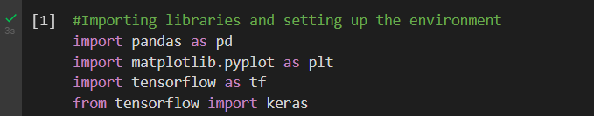
bb
SETTING UP THE
ENVIRONMENT
The environment of our project is set using the following libraries of python and using these will give us the ideal base for advancing with our time series forecasting model.
https://www.pexels.com/photo/ocean-water-wave-photo-1295138/
aa

Slide 17
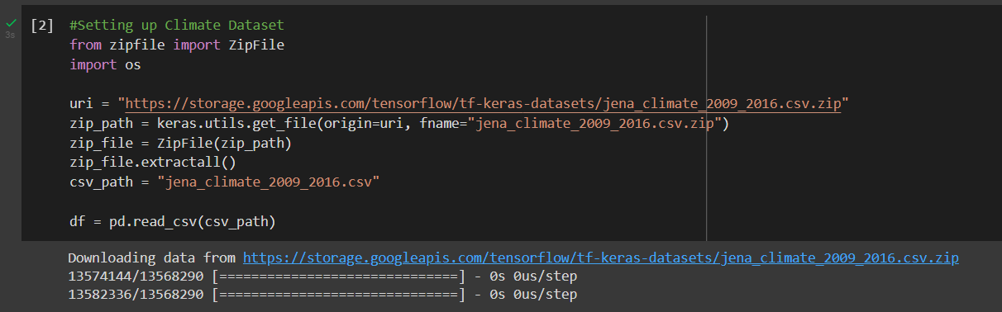
bb
DATASET FOR OUR MODEL
The environment of our project is set using the following libraries of python and using these will give us the ideal base for advancing with our time series forecasting model.
We will be using the Jena Climate dataset recorded by the Max Planck Institute for Biogeochemistry. The dataset consists of 14 features such as temperature, pressure, humidity etc, recorded once per 10 minutes.
Time-frame Considered: Jan 10, 2009 - December 31, 2016
https://www.pexels.com/photo/ocean-water-wave-photo-1295138/
aa

Slide 18
bb
DATA VISUALIZATION
Raw Data Visualization:
To give us a sense of the data we are working with, each feature has been plotted below. This shows the distinct pattern of each feature over the time period from 2009 to 2016. It also shows where anomalies are present, which will be addressed during normalization.
https://www.pexels.com/photo/ocean-water-wave-photo-1295138/
aa

Slide 19
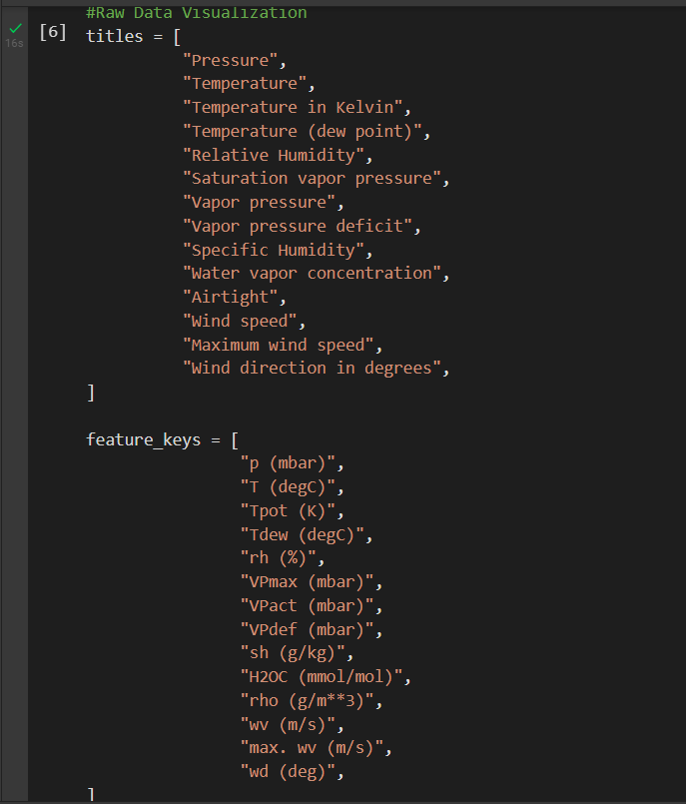
bb
https://www.pexels.com/photo/ocean-water-wave-photo-1295138/
aa

Slide 20
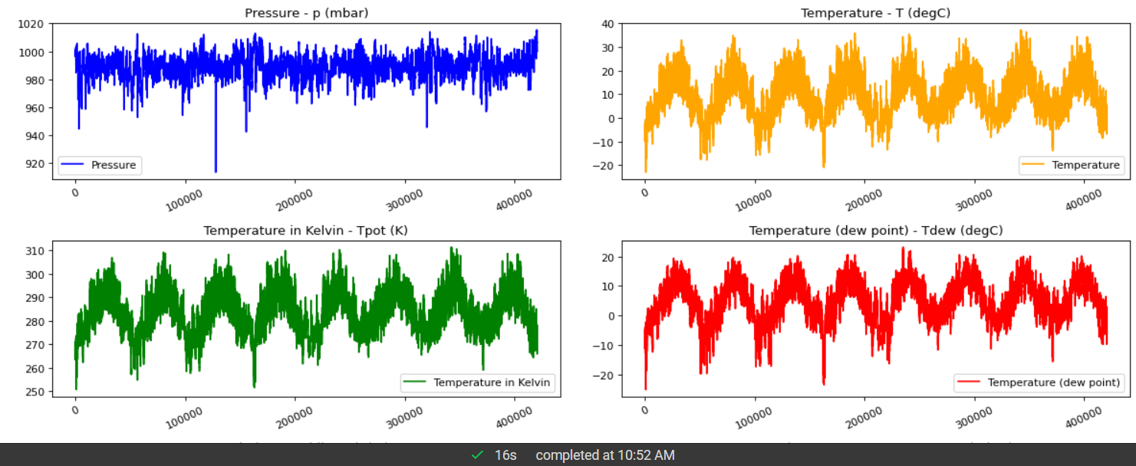
bb
Results for raw visualization:
https://www.pexels.com/photo/ocean-water-wave-photo-1295138/
aa

Slide 21
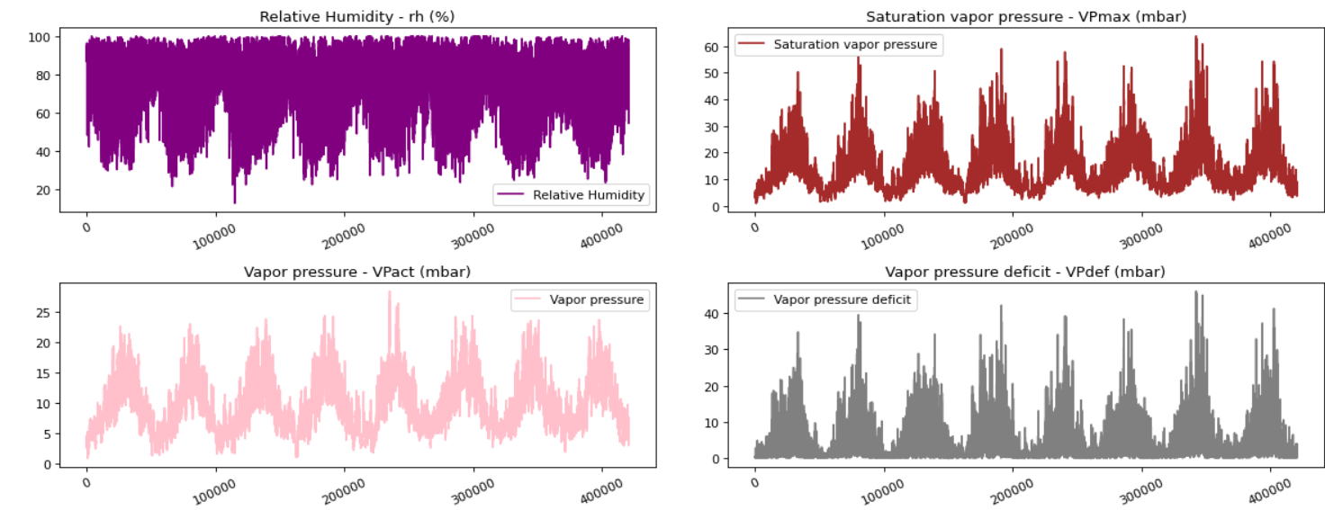
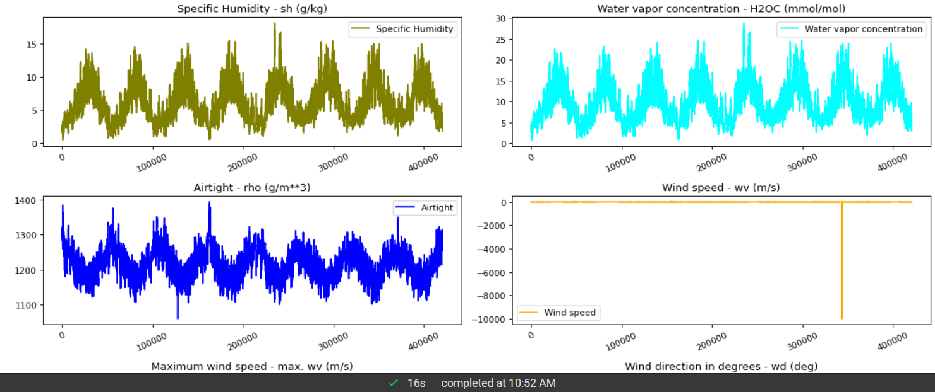
bb
https://www.pexels.com/photo/ocean-water-wave-photo-1295138/
aa

Slide 22
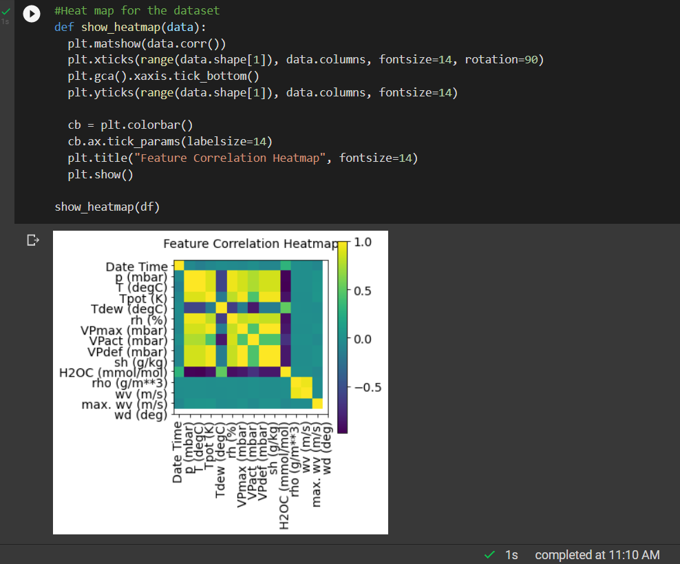
bb
This heat map shows the correlation between different features.
https://www.pexels.com/photo/ocean-water-wave-photo-1295138/
aa

Slide 23
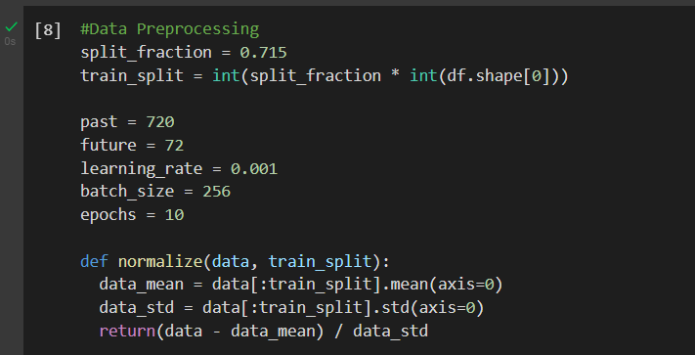
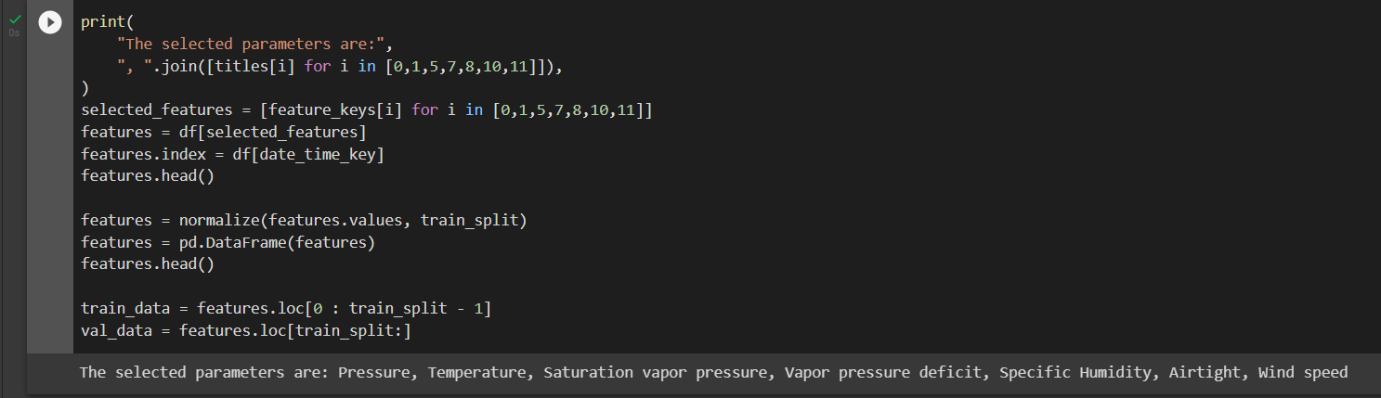
bb
Data preprocessing
We can see from the correlation heatmap, few parameters like Relative Humidity and Specific Humidity are redundant. Hence we will be using select features, not all.
https://www.pexels.com/photo/ocean-water-wave-photo-1295138/
aa

Slide 24
bb
TRAINING AND VALIDATION OF DATASET
Training and Validation of Dataset
The training dataset labels start from the 792nd observation (720 + 72).
The timeseries_dataset_from_array function takes in a sequence of data-points gathered at equal intervals, along with time series parameters such as length of the sequences/windows, spacing between two sequence/windows, etc., to produce batches of sub-timeseries inputs and targets sampled from the main timeseries.
https://www.pexels.com/photo/ocean-water-wave-photo-1295138/
aa

Slide 25
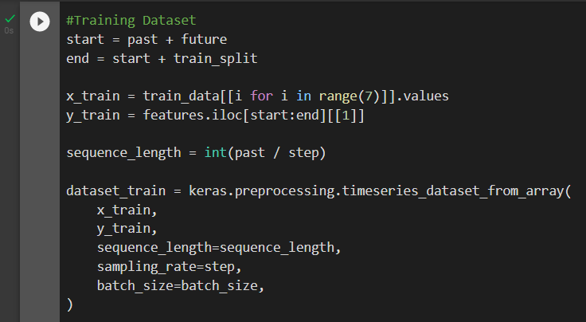
bb
https://www.pexels.com/photo/ocean-water-wave-photo-1295138/
aa

Slide 26
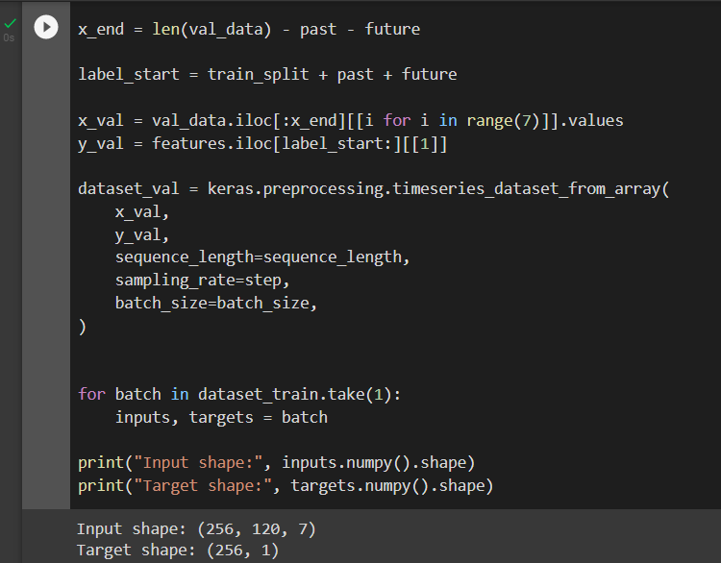
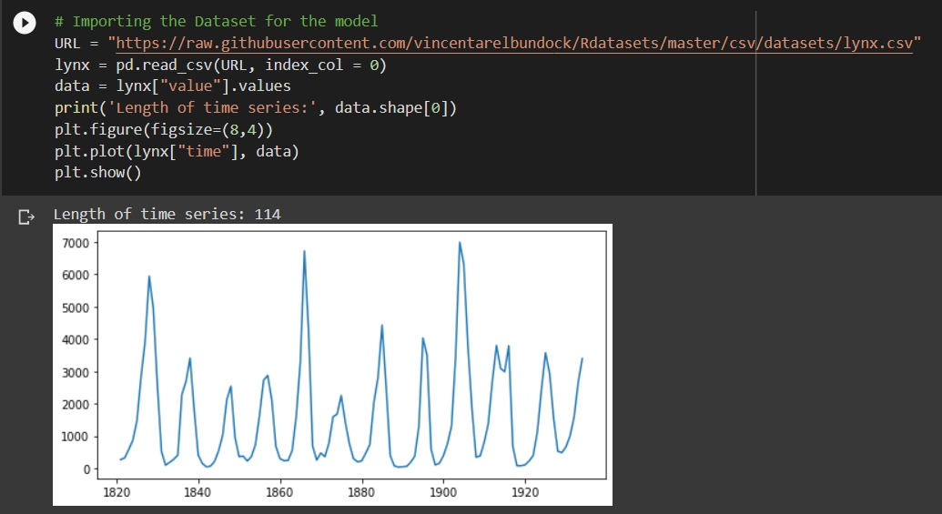
bb
The validation dataset must not contain the last 792 rows as we won't have label data for those records, hence 792 must be subtracted from the end of the data.
The validation label dataset must start from 792 after train_split, hence we must add past + future (792) to label_start.
https://www.pexels.com/photo/ocean-water-wave-photo-1295138/
aa

Slide 27
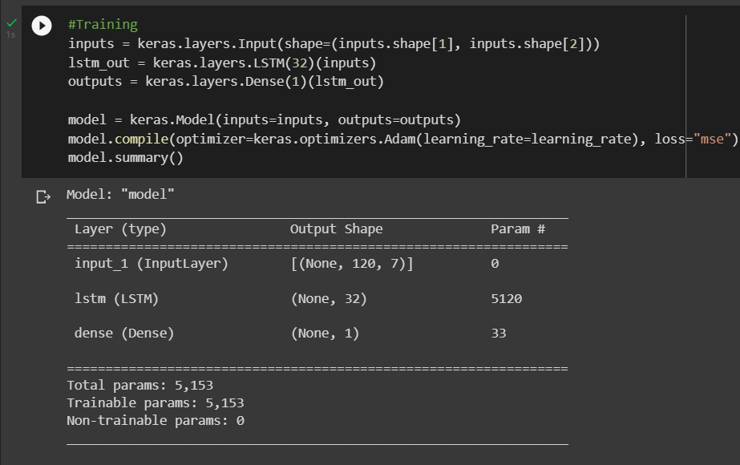
bb
Results of training the Data
The following results show a detailed output of the trained data.
https://www.pexels.com/photo/ocean-water-wave-photo-1295138/
aa

Slide 28
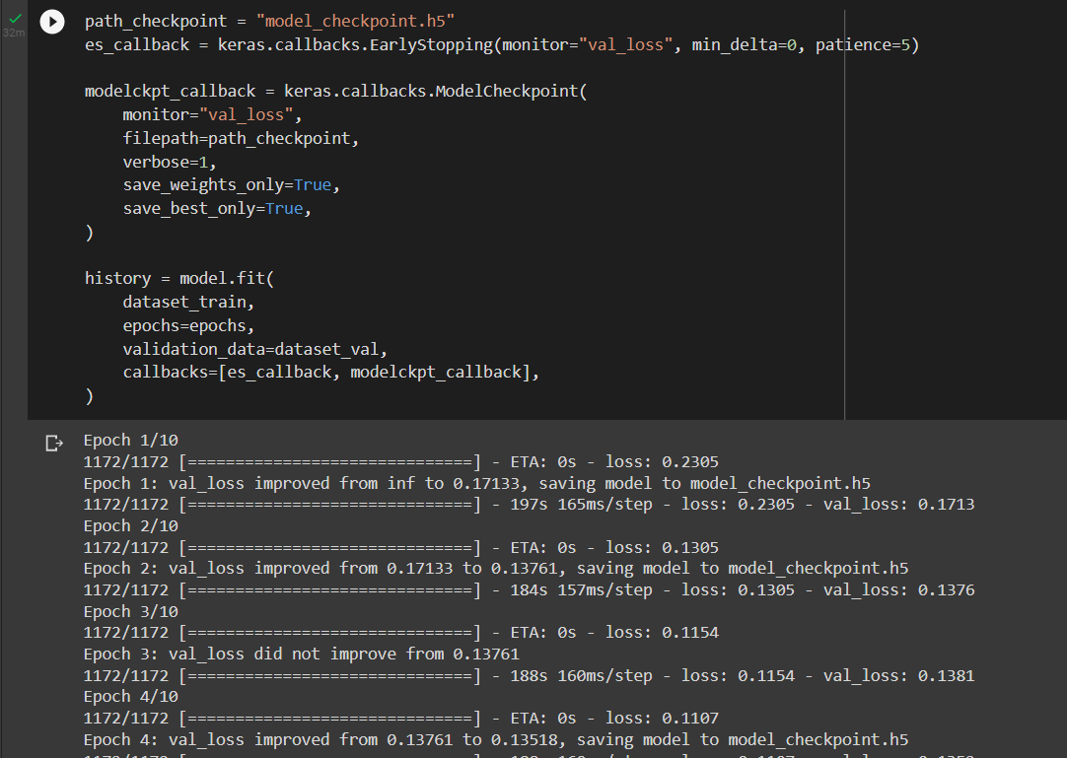
bb
We'll use the ModelCheckpoint callback to regularly save checkpoints, and the EarlyStopping callback to interrupt training when the validation loss is no longer improving.
https://www.pexels.com/photo/ocean-water-wave-photo-1295138/
aa

Slide 29
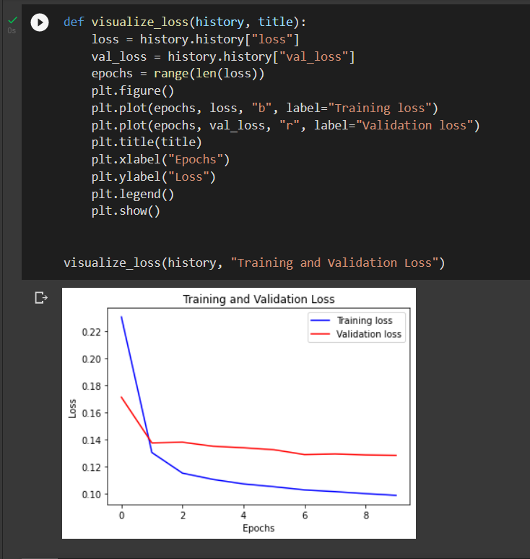
bb
We can visualize the loss with the function below. After one point, the loss stops decreasing.
https://www.pexels.com/photo/ocean-water-wave-photo-1295138/
aa

Slide 30
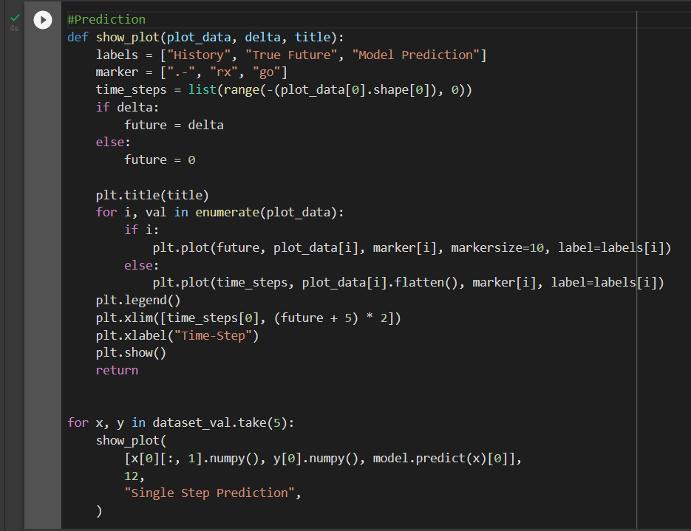
bb
PREDICTION
The trained model above is now able to make predictions for 5 sets of values from the validation set.
https://www.pexels.com/photo/ocean-water-wave-photo-1295138/
aa

Slide 31
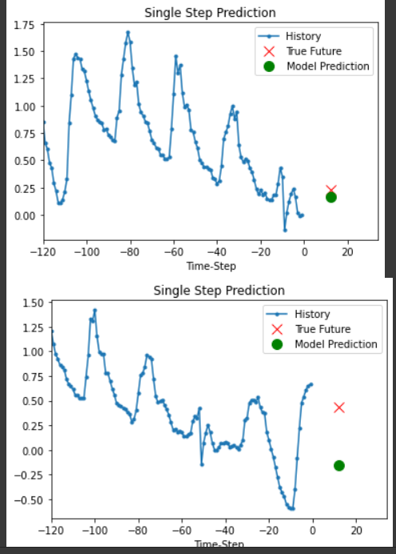
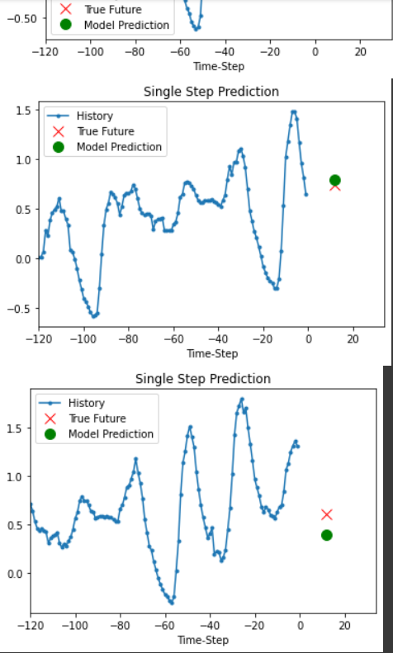
bb
https://www.pexels.com/photo/ocean-water-wave-photo-1295138/
aa

Slide 32

JAX
JAX is an automatic differentiation (AD) toolbox developed by a group of people at Google Brain and the open source community. It aims to bring differentiable programming in NumPy-style onto TPUs. On the highest level JAX combines the previous projects XLA & Autograd to accelorate your favorite linear algebra-based projects.

Slide 33
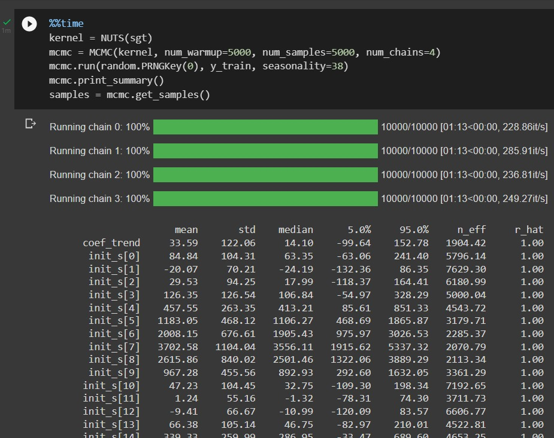
bb
NEW MODEL
https://www.pexels.com/photo/ocean-water-wave-photo-1295138/
aa

Slide 34
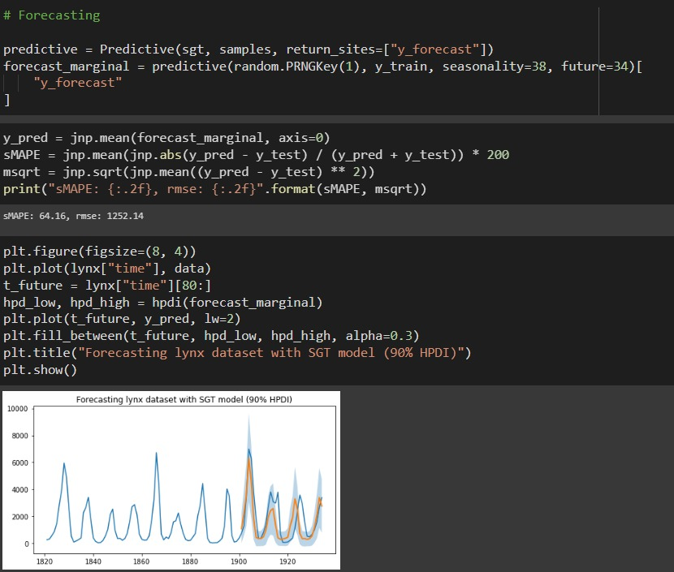
bb
NEW PREDICTION
https://www.pexels.com/photo/ocean-water-wave-photo-1295138/
aa

Slide 35
bb
CONCLUSION
Thus, we could implement a seasonal SARIMA model in Python. We made extensive use of the pandas and statsmodels libraries and showed how to run model diagnostics, as well as how to produce forecasts of the temperature.
Here are a few other things we can try additionally to our coded model:
Change the start date of our dynamic forecasts to see how this affects the overall quality of your forecasts.
Try more combinations of parameters to see if we can improve the goodness-of-fit of the model.
Select a different metric to select the best model. For example, we used the AIC measure to find the best model, but we could seek to optimize the out-of-sample mean square error instead.
https://www.pexels.com/photo/ocean-water-wave-photo-1295138/
aa

Slide 36
CONTRIBUTION
Uday
Agarwal
Aryan
Tandon
Parv Bhargava
Aabir Dutta
Data Visualization
Data Visualization
Core Code
Core Code
Mriganka Das
Abdul Raziq Khan
Govit Kharsare
Vimal Tiwari
Finding real world applications of our project
Dataset Description
Literature Review
Literature Review

Slide 37
bb
THANK YOU!
https://www.pexels.com/photo/ocean-water-wave-photo-1295138/
aa

