Slide 1
Project title: Occurrence of Diabetes in Pima Indian Women
Group members:
1. Naren Vaishnavi
2. Jerin Roy
3. Aabir Kumar Datta
Date : 05/02/2017

Slide 2

CRISP- Data Mining

Slide 3
Phase 1: Business Understanding
Domain Perspective: Diabetes is a disease that occurs when our blood glucose or blood sugar is too high. Having too much glucose in our blood can cause health problems, such as heart disease, nerve damage, kidney problems and so on.
Objective: Test the various attributes of the dataset and find out the relationship between the attributes and if or not that is a significant indicator of diabetes. Establishing a relationship between number of pregnancies and diabetes.

Slide 4
Phase 2:Data Understanding Phase
“Blood Pressure” is one of pivotal attributes that can be the possible reasons that a women may be diabetic. Biologically, normal range for blood pressure is 80-120 in order to put it in “low blood pressure” and “high blood pressure category”.
“BMI” attribute that is referred for Body Mass Index has the following stable ranges for normal human body:
Underweight: BMI is less than 18.5.
Normal weight: BMI is 18.5 to 24.9.
Overweight: BMI is 25 to 29.9.
Obese: BMI is 30 or more.
Insulin is a hormone made by the pancreas that allows your body to use sugar (glucose) from carbohydrates in the food that you eat for energy or to store glucose for future use. Insulin helps keeps your blood sugar level from getting too high (hyperglycaemia) or too low (hypoglycaemia). 2-Hour serum insulin (mu U/ml) is taken into account.
Skin Thickness: Triceps skin fold thickness (mm)

Slide 5
Getting a feel of the data fields
Pregnancies
Glucose
BloodPressure
Insulin
SkinThickness
BMI
DiabetesPedigreeFunction
Age
Outcome

Slide 6
Getting a feel of the fields and Data
Pregnancies Glucose BloodPressure SkinThickness Insulin BMI DiabetesPedigreeFunction Age
1 6 148 72 35.00000 222.8656 33.6 0.627 50
2 1 85 66 29.00000 69.7751 26.6 0.351 31
3 8 183 64 21.39757 258.5094 23.3 0.672 32
4 1 89 66 23.00000 94.0000 28.1 0.167 21
5 0 137 40 35.00000 168.0000 43.1 2.288 33

Slide 7
Phase 3: Data Preparation Phase
Here the main motive is to predict the chances of someone getting diabetes, while looking at its vital parameters like: Blood Pressure,Insulin,BMI and skin thickness.
Hence, we adopted “Imputation of missing values” , using “MICE” package.
The mice package in R, helps you imputing missing values with plausible data values. These plausible values are drawn from a distribution specifically designed for each missing data point.
We also tried to do min-max normalization, so as to normalize the data and reduce the range gap which persists between them.
Removing outliers is no solution as it impacts adversely on the sensitivity of the data, therefore we did the transformation on numerical variables which impacts glucose levels directly or indirectly. min max normalization to normalize skin thickness, insulin, BMI and Blood Pressure was done

Slide 8
Percentage of missing values
Pregnancies 0.0000000
Glucose 0.6510417
BloodPressure 4.5572917
SkinThickness 29.5572917
Insulin 48.6979167
BMI 1.4322917
DiabetesPedigree
Function 0.0000000
Age 0.0000000

Slide 9
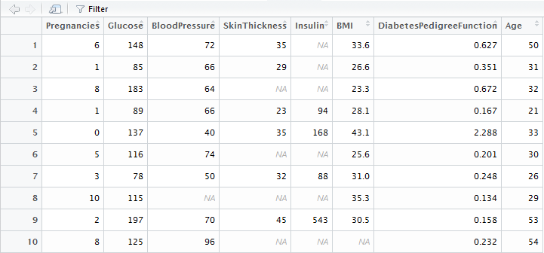
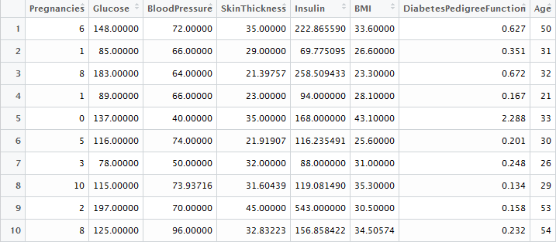
Imputation of missing values
mice(data, m = 5, maxit = 5, Meth = 'norm.predict', seed=500)

Slide 10
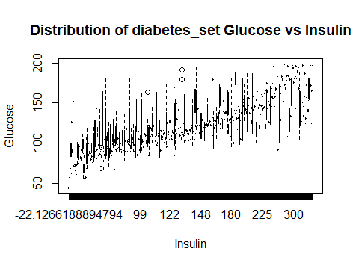
Distribution of Glucose vs Insulin to detect outliers:

Slide 11
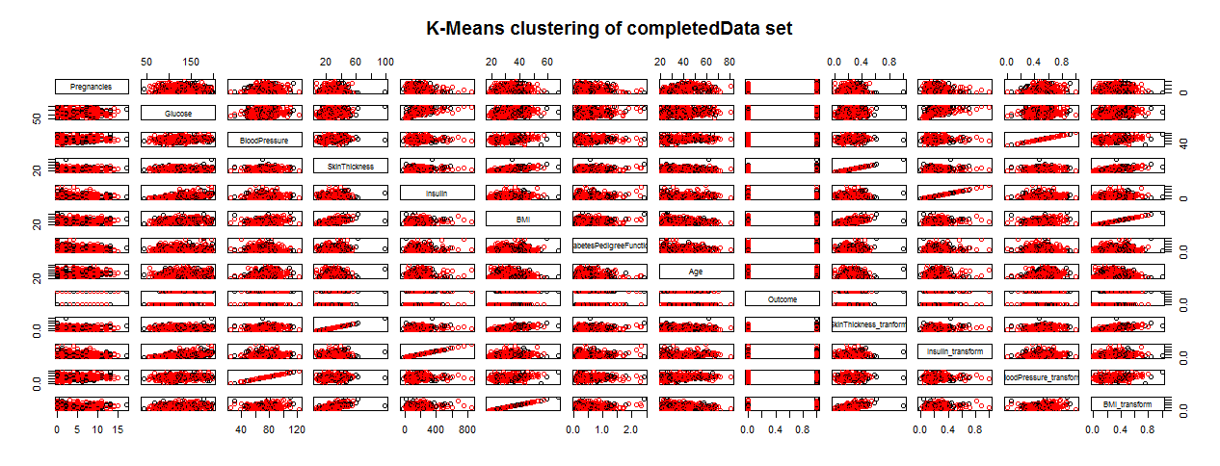
Clustering of Complete Data Set

Slide 12
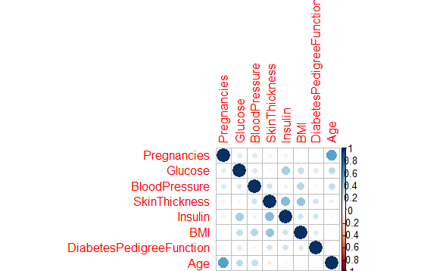
Correlation matrix
Before running a PCA we need to know the attributes that are co related.
Therefore, we run a co relation analysis between all the numerical attributes.

Slide 13
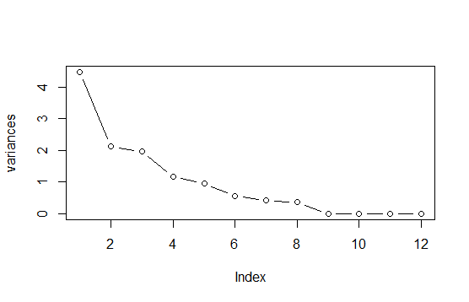
Principal Component Analysis
The PC analysis shows that the attributes having variances which are above 1 form a major percentage of dataset.
Based on Kaiser’s criterion we retain factors with eigen values greater than 1.
From the plot it can be seen that the first four components contribute mainly towards the dataset.
RC1 RC2 RC3 RC4
SS loadings 3.393 2.683 2.044 1.601
Proportion Var 0.283 0.224 0.170 0.133
Cumulative Var 0.283 0.506 0.677 0.810

Slide 14
T-test
Null Hypothesis: There is no difference in the mean number of pregnancies
for Pima Indian women with diabetes and those without diabetes.
Alternative Hypothesis: The mean number of pregnancies for all Pima Indians
with diabetes is greater than that of the mean number of pregnancies
for those without diabetes.
We conduct the test at a significance level of 0.01.
Preg_Diabetec_Yes <- subset(completedData, completedData$outcome == 1,
select = Pregnancies)
Preg_Diabetec_No <- subset(completedData, completedData$outcome == 0,
select = Pregnancies)
t.test(Preg_Diabetec_Yes, Preg_Diabetec_No, alternative = c("greater"),
var.equal=FALSE, paired=FALSE)
p = 3.411e-09 ; Since this value is less than our level of 0.01, we reject the null
hypothesis, and accept the alternative hypothesis.

Slide 15
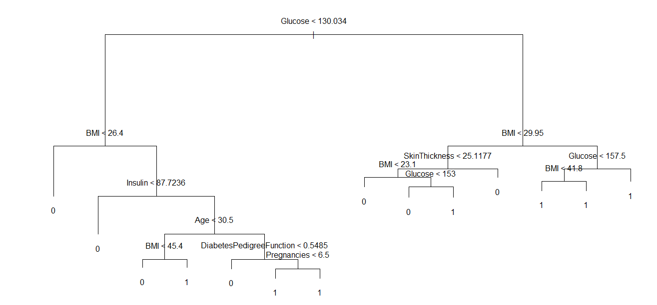
Phase 4: Modelling Decision Tree Plot
The decision tree plot
Shows the factors which
Contribute towards
Diabetes.
For the PIMA Indians data
Set the decision tree plot
Has an efficiency of 74%

Slide 16
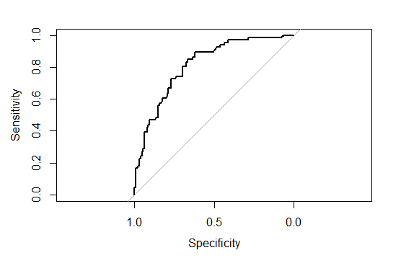
Random Forest
Random forest is an
Ensemble of
Many decision trees and the
Average of all the decision
Trees is taken and applied to the
Test set.
The plot shows the auc
Curve for the random forest
Modelling.
The accuracy of random forest
model is 75%

Slide 17
Finding the best mtry for random forest
For getting a good model for random forest we need to optimize the mtry value while making models.
Too low value is not good and high value is also a bad option.
To find an optimal value we can use tuneRF function.
bestmtry <- tuneRF(train,train$Outcome, ntreeTry = 700,stepFactor = 1.2,improve = 0.01, trace = T, plot = T)
the above function will try different values for mtry and if there is an improvement of 0.01 in the model it will go forward else will stop looking for more values.

Slide 18
Neural Networks
Artificial neural networks (hereafter, neural networks) represent an attempt at a very basic level to imitate the type of nonlinear learning that occurs in the networks of neurons found in nature.
Figure shows an artificial neuron model used in most neural networks. The inputs (x_{i}) are collected from upstream neurons (or the data set) and combined through a combination function such as summation (Σ), which is then input into a (usually nonlinear) activation function to produce an output response (y), which is then channelled downstream to other neurons.

Slide 19
Neural Networks
Creating a neural network with 4 input layers, 2 hidden layers containing 5 neurons and 3 neurons each and 1 output layer. We have set linear.output to TRUE because we want linear regression and not classification. Normalised data is a must.
neunet <- neuralnet(Outcome ~ SkinThickness_tranform + Glucose_transform + Insulin_transform + BMI_transform
, data = train, hidden = c(5,3), linear.output = T)
We prepare the neural network model by feeding in the training test data and make it ready to for testing on the test set data. Clearly, neural networks is a supervised technique where we are making the model aware of the kinds of data by feeding it with information.

Slide 20
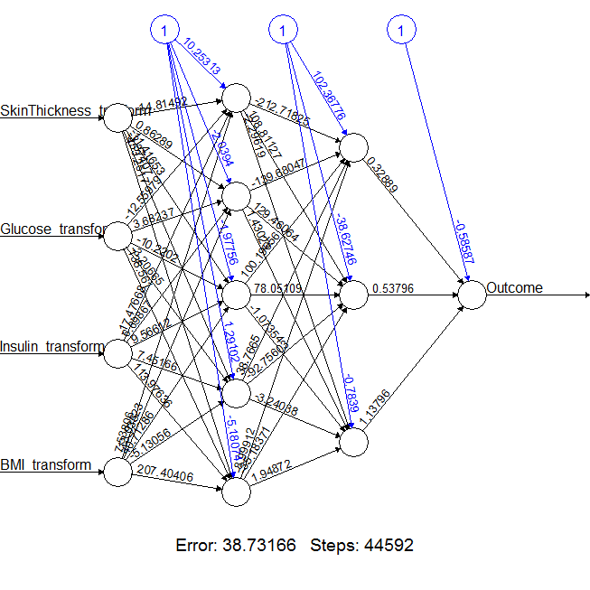
Neural Networks
plot(neunet)
This is the graphical representation of the model with weights on each connection :
The black lines show the connections between each layer and the weights on each connection while the blue lines show the bias term added in each step. The bias can be thought as the intercept of a linear model. The net is essentially a black box so we cannot say that much about the fitting, the weights and the model. Suffice to say that the training algorithm has converged and therefore the model is ready to be used.

Slide 21
Neural Networks
The temp dataset contains only the columns SkinThickness_tranform", "Glucose_transform", "Insulin_transform", "BMI_transform" of the training data set.
Only these variables are used for input.
temp_test <- subset(test, select = c("SkinThickness_tranform", "Glucose_transform", "Insulin_transform",
"BMI_transform"))
Computation of output variable based on required input variables.
neunet.results <- compute(neunet, temp_test)

Slide 22
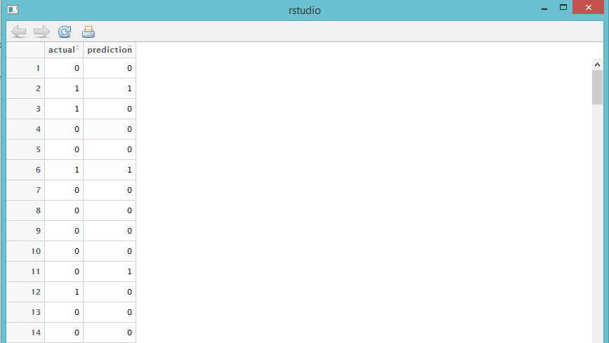
Neural Networks
Comparison between actual Output values from our dataset and predicted Output values using the Neural Network Algorithm.
0 indicated No Diabetes and 1 indicates Diabetes.

Slide 23
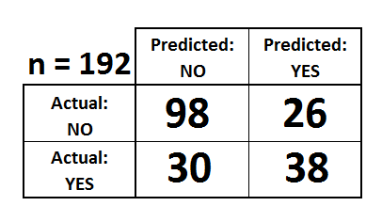
Neural Networks
Confusion matrix for the Outcome values.
table(test$Outcome,neunet.results$net.result)
All the 192 values in the test dataset is accounted for as the total comes to 192.

Slide 24
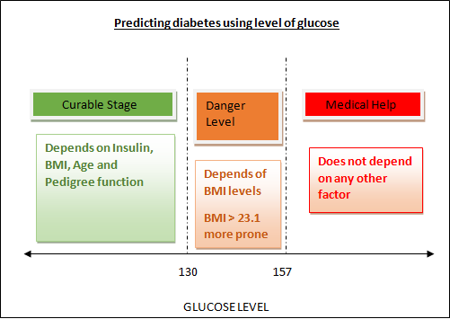

Slide 25

Medicinal Recommendations
Get more physical activity
Get plenty of fiber (Foods high in fiber
include fruits, vegetables, beans, whole grains and nuts.)
3.Go for whole grains like: bread, pasta ,cereals etc.

Slide 26
References :
https://www.niddk.nih.gov/health-information/diabetes
http://machinelearningmastery.com/case-study-predicting-
the-onset-of-diabetes-within-five-years-part-1-of-3/
http://www.rci.rutgers.edu/~cabrera/587/pima.pdf
https://rpubs.com/ikodesh/53189

Slide 27
Thank You

