Slide 1
Machine Learning - Introduction
CSE 4311 – Neural Networks and Deep Learning
Vassilis Athitsos
Computer Science and Engineering Department
University of Texas at Arlington

Slide 2
What is Machine Learning
Quote by Tom M. Mitchell:
"A computer program is said to learn from experience E with respect to some class of tasks T and performance measure P if its performance at tasks in T, as measured by P, improves with experience E."
To define a machine learning problem, we need to specify:
The experience (usually known as training data).
The task (classification, regression, …)
The performance measure (classification accuracy, squared error, …).

Slide 3
Types of Machine Learning
(source: Wikipedia)
Supervised Learning.
The computer is presented with example inputs and their desired outputs, given by a "teacher", and the goal is to learn a general rule that maps inputs to outputs.
Unsupervised Learning.
No example outputs are given to the learning algorithm, leaving it on its own to find structure in its input.
Reinforcement Learning.
A computer program interacts with a dynamic environment and must perform a certain goal (such as driving a car or playing chess). The program is provided feedback (rewards and punishments).

Slide 4
Supervised Learning
The computer is presented with example inputs and their desired outputs, given by a "teacher".
Goal: learn a general function that maps inputs to outputs.

Slide 5
Supervised Learning
Example: recognizing the digits of zip codes.
The training set consists of images of digits and the names of those digits.
example inputs
one
one
two
three
three
four
four
five
six
six
seven
eight
nine
nine
zero
desired outputs (class labels)

Slide 6










Supervised Learning
Example: face recognition
The training set consists of images of faces and the IDs of those faces.
example inputs
Person 534
Person 789
Person 956
Person 126
Person 120
Person 521
Person 457
Person 917
Person 017
Person 398
desired outputs (class labels)

Slide 7
Regression, Classification, Pattern Recognition
When the desired output belongs to one of a finite number of categories, then the supervised learning problem is called a classification problem.
When the desired output contains one or more values from a continuous space, then the supervised learning problem is called a regression problem.

Slide 8
Unsupervised Learning
No example outputs are given to the learning algorithm, leaving it on its own to find structure in its input.
Example: figure out how many different types of digits appear in this set:

Slide 9






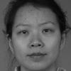

Unsupervised Learning
No example outputs are given to the learning algorithm, leaving it on its own to find structure in its input.
Example: figure out how many different people appear in this set of face photos:

Slide 10
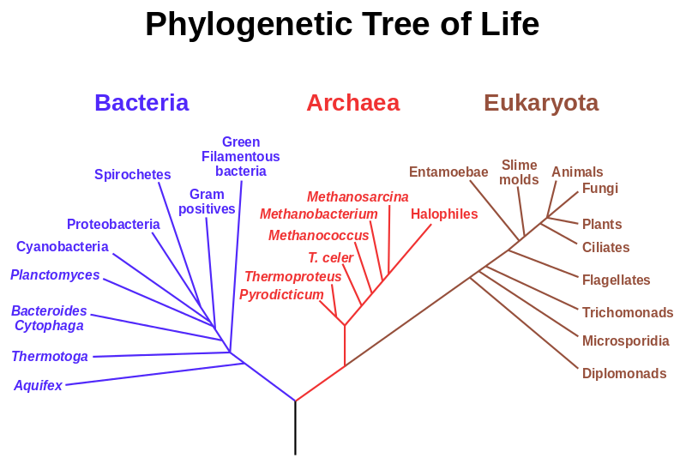
Applications of Unsupervised Learning
Clustering.
E.g., categorize living organisms into hierarchical groups.
Source: https://en.wikipedia.org/wiki/Phylogenetic_tree

Slide 11
Applications of Unsupervised Learning
Anomaly detection.
Figure out if someone at an airport is behaving abnormally, which may be a sign of danger.
Figure out if an engine is behaving abnormally, which may be a sign of malfunction/damage.
This can also be treated as a supervised learning problem, if someone provides training examples that are labeled as "anomalies".
If it is treated as an unsupervised learning problem, then an anomaly model must be built without such training examples.

Slide 12
Reinforcement Learning
Learn what actions to take so as to maximize reward.
Correct pairs of input/output are not presented to the system.
The system needs to explore different actions at different situations, to see what rewards it gets.
However, the system also needs to exploit its knowledge so as to maximize rewards.
Problem: what is the optimal balance between exploration and exploitation?

Slide 13
Applications of Reinforcement Learning
A robot learning how to move a robotic arm, or how to walk on two legs.
A car learning how to drive itself.
A computer program learning how to play a board game, like chess, tic-tac-toe, etc.

Slide 14
Machine Learning and Pattern Recognition
Machine learning and pattern recognition are not the same thing.
This is a point that confuses many people.
You can use machine learning to learn things that are not classifiers. For example:
Learn how to walk on two feet.
Learn how to grasp a medical tool.
You can construct classifiers without machine learning.
You can hardcode a bunch of rules that the classifier applies to each pattern in order to estimate its class.
However, machine learning and pattern recognition are heavily related.
A big part of machine learning research focuses on pattern recognition.
Modern pattern recognition systems are usually exclusively based on machine learning.

Slide 15
Our Focus: Supervised Learning
(source: Wikipedia)
Supervised Learning.
The computer is presented with example inputs and their desired outputs, given by a "teacher", and the goal is to learn a general rule that maps inputs to outputs.
Unsupervised Learning.
No example outputs are given to the learning algorithm, leaving it on its own to find structure in its input.
Reinforcement Learning.
A computer program interacts with a dynamic environment and must perform a certain goal (such as driving a car or playing chess). The program is provided feedback (rewards and punishments).

Slide 16
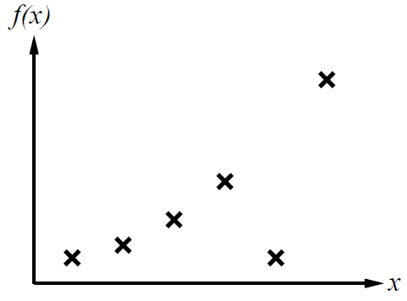
A Simple Learning Task
This is a toy regression example..
Source. S. Russell and P. Norvig, "Artificial Intelligence: A Modern Approach".
Here, the input is a single real number.
The output is also a real number.
So, our target function F_{true} is a function from the reals to the reals.
Usually patterns are much more complex.
In this example it is easy to visualize training examples and learned functions.

Slide 17
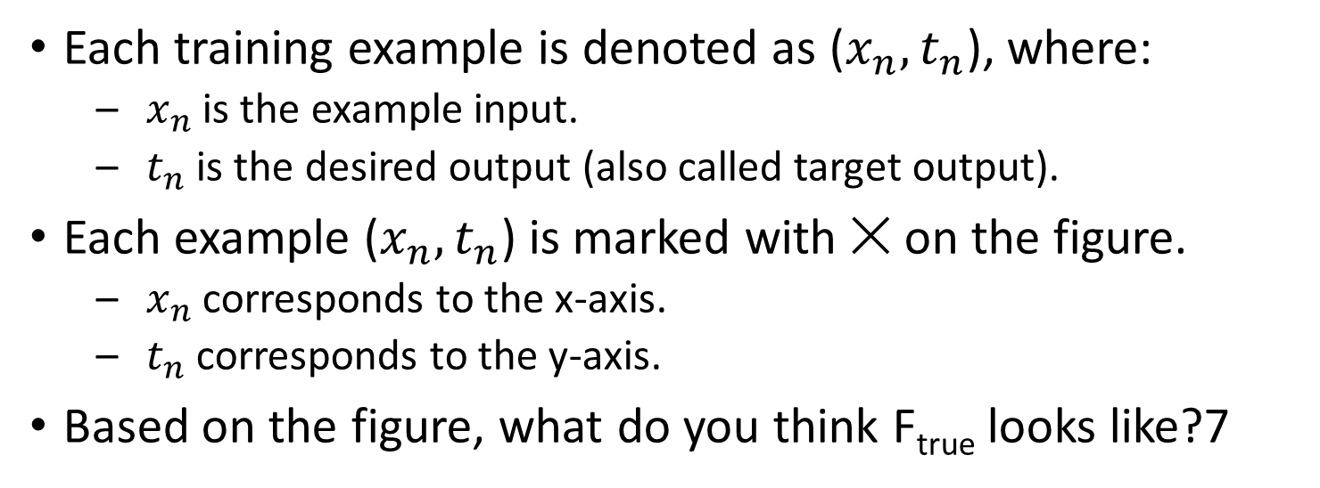
A Simple Learning Task
Each training example is denoted as ($x_{n}, t_{n}$), where:
$x_{n}$ is the example input.
$t_{n}$ is the desired output (also called target output).
Each example ($x_{n}, t_{n}$) is marked with ✕ on the figure.
$x_{n}$ corresponds to the x-axis.
$t_{n}$ corresponds to the y-axis.
Based on the figure, what do you think F_{true} looks like?7

Slide 18
A Simple Learning Task
Different people may give different answers as to what F_{true} may look like.
That shows the challenge in supervised learning: we can find some plausible functions, but:
How do we know which one of them is correct?
Given many choices for the function, how can we evaluate each choice?

Slide 19
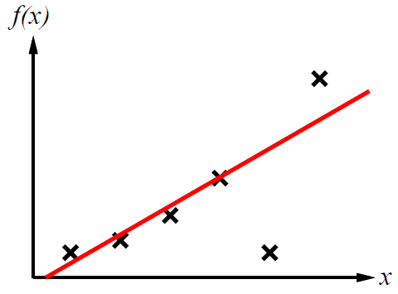
A Simple Learning Task
Here is one possible function F.
Can anyone guess how it was obtained?

Slide 20
A Simple Learning Task
Here is one possible function F.
Can anyone guess how it was obtained?
It was obtained by fitting a line to the training data.

Slide 21
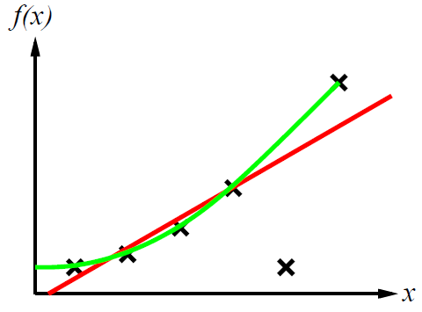
A Simple Learning Task
Here we see another possible function F, shown in green.
It looks like a quadratic function (second degree polynomial).
It fits all the data perfectly, except for one.

Slide 22
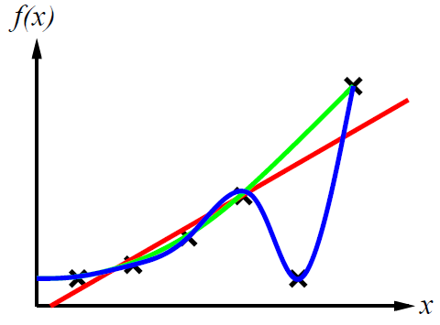
A Simple Learning Task
Here we see a third possible function F, shown in blue.
It looks like a cubic degree polynomial.
It fits all the data perfectly.

Slide 23
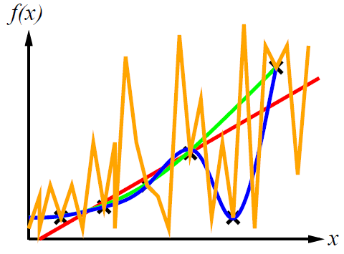
A Simple Learning Task
Here we see a fourth possible function F, shown in orange.
It zig-zags a lot.
It fits all the data perfectly.

Slide 24
The Model Selection Problem
Overall, we can come up with an infinite number of possible functions here.
The question is, how do we choose which one is best?
Or, an easier version, how do we choose a good one.
This is called the model selection problem: out of an infinite number of possible models for our data, we must choose one.

Slide 25
The Model Selection Problem
An easier version of the model selection problem: given a model (i.e., a function modeling our data), how can we measure how good this model is?
What are your thoughts on this?

Slide 26
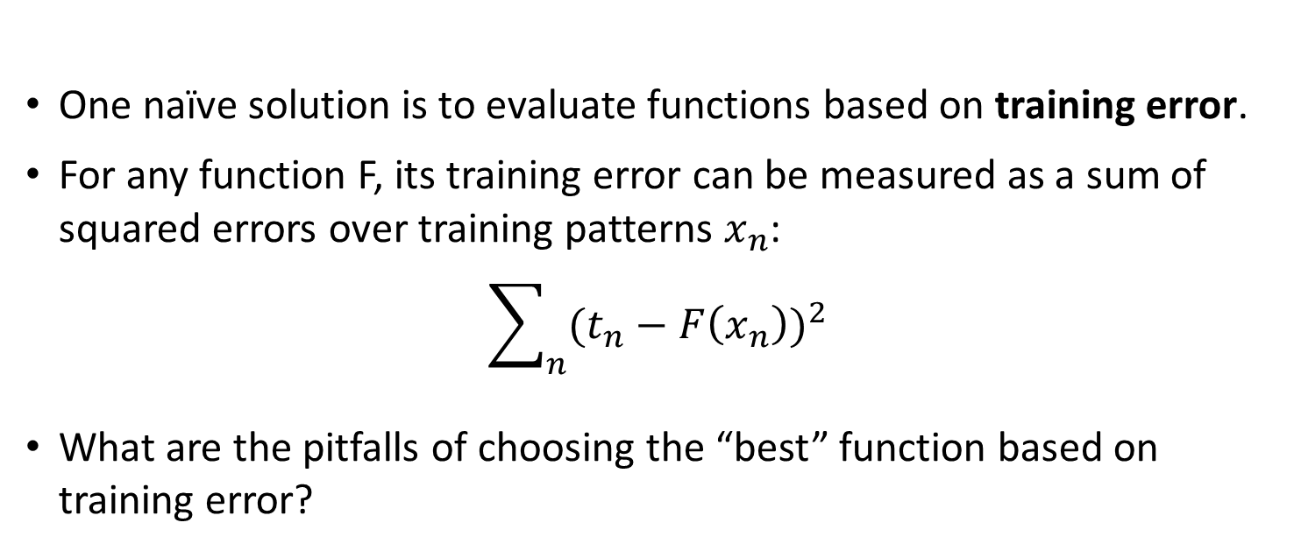
A Simple Learning Task
One naïve solution is to evaluate functions based on training error.
For any function F, its training error can be measured as a sum of squared errors over training patterns $x_{n}$:
$$\sum_{n}{{(t_{n}−F\left(x_{n}\right))}^{2}}$$
What are the pitfalls of choosing the “best” function based on training error?

Slide 27
A Simple Learning Task
What are the pitfalls of choosing the “best” function based on training error?
The zig-zagging orange function comes out as “perfect”: its training error is zero.
As a human, would you find more reasonable the orange function or the blue function (cubic polynomial)?
They both have zero training error.

Slide 28
A Simple Learning Task
What are the pitfalls of choosing the “best” function based on training error?
The zig-zagging orange function comes out as “perfect”: its training error is zero.
As a human, would you find more reasonable the orange function or the blue function (cubic polynomial)?
They both have zero training error.
However, the zig-zagging function looks pretty arbitrary.

Slide 29
A Simple Learning Task
Ockham’s razor: given two equally good explanations, choose the more simple one.
This is an old philosophical principle (Ockham lived in the 14th century).
Based on that, we prefer a cubic polynomial over a crazy zig-zagging function, because it is more simple, and they both have zero training error.

Slide 30
A Simple Learning Task
However, real life is more complicated.
What if none of the functions have zero training error?
How do we weigh simplicity versus training error?

Slide 31
A Simple Learning Task
However, real life is more complicated.
What if none of the functions have zero training error?
How do we weigh simplicity versus training error?
There is no standard or straightforward solution to this.
There exist many machine learning algorithms. Each corresponds to a different approach for resolving the trade-off between simplicity and training error.

Slide 32
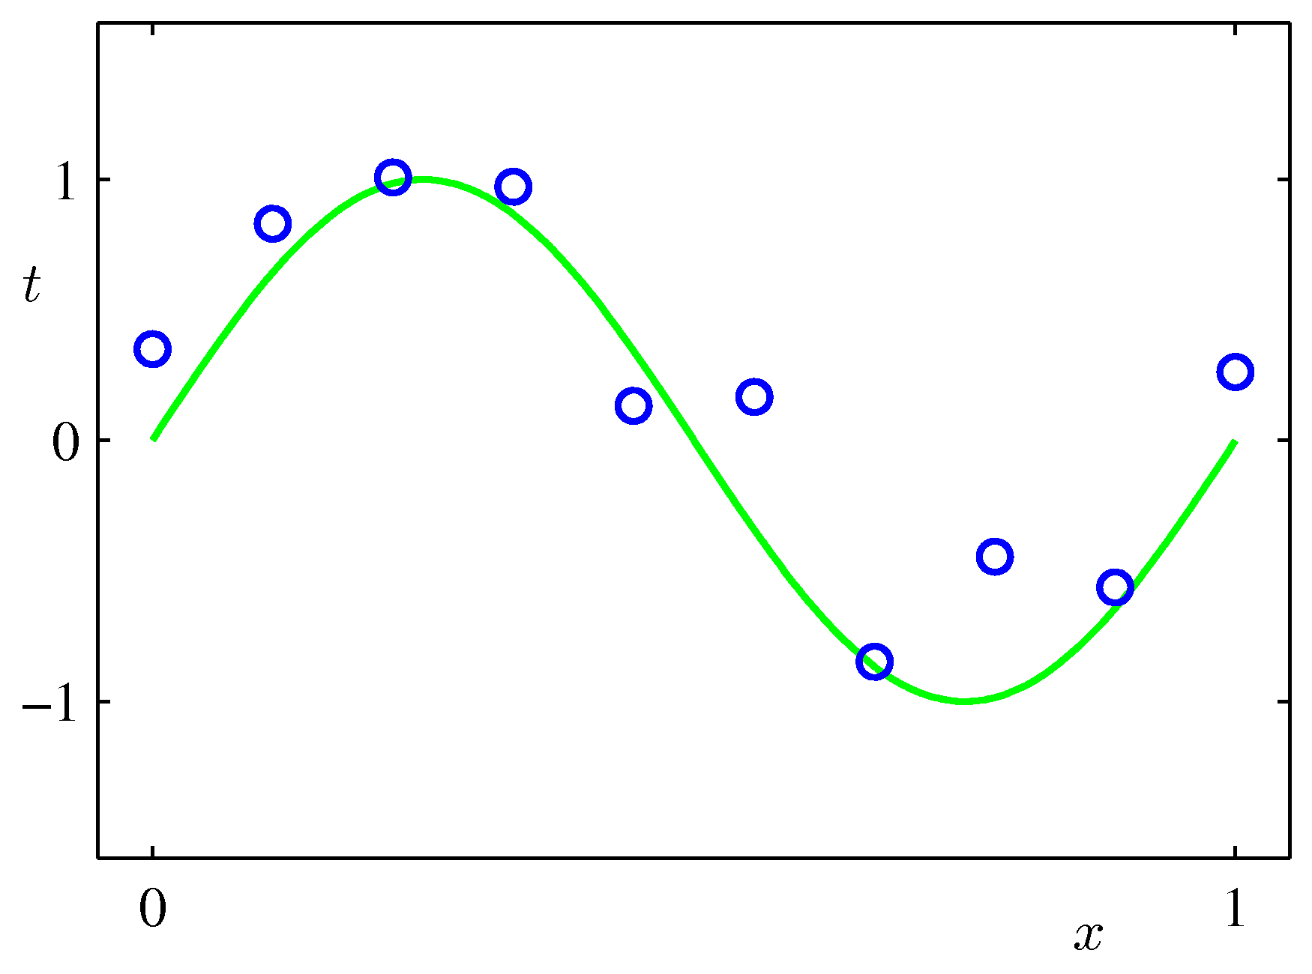
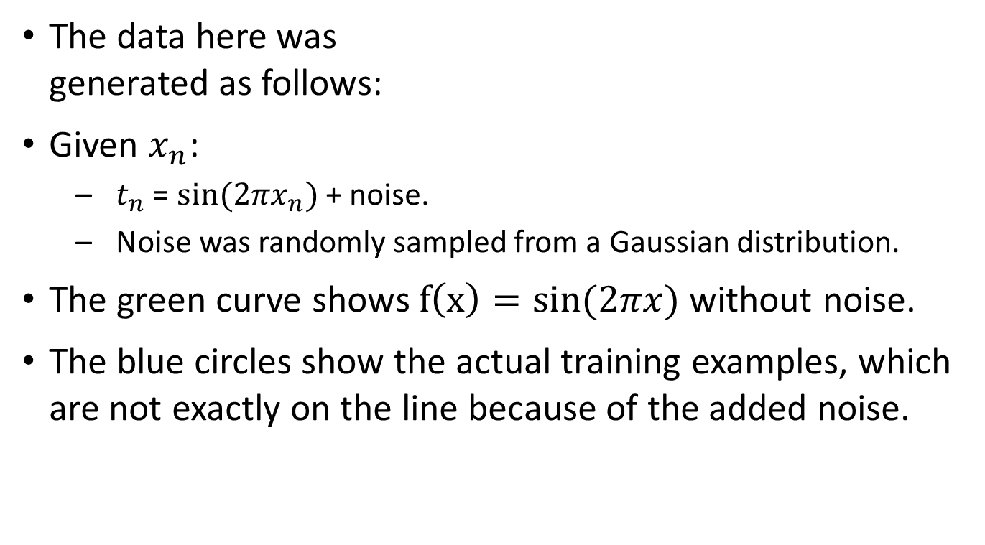
Another Example
The data here was generated as follows:
Given $x_{n}$:
$t_{n}$ = ${sin⁡(2πx}_{n})$ + noise.
Noise was randomly sampled from a Gaussian distribution.
The green curve shows $f\left(x\right)=sin⁡(2πx)$without noise.
The blue circles show the actual training examples, which are not exactly on the line because of the added noise.

Slide 33
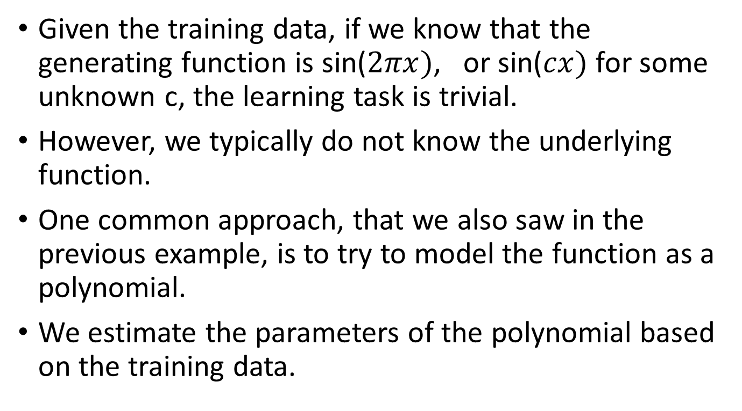
Polynomial Fitting
Given the training data, if we know that the generating function is sin($2πx)$, or sin($cx)$ for some unknown c, the learning task is trivial.
However, we typically do not know the underlying function.
One common approach, that we also saw in the previous example, is to try to model the function as a polynomial.
We estimate the parameters of the polynomial based on the training data.

Slide 34
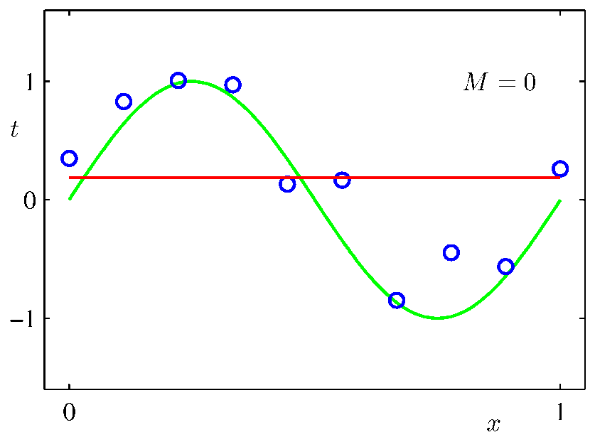
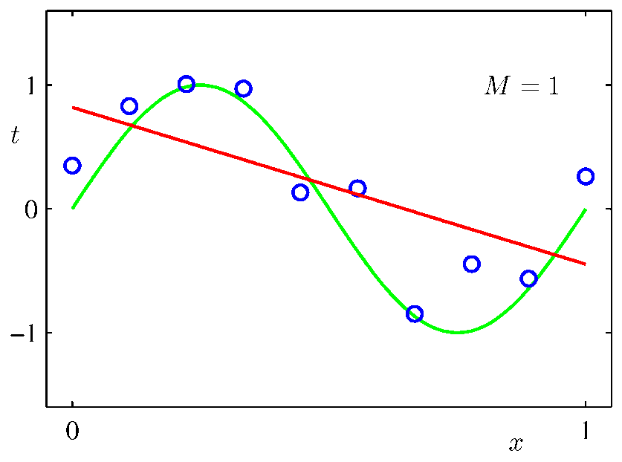
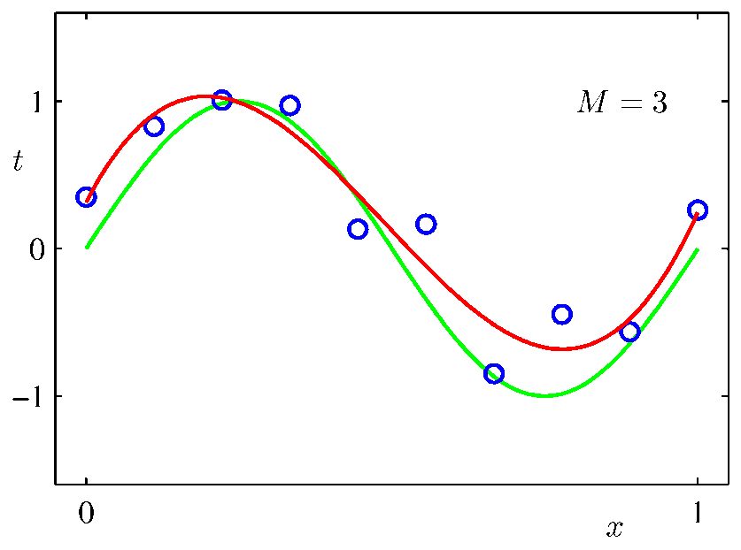
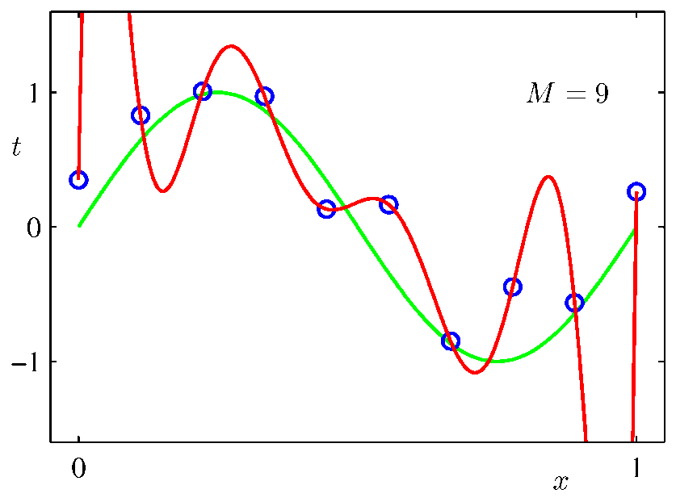
Polynomial Fitting
Here are estimated polynomials of degrees 0, 1, 3, 9.

Slide 35
Polynomial Fitting
Notice the overfitting problem with the 9th degree polynomial.

Slide 36
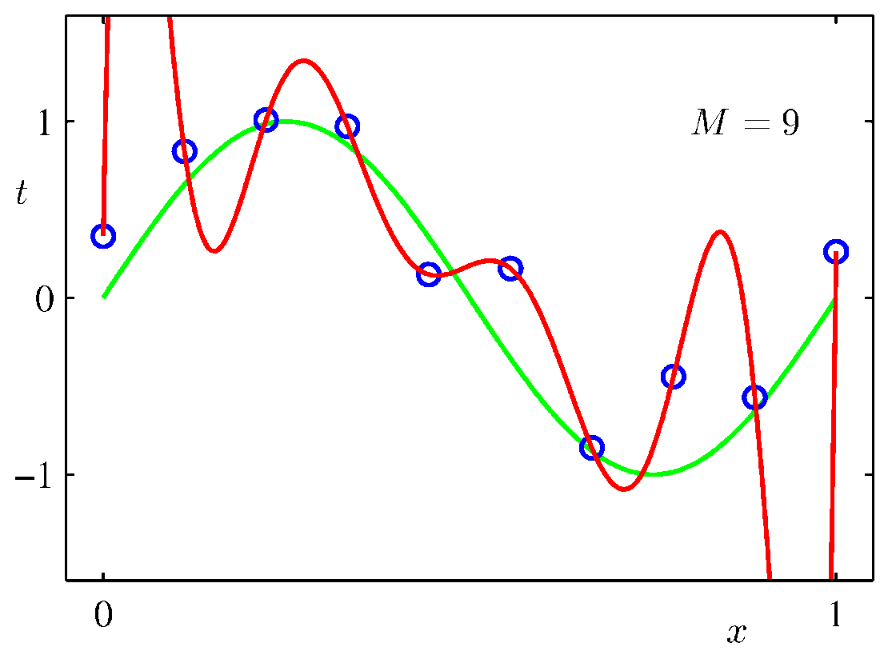
Overfitting
Overfitting is a huge problem in machine learning.
Overfitting means that the learned function fits very well (or perfectly) the training data, but works very poorly on test data.
Some times, when our models have too many parameters (like a 9th degree polynomial), those parameters get tuned to match the noise in the data.

Slide 37
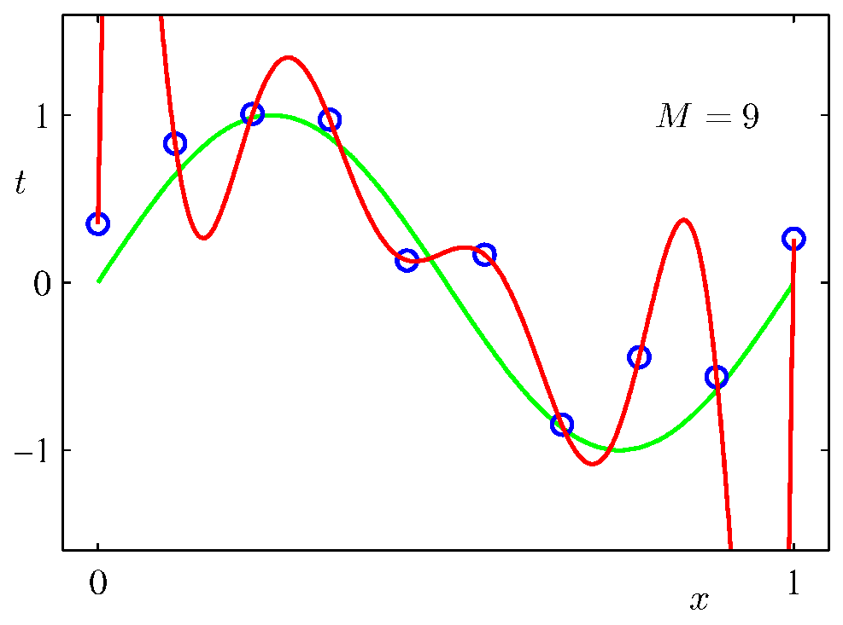
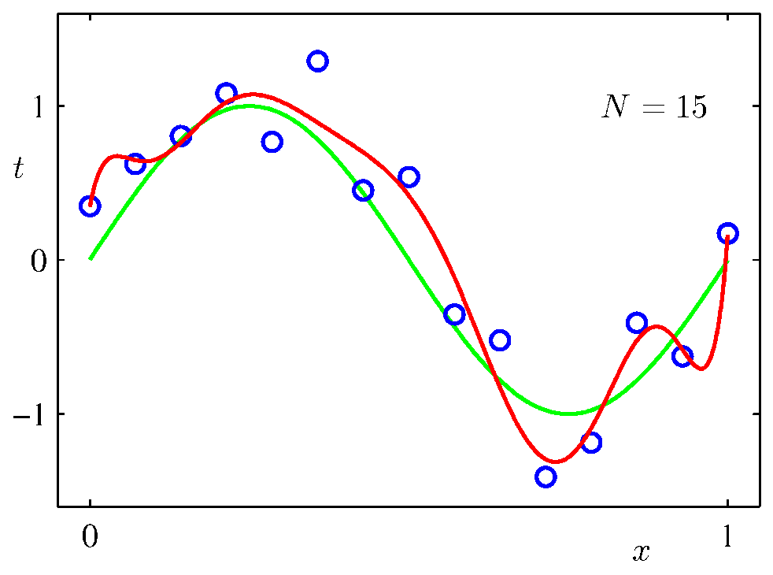
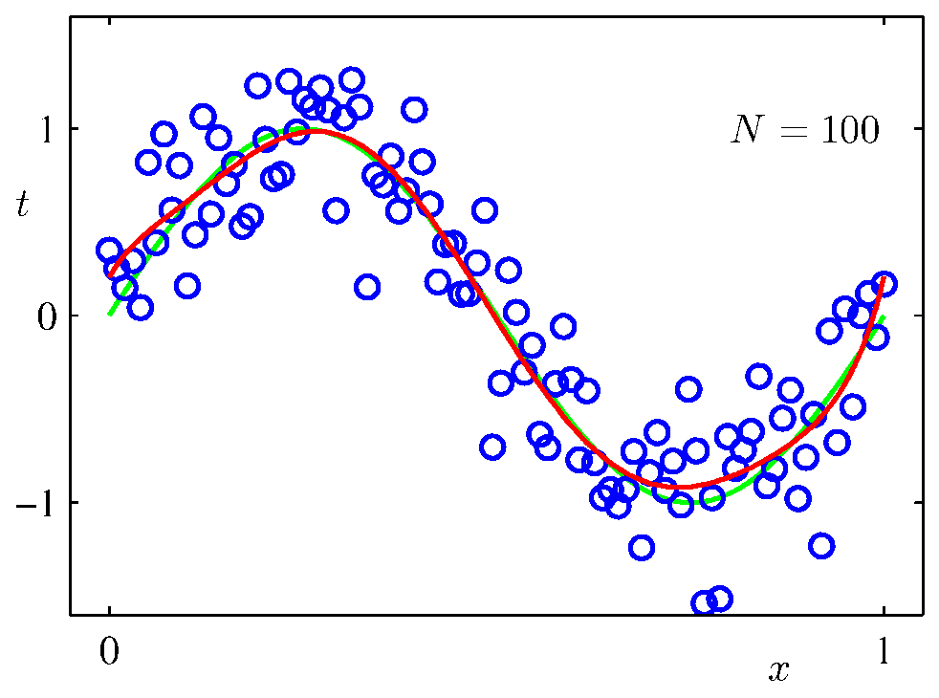
More Training, Less Overfitting
Increasing the amount of training data (from 10 to 15, and then to 100) reduces overfitting.

Slide 38
Hyperparameters
The degree M of the polynomial is a hyperparameter.
A hyperparameter is a parameter that we (the humans) need to choose, as opposed to parameters that our machine learning algorithm is supposed to learn.
To find good hyperparameter values:
We typically try many different values, and we see which one works best.
We typically try how well these values work on a validation set (see next slide).

Slide 39
Using a Test Set
If we want to evaluate one or more methods, to see how well they work, we use a test set.
Test examples should not appear either in the training set or in the validation set.
Error rates on the test set are a reliable estimate of how well a function generalizes to data outside training.
Error rates on the training set are not reliable for that task.
Error rates on the validation set are still not quite reliable, as the validation set was used to choose some parameters.

Slide 40
Training, Validation, Test Sets
In summary, the data that we have available for a learning problem are typically split into training, validation, and test sets, whose roles are very different:
Training set: use to learn the function that we want to learn, that maps inputs to outputs.
Validation set: use to evaluate different values of hyperparameters (like λ for regularization) that need to be hardcoded during training.
Train with different values, and then see how well each resulting function works on the validation set.
Test set: use to evaluate the final product (after the choice of hyperparameters has been finalized).

