Slide 1
Neural Networks Part 1 – Introduction, the Inference Module
CSE 4311 – Neural Networks and Deep Learning
Vassilis Athitsos
Computer Science and Engineering Department
University of Texas at Arlington

Slide 2
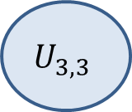
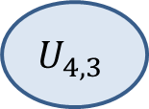
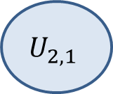

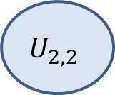
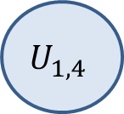
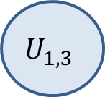
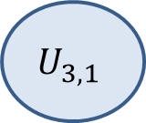
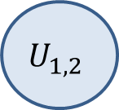
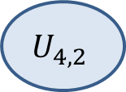



Neural Networks are Graphs
Input layer
$$U_{1,1}$$
1st Hidden Layer
2nd Hidden Layer
Output layer
$$U_{2,1}$$
$$U_{3,1}$$
$$U_{4,1}$$
$$U_{1,2}$$
$$U_{2,2}$$
$$U_{3,2}$$
$$U_{4,2}$$
$$U_{1,3}$$
$$U_{2,3}$$
$$U_{3,3}$$
$$U_{4,3}$$
$$U_{1,4}$$
This is an example of a neural network.
The drawing will make more sense later.
What is important at this point is that a neural network is a weighted directed graph.

Slide 3
Neural Networks are Graphs
Input layer
$$U_{1,1}$$
1st Hidden Layer
2nd Hidden Layer
Output layer
$$U_{2,1}$$
$$U_{3,1}$$
$$U_{4,1}$$
$$U_{1,2}$$
$$U_{2,2}$$
$$U_{3,2}$$
$$U_{4,2}$$
$$U_{1,3}$$
$$U_{2,3}$$
$$U_{3,3}$$
$$U_{4,3}$$
$$U_{1,4}$$
A directed graph consists of nodes and directed edges.
Each node (also called unit) produces some output.
Edges go from the output of a unit to the input of another unit.

Slide 4
Input Units and Perceptrons
Input layer
$$U_{1,1}$$
1st Hidden Layer
2nd Hidden Layer
Output layer
$$U_{2,1}$$
$$U_{3,1}$$
$$U_{4,1}$$
$$U_{1,2}$$
$$U_{2,2}$$
$$U_{3,2}$$
$$U_{4,2}$$
$$U_{1,3}$$
$$U_{2,3}$$
$$U_{3,3}$$
$$U_{4,3}$$
$$U_{1,4}$$
There are various types of units. The two most simple are:
Input units. They make up the input layer.
Perceptrons. They make up the rest of the layers. They are the computational units of the neural network.

Slide 5
Input Units
Input layer
$$U_{1,1}$$
1st Hidden Layer
2nd Hidden Layer
Output layer
$$U_{2,1}$$
$$U_{3,1}$$
$$U_{4,1}$$
$$U_{1,2}$$
$$U_{2,2}$$
$$U_{3,2}$$
$$U_{4,2}$$
$$U_{1,3}$$
$$U_{2,3}$$
$$U_{3,3}$$
$$U_{4,3}$$
$$U_{1,4}$$
Input units are very simple.
They represent the input to the neural network.
We will define them more formally a bit later, but they are basically a notational convenience.

Slide 6


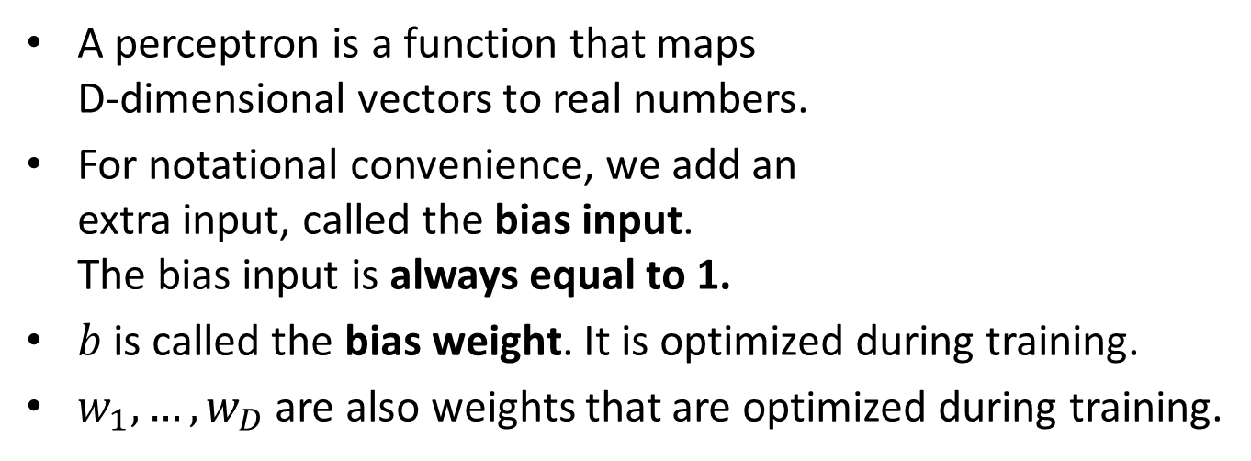

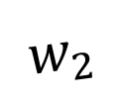

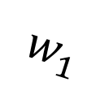

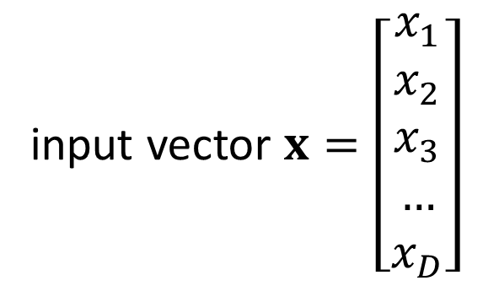

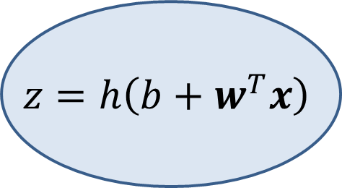


Perceptrons
$$1$$
$$b$$
$$x_{1}$$
$$w_{1}$$
$$z=h\left(b+w^{T}x\right)$$
Output: $z$
$$w_{2}$$
$$x_{2}$$
$$…$$
$$w_{D}$$
$$x_{D}$$
input vector $x=\left[\begin{aligned}x_{1} \\ x_{2} \\ x_{3} \\ … \\ x_{D}\end{aligned}\right]$
A perceptron is a function that maps D-dimensional vectors to real numbers.
For notational convenience, we add an extra input, called the bias input. The bias input is always equal to 1.
$b$ is called the bias weight. It is optimized during training.
$w_{1},…,w_{D}$ are also weights that are optimized during training.

Slide 7
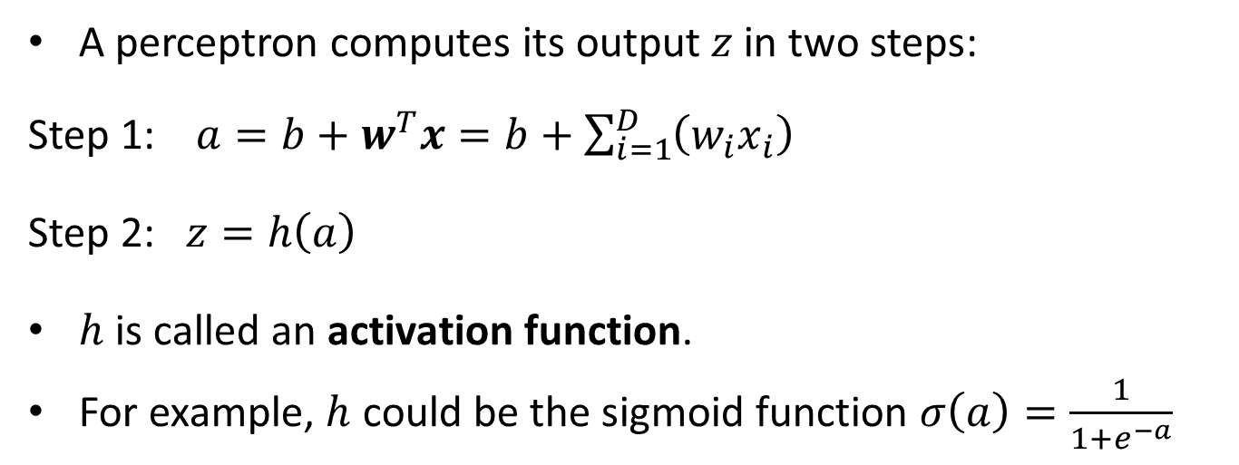
Perceptrons
$$1$$
$$b$$
$$x_{1}$$
$$w_{1}$$
$$z=h\left(b+w^{T}x\right)$$
Output: $z$
$$w_{2}$$
$$x_{2}$$
$$…$$
$$w_{D}$$
$$x_{D}$$
A perceptron computes its output $z$ in two steps:
Step 1: $a=b+w^{T}x=b+\sum_{i=1}^{D}{\left(w_{i}x_{i}\right)}$
Step 2: $z=h\left(a\right)$
$h$ is called an activation function.
For example, $h$ could be the sigmoid function $σ\left(a\right)=\frac{1}{1+e^{−a}}$

Slide 8
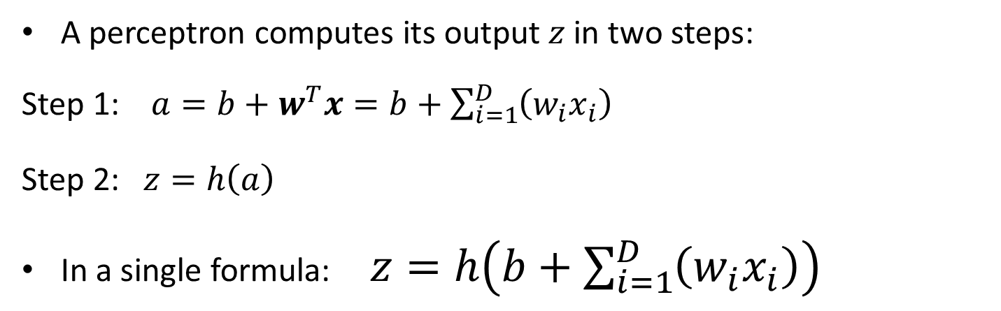
Perceptrons
$$1$$
$$b$$
$$x_{1}$$
$$w_{1}$$
$$z=h\left(b+w^{T}x\right)$$
Output: $z$
$$w_{2}$$
$$x_{2}$$
$$…$$
$$w_{D}$$
$$x_{D}$$
A perceptron computes its output $z$ in two steps:
Step 1: $a=b+w^{T}x=b+\sum_{i=1}^{D}{\left(w_{i}x_{i}\right)}$
Step 2: $z=h\left(a\right)$
In a single formula: $z=h\left(b+\sum_{i=1}^{D}{\left(w_{i}x_{i}\right)}\right)$

Slide 9
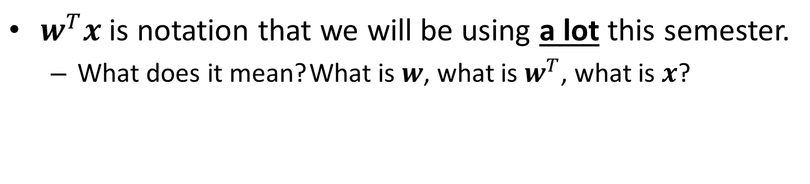
Notation
$$1$$
$$b$$
$$x_{1}$$
$$w_{1}$$
$$z=h\left(b+w^{T}x\right)$$
Output: $z$
$$w_{2}$$
$$x_{2}$$
$$…$$
$$w_{D}$$
$$x_{D}$$
$w^{T}x$ is notation that we will be using a lot this semester.
What does it mean? What is $w$, what is $w^{T}$, what is $x$?

Slide 10
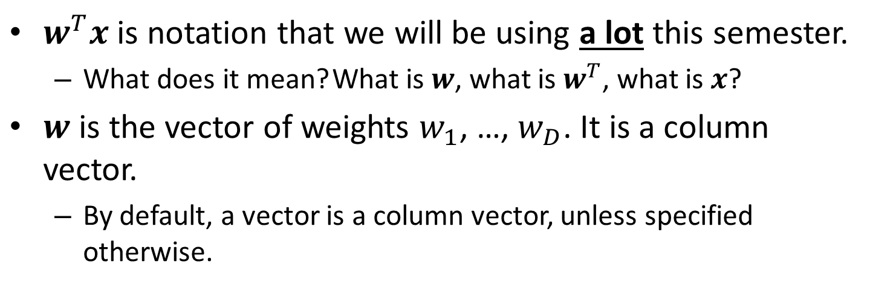
Notation
$$1$$
$$b$$
$$x_{1}$$
$$w_{1}$$
$$z=h\left(b+w^{T}x\right)$$
Output: $z$
$$w_{2}$$
$$x_{2}$$
$$…$$
$$w_{D}$$
$$x_{D}$$
$w^{T}x$ is notation that we will be using a lot this semester.
What does it mean? What is $w$, what is $w^{T}$, what is $x$?
$w$ is the vector of weights $w_{1}$, …, $w_{D}$. It is a column vector.
By default, a vector is a column vector, unless specified otherwise.

Slide 11
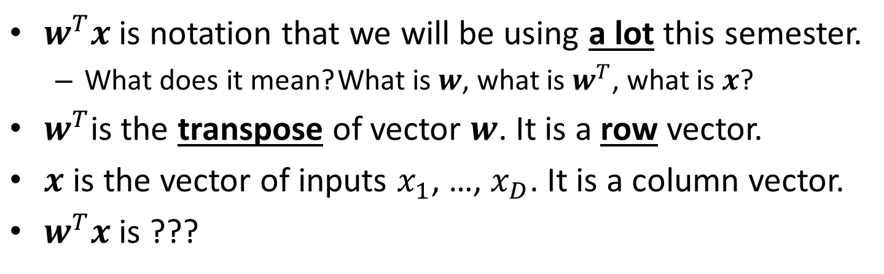
Notation
$$1$$
$$b$$
$$x_{1}$$
$$w_{1}$$
$$z=h\left(b+w^{T}x\right)$$
Output: $z$
$$w_{2}$$
$$x_{2}$$
$$…$$
$$w_{D}$$
$$x_{D}$$
$w^{T}x$ is notation that we will be using a lot this semester.
What does it mean? What is $w$, what is $w^{T}$, what is $x$?
$w^{T}$is the transpose of vector $w$. It is a row vector.
$x$ is the vector of inputs $x_{1}$, …, $x_{D}$. It is a column vector.
$w^{T}x$ is ???

Slide 12
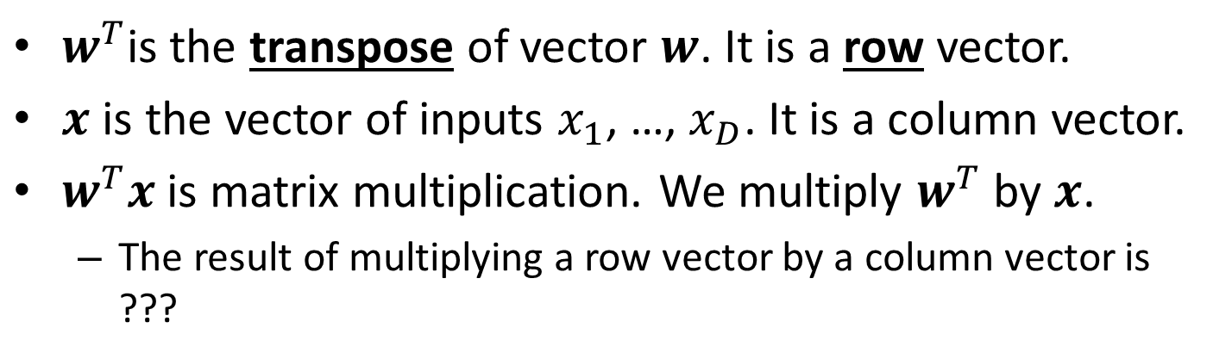
Notation
$$1$$
$$b$$
$$x_{1}$$
$$w_{1}$$
$$z=h\left(b+w^{T}x\right)$$
Output: $z$
$$w_{2}$$
$$x_{2}$$
$$…$$
$$w_{D}$$
$$x_{D}$$
$w^{T}$is the transpose of vector $w$. It is a row vector.
$x$ is the vector of inputs $x_{1}$, …, $x_{D}$. It is a column vector.
$w^{T}x$ is matrix multiplication. We multiply $w^{T}$ by $x$.
The result of multiplying a row vector by a column vector is ???

Slide 13
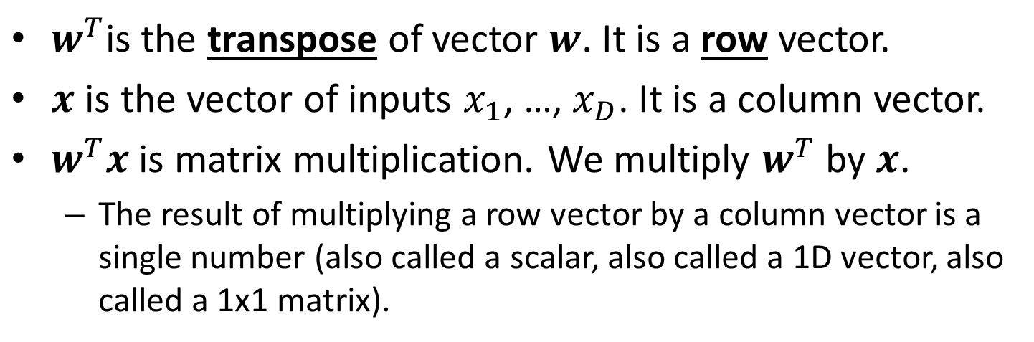
Notation
$$1$$
$$b$$
$$x_{1}$$
$$w_{1}$$
$$z=h\left(b+w^{T}x\right)$$
Output: $z$
$$w_{2}$$
$$x_{2}$$
$$…$$
$$w_{D}$$
$$x_{D}$$
$w^{T}$is the transpose of vector $w$. It is a row vector.
$x$ is the vector of inputs $x_{1}$, …, $x_{D}$. It is a column vector.
$w^{T}x$ is matrix multiplication. We multiply $w^{T}$ by $x$.
The result of multiplying a row vector by a column vector is a single number (also called a scalar, also called a 1D vector, also called a 1x1 matrix).

Slide 14
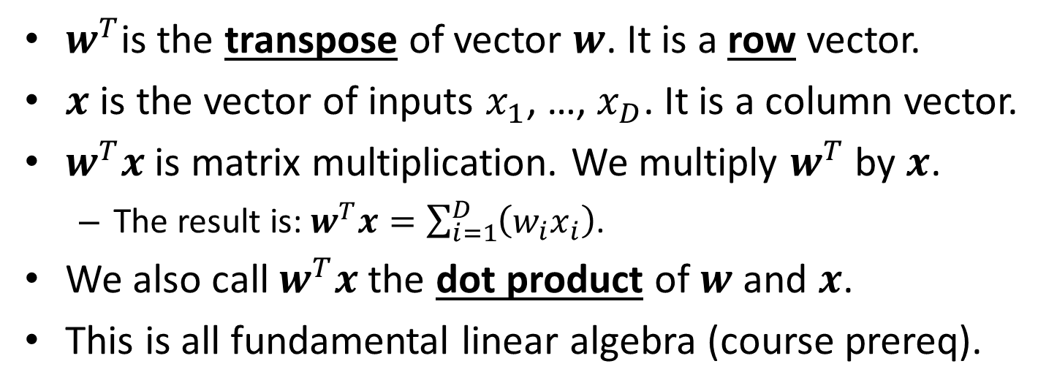
Notation
$$1$$
$$b$$
$$x_{1}$$
$$w_{1}$$
$$z=h\left(b+w^{T}x\right)$$
Output: $z$
$$w_{2}$$
$$x_{2}$$
$$…$$
$$w_{D}$$
$$x_{D}$$
$w^{T}$is the transpose of vector $w$. It is a row vector.
$x$ is the vector of inputs $x_{1}$, …, $x_{D}$. It is a column vector.
$w^{T}x$ is matrix multiplication. We multiply $w^{T}$ by $x$.
The result is: $w^{T}x=\sum_{i=1}^{D}{\left(w_{i}x_{i}\right)}$.
We also call $w^{T}x$ the dot product of $w$ and $x$.
This is all fundamental linear algebra (course prereq).

Slide 15
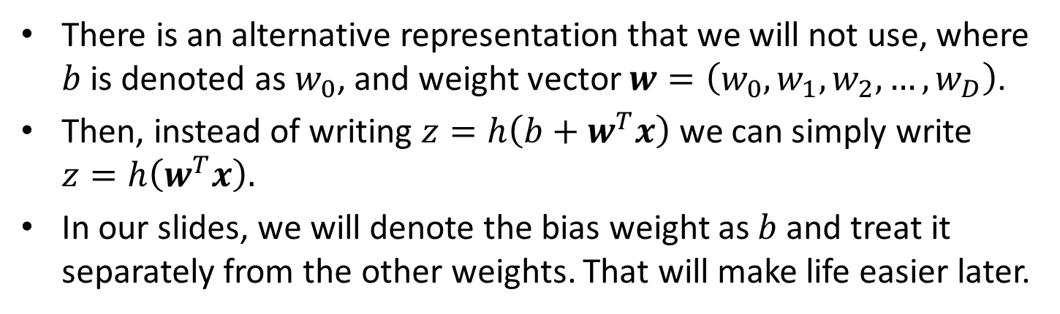
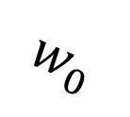
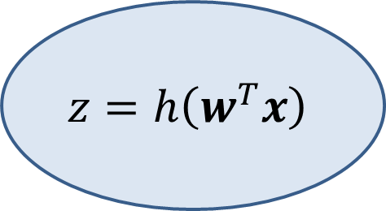
Notation for Bias Weight
$$1$$
$$w_{0}$$
$$x_{1}$$
$$w_{1}$$
$$z=h\left(w^{T}x\right)$$
Output: $z$
$$w_{2}$$
$$x_{2}$$
$$…$$
$$w_{D}$$
$$x_{D}$$
There is an alternative representation that we will not use, where $b$ is denoted as $w_{0}$, and weight vector $w=\left(w_{0},w_{1},w_{2},…,w_{D}\right)$.
Then, instead of writing $z=h\left(b+w^{T}x\right)$ we can simply write $z=h\left(w^{T}x\right).$
In our slides, we will denote the bias weight as $b$ and treat it separately from the other weights. That will make life easier later.

Slide 16
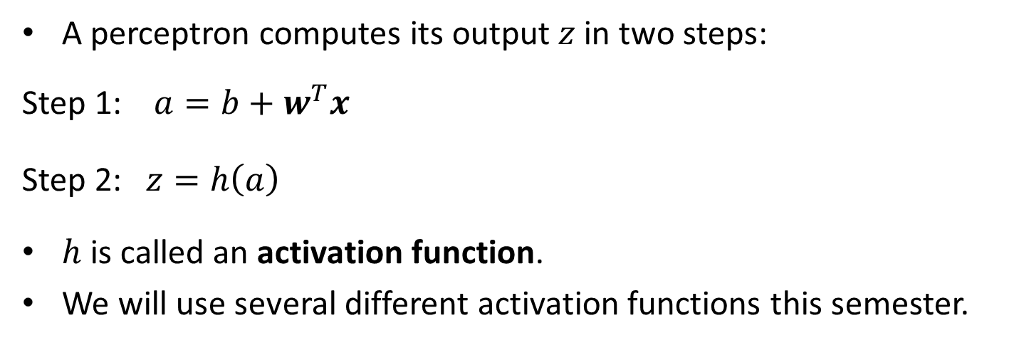
Perceptrons
$$1$$
$$b$$
$$x_{1}$$
$$w_{1}$$
$$z=h\left(b+w^{T}x\right)$$
Output: $z$
$$w_{2}$$
$$x_{2}$$
$$…$$
$$w_{D}$$
$$x_{D}$$
A perceptron computes its output $z$ in two steps:
Step 1: $a=b+w^{T}x$
Step 2: $z=h\left(a\right)$
$h$ is called an activation function.
We will use several different activation functions this semester.

Slide 17
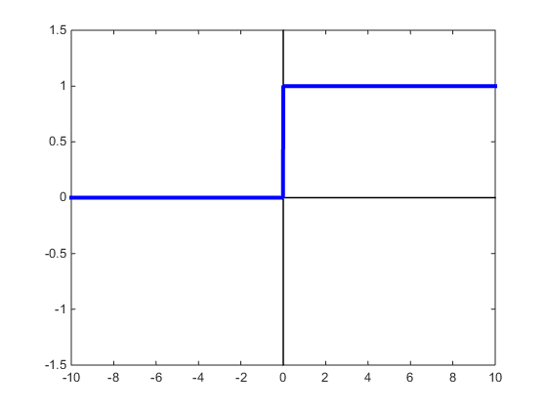
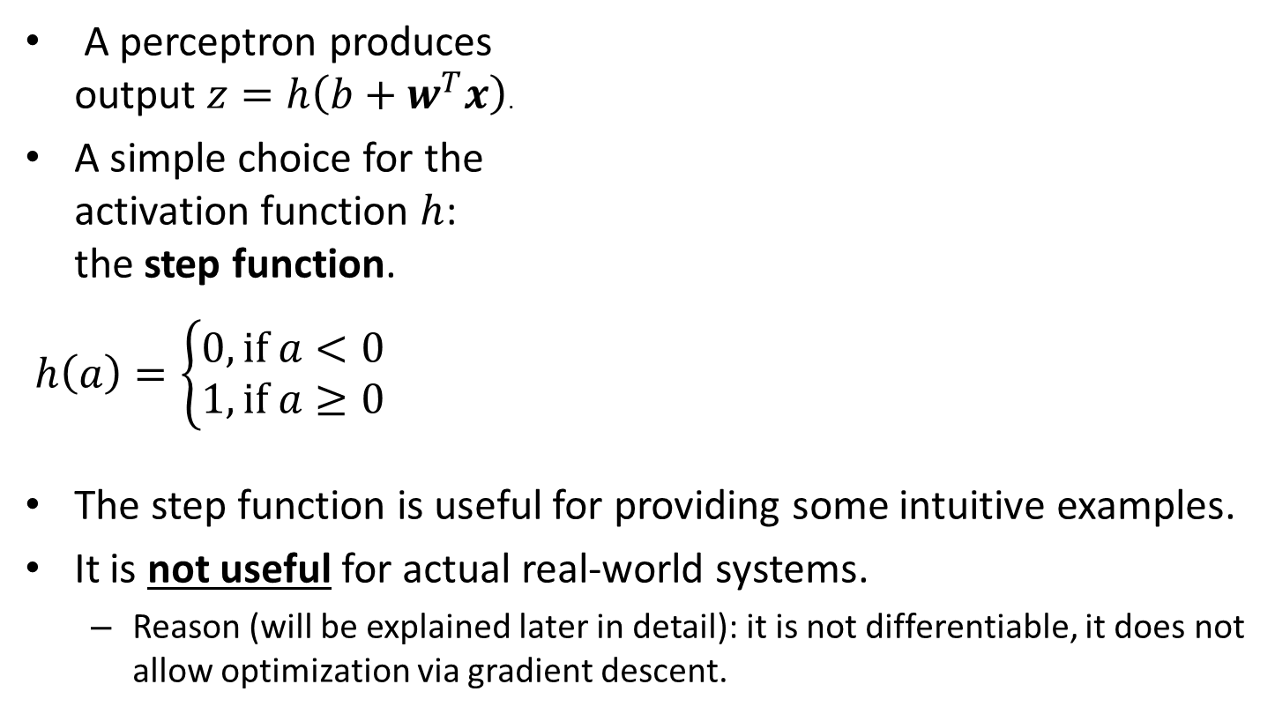
Activation Functions
A perceptron produces output $z=h\left(b+w^{T}x\right)$.
A simple choice for the activation function $h$: the step function.
$h\left(a\right)=\left\{\begin{aligned}0, if a<0 \\ 1,if a≥0\end{aligned}\right.$
The step function is useful for providing some intuitive examples.
It is not useful for actual real-world systems.
Reason (will be explained later in detail): it is not differentiable, it does not allow optimization via gradient descent.

Slide 18
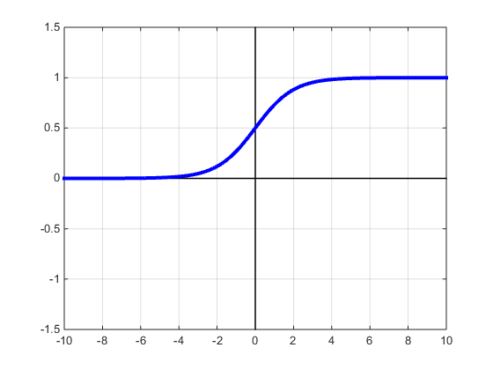
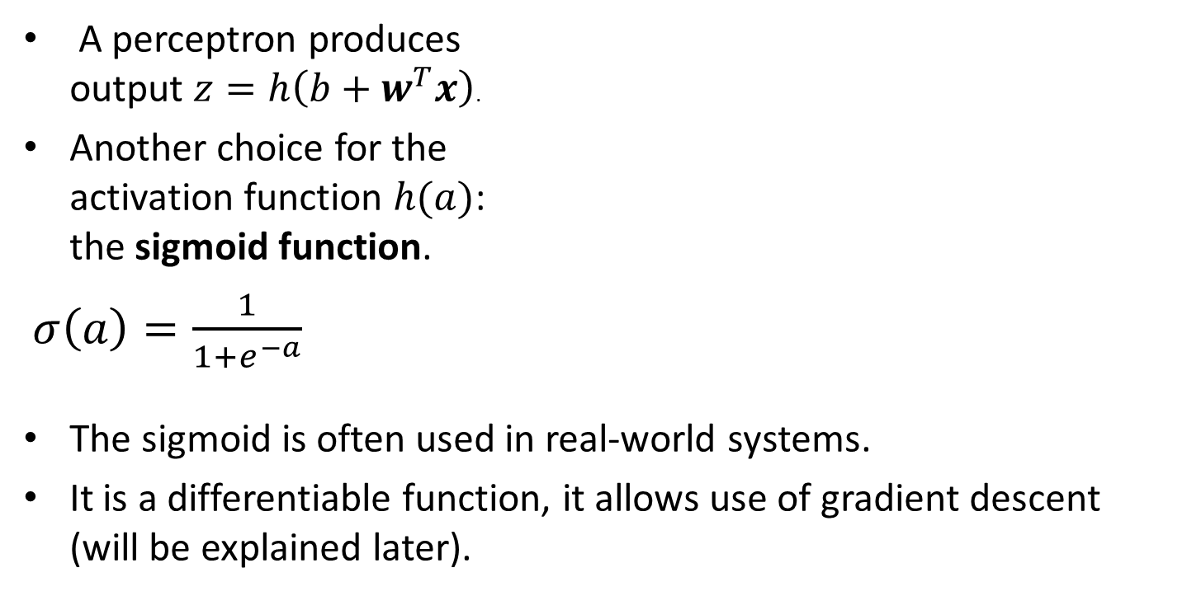
Activation Functions
A perceptron produces output $z=h\left(b+w^{T}x\right)$.
Another choice for the activation function $h(a)$: the sigmoid function.
$σ\left(a\right)=\frac{1}{1+e^{−a}}$
The sigmoid is often used in real-world systems.
It is a differentiable function, it allows use of gradient descent (will be explained later).

Slide 19
Perceptrons and Neurons
$$1$$
$$b$$
$$x_{1}$$
$$w_{1}$$
$$z=h\left(b+w^{T}x\right)$$
Output: $z$
$$w_{2}$$
$$x_{2}$$
$$…$$
$$w_{D}$$
$$x_{D}$$
Perceptrons are inspired by neurons.
Neurons are the cells forming the nervous system, and the brain.
Neurons somehow sum up their inputs, and if the sum exceeds a threshold, they "fire".
Since brains are "intelligent", computer scientists have been hoping that perceptron-based systems can be used to model intelligence.

Slide 20
Separate Modules: Training, Inference
Neural networks are supervised learning models.
Typically, implementing a supervised learning model requires implementing two separate modules:
A training module, that uses training data to construct the model.
An inference module, that applies the model to new data, to recognize the class that the new data belong to.

Slide 21
Separate Modules: Training, Inference
In the real world, training is done before inference.
We cannot use a model before we construct that model.
For teaching purposes, we start with the inference module. It is more simple to understand and implement.
The training module includes the inference module as a subcomponent.
We will start by seeing some simple examples of perceptrons and neural networks.
We just want to see how to apply them to test data.
We will NOT worry (for now) about training them.
Still, just as a preview: the job of training is to assign values to the weights.
At inference time, the weights are fixed.

Slide 22
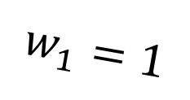
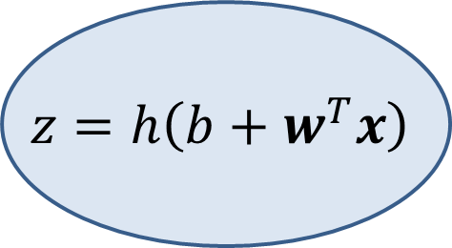
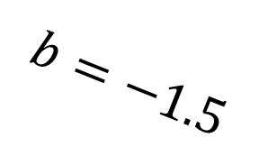



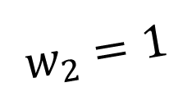
Example: The AND Perceptron
Suppose we use the step function for activation.
Suppose boolean value false is represented as number 0.
Suppose boolean value true is represented as number 1.
Then, the perceptron below computes the boolean AND function:
false AND false = false
false AND true = false
true AND false = false
true AND true = true
$$1$$
$$b=−1.5$$
$$x_{1}$$
$$w_{1}=1$$
$$z=h\left(b+w^{T}x\right)$$
Output: $z$
$$w_{2}=1$$
$$x_{2}$$

Slide 23
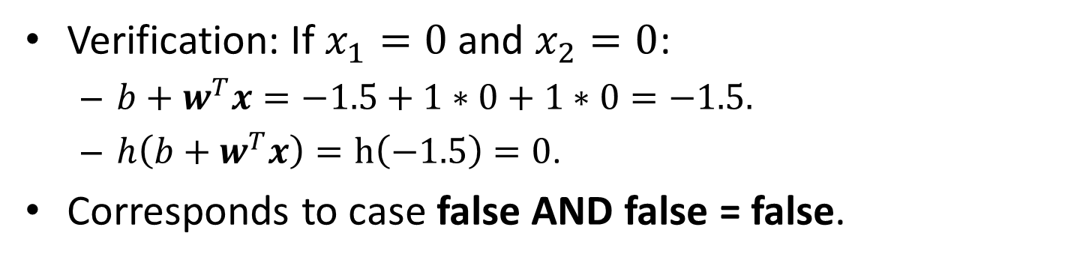
Example: The AND Perceptron
Verification: If $x_{1}=0$ and $x_{2}=0$:
$b+w^{T}x=−1.5+1∗0+1∗0=−1.5.$
$h\left(b+w^{T}x\right)=h\left(−1.5\right)=0$.
Corresponds to case false AND false = false.
false AND false = false
false AND true = false
true AND false = false
true AND true = true
$$1$$
$$b=−1.5$$
$$x_{1}$$
$$w_{1}=1$$
$$z=h\left(b+w^{T}x\right)$$
Output: $z$
$$w_{2}=1$$
$$x_{2}$$

Slide 24
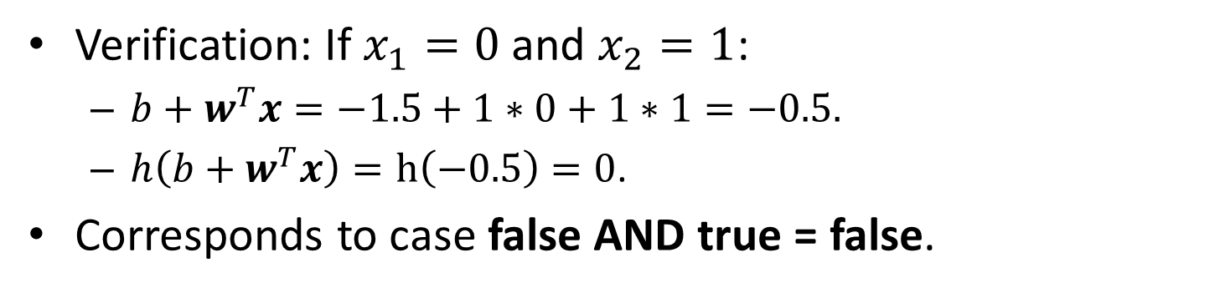
Example: The AND Perceptron
Verification: If $x_{1}=0$ and $x_{2}=1$:
$b+w^{T}x=−1.5+1∗0+1∗1=−0.5.$
$h\left(b+w^{T}x\right)=h\left(−0.5\right)=0$.
Corresponds to case false AND true = false.
false AND false = false
false AND true = false
true AND false = false
true AND true = true
$$1$$
$$b=−1.5$$
$$x_{1}$$
$$w_{1}=1$$
$$z=h\left(b+w^{T}x\right)$$
Output: $z$
$$w_{2}=1$$
$$x_{2}$$

Slide 25
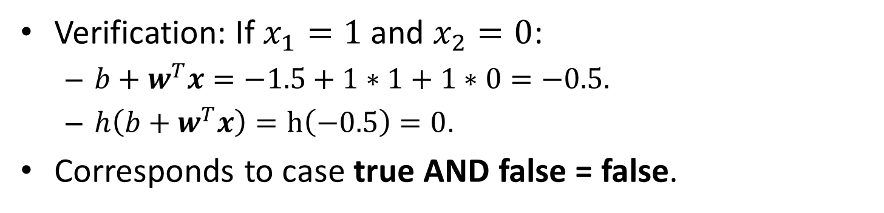
Example: The AND Perceptron
Verification: If $x_{1}=1$ and $x_{2}=0$:
$b+w^{T}x=−1.5+1∗1+1∗0=−0.5.$
$h\left(b+w^{T}x\right)=h\left(−0.5\right)=0$.
Corresponds to case true AND false = false.
false AND false = false
false AND true = false
true AND false = false
true AND true = true
$$1$$
$$b=−1.5$$
$$x_{1}$$
$$w_{1}=1$$
$$z=h\left(b+w^{T}x\right)$$
Output: $z$
$$w_{2}=1$$
$$x_{2}$$

Slide 26
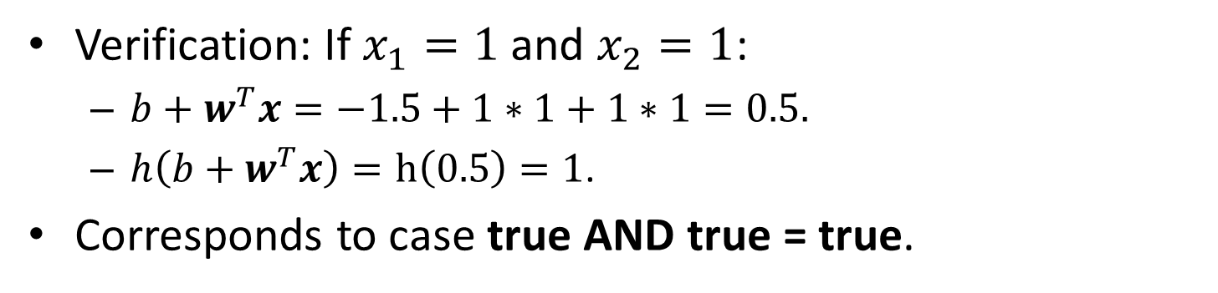
Example: The AND Perceptron
Verification: If $x_{1}=1$ and $x_{2}=1$:
$b+w^{T}x=−1.5+1∗1+1∗1=0.5.$
$h\left(b+w^{T}x\right)=h\left(0.5\right)=1$.
Corresponds to case true AND true = true.
false AND false = false
false AND true = false
true AND false = false
true AND true = true
$$1$$
$$b=−1.5$$
$$x_{1}$$
$$w_{1}=1$$
$$z=h\left(b+w^{T}x\right)$$
Output: $z$
$$w_{2}=1$$
$$x_{2}$$

Slide 27
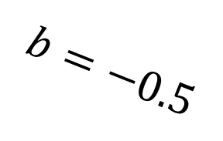
Example: The OR Perceptron
Suppose we use the step function for activation.
Suppose boolean value false is represented as number 0.
Suppose boolean value true is represented as number 1.
Then, the perceptron below computes the boolean OR function:
false OR false = false
false OR true = true
true OR false = true
true OR true = true
$$1$$
$$b=−0.5$$
$$x_{1}$$
$$w_{1}=1$$
$$z=h\left(b+w^{T}x\right)$$
Output: $z$
$$w_{2}=1$$
$$x_{2}$$

Slide 28
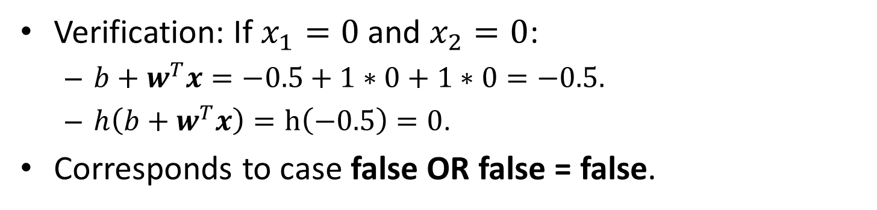
Example: The OR Perceptron
Verification: If $x_{1}=0$ and $x_{2}=0$:
$b+w^{T}x=−0.5+1∗0+1∗0=−0.5.$
$h\left(b+w^{T}x\right)=h\left(−0.5\right)=0$.
Corresponds to case false OR false = false.
false OR false = false
false OR true = true
true OR false = true
true OR true = true
$$1$$
$$b=−0.5$$
$$x_{1}$$
$$w_{1}=1$$
$$z=h\left(b+w^{T}x\right)$$
Output: $z$
$$w_{2}=1$$
$$x_{2}$$

Slide 29
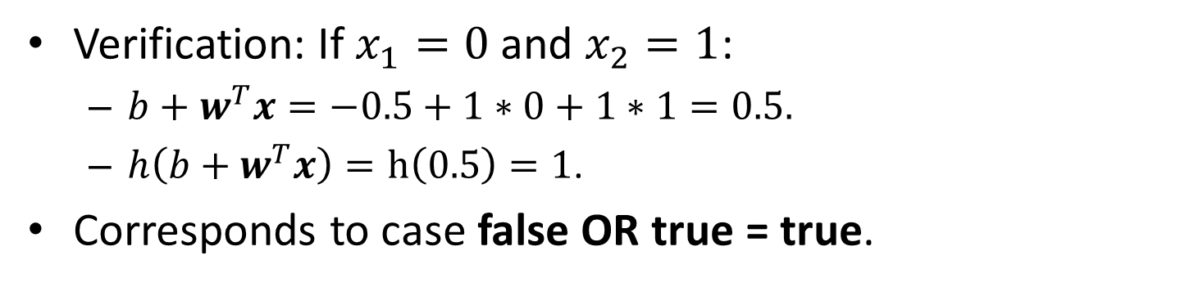
Example: The OR Perceptron
Verification: If $x_{1}=0$ and $x_{2}=1$:
$b+w^{T}x=−0.5+1∗0+1∗1=0.5.$
$h\left(b+w^{T}x\right)=h\left(0.5\right)=1$.
Corresponds to case false OR true = true.
false OR false = false
false OR true = true
true OR false = true
true OR true = true
$$1$$
$$b=−0.5$$
$$x_{1}$$
$$w_{1}=1$$
$$z=h\left(b+w^{T}x\right)$$
Output: $z$
$$w_{2}=1$$
$$x_{2}$$

Slide 30
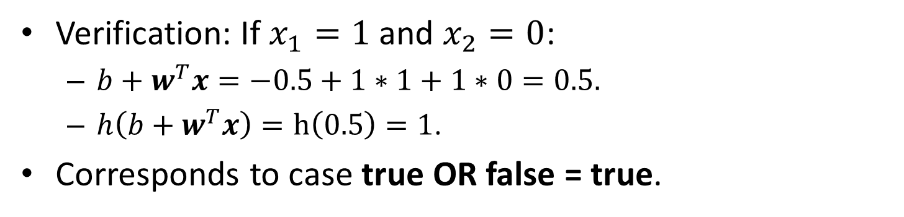
Example: The OR Perceptron
Verification: If $x_{1}=1$ and $x_{2}=0$:
$b+w^{T}x=−0.5+1∗1+1∗0=0.5.$
$h\left(b+w^{T}x\right)=h\left(0.5\right)=1$.
Corresponds to case true OR false = true.
false OR false = false
false OR true = true
true OR false = true
true OR true = true
$$1$$
$$b=−0.5$$
$$x_{1}$$
$$w_{1}=1$$
$$z=h\left(b+w^{T}x\right)$$
Output: $z$
$$w_{2}=1$$
$$x_{2}$$

Slide 31
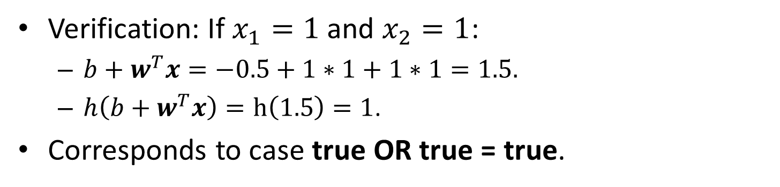
Example: The OR Perceptron
Verification: If $x_{1}=1$ and $x_{2}=1$:
$b+w^{T}x=−0.5+1∗1+1∗1=1.5.$
$h\left(b+w^{T}x\right)=h\left(1.5\right)=1$.
Corresponds to case true OR true = true.
false OR false = false
false OR true = true
true OR false = true
true OR true = true
$$1$$
$$b=−0.5$$
$$x_{1}$$
$$w_{1}=1$$
$$z=h\left(b+w^{T}x\right)$$
Output: $z$
$$w_{2}=1$$
$$x_{2}$$

Slide 32

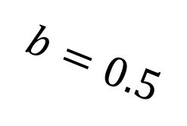

Example: The NOT Perceptron
Suppose we use the step function for activation.
Suppose boolean value false is represented as number 0.
Suppose boolean value true is represented as number 1.
Then, the perceptron below computes the boolean NOT function:
NOT(false) = true
NOT(true) = false
$$1$$
$$b=0.5$$
$$z=h\left(b+w^{T}x\right)$$
$$w_{1}=−1$$
Output: $z$
$$x_{1}$$

Slide 33
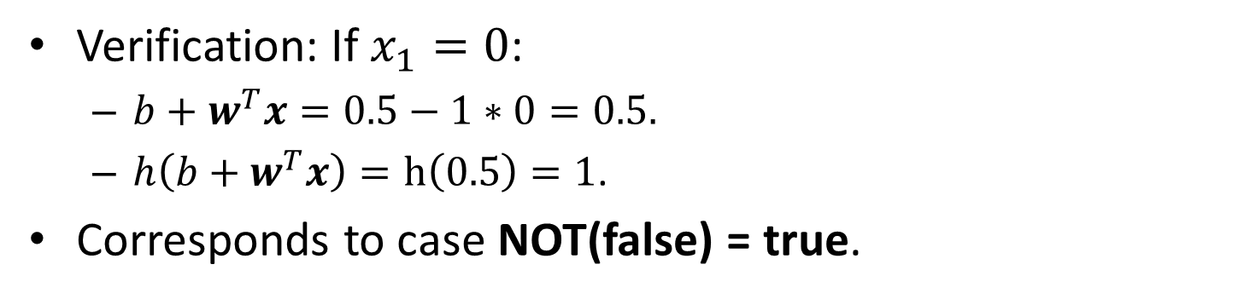
Example: The NOT Perceptron
Verification: If $x_{1}=0$:
$b+w^{T}x=0.5−1∗0=0.5.$
$h\left(b+w^{T}x\right)=h\left(0.5\right)=1$.
Corresponds to case NOT(false) = true.
NOT(false) = true
NOT(true) = false
$$1$$
$$b=0.5$$
$$z=h\left(b+w^{T}x\right)$$
$$w_{1}=−1$$
Output: $z$
$$x_{1}$$

Slide 34
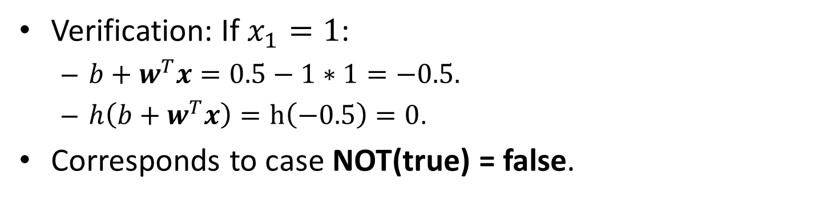
Example: The NOT Perceptron
Verification: If $x_{1}=1$:
$b+w^{T}x=0.5−1∗1=−0.5.$
$h\left(b+w^{T}x\right)=h\left(−0.5\right)=0$.
Corresponds to case NOT(true) = false.
NOT(false) = true
NOT(true) = false
$$1$$
$$b=0.5$$
$$z=h\left(b+w^{T}x\right)$$
$$w_{1}=−1$$
Output: $z$
$$x_{1}$$

Slide 35
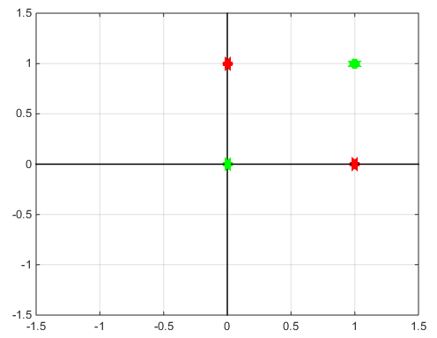
The XOR Function
false XOR false = false
false XOR true = true
true XOR false = true
true XOR true = false
As before, false is 0, true is 1.
The figure shows the four input points of the XOR function.
red corresponds to output value true.
green corresponds to output value false.
The two classes (true and false) are not linearly separable.
This means that we cannot separate them with a straight line.
It can be proven that no perceptron can compute the XOR function (because the dot product is a linear operation).

Slide 36
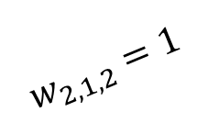
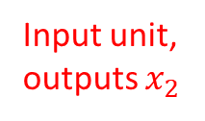
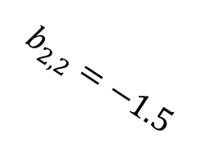








Our First Neural Network: XOR
A neural network is built using perceptrons as building blocks.
The inputs to some perceptrons are outputs of other perceptrons.
Here is an example neural network computing the XOR function.
Input unit, outputs $x_{1}$
$$b_{2,1}=−0.5$$
Unit 2,1
$$w_{2,1,1}=1$$
$$b_{3,1}=−0.5$$
Unit 1,1
$$w_{3,1,1}=1$$
$$w_{2,1,2}=1$$
Unit 3,1
Output:
$$b_{2,2}=−1.5$$
Unit 1,2
$$w_{2,2,1}=1$$
$$w_{3,1,2}=−1$$
Unit 2,2
$$w_{2,2,2}=1$$
Input unit, outputs $x_{2}$

Slide 37

Our First Neural Network: XOR
Terminology: inputs and perceptrons are all called “units”.
Units are grouped in layers: layer 1 (input), layer 2, layer 3 (output).
The input layer just represents the inputs to the network.
There are two inputs: $x_{1}$ and $x_{2}$.
Input unit, outputs $x_{1}$
$$b_{2,1}=−0.5$$
Unit 2,1
$$w_{2,1,1}=1$$
$$b_{3,1}=−0.5$$
Unit 1,1
$$w_{3,1,1}=1$$
$$w_{2,1,2}=1$$
Unit 3,1
Output:
$$b_{2,2}=−1.5$$
Unit 1,2
$$w_{2,2,1}=1$$
$$w_{3,1,2}=−1$$
Unit 2,2
$$w_{2,2,2}=1$$
Input unit, outputs $x_{2}$
37

Slide 38

Our First Neural Network: XOR
Such networks are called layered networks, more details later.
Each unit is indexed by two numbers (layer index, unit index).
Each bias weight $b$ is indexed by the same two numbers as its unit.
Each weight $w$ is indexed by three numbers (layer, unit, weight).
Input unit, outputs $x_{1}$
$$b_{2,1}=−0.5$$
Unit 2,1
$$w_{2,1,1}=1$$
$$b_{3,1}=−0.5$$
Unit 1,1
$$w_{3,1,1}=1$$
$$w_{2,1,2}=1$$
Unit 3,1
Output:
$$b_{2,2}=−1.5$$
Unit 1,2
$$w_{2,2,1}=1$$
$$w_{3,1,2}=−1$$
Unit 2,2
$$w_{2,2,2}=1$$
Input unit, outputs $x_{2}$
38

Slide 39
Our First Neural Network: XOR
Note: every weight is associated with two units: it connects the output of a unit with an input of another unit.
Which of the two units do we use to index the weight?
Input unit, outputs $x_{1}$
$$b_{2,1}=−0.5$$
Unit 2,1
$$w_{2,1,1}=1$$
$$b_{3,1}=−0.5$$
Unit 1,1
$$w_{3,1,1}=1$$
$$w_{2,1,2}=1$$
Unit 3,1
Output:
$$b_{2,2}=−1.5$$
Unit 1,2
$$w_{2,2,1}=1$$
$$w_{3,1,2}=−1$$
Unit 2,2
$$w_{2,2,2}=1$$
Input unit, outputs $x_{2}$
39

Slide 40

Our First Neural Network: XOR
To index a weight $w$, we use the layer number and unit number of the unit for which $w$ is an incoming weight.
Weights incoming to unit $l,i$ are indexed as $l,i,j$, where $j$ ranges from 1 to the number of incoming weights for unit $l,i$.
Input unit, outputs $x_{1}$
$$b_{2,1}=−0.5$$
Unit 2,1
$$w_{2,1,1}=1$$
$$b_{3,1}=−0.5$$
Unit 1,1
$$w_{3,1,1}=1$$
$$w_{2,1,2}=1$$
Unit 3,1
Output:
$$b_{2,2}=−1.5$$
Unit 1,2
$$w_{2,2,1}=1$$
$$w_{3,1,2}=−1$$
Unit 2,2
$$w_{2,2,2}=1$$
Input unit, outputs $x_{2}$
40

Slide 41

Our First Neural Network: XOR
Weights incoming to unit $l,i$ are indexed as $l,i,j$, where $j$ ranges from 1 to the number of incoming weights for unit $l,i$.
Since the input layer (which is layer 1) has no incoming weights, there are no weights indexed as $w_{1,i,j}$.
Input unit, outputs $x_{1}$
$$b_{2,1}=−0.5$$
Unit 2,1
$$w_{2,1,1}=1$$
$$b_{3,1}=−0.5$$
Unit 1,1
$$w_{3,1,1}=1$$
$$w_{2,1,2}=1$$
Unit 3,1
Output:
$$b_{2,2}=−1.5$$
Unit 1,2
$$w_{2,2,1}=1$$
$$w_{3,1,2}=−1$$
Unit 2,2
$$w_{2,2,2}=1$$
Input unit, outputs $x_{2}$
41

Slide 42
Our First Neural Network: XOR
The XOR network shows how individual perceptrons can be combined to perform more complicated functions.
Logical OR
Input unit, outputs $x_{1}$
$$b_{2,1}=−0.5$$
Unit 2,1
Logical A AND (NOT B)
$$w_{2,1,1}=1$$
$$b_{3,1}=−0.5$$
Unit 1,1
$$w_{3,1,1}=1$$
$$w_{2,1,2}=1$$
Unit 3,1
Output:
$$b_{2,2}=−1.5$$
Logical AND
Unit 1,2
$$w_{2,2,1}=1$$
$$w_{3,1,2}=−1$$
Unit 2,2
$$w_{2,2,2}=1$$
Input unit, outputs $x_{2}$

Slide 43








Computing the Output: An Example
Suppose that $x_{1}=0,x_{2}=1$ (corresponding to false XOR true).
For Unit 2,1, which performs a logical OR:
The output is $h\left(−0.5+0∗1+1∗1\right)=h\left(0.5\right)$.
Assuming that $h$is the step function, $h\left(0.5\right)=1$, so Unit 2,1 outputs 1.
Input unit, outputs $0$
$$−0.5$$
Unit 2,1 (OR)
$$1$$
$$b_{3,1}=−0.5$$
$$0 \text{∗} \text{1}$$
Unit 1,1
$$w_{3,1,1}=1$$
Unit 3,1 (A AND (NOT B))
$$1 \text{∗} \text{1}$$
Output:
$$b_{2,2}=−1.5$$
Unit 1,2
$$w_{2,2,1}=1$$
$$w_{3,1,2}=−1$$
Unit 2,2
(AND)
$$w_{2,2,2}=1$$
Input unit, outputs $1$

Slide 44





Computing the Output: An Example
Suppose that $x_{1}=0,x_{2}=1$ (corresponding to false XOR true).
For Unit 2,2, which performs a logical AND:
The output is $h\left(−1.5+0∗1+1∗1\right)=h\left(−0.5\right)$.
Since $h$is the step function, $h\left(−0.5\right)=0$, so Unit 2,2 outputs 0.
Input unit, outputs $0$
$$−0.5$$
Unit 2,1 (OR)
$$1$$
$$b_{3,1}=−0.5$$
$$0 \text{∗} \text{1}$$
Unit 1,1
$$w_{3,1,1}=1$$
Unit 3,1 (A AND (NOT B))
$$1 \text{∗} \text{1}$$
Output:
$$−1.5$$
Unit 1,2
$$0∗1$$
$$w_{3,1,2}=−1$$
Unit 2,2
(AND)
$$0$$
$$1∗1$$
Input unit, outputs $1$

Slide 45

Computing the Output: An Example
Suppose that $x_{1}=0,x_{2}=$1 (corresponding to false XOR true).
Unit 3,1 is the output unit, computing the A AND (NOT B) function:
One input is the output of the OR unit, which is 1.
The other input is the output of the AND unit, which is 0.
Input unit, outputs $0$
$$−0.5$$
Unit 2,1 (OR)
$$1$$
$$b_{3,1}=−0.5$$
$$0 \text{∗} \text{1}$$
Unit 1,1
$$w_{3,1,1}=1$$
Unit 3,1 (A AND (NOT B))
$$1 \text{∗} \text{1}$$
Output:
$$−1.5$$
Unit 1,2
$$0∗1$$
$$w_{3,1,2}=−1$$
Unit 2,2
(AND)
$$0$$
$$1∗1$$
Input unit, outputs $1$

Slide 46





Computing the Output: An Example
Suppose that $x_{1}=0,x_{2}=$1 (corresponding to false XOR true).
For the output unit (computing the A AND (NOT B) function):
The output is $h\left(−0.5+1∗1+0∗(−1)\right)=h\left(0.5\right)$.
Since $h$is the step function, $h\left(0.5\right)=1$, so Unit 3,1 outputs 1.
Input unit, outputs $0$
$$−0.5$$
Unit 2,1 (OR)
$$−0.5$$
$$0 \text{∗} \text{1}$$
Unit 1,1
$$1∗1$$
Unit 3,1 (A AND (NOT B))
$$1 \text{∗} \text{1}$$
Output:
$$−1.5$$
$$1$$
Unit 1,2
$$0∗1$$
$$0∗(−1)$$
Unit 2,2
(AND)
$$1∗1$$
Input unit, outputs $1$

Slide 47






Verifying the XOR Network
We can follow the same process to compute the output of this network for the other three cases.
Here we consider the case where $x_{1}=0,x_{2}=0$ (corresponding to false XOR false).
The output is 0, as it should be.
Input unit, outputs $0$
$$−0.5$$
Unit 2,1 (OR)
$$−0.5$$
$$0 \text{∗} \text{1}$$
Unit 1,1
$$0∗1$$
Unit 3,1 (A AND (NOT B))
$$0 \text{∗} \text{1}$$
Output:
$$−1.5$$
$$0$$
Unit 1,2
$$0∗1$$
$$0∗(−1)$$
Unit 2,2
(AND)
$$0∗1$$
Input unit, outputs $0$

Slide 48




Verifying the XOR Network
We can follow the same process to compute the output of this network for the other three cases.
Here we consider the case where $x_{1}=1,x_{2}=0$ (corresponding to true XOR false).
The output is 1, as it should be.
Input unit, outputs $1$
$$−0.5$$
Unit 2,1 (OR)
$$−0.5$$
$$1 \text{∗} \text{1}$$
Unit 1,1
$$1∗1$$
Unit 3,1 (A AND (NOT B))
$$0 \text{∗} \text{1}$$
Output:
$$−1.5$$
$$1$$
Unit 1,2
$$1∗1$$
$$0∗(−1)$$
Unit 2,2
(AND)
$$0∗1$$
Input unit, outputs $0$

Slide 49


Verifying the XOR Network
We can follow the same process to compute the output of this network for the other three cases.
Here we consider the case where $x_{1}=1,x_{2}=1$ (corresponding to true XOR true).
The output is 0, as it should be.
Input unit, outputs $1$
$$−0.5$$
Unit 2,1 (OR)
$$−0.5$$
$$1 \text{∗} \text{1}$$
Unit 1,1
$$1∗1$$
Unit 3,1 (A AND (NOT B))
$$1 \text{∗} \text{1}$$
Output:
$$−1.5$$
$$0$$
Unit 1,2
$$1∗1$$
$$1∗(−1)$$
Unit 2,2
(AND)
$$1∗1$$
Input unit, outputs $1$

Slide 50











Neural Networks
Our XOR neural network consists of five units:
Two input units, that just represent the two inputs to the network.
Three perceptrons.
Input unit, outputs $x_{1}$
$$b_{2,1}=−0.5$$
Unit 2,1
$$w_{2,1,1}=1$$
$$b_{3,1}=−0.5$$
Unit 1,1
$$w_{3,1,1}=1$$
$$w_{2,1,2}=1$$
Unit 3,1
Output:
$$b_{2,2}=−1.5$$
Unit 1,2
$$w_{2,2,1}=1$$
$$w_{3,1,2}=−1$$
Unit 2,2
$$w_{2,2,2}=1$$
Input unit, outputs $x_{2}$

Slide 51
Neural Network Layers
Usually, as in the XOR example, neural networks are organized into layers.
The input layer is the initial layer of input units (units 1,1 and 1,2 in our example).
The output layer is at the end (unit 3,1 in our example).
Zero, one or more hidden layers can be between the input and output layers.
Input unit, outputs $x_{1}$
$$b_{2,1}=−0.5$$
Unit 2,1
$$w_{2,1,1}=1$$
$$b_{3,1}=−0.5$$
Unit 1,1
$$w_{3,1,1}=1$$
$$w_{2,1,2}=1$$
Unit 3,1
Output:
$$b_{2,2}=−1.5$$
Unit 1,2
$$w_{2,2,1}=1$$
$$w_{3,1,2}=−1$$
Unit 2,2
$$w_{2,2,2}=1$$
Input unit, outputs $x_{2}$

Slide 52
Neural Network Layers
There is only one hidden layer in our example, containing units 2,1 and 2,2.
Each hidden layer's inputs are outputs from the previous layer.
Each hidden layer's outputs are inputs to the next layer.
The first hidden layer's inputs come from the input layer.
The last hidden layer's outputs are inputs to the output layer.
Input unit, outputs $x_{1}$
$$b_{2,1}=−0.5$$
Unit 2,1
$$w_{2,1,1}=1$$
$$b_{3,1}=−0.5$$
Unit 1,1
$$w_{3,1,1}=1$$
$$w_{2,1,2}=1$$
Unit 3,1
Output:
$$b_{2,2}=−1.5$$
Unit 1,2
$$w_{2,2,1}=1$$
$$w_{3,1,2}=−1$$
Unit 2,2
$$w_{2,2,2}=1$$
Input unit, outputs $x_{2}$

Slide 53
Feedforward Networks
Feedforward networks are networks where there are no directed loops.
If there are no loops, the output of a unit cannot (directly or indirectly) influence its input.
There are some varieties of neural networks that are not feedforward or layered. For start, we focus on layered feedforward networks.
Input unit, outputs $x_{1}$
$$b_{2,1}=−0.5$$
Unit 2,1
$$w_{2,1,1}=1$$
$$b_{3,1}=−0.5$$
Unit 1,1
$$w_{3,1,1}=1$$
$$w_{2,1,2}=1$$
Unit 3,1
Output:
$$b_{2,2}=−1.5$$
Unit 1,2
$$w_{2,2,1}=1$$
$$w_{3,1,2}=−1$$
Unit 2,2
$$w_{2,2,2}=1$$
Input unit, outputs $x_{2}$

Slide 54

Computing the Output
Notation: $L$ is the number of layers. Layer 1 is the input layer, layer $L$ is the output layer.
The outputs of the units of layer 1 are simply the inputs to the network.
For $(layer l=2;l≤L;l=l+1)$:
Compute the outputs of layer $l$, given the outputs of layer $l−1$.
Input unit, outputs $x_{1}$
$$b_{2,1}=−0.5$$
Unit 2,1
$$w_{2,1,1}=1$$
$$b_{3,1}=−0.5$$
Unit 1,1
$$w_{3,1,1}=1$$
$$w_{2,1,2}=1$$
Unit 3,1
Output:
$$b_{2,2}=−1.5$$
Unit 1,2
$$w_{2,2,1}=1$$
$$w_{3,1,2}=−1$$
Unit 2,2
$$w_{2,2,2}=1$$
Input unit, outputs $x_{2}$

Slide 55

Computing the Output
To compute the outputs of layer $l$ (where $l>1$), we simply need to compute the output of each perceptron belonging to layer $l$.
For each such perceptron, its inputs are coming from outputs of units at layer $l−1$, which we have already computed.
Remember, we compute layer outputs in increasing order of $l$.
Input unit, outputs $x_{1}$
$$b_{2,1}=−0.5$$
Unit 2,1
$$w_{2,1,1}=1$$
$$b_{3,1}=−0.5$$
Unit 1,1
$$w_{3,1,1}=1$$
$$w_{2,1,2}=1$$
Unit 3,1
Output:
$$b_{2,2}=−1.5$$
Unit 1,2
$$w_{2,2,1}=1$$
$$w_{3,1,2}=−1$$
Unit 2,2
$$w_{2,2,2}=1$$
Input unit, outputs $x_{2}$

Slide 56
Multiple Output Units
The output layer can have multiple units.
This simply corresponds to the neural network producing a multidimensional output.
3D output here.
Output layer
Unit 2,1
Unit 3,1
Input layer
Unit 1,1
Unit 3,2
Unit 1,2
Unit 2,2
Unit 3,3

Slide 57
Simplified Drawings
Drawings of larger neural networks can get very complicated.
Various conventions can be used to simplify the picture.
Weight values not shown.
Biases not shown.
Unit numbers not shown.
Edges not shown.
Output layer
Input layer

Slide 58






A More Complicated Network
Layer 1 (Input layer)
Layer 2 (1st Hidden Layer)
Layer 3 (2nd Hidden Layer)
Layer 4 (Output layer)
$$U_{1,1}$$
$$U_{2,1}$$
$$U_{3,1}$$
$$U_{4,1}$$
$$U_{1,2}$$
$$U_{2,2}$$
$$U_{3,2}$$
$$U_{1,3}$$
$$U_{4,2}$$
$$U_{2,3}$$
$$U_{3,3}$$
$$U_{1,4}$$
$$U_{2,4}$$
$$U_{3,4}$$
$$U_{4,3}$$
$$U_{1,5}$$

Slide 59
Fully Connected Layers
An important property of a layer is how its units are connected to the previous layer.
Obviously, this is not applicable to the input layer, that has no previous layer.
The most simple type (and most expensive computationally) is a fully connected layer.
Every unit in this layer is connected to every unit in the previous layer.
At first, we will work with fully connected layers.
This will be the type that you will implement first.
Then we will talk about other types of layers.
Convolutional, max-pooling, LSTM are examples of types of layers that we will study and use in later assignments.

Slide 60
What Neural Networks Can Compute
An individual perceptron is a linear classifier.
The weights of the perceptron define a linear boundary between two classes.
Layered feedforward neural networks with one hidden layer can compute any continuous function.
Layered feedforward neural networks with two hidden layers can compute any mathematical function.
This has been known for decades, and is one reason scientists have been optimistic about the potential of neural networks to model intelligent systems.
Another reason is the analogy between neural networks and biological brains, which have been a standard of intelligence we are still trying to achieve.
There is only one catch: How do we find the right weights?

Slide 61
Finding the Right Weights
The next topic will be how to train a neural network.
To define a neural network we need to specify two things:
The topology.
layers.
nodes per layer.
how nodes in one layer are connected to nodes in the next layers.
The weights of the edges.
We typically come up with the topology manually.
Would be great to learn it automatically, but current methods do not work very well.
So, typically, topology specifications are hyperparameters.
The goal of training is to find good values for the weights.

