Slide 1
Neural Networks – Part 2
Training as an Optimization Problem.
Gradient Descent
CSE 4311 – Neural Networks and Deep Learning
Vassilis Athitsos
Computer Science and Engineering Department
University of Texas at Arlington

Slide 2
Training a Neural Network
To train a neural network we need:
Values for hyperparameters specifying the network topology (number of layers, units per layer, connectivity of layers).
Other hyperparameters, besides network topology.
More details later.
A training set.
This is a typical supervised learning problem, so each element of a training set is a pair of an example input and a target output.
Typically, both the input and the output are multidimensional.
An optimization criterion.
This is a quantitative performance measure, that tells us how well the network performs on the training data.

Slide 3
Plan
We start with training the simplest neural network:
A single perceptron.
Training a neural network is an optimization problem.
We will define what that means.
In general, optimization problems can be solved in different ways.
For neural networks in particular, we will solve the optimization problem using gradient descent.
Again, we will define what that means.
We will apply gradient descent to train a perceptron.
Then, we will address more general neural networks.

Slide 4
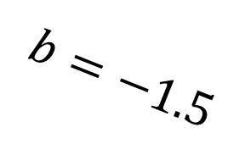




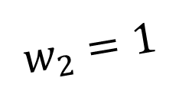

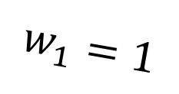
Training the AND Perceptron
When we discussed the AND perceptron before, we hardcoded the weights.
$$1$$
$$b=−1.5$$
$$x_{1}$$
$$w_{1}=1$$
$$z=h\left(b+w^{T}x\right)$$
Output: $z$
$$w_{2}=1$$
$$x_{2}$$

Slide 5
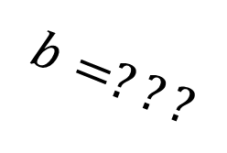
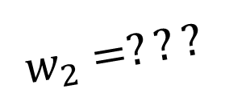
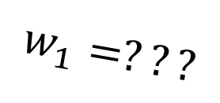
Training the AND Perceptron
When we discussed the AND perceptron before, we hardcoded the weights.
Now, as a toy example, we will see how we could train this perceptron, so that we learn the weights using training data.
$$1$$
$$b=???$$
$$x_{1}$$
$$w_{1}=???$$
$$z=h\left(b+w^{T}x\right)$$
Output: $z$
$$w_{2}=???$$
$$x_{2}$$

Slide 6
Drawing This as a Neural Network
If we think of the AND perceptron as a neural network, what topology does it have?
How many layers?
How many units in each layer?
$$1$$
$$b=???$$
$$x_{1}$$
$$w_{1}=???$$
$$z=h\left(b+w^{T}x\right)$$
Output: $z$
$$w_{2}=???$$
$$x_{2}$$

Slide 7




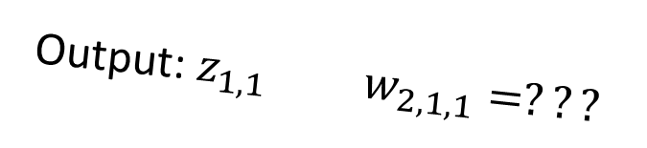

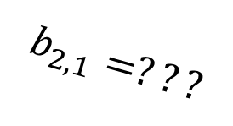

Drawing This as a Neural Network
If we think of the AND perceptron as a neural network, what topology does it have?
How many layers? Two (don’t forget the input layer).
How many units in each layer?
Input layer: 2 units
Output layer: 1 unit (the actual perceptron).
input layer
bias input $1$
$$b_{2,1}=???$$
output layer
$$U_{1,1}$$
Output: $z_{1,1}$ $w_{2,1,1}=???$
$$U_{2,1}$$
Output:${ z}_{2,1}$
Output: $z_{1,2}$ $w_{2,1,2}=???$
$$U_{1,2}$$

Slide 8

Training Set
This is a toy problem, there are only four possible cases:
$x_{1}={\left(0.0, 0.0\right)}^{T}$ $t_{1}=0$
$x_{2}={\left(0.0, 1.0\right)}^{T}$ $t_{2}=1$
$x_{3}={\left(1.0, 0.0\right)}^{T}$ $t_{3}=1$
$x_{4}={\left(1.0, 1.0\right)}^{T}$ $t_{4}=1$
input layer
bias input $1$
$$b_{2,1}=???$$
output layer
$$U_{1,1}$$
Output: $z_{1,1}$ $w_{2,1,1}=???$
$$U_{2,1}$$
Output:${ z}_{2,1}$
Output: $z_{1,2}$ $w_{2,1,2}=???$
$$U_{1,2}$$

Slide 9
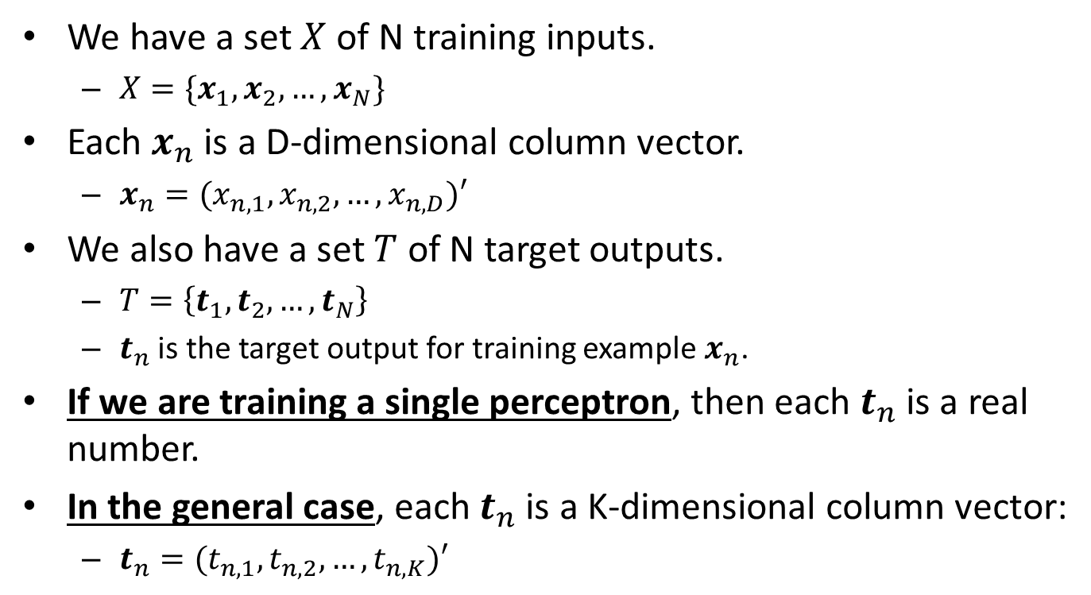
Perceptron Training: Notation for Training Set
We have a set $X$ of N training inputs.
$X=\{x_{1},x_{2},…,x_{N}\}$
Each $x_{n}$ is a D-dimensional column vector.
$x_{n}=(x_{n,1},x_{n,2},…,x_{n,D})′$
We also have a set $T$ of N target outputs.
$T=\left\{t_{1},t_{2},…,t_{N}\right\}$
$t_{n}$ is the target output for training example $x_{n}$.
If we are training a single perceptron, then each $t_{n}$ is a real number.
In the general case, each $t_{n}$ is a K-dimensional column vector:
$t_{n}=(t_{n,1},t_{n,2},…,t_{n,K})′$

Slide 10
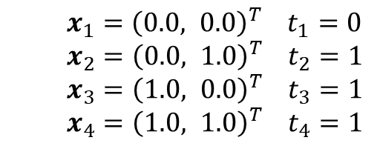
Training Goal
$x_{1}={\left(0.0, 0.0\right)}^{T}$ $t_{1}=0$
$x_{2}={\left(0.0, 1.0\right)}^{T}$ $t_{2}=1$
$x_{3}={\left(1.0, 0.0\right)}^{T}$ $t_{3}=1$
$x_{4}={\left(1.0, 1.0\right)}^{T}$ $t_{4}=1$
What do we want our training to achieve?
input layer
bias input $1$
$$b_{2,1}=???$$
output layer
$$U_{1,1}$$
Output: $z_{1,1}$ $w_{2,1,1}=???$
$$U_{2,1}$$
Output:${ z}_{2,1}$
Output: $z_{1,2}$ $w_{2,1,2}=???$
$$U_{1,2}$$

Slide 11
Training Goal
$x_{1}={\left(0.0, 0.0\right)}^{T}$ $t_{1}=0$
$x_{2}={\left(0.0, 1.0\right)}^{T}$ $t_{2}=1$
$x_{3}={\left(1.0, 0.0\right)}^{T}$ $t_{3}=1$
$x_{4}={\left(1.0, 1.0\right)}^{T}$ $t_{4}=1$
What do we want our training to achieve?
Intuitively, we want to come up with weights so that each input is mapped to the correct output.
We want a general approach, that can be applied to any training set.
input layer
bias input $1$
$$b_{2,1}=???$$
output layer
$$U_{1,1}$$
Output: $z_{1,1}$ $w_{2,1,1}=???$
$$U_{2,1}$$
Output:${ z}_{2,1}$
Output: $z_{1,2}$ $w_{2,1,2}=???$
$$U_{1,2}$$

Slide 12
Training as an Optimization Problem
Training a neural network is an optimization problem.
In an optimization problem we need to:
Define what parameters we are optimizing. This is also called the search space (the space of possible choices).
Define a quantitative optimization criterion.
For any choice of parameters, this criterion will measure will tell us how good they are.
If we have two different choices, this criterion will tell us which choice one is better.
Define an optimization algorithm for finding a good set of parameters.

Slide 13
Parameters We Optimize
$x_{1}={\left(0.0, 0.0\right)}^{T}$ $t_{1}=0$
$x_{2}={\left(0.0, 1.0\right)}^{T}$ $t_{2}=1$
$x_{3}={\left(1.0, 0.0\right)}^{T}$ $t_{3}=1$
$x_{4}={\left(1.0, 1.0\right)}^{T}$ $t_{4}=1$
In a neural network, what parameters are we optimizing?
input layer
bias input $1$
$$b_{2,1}=???$$
output layer
$$U_{1,1}$$
Output: $z_{1,1}$ $w_{2,1,1}=???$
$$U_{2,1}$$
Output:${ z}_{2,1}$
Output: $z_{1,2}$ $w_{2,1,2}=???$
$$U_{1,2}$$

Slide 14

Parameters We Optimize
$x_{1}={\left(0.0, 0.0\right)}^{T}$ $t_{1}=0$
$x_{2}={\left(0.0, 1.0\right)}^{T}$ $t_{2}=1$
$x_{3}={\left(1.0, 0.0\right)}^{T}$ $t_{3}=1$
$x_{4}={\left(1.0, 1.0\right)}^{T}$ $t_{4}=1$
In a neural network, what parameters are we optimizing?
Bias weights b and regular weights w.
In our toy example, this gives us three values that we have to optimize: $b_{2,1}$, $w_{2,1,1}$, $w_{2,1,2}$.
input layer
bias input $1$
$$b_{2,1}=???$$
output layer
$$U_{1,1}$$
Output: $z_{1,1}$ $w_{2,1,1}=???$
$$U_{2,1}$$
Output:${ z}_{2,1}$
Output: $z_{1,2}$ $w_{2,1,2}=???$
$$U_{1,2}$$

Slide 15

Optimization Criterion
$x_{1}={\left(0.0, 0.0\right)}^{T}$ $t_{1}=0$
$x_{2}={\left(0.0, 1.0\right)}^{T}$ $t_{2}=1$
$x_{3}={\left(1.0, 0.0\right)}^{T}$ $t_{3}=1$
$x_{4}={\left(1.0, 1.0\right)}^{T}$ $t_{4}=1$
Suppose that we are considering some values for $b_{2,1}$, $w_{2,1,1}$, $w_{2,1,2}$.
What quantitative criterion can we use to measure how good (or bad) those values are?
input layer
bias input $1$
$$b_{2,1}=???$$
output layer
$$U_{1,1}$$
Output: $z_{1,1}$ $w_{2,1,1}=???$
$$U_{2,1}$$
Output:${ z}_{2,1}$
Output: $z_{1,2}$ $w_{2,1,2}=???$
$$U_{1,2}$$

Slide 16
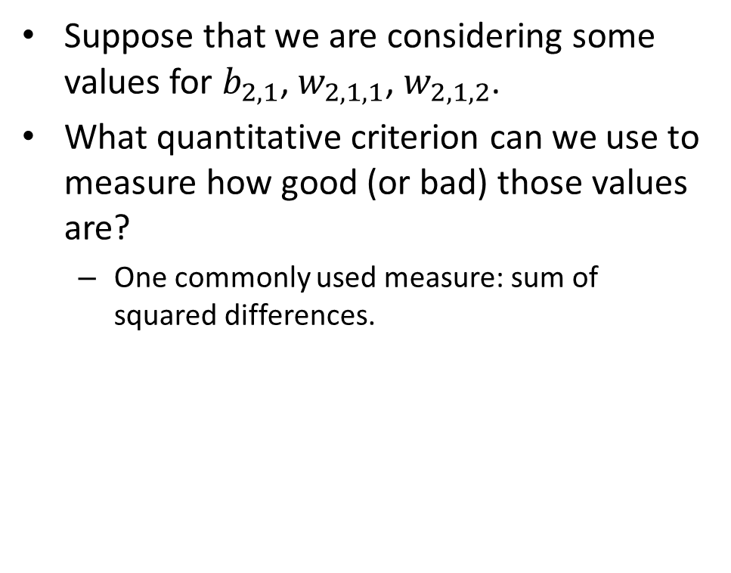
Optimization Criterion
$x_{1}={\left(0.0, 0.0\right)}^{T}$ $t_{1}=0$
$x_{2}={\left(0.0, 1.0\right)}^{T}$ $t_{2}=1$
$x_{3}={\left(1.0, 0.0\right)}^{T}$ $t_{3}=1$
$x_{4}={\left(1.0, 1.0\right)}^{T}$ $t_{4}=1$
Suppose that we are considering some values for $b_{2,1}$, $w_{2,1,1}$, $w_{2,1,2}$.
What quantitative criterion can we use to measure how good (or bad) those values are?
One commonly used measure: sum of squared differences.
input layer
bias input $1$
$$b_{2,1}=???$$
output layer
$$U_{1,1}$$
Output: $z_{1,1}$ $w_{2,1,1}=???$
$$U_{2,1}$$
Output:${ z}_{2,1}$
Output: $z_{1,2}$ $w_{2,1,2}=???$
$$U_{1,2}$$

Slide 17
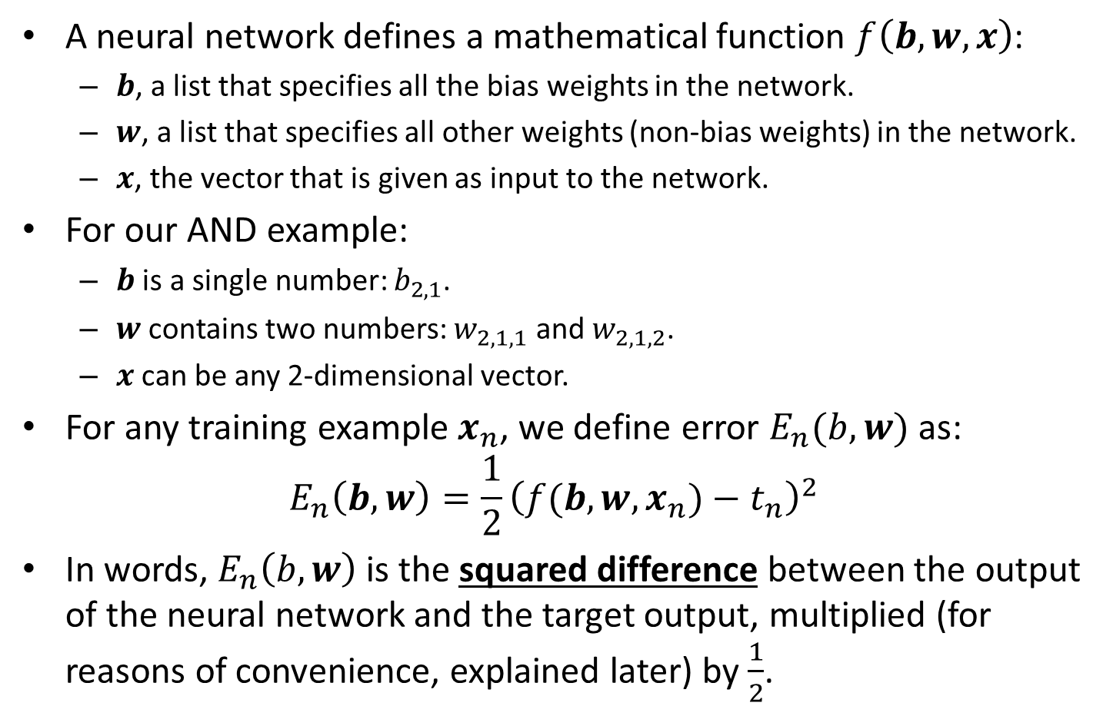
Squared Differences
A neural network defines a mathematical function $f\left(b, w, x\right)$:
$b$, a list that specifies all the bias weights in the network.
$w$, a list that specifies all other weights (non-bias weights) in the network.
$x$, the vector that is given as input to the network.
For our AND example:
$b$ is a single number: $b_{2,1}$.
$w$ contains two numbers: $w_{2,1,1}$ and $w_{2,1,2}$.
$x$ can be any 2-dimensional vector.
For any training example $x_{n}$, we define error $E_{n}(b,w)$ as:
$$E_{n}\left(b,w\right)=\frac{1}{2}{\left(f(b, w, x_{n})−t_{n}\right)}^{2}$$
In words, $E_{n}\left(b,w\right)$ is the squared difference between the output of the neural network and the target output, multiplied (for reasons of convenience, explained later) by $\frac{1}{2}$.

Slide 18
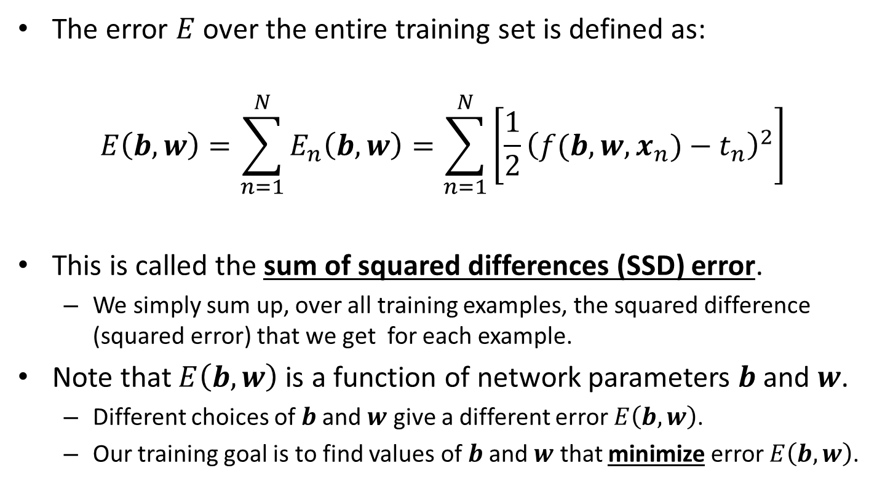
Sum of Squared Differences
The error $E$ over the entire training set is defined as:
$$E\left(b,w\right)=\sum_{n=1}^{N}{E_{n}\left(b,w\right)}=\sum_{n=1}^{N}{\left[\frac{1}{2}{\left(f(b, w, x_{n})−t_{n}\right)}^{2}\right]}$$
This is called the sum of squared differences (SSD) error.
We simply sum up, over all training examples, the squared difference (squared error) that we get for each example.
Note that $E\left(b,w\right)$ is a function of network parameters $b$and $w$.
Different choices of $b$and $w$ give a different error $E\left(b,w\right)$.
Our training goal is to find values of $b$and $w$ that minimize error $E\left(b,w\right)$.

Slide 19
Global and Local Optima
Optimization can be maximization or minimization.
We typically want to maximize if our optimization criterion relates to accuracy, fitness, utility…
We typically want to minimize if our optimization criterion relates to error, cost, time or space complexity…
In our case, our optimization criterion is SSD error, so we want to minimize that.
An optimum is a maximum when we want to maximize, and a minimum when we want to minimize.
The goal in optimization is to find an optimum.

Slide 20
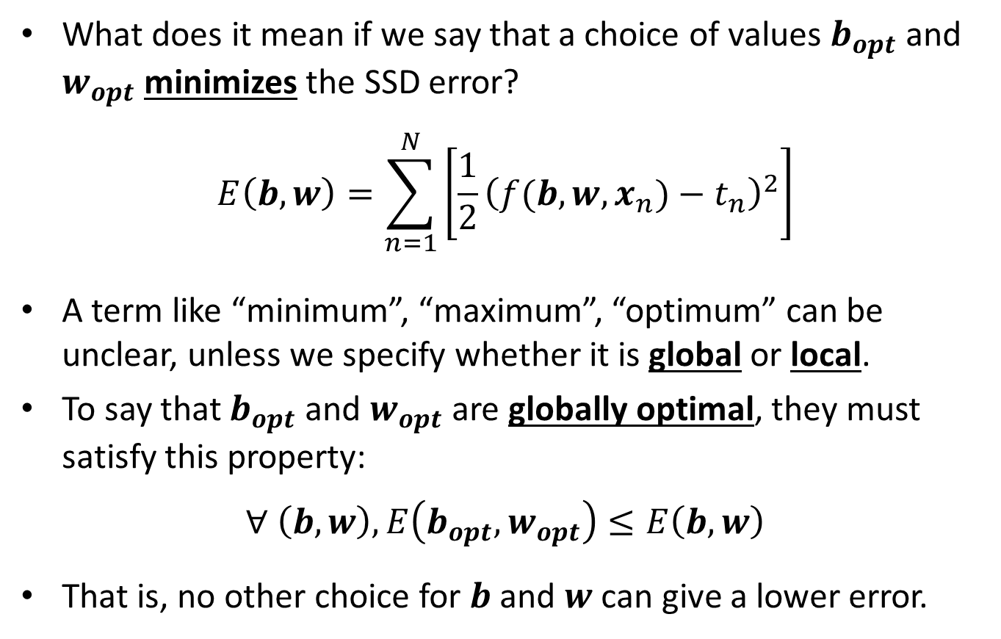
Global and Local Optima
What does it mean if we say that a choice of values $b_{opt}$and $w_{opt}$ minimizes the SSD error?
$$E\left(b,w\right)=\sum_{n=1}^{N}{\left[\frac{1}{2}{\left(f(b, w, x_{n})−t_{n}\right)}^{2}\right]}$$
A term like “minimum”, “maximum”, “optimum” can be unclear, unless we specify whether it is global or local.
To say that $b_{opt}$ and $w_{opt}$ are globally optimal, they must satisfy this property:
$$∀ \left(b,w\right), E\left(b_{opt},w_{opt}\right)≤E\left(b,w\right)$$
That is, no other choice for $b$ and $w$ can give a lower error.

Slide 21
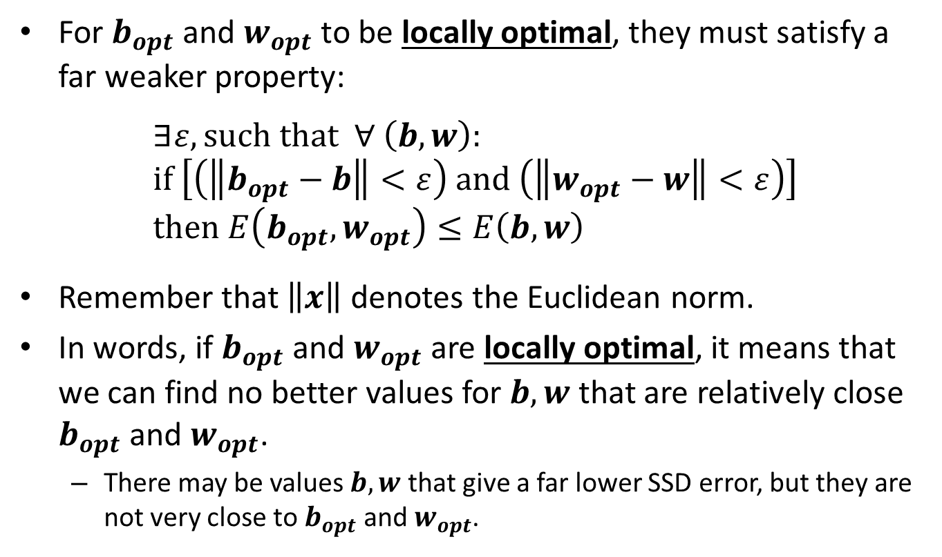
Global and Local Optima
For $b_{opt}$ and $w_{opt}$ to be locally optimal, they must satisfy a far weaker property:
$$∃ε, such that ∀ \left(b,w\right): \\ if \left[\left(\left\|b_{opt}−b\right\|<ε\right) and \left(\left\|w_{opt}−w\right\|<ε\right)\right] \\ then E\left(b_{opt},w_{opt}\right)≤E\left(b,w\right)$$
Remember that $\left\|x\right\|$ denotes the Euclidean norm.
In words, if $b_{opt}$ and $w_{opt}$ are locally optimal, it means that we can find no better values for $b,w$ that are relatively close $b_{opt}$ and $w_{opt}$.
There may be values $b,w$ that give a far lower SSD error, but they are not very close to $b_{opt}$ and $w_{opt}$.

Slide 22
Global and Local Optima
In any optimization method, it is important to understand if the result is globally or locally optimal.
For neural networks, we do not have any method that finds globally optimal solutions in a reasonable amount of time (like polynomial time).
The standard training algorithm (called backpropagation) finds a locally optimal solution.
Mathematically we wish we could do better.
In practice, the results are often good enough, otherwise neural networks would not be as popular.

Slide 23
Training as an Optimization Problem
As we said, in an optimization problem we need to:
Define what parameters we are optimizing. This is also called the search space (the space of possible choices).
For neural networks, what is that?
Define a quantitative optimization criterion.
For neural networks, what is that?
Define an optimization algorithm for finding a good set of parameters.
For neural networks, what is that?

Slide 24
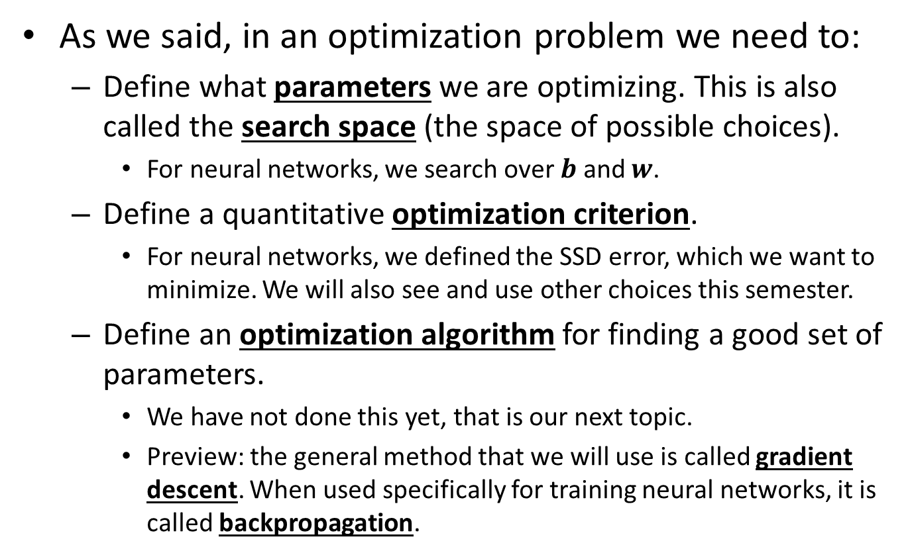
Training as an Optimization Problem
As we said, in an optimization problem we need to:
Define what parameters we are optimizing. This is also called the search space (the space of possible choices).
For neural networks, we search over $b$ and $w$.
Define a quantitative optimization criterion.
For neural networks, we defined the SSD error, which we want to minimize. We will also see and use other choices this semester.
Define an optimization algorithm for finding a good set of parameters.
We have not done this yet, that is our next topic.
Preview: the general method that we will use is called gradient descent. When used specifically for training neural networks, it is called backpropagation.

Slide 25
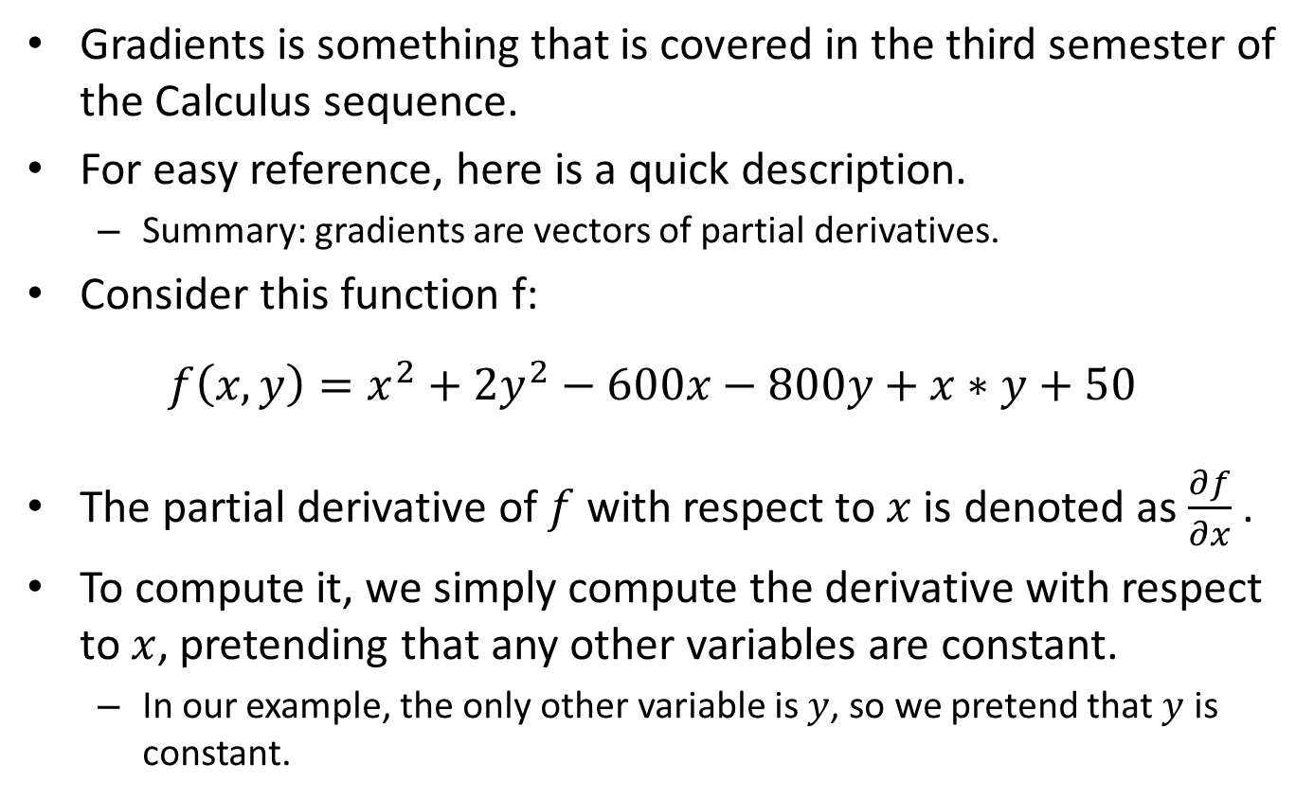
Gradients and Partial Derivatives
Gradients is something that is covered in the third semester of the Calculus sequence.
For easy reference, here is a quick description.
Summary: gradients are vectors of partial derivatives.
Consider this function f:
$$f\left(x,y\right)=x^{2}+2y^{2}−600x−800y+x∗y+50$$
The partial derivative of $f$ with respect to $x$ is denoted as $\frac{∂f}{∂x}$ .
To compute it, we simply compute the derivative with respect to $x$, pretending that any other variables are constant.
In our example, the only other variable is $y$, so we pretend that $y$ is constant.

Slide 26
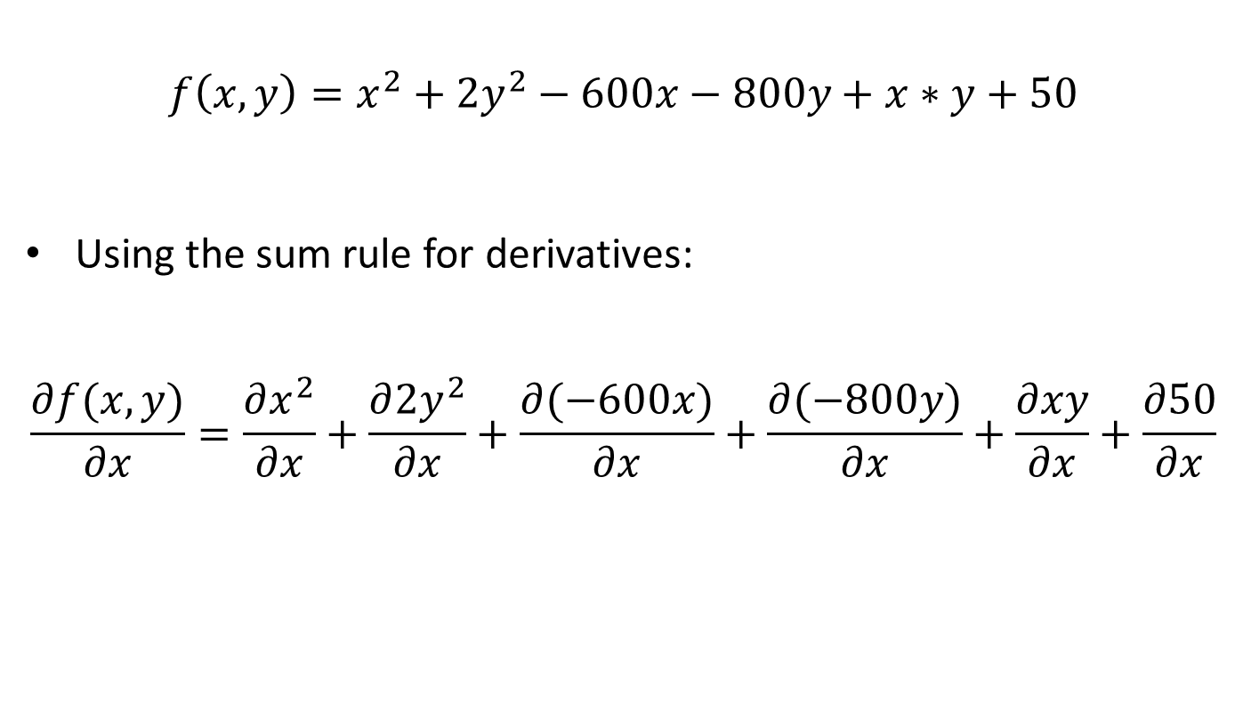
Partial Derivatives
$$f\left(x,y\right)=x^{2}+2y^{2}−600x−800y+x∗y+50$$
Using the sum rule for derivatives:
$$\frac{∂f(x,y)}{∂x}=\frac{∂x^{2}}{∂x}+\frac{∂{2y}^{2}}{∂x}+\frac{∂(−600x)}{∂x}+\frac{∂(−800y)}{∂x}+\frac{∂xy}{∂x}+\frac{∂50}{∂x}$$

Slide 27
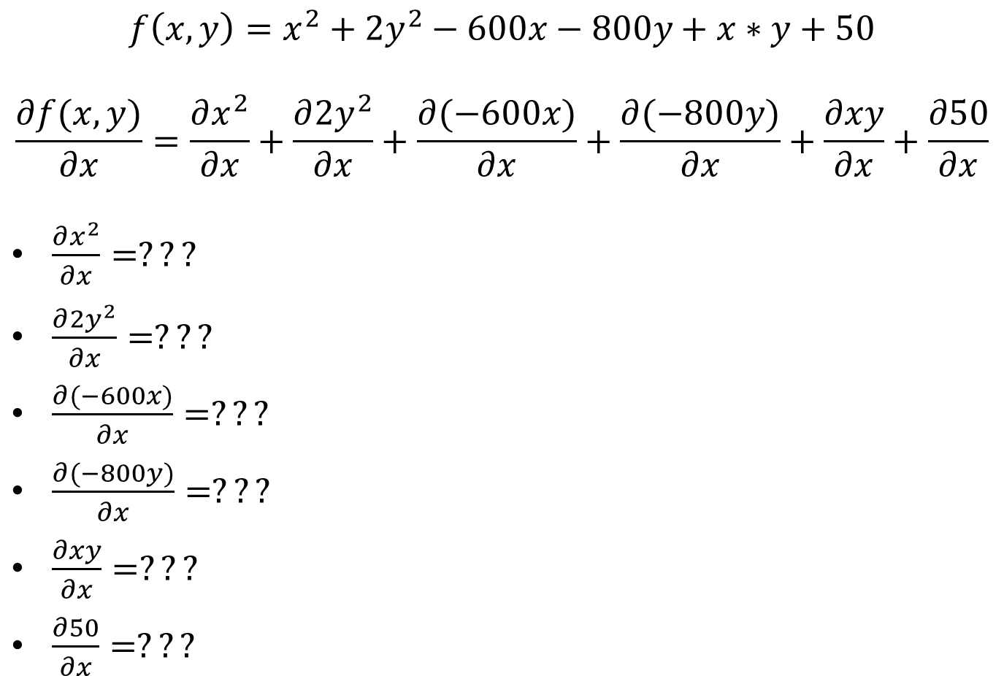
Partial Derivatives
$$f\left(x,y\right)=x^{2}+2y^{2}−600x−800y+x∗y+50$$
$$\frac{∂f(x,y)}{∂x}=\frac{∂x^{2}}{∂x}+\frac{∂{2y}^{2}}{∂x}+\frac{∂(−600x)}{∂x}+\frac{∂(−800y)}{∂x}+\frac{∂xy}{∂x}+\frac{∂50}{∂x}$$
$\frac{∂x^{2}}{∂x}=???$
$\frac{∂{2y}^{2}}{∂x}=???$
$\frac{∂(−600x)}{∂x}=???$
$\frac{∂(−800y)}{∂x}=???$
$\frac{∂xy}{∂x}=???$
$\frac{∂50}{∂x}=???$

Slide 28
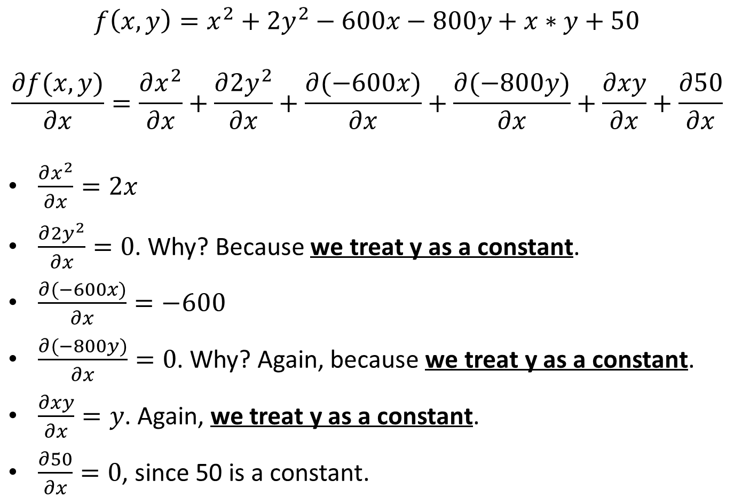
Partial Derivatives
$$f\left(x,y\right)=x^{2}+2y^{2}−600x−800y+x∗y+50$$
$$\frac{∂f(x,y)}{∂x}=\frac{∂x^{2}}{∂x}+\frac{∂{2y}^{2}}{∂x}+\frac{∂(−600x)}{∂x}+\frac{∂(−800y)}{∂x}+\frac{∂xy}{∂x}+\frac{∂50}{∂x}$$
$\frac{∂x^{2}}{∂x}=2x$
$\frac{∂{2y}^{2}}{∂x}=0$. Why? Because we treat y as a constant.
$\frac{∂(−600x)}{∂x}=−600$
$\frac{∂(−800y)}{∂x}=\text{0}$. Why? Again, because we treat y as a constant.
$\frac{∂xy}{∂x}=y$. Again, we treat y as a constant.
$\frac{∂50}{∂x}=0$, since 50 is a constant.

Slide 29

Partial Derivatives
$$f\left(x,y\right)=x^{2}+2y^{2}−600x−800y+x∗y+50$$
Based on the previous calculations, the partial derivative $\frac{∂f(x,y)}{∂x}$ is:
$$\frac{∂f(x,y)}{∂x}=2x−600+y$$

Slide 30
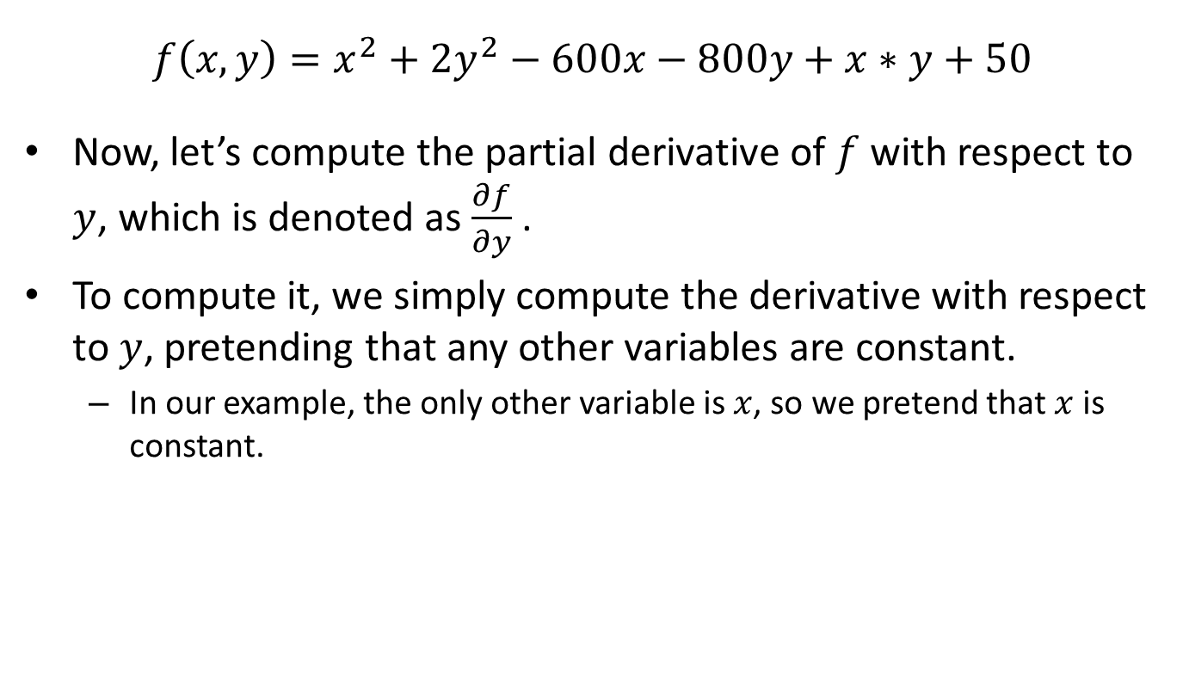
Partial Derivatives
$$f\left(x,y\right)=x^{2}+2y^{2}−600x−800y+x∗y+50$$
Now, let’s compute the partial derivative of $f$ with respect to $y$, which is denoted as $\frac{∂f}{∂y}$ .
To compute it, we simply compute the derivative with respect to $y$, pretending that any other variables are constant.
In our example, the only other variable is $x$, so we pretend that $x$ is constant.

Slide 31
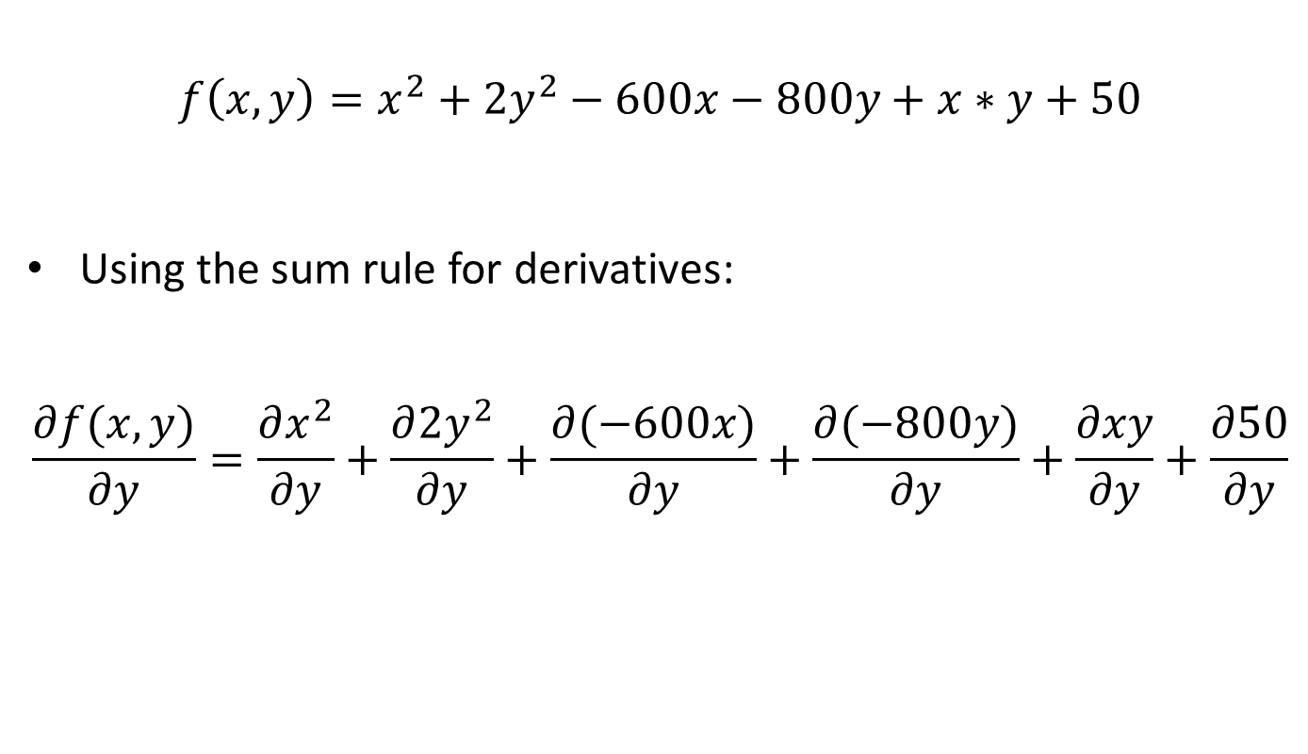
Partial Derivatives
$$f\left(x,y\right)=x^{2}+2y^{2}−600x−800y+x∗y+50$$
Using the sum rule for derivatives:
$$\frac{∂f(x,y)}{∂y}=\frac{∂x^{2}}{∂y}+\frac{∂{2y}^{2}}{∂y}+\frac{∂(−600x)}{∂y}+\frac{∂(−800y)}{∂y}+\frac{∂xy}{∂y}+\frac{∂50}{∂y}$$

Slide 32
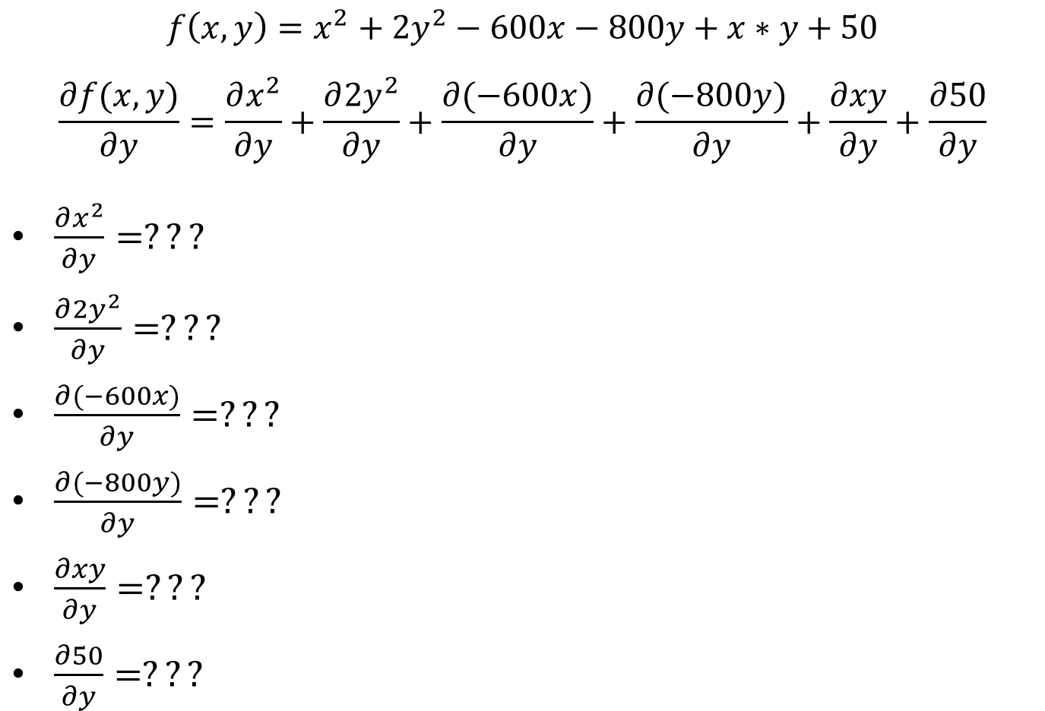
Partial Derivatives
$$f\left(x,y\right)=x^{2}+2y^{2}−600x−800y+x∗y+50$$
$$\frac{∂f(x,y)}{∂y}=\frac{∂x^{2}}{∂y}+\frac{∂{2y}^{2}}{∂y}+\frac{∂(−600x)}{∂y}+\frac{∂(−800y)}{∂y}+\frac{∂xy}{∂y}+\frac{∂50}{∂y}$$
$\frac{∂x^{2}}{∂y}=???$
$\frac{∂{2y}^{2}}{∂y}=???$
$\frac{∂(−600x)}{∂y}=???$
$\frac{∂(−800y)}{∂y}=???$
$\frac{∂xy}{∂y}=???$
$\frac{∂50}{∂y}=???$

Slide 33
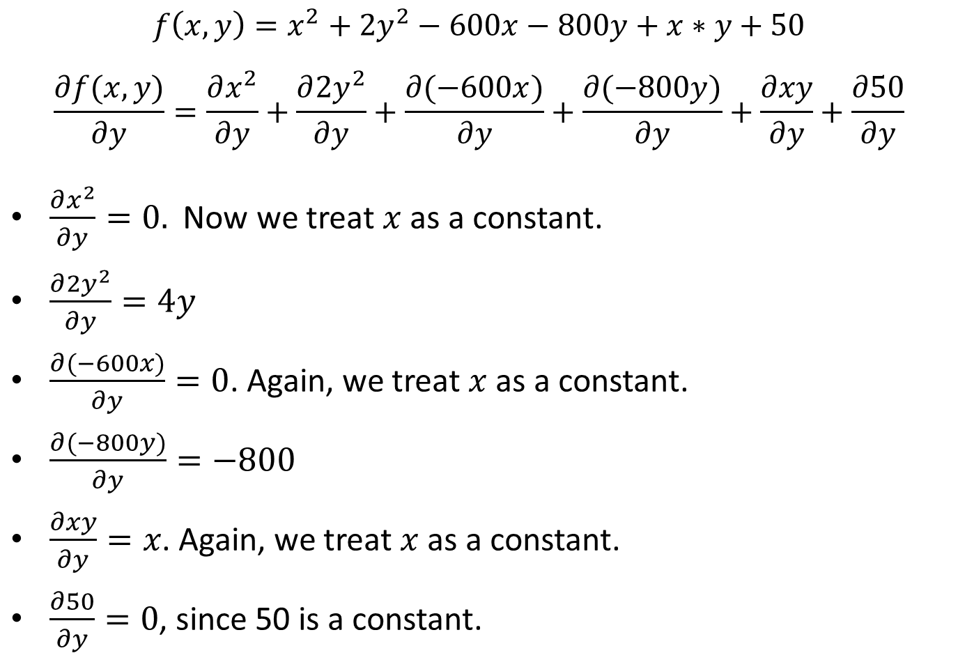
Partial Derivatives
$$f\left(x,y\right)=x^{2}+2y^{2}−600x−800y+x∗y+50$$
$$\frac{∂f(x,y)}{∂y}=\frac{∂x^{2}}{∂y}+\frac{∂{2y}^{2}}{∂y}+\frac{∂(−600x)}{∂y}+\frac{∂(−800y)}{∂y}+\frac{∂xy}{∂y}+\frac{∂50}{∂y}$$
$\frac{∂x^{2}}{∂y}=0.$ Now we treat $x$ as a constant.
$\frac{∂{2y}^{2}}{∂y}=4y$
$\frac{∂(−600x)}{∂y}=0$. Again, we treat $x$ as a constant.
$\frac{∂(−800y)}{∂y}=−800$
$\frac{∂xy}{∂y}=x$. Again, we treat $x$ as a constant.
$\frac{∂50}{∂y}=0$, since 50 is a constant.

Slide 34

Partial Derivatives
$$f\left(x,y\right)=x^{2}+2y^{2}−600x−800y+x∗y+50$$
Based on the previous calculations, the partial derivative $\frac{∂f(x,y)}{∂y}$ is:
$$\frac{∂f(x,y)}{∂y}=4y−800+x$$

Slide 35
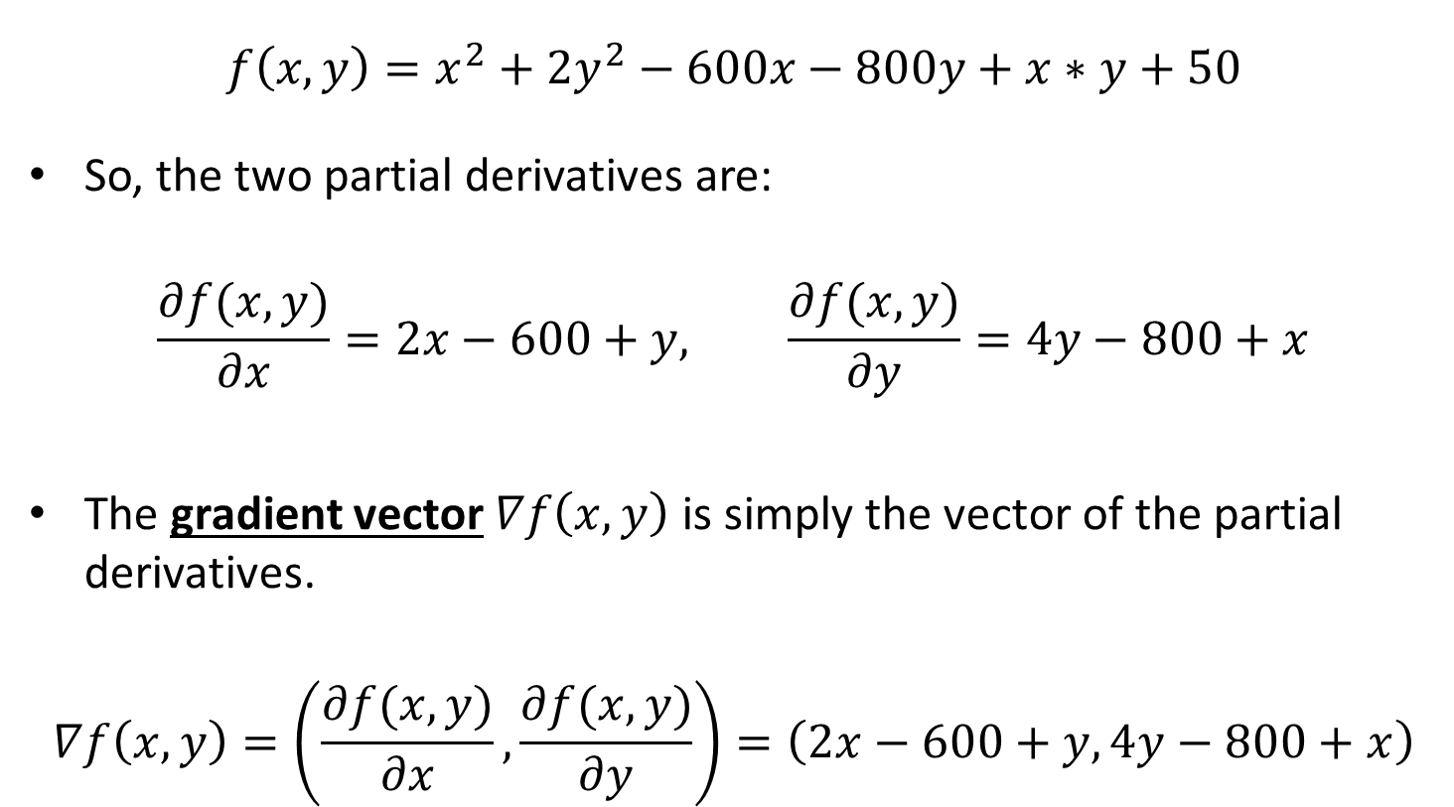
Gradients
$$f\left(x,y\right)=x^{2}+2y^{2}−600x−800y+x∗y+50$$
So, the two partial derivatives are:
$$\frac{∂f(x,y)}{∂x}=2x−600+y, \frac{∂f(x,y)}{∂y}=4y−800+x$$
The gradient vector $∇f\left(x,y\right)$ is simply the vector of the partial derivatives.
$$∇f\left(x,y\right)=\left(\frac{∂f(x,y)}{∂x},\frac{∂f(x,y)}{∂y}\right)=\left(2x−600+y,4y−800+x\right)$$

Slide 36
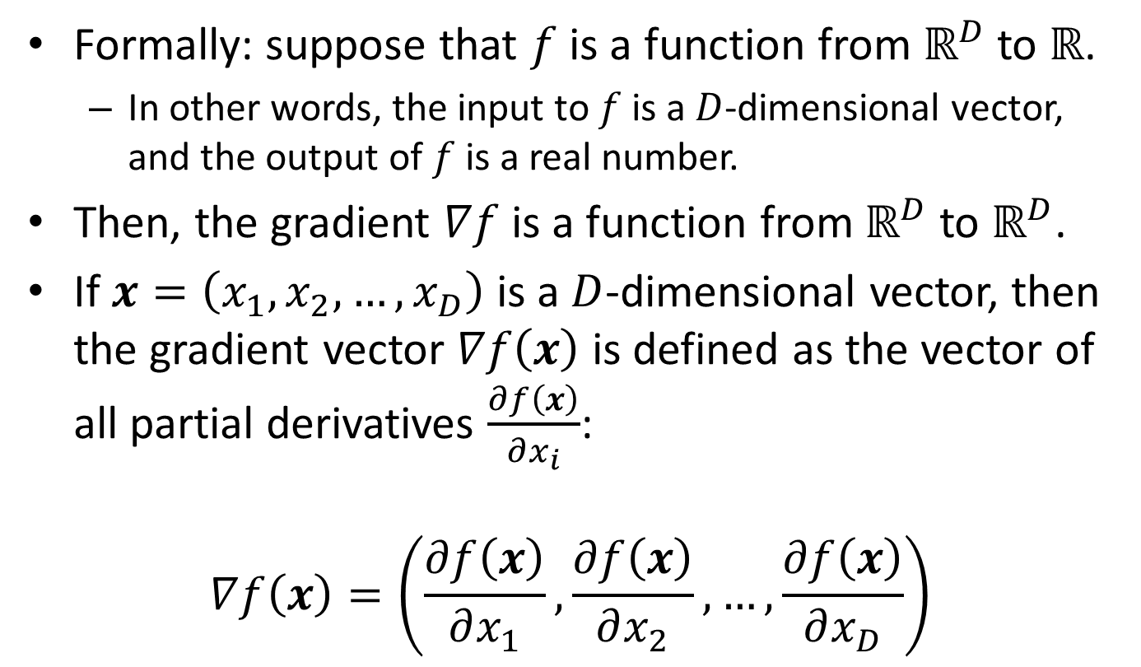
Gradients
Formally: suppose that $f$ is a function from $ℝ^{D}$ to $ℝ$.
In other words, the input to $f$ is a $D$-dimensional vector, and the output of $f$ is a real number.
Then, the gradient $∇f$ is a function from $ℝ^{D}$ to $ℝ^{D}$.
If $x=\left(x_{1},x_{2}, …,x_{D}\right)$ is a $D$-dimensional vector, then the gradient vector $∇f\left(x\right)$ is defined as the vector of all partial derivatives $\frac{∂f\left(x\right)}{∂x_{i}}$:
$$∇f\left(x\right)=\left(\frac{∂f\left(x\right)}{∂x_{1}},\frac{∂f\left(x\right)}{∂x_{2}},…,\frac{∂f\left(x\right)}{∂x_{D}}\right)$$

Slide 37
Gradients and Neural Networks
Gradients can be used to find local minima.
In training a neural network, we typically want to find a local minimum of the optimization criterion.
For example, the optimization criterion can be the sum of squared differences.
So, we need to review how gradients are used in such problems.
The method is called gradient descent.

Slide 38
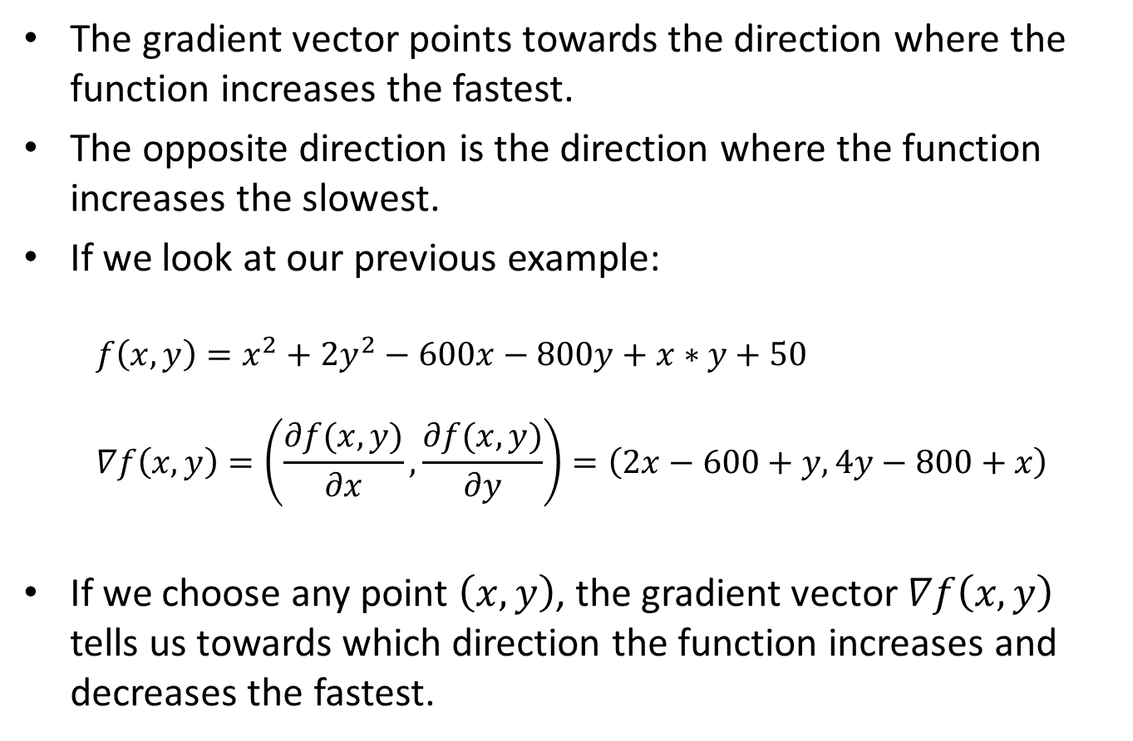
Direction of the Gradient
The gradient vector points towards the direction where the function increases the fastest.
The opposite direction is the direction where the function increases the slowest.
If we look at our previous example:
$$f\left(x,y\right)=x^{2}+2y^{2}−600x−800y+x∗y+50 \\ ∇f\left(x,y\right)=\left(\frac{∂f(x,y)}{∂x},\frac{∂f(x,y)}{∂y}\right)=\left(2x−600+y,4y−800+x\right)$$
If we choose any point $\left(x,y\right)$, the gradient vector $∇f\left(x,y\right)$ tells us towards which direction the function increases and decreases the fastest.

Slide 39
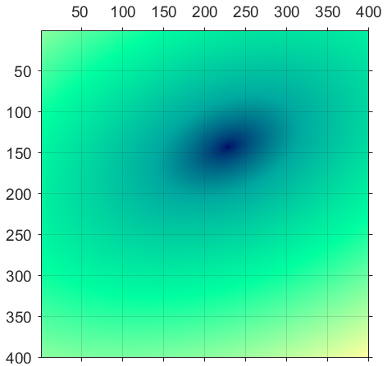
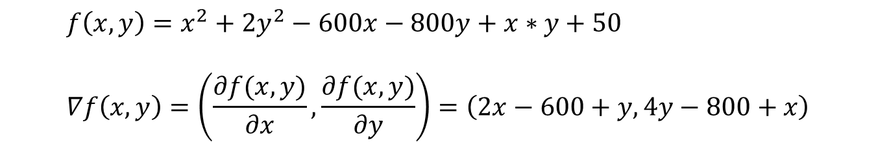
Some Examples
$$f\left(x,y\right)=x^{2}+2y^{2}−600x−800y+x∗y+50 \\ ∇f\left(x,y\right)=\left(\frac{∂f(x,y)}{∂x},\frac{∂f(x,y)}{∂y}\right)=\left(2x−600+y,4y−800+x\right)$$
Here is a visualization of this function, for the region: 0 < x < 400, 0 < y < 400
Larger values are yellow (see bottom left of figure).
Middle values are green.
Low values are blue.
The lowest values are black.

Slide 40
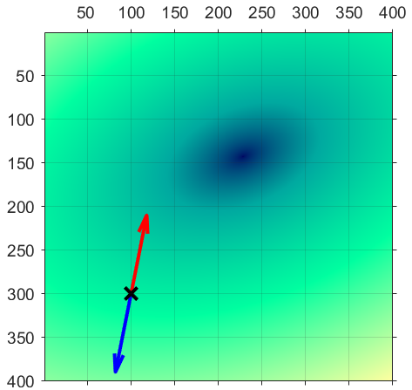
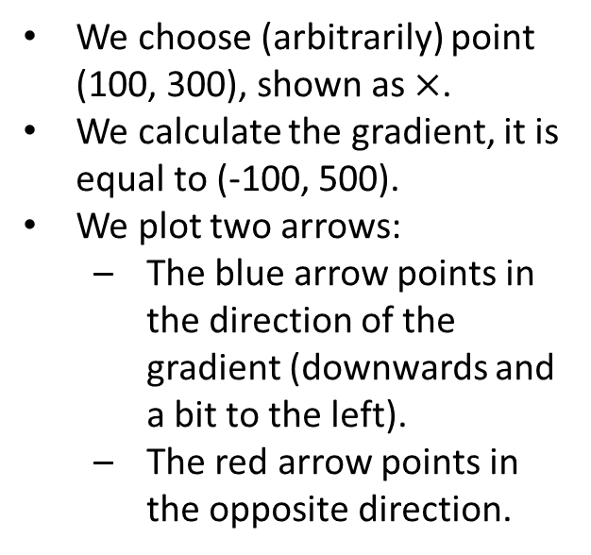
Some Examples
$$f\left(x,y\right)=x^{2}+2y^{2}−600x−800y+x∗y+50 \\ ∇f\left(x,y\right)=\left(\frac{∂f(x,y)}{∂x},\frac{∂f(x,y)}{∂y}\right)=\left(2x−600+y,4y−800+x\right)$$
We choose (arbitrarily) point (100, 300), shown as $×$.
We calculate the gradient, it is equal to (-100, 500).
We plot two arrows:
The blue arrow points in the direction of the gradient (downwards and a bit to the left).
The red arrow points in the opposite direction.

Slide 41
Some Examples
$$f\left(x,y\right)=x^{2}+2y^{2}−600x−800y+x∗y+50 \\ ∇f\left(x,y\right)=\left(\frac{∂f(x,y)}{∂x},\frac{∂f(x,y)}{∂y}\right)=\left(2x−600+y,4y−800+x\right)$$
We can see that:
The function values increase (at least for a while) if we start moving towards the direction of the gradient.
The function values decrease (again, at least for a while) if we start moving in the opposite direction.

Slide 42
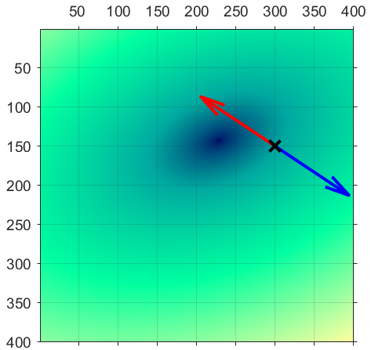
Some Examples
$$f\left(x,y\right)=x^{2}+2y^{2}−600x−800y+x∗y+50 \\ ∇f\left(x,y\right)=\left(\frac{∂f(x,y)}{∂x},\frac{∂f(x,y)}{∂y}\right)=\left(2x−600+y,4y−800+x\right)$$
We now choose another point, (300, 150), shown as X.
We calculate the gradient, it is equal to (150, 100).
Again, we plot two arrows:
One pointing towards the direction of the gradient (downwards and to the right).
One pointing in the opposite direction.

Slide 43
Some Examples
$$f\left(x,y\right)=x^{2}+2y^{2}−600x−800y+x∗y+50 \\ ∇f\left(x,y\right)=\left(\frac{∂f(x,y)}{∂x},\frac{∂f(x,y)}{∂y}\right)=\left(2x−600+y,4y−800+x\right)$$
Again, we see that:
The function values increase if we start moving (at least for a while) towards the direction of the gradient.
The function values decrease (at least for a while) in the opposite direction.
Note that, in this example, after a bit the values start increasing again.

Slide 44
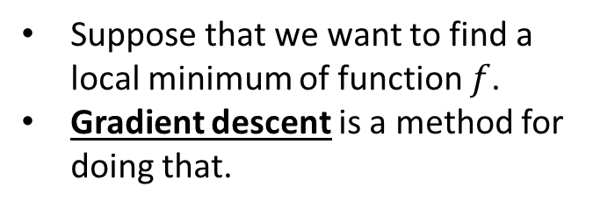
Gradient Descent
$$f\left(x,y\right)=x^{2}+2y^{2}−600x−800y+x∗y+50 \\ ∇f\left(x,y\right)=\left(\frac{∂f(x,y)}{∂x},\frac{∂f(x,y)}{∂y}\right)=\left(2x−600+y,4y−800+x\right)$$
Suppose that we want to find a local minimum of function $f$.
Gradient descent is a method for doing that.

Slide 45
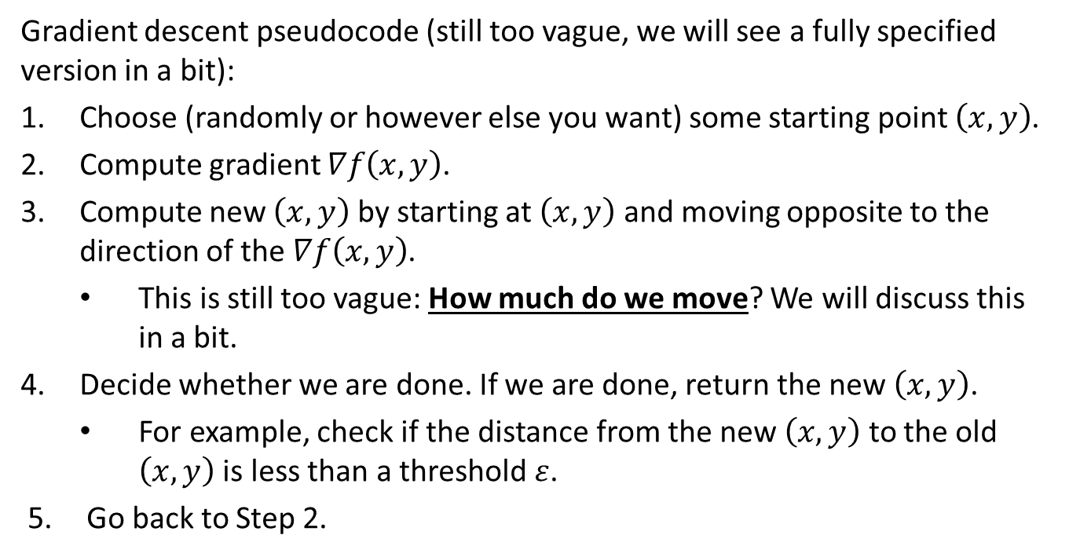
Gradient Descent
Gradient descent pseudocode (still too vague, we will see a fully specified version in a bit):
Choose (randomly or however else you want) some starting point $\left(x,y\right)$.
Compute gradient $∇f\left(x,y\right)$.
Compute new $\left(x,y\right)$ by starting at $\left(x,y\right)$ and moving opposite to the direction of the $∇f\left(x,y\right)$.
This is still too vague: How much do we move? We will discuss this in a bit.
Decide whether we are done. If we are done, return the new $\left(x,y\right)$.
For example, check if the distance from the new $\left(x,y\right)$ to the old $\left(x,y\right)$ is less than a threshold $ε$.
Go back to Step 2.

Slide 46
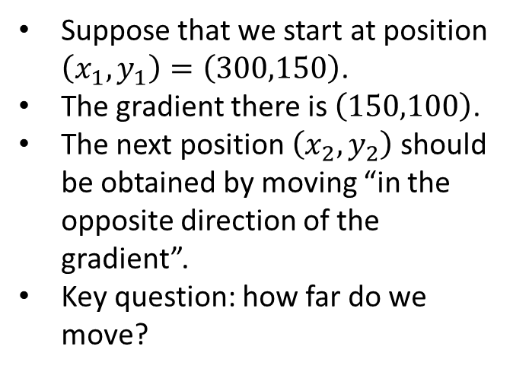
Gradient Descent
$$f\left(x,y\right)=x^{2}+2y^{2}−600x−800y+x∗y+50 \\ ∇f\left(x,y\right)=\left(\frac{∂f(x,y)}{∂x},\frac{∂f(x,y)}{∂y}\right)=\left(2x−600+y,4y−800+x\right)$$
Suppose that we start at position $\left(x_{1},y_{1}\right)=\left(300,150\right)$.
The gradient there is $\left(150,100\right)$.
The next position $\left(x_{2},y_{2}\right)$ should be obtained by moving “in the opposite direction of the gradient”.
Key question: how far do we move?

Slide 47
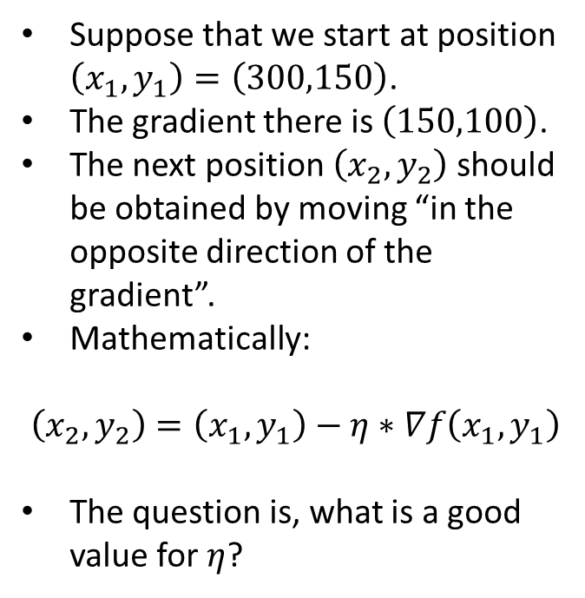
Gradient Descent
$$f\left(x,y\right)=x^{2}+2y^{2}−600x−800y+x∗y+50 \\ ∇f\left(x,y\right)=\left(\frac{∂f(x,y)}{∂x},\frac{∂f(x,y)}{∂y}\right)=\left(2x−600+y,4y−800+x\right)$$
Suppose that we start at position $\left(x_{1},y_{1}\right)=\left(300,150\right)$.
The gradient there is $\left(150,100\right)$.
The next position $\left(x_{2},y_{2}\right)$ should be obtained by moving “in the opposite direction of the gradient”.
Mathematically:
$$\left(x_{2},y_{2}\right)=\left(x_{1},y_{1}\right)−η∗∇f\left(x_{1},y_{1}\right)$$
The question is, what is a good value for $η$?

Slide 48
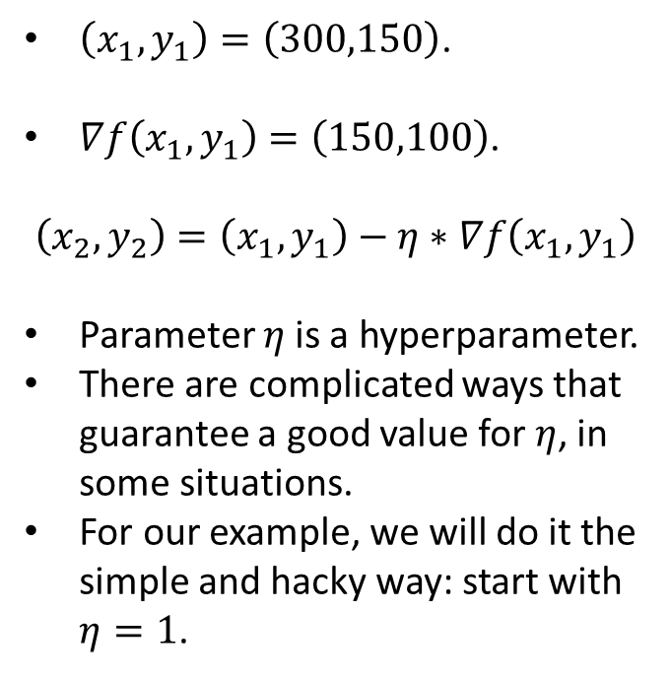
Gradient Descent
$$f\left(x,y\right)=x^{2}+2y^{2}−600x−800y+x∗y+50 \\ ∇f\left(x,y\right)=\left(\frac{∂f(x,y)}{∂x},\frac{∂f(x,y)}{∂y}\right)=\left(2x−600+y,4y−800+x\right)$$
$\left(x_{1},y_{1}\right)=\left(300,150\right)$.
$∇f\left(x_{1},y_{1}\right)=\left(150,100\right)$.
$$\left(x_{2},y_{2}\right)=\left(x_{1},y_{1}\right)−η∗∇f\left(x_{1},y_{1}\right)$$
Parameter $η$is a hyperparameter.
There are complicated ways that guarantee a good value for $η$, in some situations.
For our example, we will do it the simple and hacky way: start with $η=1$.

Slide 49
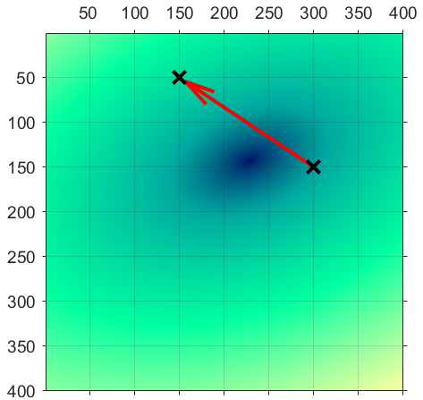
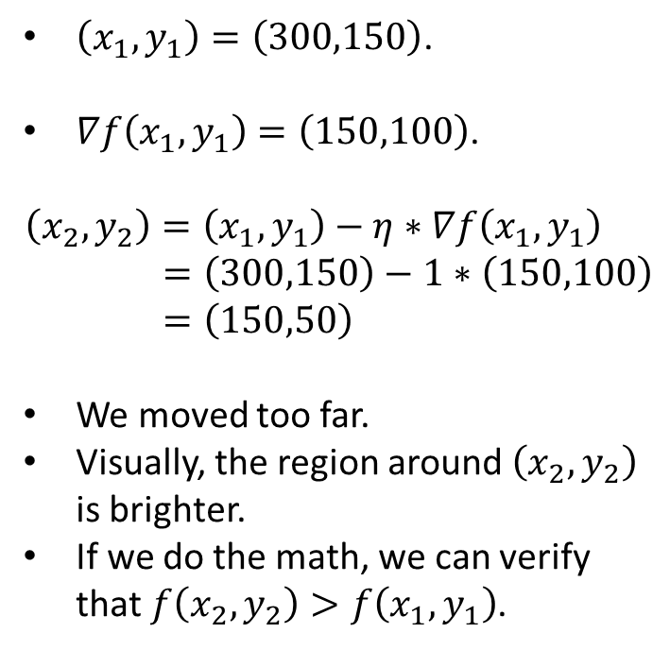
Gradient Descent
$\left(x_{1},y_{1}\right)=\left(300,150\right)$.
$∇f\left(x_{1},y_{1}\right)=\left(150,100\right)$.
$$\left(x_{2},y_{2}\right)=\left(x_{1},y_{1}\right)−η∗∇f\left(x_{1},y_{1}\right) \\ =\left(300,150\right)−1∗\left(150,100\right) \\ =\left(150,50\right)$$
We moved too far.
Visually, the region around $\left(x_{2},y_{2}\right)$ is brighter.
If we do the math, we can verify that $f\left(x_{2},y_{2}\right)>f\left(x_{1},y_{1}\right)$.

Slide 50
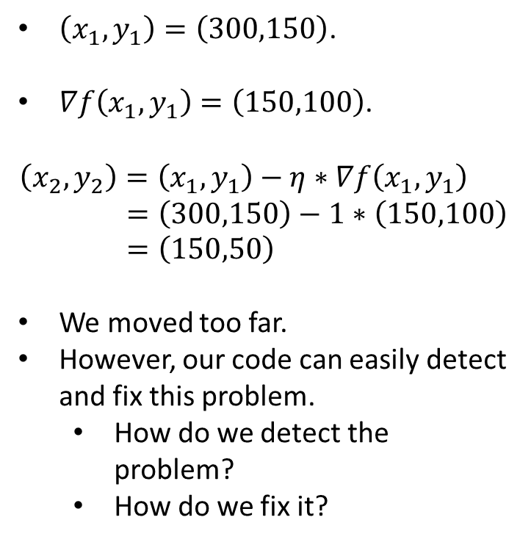
Gradient Descent
$\left(x_{1},y_{1}\right)=\left(300,150\right)$.
$∇f\left(x_{1},y_{1}\right)=\left(150,100\right)$.
$$\left(x_{2},y_{2}\right)=\left(x_{1},y_{1}\right)−η∗∇f\left(x_{1},y_{1}\right) \\ =\left(300,150\right)−1∗\left(150,100\right) \\ =\left(150,50\right)$$
We moved too far.
However, our code can easily detect and fix this problem.
How do we detect the problem?
How do we fix it?

Slide 51

Gradient Descent
$\left(x_{1},y_{1}\right)=\left(300,150\right)$.
$∇f\left(x_{1},y_{1}\right)=\left(150,100\right)$.
$$\left(x_{2},y_{2}\right)=\left(x_{1},y_{1}\right)−η∗∇f\left(x_{1},y_{1}\right) \\ =\left(300,150\right)−1∗\left(150,100\right) \\ =\left(150,50\right)$$
We moved too far.
How do we detect the problem?
If $f\left(x_{2},y_{2}\right)>f\left(x_{1},y_{1}\right)$, we have a problem.
How do we fix it?
Reset $η$to a smaller value, like half its previous value, and try again.
So, what would be the new $η$?

Slide 52


Gradient Descent
Our new $η$is 0.5:
$\left(x_{1},y_{1}\right)=\left(300,150\right)$.
$∇f\left(x_{1},y_{1}\right)=\left(150,100\right)$.
$$\left(x_{2},y_{2}\right)=\left(x_{1},y_{1}\right)−η∗∇f\left(x_{1},y_{1}\right) \\ =\left(300,150\right)−0.5∗\left(150,100\right) \\ =\left(225,100\right)$$
The function value at (225,100) is indeed smaller than at (300, 150), as we can see by the darker color.
Again, we can verify by doing the math.
What do we do next?

Slide 53


Gradient Descent
Our progress so far:
$\left(x_{1},y_{1}\right)=\left(300,150\right)$.
$\left(x_{2},y_{2}\right)=\left(225,100\right)$.
Current value for $η$ is $0.5$.
Next step: compute the next point in our descent, $\left(x_{3},y_{3}\right)$, based on the gradient at $\left(x_{2},y_{2}\right)$.
$$\left(x_{3},y_{3}\right)=\left(x_{2},y_{2}\right)−η∗∇f\left(x_{2},y_{2}\right) \\ =\left(225,100\right)−0.5∗\left(−50,−175\right) \\ =\left(250, 187.50\right)$$

Slide 54

Gradient Descent
Our progress so far:
$\left(x_{1},y_{1}\right)=\left(300,150\right)$.
$\left(x_{2},y_{2}\right)=\left(225,100\right)$.
Current value for $η$ is $0.5$.
Next step: compute the next point in our descent, $\left(x_{3},y_{3}\right)$, based on the gradient at $\left(x_{2},y_{2}\right)$.
$$\left(x_{3},y_{3}\right)=\left(x_{2},y_{2}\right)−η∗∇f\left(x_{2},y_{2}\right) \\ =\left(225,100\right)−0.5∗\left(−50,−175\right) \\ =\left(250, 187.50\right)$$
Turns out that, again, $η$ was too large, and $f\left(x_{3},y_{3}\right)>f\left(x_{2},y_{2}\right)$.
So, we try again with new $η=0.25$.

Slide 55


Gradient Descent
Our progress so far:
$\left(x_{1},y_{1}\right)=\left(300,150\right)$.
$\left(x_{2},y_{2}\right)=\left(225,100\right)$.
Current value for $η$ is $0.25$.
$$\left(x_{3},y_{3}\right)=\left(x_{2},y_{2}\right)−η∗∇f\left(x_{2},y_{2}\right) \\ =\left(225,100\right)−0.25∗\left(−50,−175\right) \\ =\left(237.5, 143.75\right)$$
This move was useful: $f\left(x_{3},y_{3}\right)<f\left(x_{2},y_{2}\right)$.
This is a process that is easy to implement.
If we continue, after 25 steps, we get (numerically close) to the minimum.

Slide 56

Gradients at Local Minima
$$\left(x_{t+1},y_{t+1}\right)=\left(x_{t},y_{t}\right)−η∗∇f\left(x_{t},y_{t}\right)$$
Mathematically, if $\left(x,y\right)$ is a local minimum, then $∇f\left(x,y \right)=???$

Slide 57

Gradients at Local Minima
$$\left(x_{t+1},y_{t+1}\right)=\left(x_{t},y_{t}\right)−η∗∇f\left(x_{t},y_{t}\right)$$
Mathematically, if $\left(x,y\right)$ is a local minimum, then $∇f\left(x,y\right)=0$ (the zero vector, not a single number).
So, if $\left(x_{t},y_{t}\right)$ is a local minimum, there will be no updates anymore.
In practice, as we get closer and closer to the local minimum, the gradient eventually starts getting closer and closer to the zero vector.
Therefore, the norm of the gradient vector can be used as a stopping criterion.

Slide 58

Gradient Descent Pseudocode
# This is a simplified version, but it still works in many cases
# $\left(x_{1},y_{1}\right)$ is the starting point for the descent.
GradientDescent($f$, $x_{1},y_{1}$, $η$, $ε$)
$t=1$
history = [$\left(x_{1},y_{1}\right)$]
while $\left(\left\|∇f\left(x_{t},y_{t}\right)\right\|>ε\right)$
$\left(x_{t+1},y_{t+1}\right)=\left(x_{t},y_{t}\right)−η∗∇f\left(x_{t},y_{t}\right)$
If $\left(f\left(x_{t+1},y_{t+1}\right)>f\left(x_{t},y_{t}\right)\right)$ $η=\frac{η}{2}$ continue
Else
add $\left(x_{t+1},y_{t+1}\right)$ to end of history
$t=t+1$
return $\left(x_{t},y_{t},history\right)$

Slide 59

Further Reading
Gradient descent is a widely applied method, both in machine learning and in many other fields.
If you are interested in more details (like how to choose $η$, a good starting point is these Wikipedia articles:
Gradient descent: https://en.wikipedia.org/wiki/Gradient_descent
Stochastic gradient descent: https://en.wikipedia.org/wiki/Stochastic_gradient_descent
Technically, we will train neural networks using stochastic gradient descent, but most of the time I will just be using the term “gradient descent”.

Slide 60
Next Steps
Our topic is (still) how to train a neural network.
We will first apply gradient descent to train a perceptron.
Then we will apply gradient descent to train a neural network.
As a reminder, the application of gradient descent to neural networks is called backpropagation.

