Slide 1

Software Refactoring Why Is It Important?
From
Engineers Wanted, Programmers not so Much
series

Slide 2
Software Developing and Software Refactoring
We believe that we design and then we code.
But over time the code will be modified, and the
integrity of the system, its structure according to that design, gradually fades.
Add New Feature
Analysis
And…
Design
Test
Planning
Developing
Refactoring
Time
Notes:
ریفکتورینگ فرآیند تغییر یک سیستم نرم افزاری است به گونه ای که رفتار خارجی کد را تغییر نمی دهد و در عین حال ساختار داخلی آن را بهبود می بخشد. این یک روش منظم برای تمیز کردن است
کدی که شانس معرفی باگ را به حداقل می رساند. در اصل زمانی که شما
با refactoring شما تعادل تغییرات کار را پیدا می کنید. متوجه می‌شوید که طراحی، به‌جای اینکه همه چیز از قبل اتفاق بیفتد، به طور مداوم در طول توسعه رخ می‌دهد. شما از ساختن سیستم یاد می گیرید که چگونه طراحی را بهبود ببخشید. تعامل حاصل منجر به برنامه ای با طراحی می شود که با ادامه توسعه خوب باقی می ماند.

Slide 3
What Is Refactoring?
Improving the design after it has been written.
The act of improving design without changing its behavior.
Refactoring is making a series of small structural changes to improve readability and maintainability of software without modifying existing behavior.

Slide 4
What does not mean Refactoring?
Refactoring is not adding a new feature.
Refactoring is not fixing a bug.
Refactoring is not optimization.

Slide 5
Why Should You Refactor?
Refactoring Improves the Design of Software
Refactoring Makes Software Easier to Understand
Refactoring Helps You Find Bugs
Refactoring Helps You Program Faster
Refactoring Helps You to learn what not to do!

Slide 6
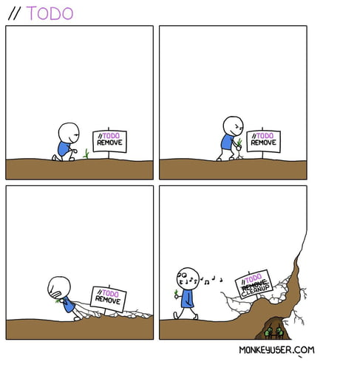
When Should You Refactor?
Refactor When You Add Function
Refactor When You Need to Fix a Bug
Refactor As You Do a Code Review

Slide 7
Clean Code
Clean code:
The main purpose of refactoring is to fight technical debt.
It transforms a mess into clean code and a simple design.
Nice! But what’s clean code, anyway?
Here are some of its features:
Clean code is obvious for other programmers.
And I’m not talking about super sophisticated algorithms. Poor variable naming, bloated classes, methods, magic numbers -you name it- all of that makes code sloppy and difficult to grasp.
Clean code doesn’t contain duplication

Slide 8
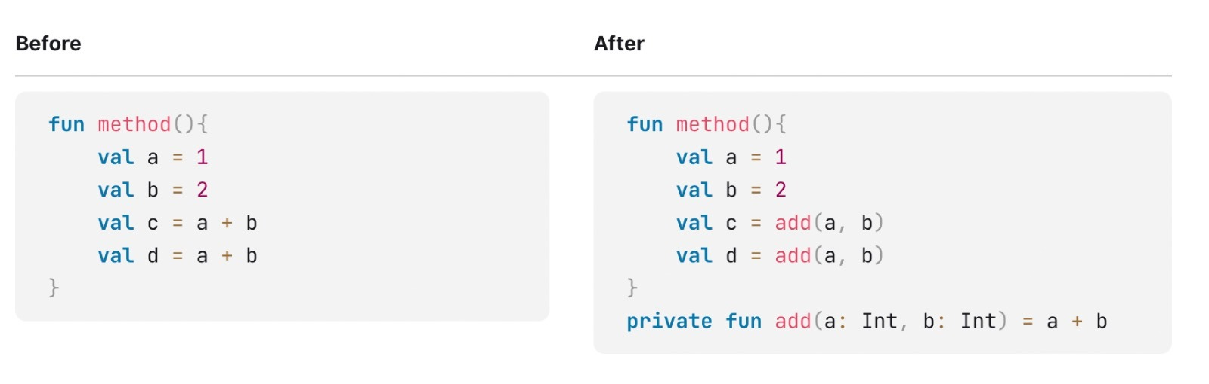
Extract method﻿

Slide 9
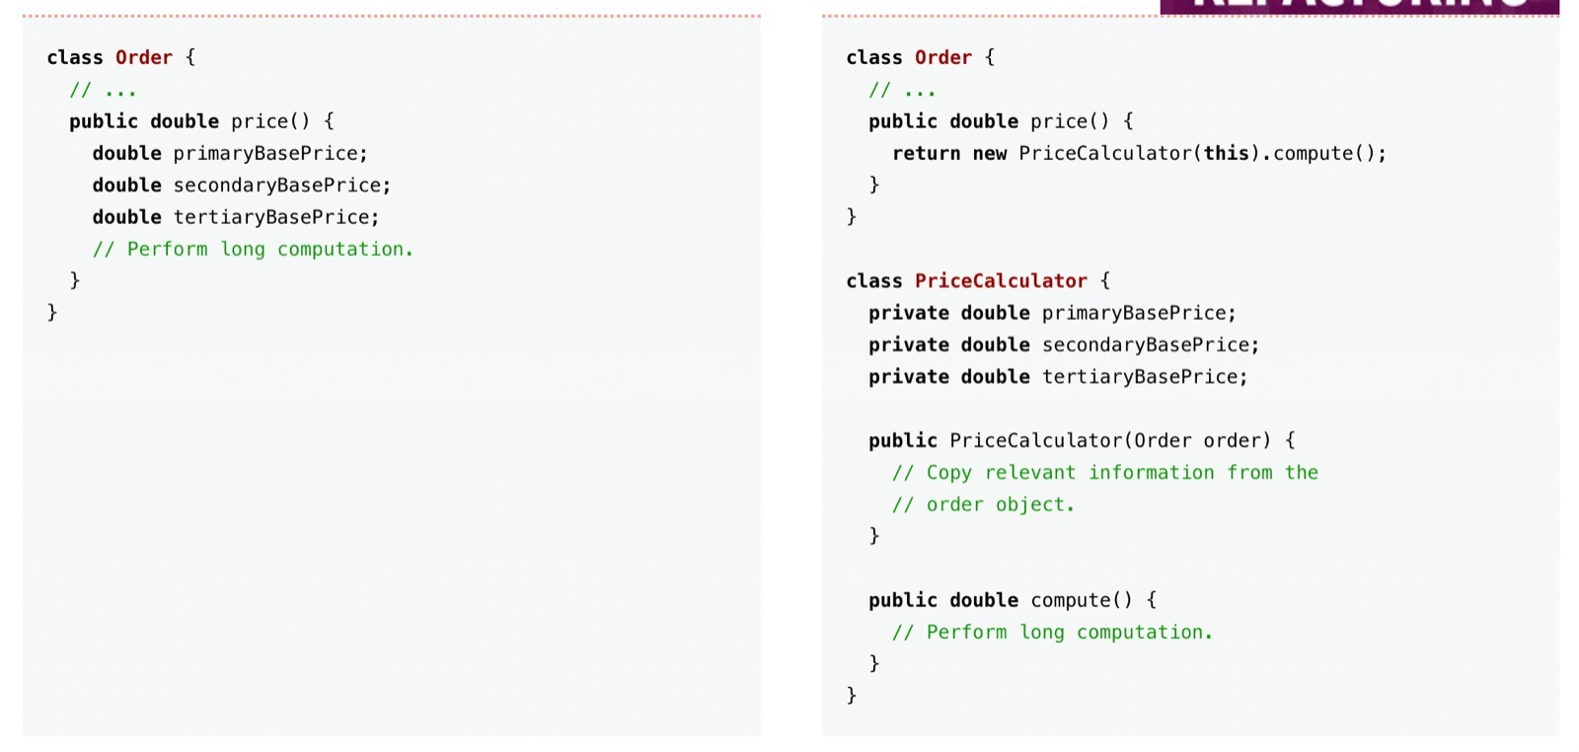
Replace Method with Method Object

Slide 10
What Do I Tell My Manager?
If the manager is technically savvy, introducing the subject may not be that hard
In these cases I give my more controversial advice:
Don't tell!
Software developers are professionals. Our job is to build effective software as rapidly as we can. If I need to fix a bug, I need to understand how the software works and I find refactoring is the fastest way to do this. A schedule-driven manager wants me to do things the fastest way I can; how I do it is my business. The fastest way is to refactor; therefore I refactor.
Notes:
Yönetici teknik olarak bilgiliyse konuyu tanıtmak o kadar da zor olmayabilir.

Slide 11
Any fool can write code that a computer can understand. Good programmers write code that humans can understand.
Martin Fowler

Slide 12
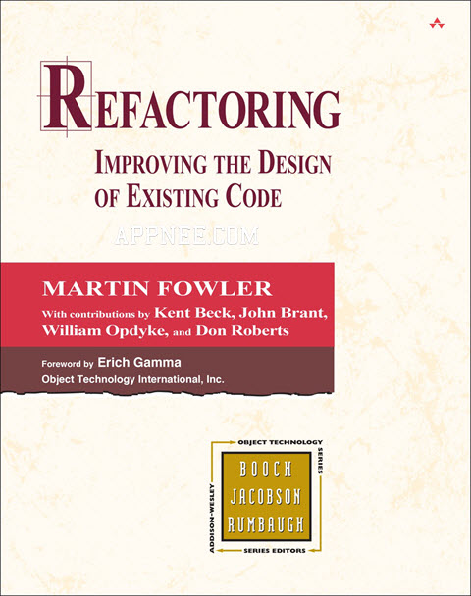
Resource
REFACTORING:
IMPROVING THE DESIGN OF EXISTING CODE
Martin Fowler‘s Refactoring is a super classic masterpiece in the field of software engineering, known as “Software Engineering Bibles” together with Erich Gamma‘s Design Patterns. They are must-read books for any programmers.

Slide 13
Thank You!
Tuğrul Akçadağ, Abolfazl Abbasi

