Slide 1

A Statistical Regression Methodology for Improving Robustness of Rotor Bar Fault Detection of Induction Motor Using Three- phase Current Estimation under Random Loading Conditions
Group 3:
Shafi Md Kawsar Zaman (ID: 201790485)
Hla- U- May Marma (ID: 201891620)
Abdullah Al Baki Sifat (ID: 201891725)
Memorial University Of Newfoundland Department Of Electrical And Computer Engineering Faculty Of Engineering & Applied Science
St. John's, NL, Canada

Slide 2
1. Introduction
2. Data Processing
3. Regression Model
4. Goodness of Fit Analysis
5. Regression Model Validation
6. Conclusion
Notes:
Firstly, followed by, then ,finally, .

Slide 3
OBJECTIVES
To develop a regression model for predicting the features (mean and standard deviation) of three- phase current signatures for any arbitrary loading of an induction motor subjected to 1 broken rotor bar fault.
To optimize the predicted data of current mean and current standard deviation by comparison with experimental ones.
To improve the robustness of Rotor Bar Fault Detection of Induction Motor.

Slide 4
Values Of Features (Means And Standard Deviations) Of Experimentally Collected Three Phase Currents Under Different Loading Percentages
Data Processing
Phase Current | Statistical Feature | 10% Loading | 30% Loading | 70% Loading | 85% Loading | 100% Loading
I₁ | Mean | 0.0021888581084187 | 0.0021345545271559 | 0.0017586836856555 | 0.0014985955136808 | 0.0014647185170065
 | Standard Deviation | 0.5134178955465929 | 0.5485363125356849 | 0.6935002645976272 | 0.7571780961699230 | 0.8335350850032065
I₂ | Mean | 0.0016965105099675 | 0.0016344780314069 | 0.0012505709264967 | 0.0013627630455443 | 0.0010380808275156
 | Standard Deviation | 0.4922847766539311 | 0.5370465056796397 | 0.7017862876521644 | 0.7697507542587756 | 0.8474599706353779
I₃ | Mean | 0.0026776313973116 | 0.0029652926860029 | 0.0042372267270223 | 0.0040494779156283 | 0.0046213501662619
 | Standard Deviation | 0.5390949639738512 | 0.5855540415378424 | 0.7432459645459280 | 0.8133753829521263 | 0.8882335933836403

Slide 5
Histograms Of Current Of Phase 1, I₁ For Loading Cases Of 10%, 30%, 70%, 85%, And 100% Of Full- Load

Slide 6
Histograms Of Current Of Phase 2, I₂ For Loading Cases Of 10%, 30%, 70%, 85%, And 100% Of Full- Load

Slide 7
Histograms Of Current Of Phase 1, I₃ For Loading Cases Of 10%, 30%, 70%, 85%, And 100% Of Full- Load

Slide 8
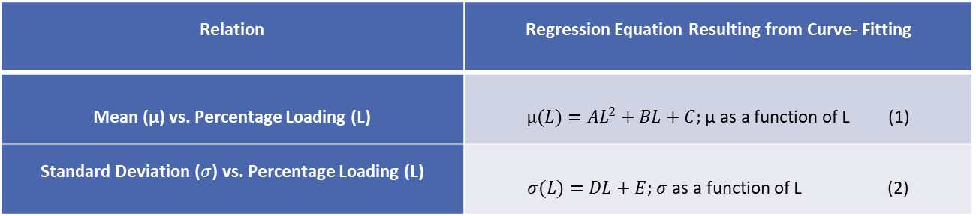
Equations By Regression Denoting Relation Between Mean And Standard Deviation Of Experimental Phase Currents And Loading Percentage
Relation | Regression Equation Resulting from Curve- Fitting
Mean (µ) vs. Percentage Loading (L) | $µ(L)=AL^{2}+BL+C$; µ as a function of L (1)
Standard Deviation ($σ$) vs. Percentage Loading (L) | $σ(L)=DL+E$; $σ$ as a function of L (2)

Slide 9
Coefficients Of Regression Equation For Mean Of Experimental Phase Currents Vs. Loading Percentage

Slide 10
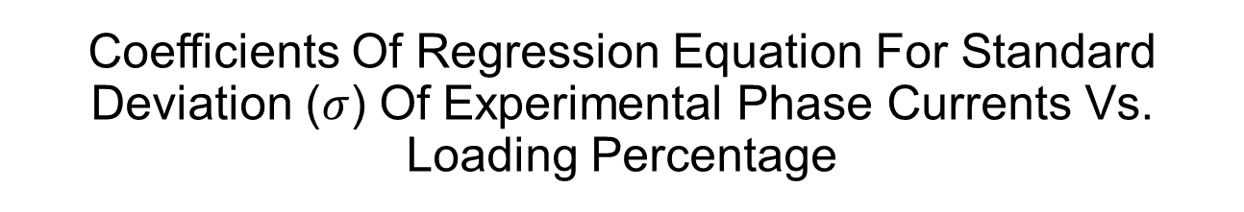
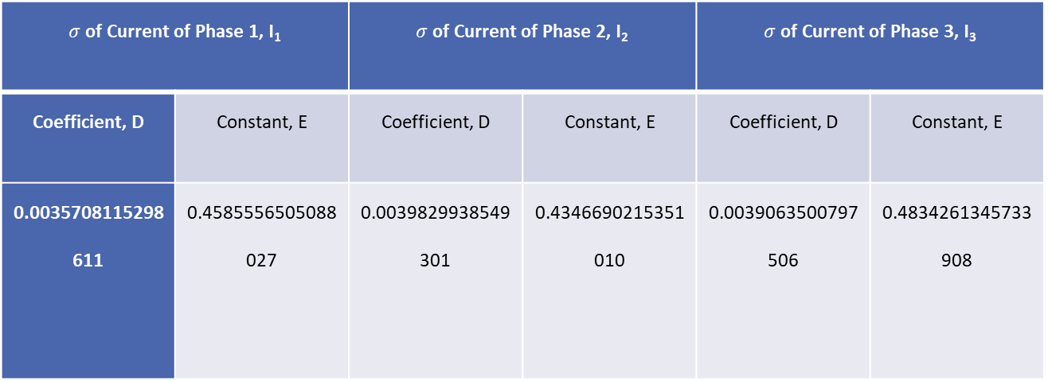
Coefficients Of Regression Equation For Standard Deviation ($σ$) Of Experimental Phase Currents Vs. Loading Percentage
$σ$ of Current of Phase 1, I₁ |  | $σ$ of Current of Phase 2, I₂ |  | $σ$ of Current of Phase 3, I₃
Coefficient, D | Constant, E | Coefficient, D | Constant, E | Coefficient, D | Constant, E
0.0035708115298611 | 0.4585556505088027 | 0.0039829938549301 | 0.4346690215351010 | 0.0039063500797506 | 0.4834261345733908

Slide 11
Coefficients Of Regression Equation For Mean Of Phase Currents Vs. Loading Percentage, Separating Positive And Negative Sequences
 | Coefficient, A | Coefficient, B | Constant, C
Mean of Positive I1 | 0.0000178613107915 | 0.0012907700040859 | 0.4478988542425746
Mean of Positive I2 | 0.0000158405117899 | 0.0018001655150320 | 0.4263418813275320
Mean of Positive I3 | 0.0000154187285184 | 0.0018416389292275 | 0.4674010995846712
Mean of Negative I1 | -0.0000178722255528 | -0.0012859541464588 | -0.4445181620563557
Mean of Negative I2 | -0.0000158947362797 | -0.0018367384684631 | -0.4230469722302160
Mean of Positive I3 | -0.0000156477473302 | -0.0018017199150833 | -0.4640741371390887

Slide 12
Coefficients Of Regression Equation For Standard Deviation Of Phase Currents Vs. Loading Percentage, Separating Positive And Negative Sequences
 | Coefficient, D | Constant, E
Standard Deviation of Positive Current of Phase 1 | 0.0015247693601749 | 0.1968401808298853
Standard Deviation of Positive Current of Phase 2 | 0.0018297383731645 | 0.1785216711026834
Standard Deviation of Positive Current of Phase 3 | 0.0017261970715102 | 0.2053203832027072
Standard Deviation of Negative Current of Phase 1 | 0.0015314247671600 | 0.1954264201037256
Standard Deviation of Negative Current of Phase 2 | 0.0018303301741044 | 0.1777509789007861
Standard Deviation of Positive Current of Phase 3 | 0.0017143422465670 | 0.2031318446070701

Slide 13
First Order Polynomial Fitting of Means of I₁ vs Load Percentage with predicted mean for 50% load

Slide 14
First Order Polynomial Fitting of Means of I₂ vs Load Percentage with predicted mean for 50% load

Slide 15
First Order Polynomial Fitting of Means of I₃ vs Load Percentage with predicted mean for 50% load

Slide 16
First Order Polynomial Fitting of Standard Deviations of I_{1,} I_{2 &} I₃ vs Load Percentage with predicted best Standard Deviation for 50%

Slide 17
Goodness of Fit
Residuals from regression model of mean of I₁
Residuals from regression model of standard deviation of I₁

Slide 18
Goodness of Fit
Residuals from regression model of mean of I₂
Residuals from regression model of standard deviation of I₂

Slide 19
Goodness of Fit
Residuals from regression model of mean of I₃
Residuals from regression model of standard deviation of I₃

Slide 20
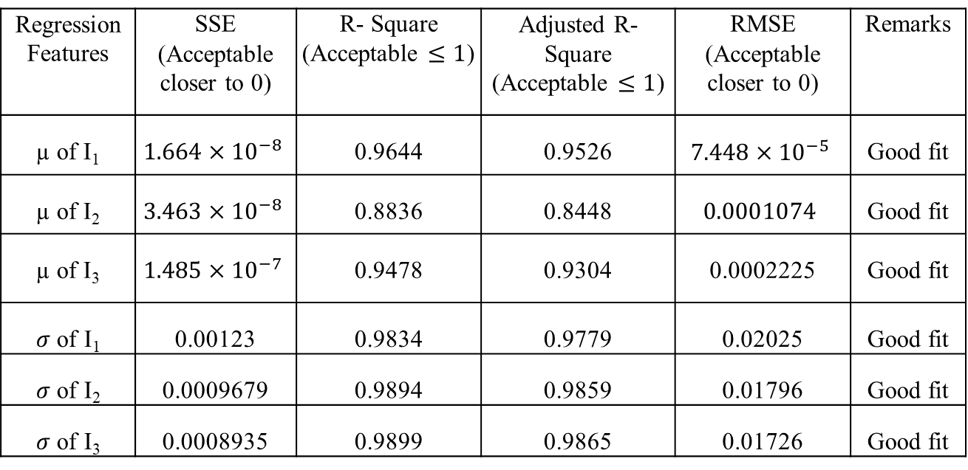
Goodness of Fit
GOODNESS OF FIT PARAMETER VALUES OF
THREE PHASE CURRENTS’ FEATURES
Regression Features | SSE (Acceptable closer to 0) | R- Square (Acceptable $≤1$) | Adjusted R- Square (Acceptable $≤1$) | RMSE (Acceptable closer to 0) | Remarks
µ of I₁ | $$1.664×{10}^{−8}$$ | 0.9644 | 0.9526 | $$7.448×{10}^{−5}$$ | Good fit
µ of I₂ | $$3.463×{10}^{−8}$$ | 0.8836 | 0.8448 | $$0.0001074$$ | Good fit
µ of I₃ | $$1.485×{10}^{−7}$$ | 0.9478 | 0.9304 | 0.0002225 | Good fit
$σ$ of I₁ | 0.00123 | 0.9834 | 0.9779 | 0.02025 | Good fit
$σ$ of I₂ | 0.0009679 | 0.9894 | 0.9859 | 0.01796 | Good fit
$σ$ of I₃ | 0.0008935 | 0.9899 | 0.9865 | 0.01726 | Good fit

Slide 21
REGRESSION MODEL VALIDATION
Distribution of Experimental I₁, 50% load
Distribution of Experimental I₁, 50% load

Slide 22
REGRESSION MODEL VALIDATION
Distribution of Experimental I₁, 50% load
Distribution of Experimental I₁, 50% load

Slide 23
REGRESSION MODEL VALIDATION
Distribution of Experimental I₃, 50% load
Distribution of Experimental I₃, 50% load

Slide 24
REGRESSION MODEL VALIDATION
ERROR IN PREDICTION OF STATISTICAL FEATURES BETWEEN
EXPERIMENTAL AND PROPOSED METHOD FOR 50% LOADING
Phase Currents | Statistical Features for 50% Loading | Features Calculated from Experimental Data | Predicted Best Features using Our Model | Prediction Error
I₁ | Mean | 0.0018890021734506 | 0.0018888806796832 | 6.504 %
 | Standard Deviation | 0.6112174211474820 | 0.6193588371971661 | 1.332 %
I₂ | Mean | 0.0014574972768154 | 0.0014576131025047 | 2.996 %
 | Standard Deviation | 0.6167324336211801 | 0.6171456443517061 | 0.067 %
I₃ | Mean | 0.0035148173427248 | 0.0035147076795838 | 4.858 %
 | Standard Deviation | 0.6575901541369190 | 0.6623313791482460 | 0.721 %

Slide 25
CONCLUSION

Slide 26
ACKNOWLEDGEMENT
We would like to show our sincere gratitude to Dr. Xiaodong Liang, Associate Professor, Memorial University for sharing the fault currents’ data with us during the course of this project, and we thank Mohammad Zawad Ali, Graduate Research Assistant, Memorial University for his insights on these data as the data were collected by him.

Slide 27
REFERENCES
[1] Gugaliya, Agam, et al. “Effective Combination of Motor Fault Diagnosis Techniques.” 2018 International Conference on Power, Instrumentation, Control and Computing (PICC), 2018.
[2] Liang, Xiaodong, and Kenneth Edomwandekhoe. “Condition Monitoring Techniques for Induction Motors.” 2017 IEEE Industry Applications Society Annual Meeting, 2017.
[3] Wen, Long, et al. “A New Convolutional Neural Network-Based Data-Driven Fault Diagnosis Method.” IEEE Transactions on Industrial Electronics, no. 7, 2018.
[4] Ting Yang, Haibo Pen, Zhaoxia Wang, and Che Sau Chang, “Feature Knowledge Based Fault Detection of Induction Motors through the Analysis of Stator Current Data,” IEEE Transactions on Instrumentation and Measurement, vol. 65, no. 3, March 2016.
[5] Martin-Diaz, Ignacio, et al. “An Experimental Comparative Evaluation of Machine Learning Techniques for Motor Fault Diagnosis under Various Operating Conditions.” IEEE Transactions on Industry Applications, no. 3, 2018.

Slide 28
Questions?

