Slide 1
“Anything goes any given Sunday, specially on Monday night.”
John Gruden

Slide 2
Using Machine Learning to beat your friends in a NFL Confidence Pool
Alain Ledon
Adjunct Professor, Baruch MFE
Amit Bhattacharyya
Sr. Data Scientist, Teachers Pay Teachers

Slide 3
Winning fantasy football leagues
Doesn't every sports fan think they know how and why things happen?
Are the pundits really better at predicting outcomes of games?
How good are point spreads at predicting the winning teams on a consistent basis?
While point spreads are the simplest and best starting point for winning a simple weekly "pick-em" league, application of machine learning to predict outcomes can show substantial and consistent improvement.

Slide 4
Fantasy league logistics
One popular format of “pick-em” fantasy leagues in the NFL is to pick outright winners of games and rank them 1-16 based on confidence in the pick (16 highest confidence).
Participants in the league accumulate points based on correct picks.
The overall winner is the person with the most points at the end of season.
Winning the league usually involves consistently picking the most likely winners and being conservative in not placing high weights on upsets.

Slide 5
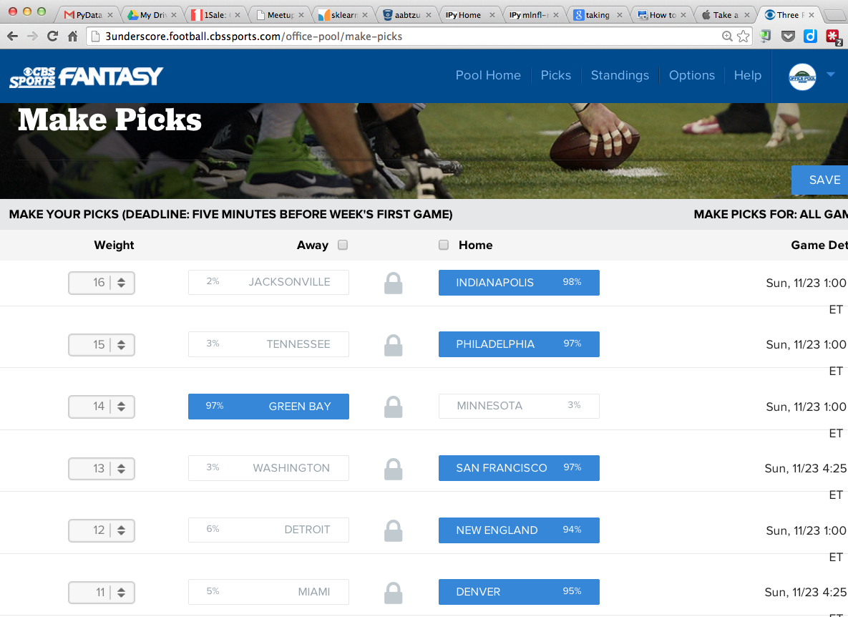

Slide 6
Fantasy league strategies
The betting world already provides a view on the likelihood of a particular team winning via the point-spread. A simple strategy is to rank the choices each week by the Vegas-provided spread.
Ad-hoc decisions based on:
Win-Loss records of teams
Opponents strength of schedule
Home vs. Away game
Division vs. Non-division game
Injury reports
Personal preferences and intuition
Ideally the point spread encapsulates all these scenarios into a single number.

Slide 7
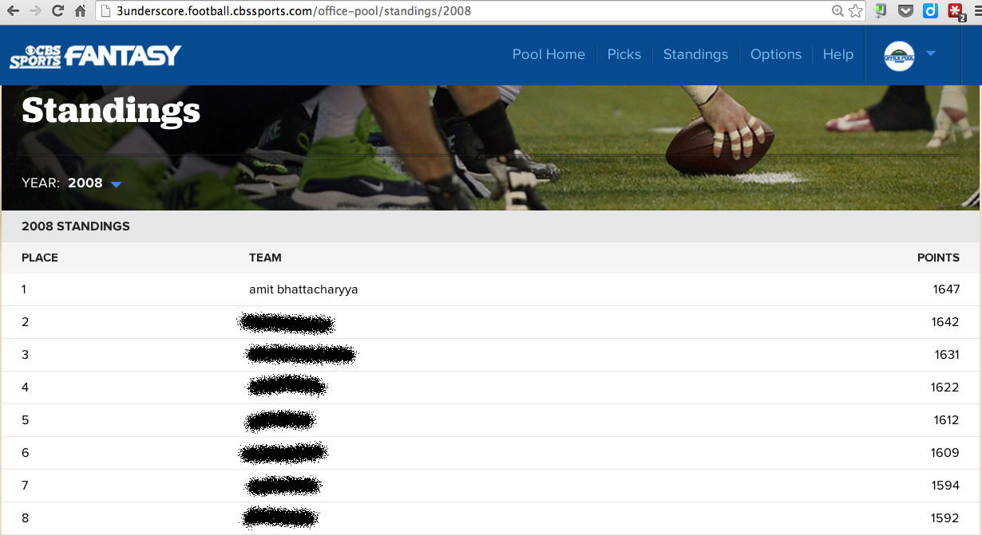
How good is the spread strategy?
In 2008, the simple spread strategy would have lost by 11 points.

Slide 8
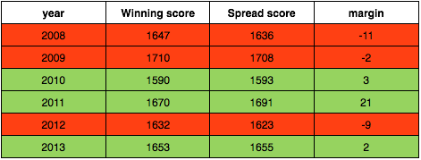
On average the spread strategy would have won in about half the years. It is important to remember that this strategy requires no thinking or guessing of any sort.
Can we do better? Can we win every year?

Slide 9
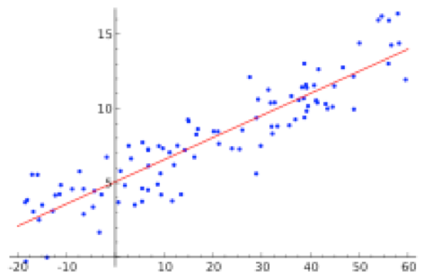
Linear vs. Logistic Regression
Linear regression is used to estimate a value based on a set of X vs. X data based on a linear model.

Slide 10
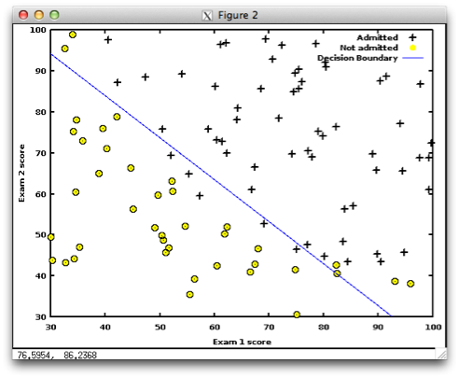
Linear vs. Logistic Regression
Logistic regression is used to classify data into two or more different groups. For simple cases a decision boundary can be used to visualize the classification.

Slide 11
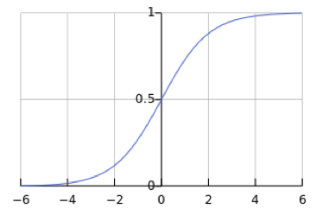
Logistic Regression
The sigmoid function is often used in logistic regression as a binary classifier because of its non-linear shape. If the predicted value is > 0.5 then classifier is True (or 1), if < 0.5 then False (or 0).
Since the goal is to predict a binary outcome, i.e. wins and loses, it makes sense to use logistic regression for our NFL fantasy league predictions.

Slide 12
Using Logistic Regression
The simplest form of logistic regression has:
N number of inputs (called features)
A single output for the binary classifier
For the NFL fantasy league:
Need to determine the relevant features
Carefully consider what the classifier should predict

Slide 13
Python To the Rescue
Use Python’s scikit-learn package to simplify implementation of logistic regression
http://scikit-learn.org/
Once the features (X) and classifiers (y) are properly defined, running the logistic regression is quite simple.
# define model
logreg = linear_model.LogisticRegression()
logreg.fit(X, y)
# compute training accuracy
sc = logreg.score(X, y)
# get results from pre-computed logreg object
p = logreg.predict(predict_X) # 0/1 classifier

Slide 14
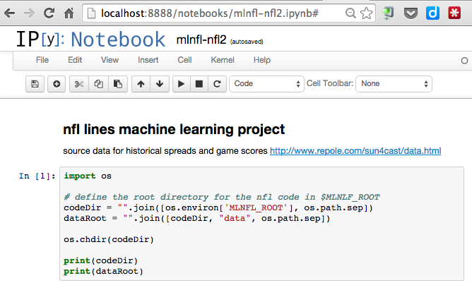
How do we use it?
Use an iPython notebook to interactively run Python code and examine results ...

Slide 15
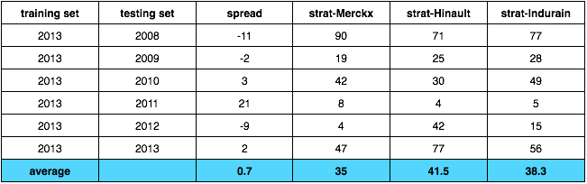
Backtesting
Does logistic regression outperform spread method consistently?
(Table shows values of how each strategy would perform compared to that year’s winner.)
Three slightly different strategies of ranking the weekly picks.
Merckx = pick favored team, rank by probability of win
Hinault = pick predicted team, rank by probability of win
Indurain = pick predicted team, rank by abs(probability - .5)

