Slide 1
Treasure Valley Cycling Alliance(TVCA) Bike Count Data Analysis
Advisor: Mike Stefancic

Slide 2

Introduction
The TVCA is an all-volunteer non-profit organization serving Southern Idaho with the goal of celebrating and promoting cycling in the Treasure Valley.
http://www.biketreasurevalley.org/

Slide 3
Problem Statement
Do facilities types/street characteristics predict the amount of bike traffic?
How does general traffic volume/speed limit and the bike volume correlate?

Slide 4
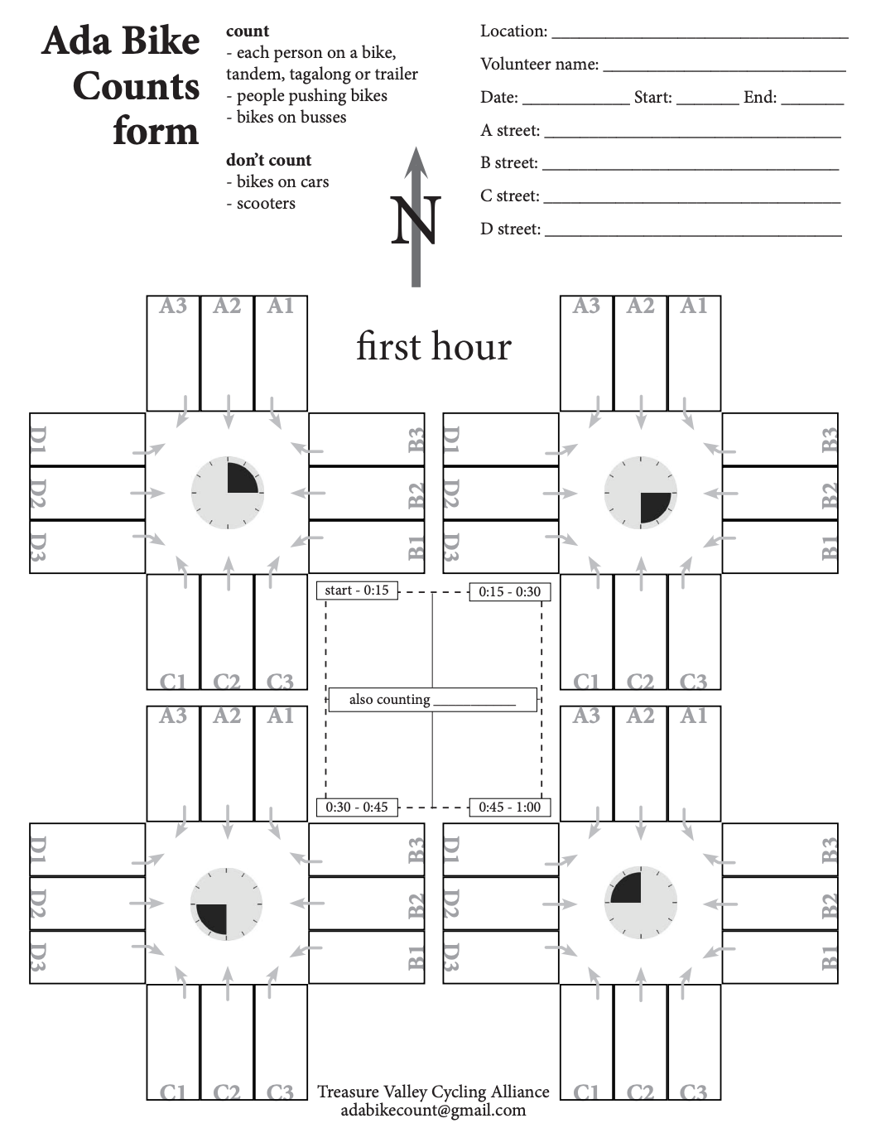
Data Collection

Slide 5
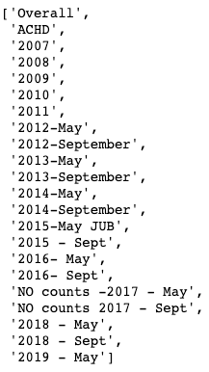
Data: csv
TVCA bicycle counts
csv
22 sheets
2007-2019

Slide 6
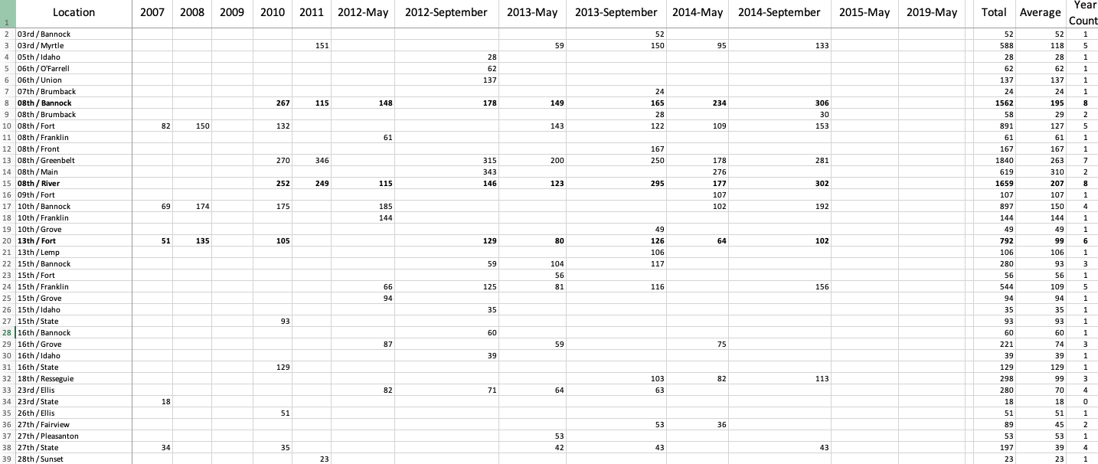
Data: Overall
Notes:
138 intersections
sparse data
collected in May and Sept or both

Slide 7
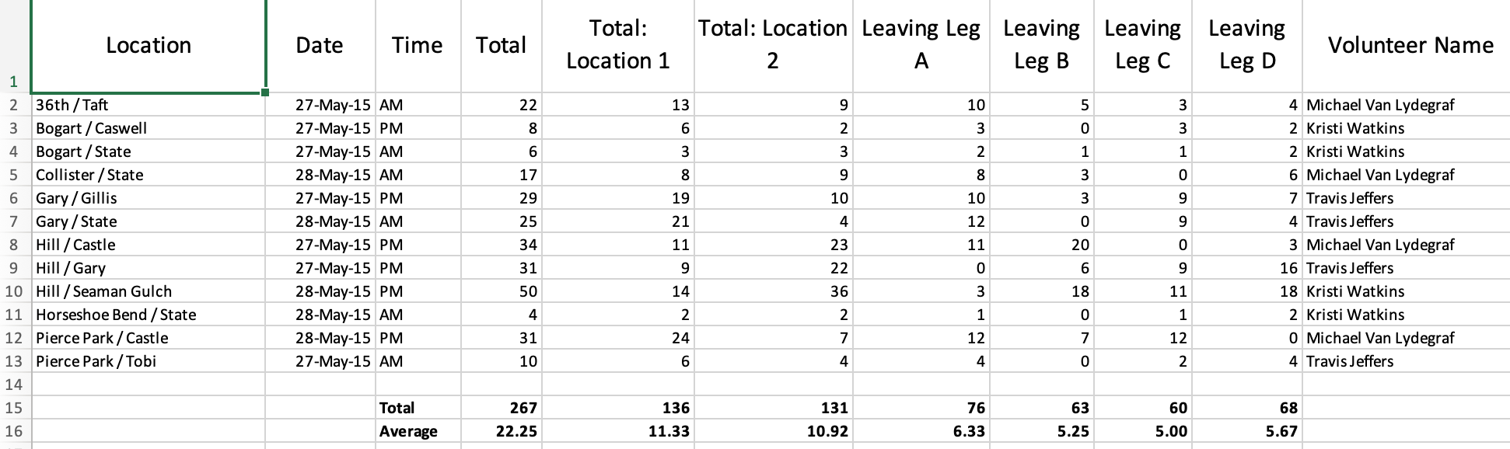
Data: sheets

Slide 8
Data: dbf
GIS data From ACHD:
Shapefile: geospatial vector data format for GIS software.
.shp — shape format; the feature geometry itself
.shx — shape index format; a positional index of the feature geometry to allow seeking forwards and backwards quickly
.dbf — attribute format; columnar attributes for each shape, in dBase IV format

Slide 9
Data: dbf
Bike Lanes
Functional classification
Traffic counts

Slide 10
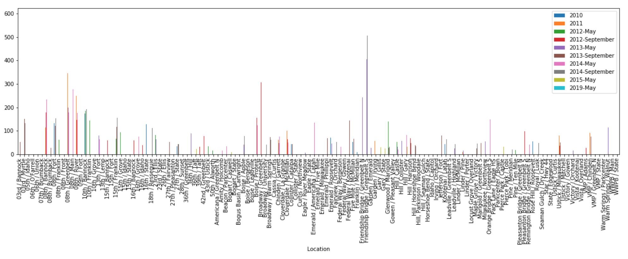
Distribution of Bike Counts

Slide 11
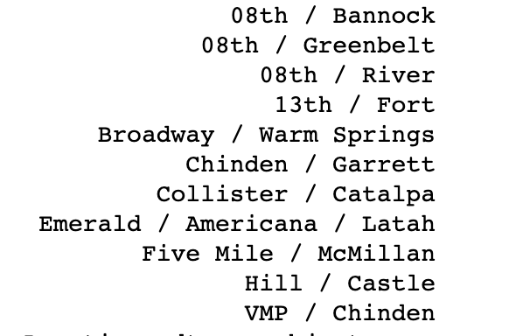
RQ1: Bike lane Infrastructure and Bike Traffic
Sparse/irregular data
Identify top intersections with the most amount of data → 11
Notes:
Spread over 138 intersections

Slide 12
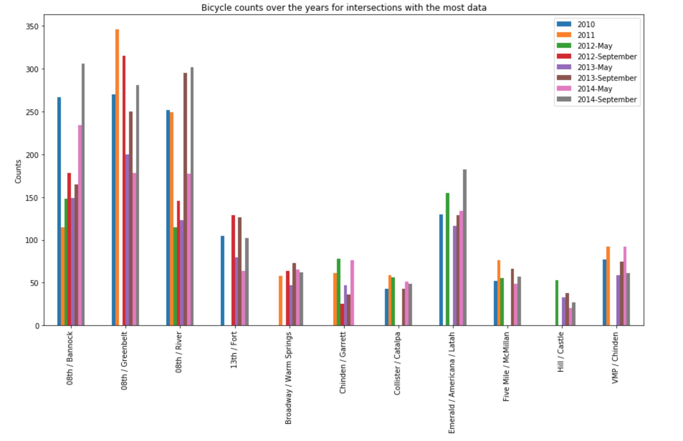
Distribution of counts for the top 11 intersections over the years
More data was collected in May than in September from 2010 to 2019

Slide 13
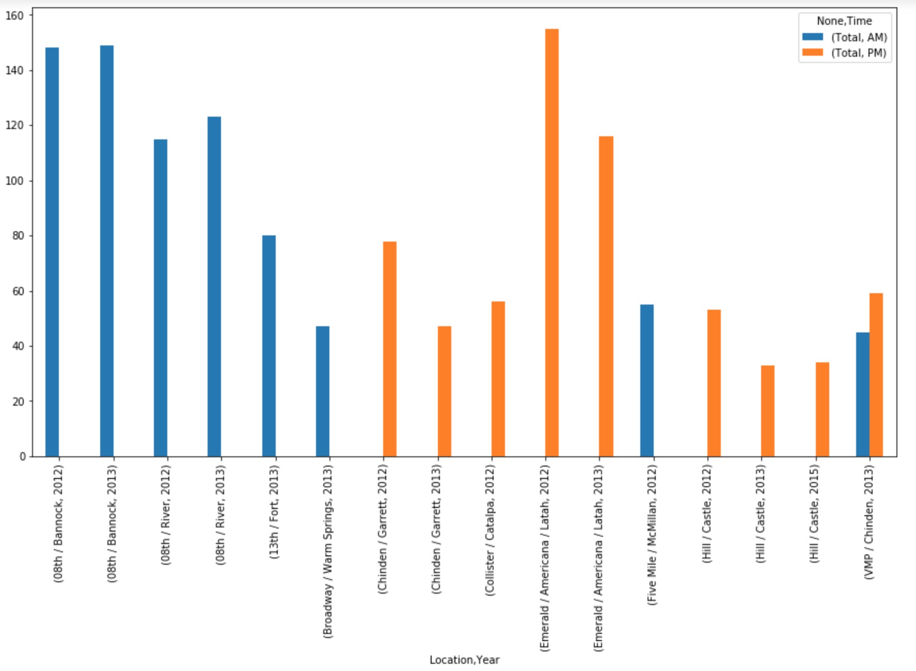
2010 - 2019 May Bike Counts over the top 10 intersections

Slide 14
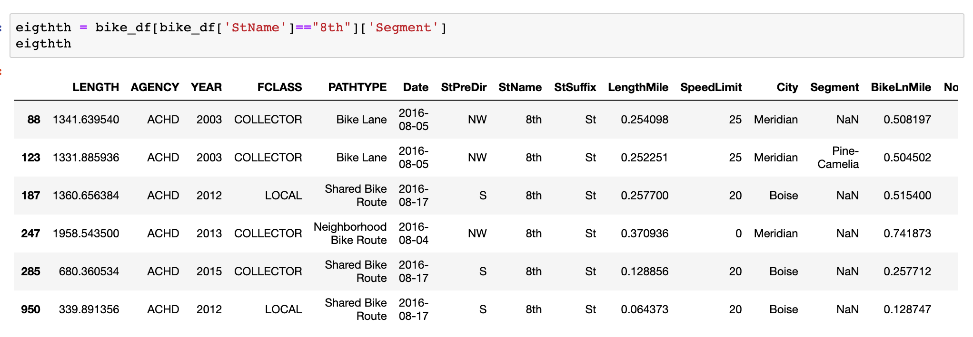
Adding Bike Lane Infrastructure to Bike Counts

Slide 15
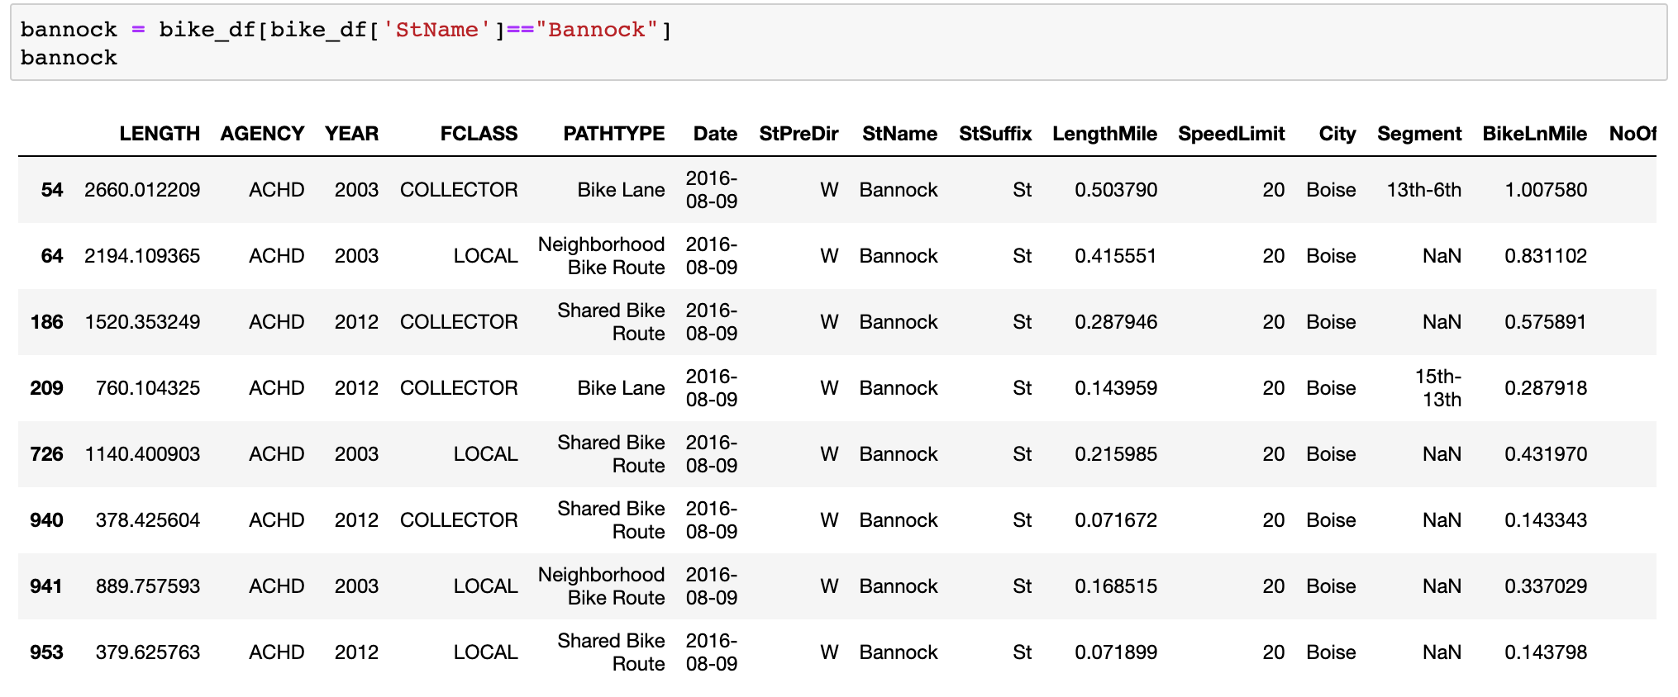
Adding Bike Lane Infrastructure to Bike Counts

Slide 16
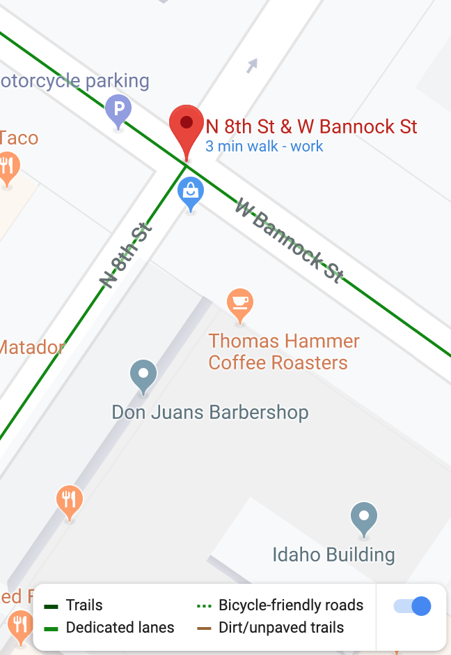
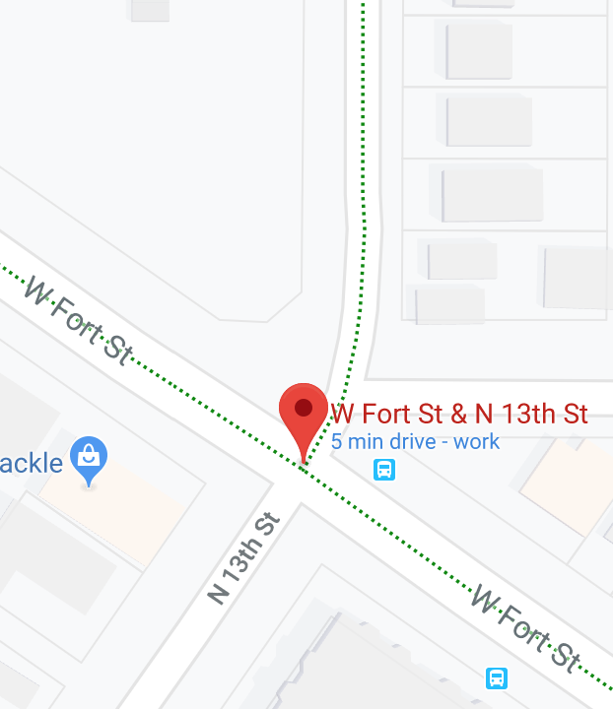
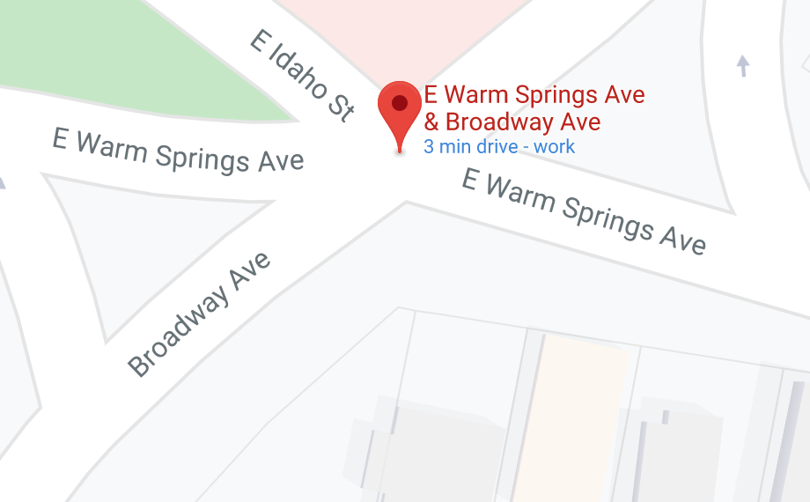
Bike lanes in Google Maps

Slide 17
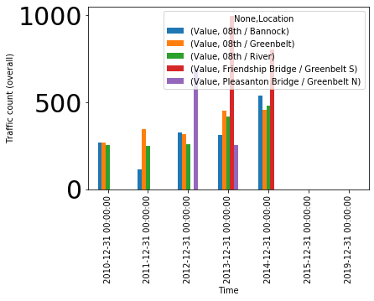
Initial Analysis
Goal: Select Intersections with most complete data
8th/Bannock has bike data for multiple time slots
Friendship Bridge/Greenbelt has bike data for only two time slots
Intersection with statistically sufficient data were selected for further analysis

Slide 18
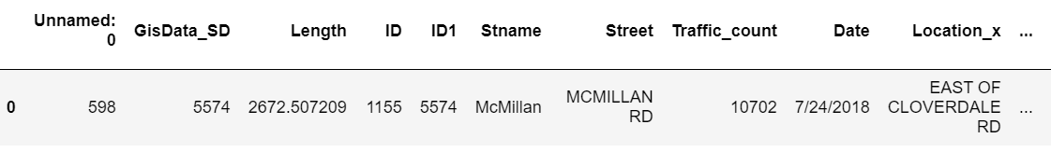
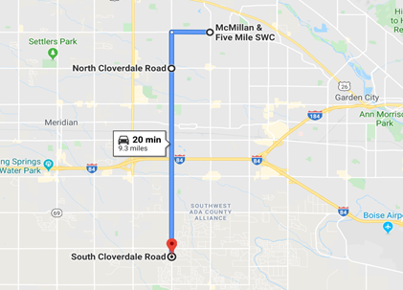
General Traffic
How were the Datasets merged?

Slide 19
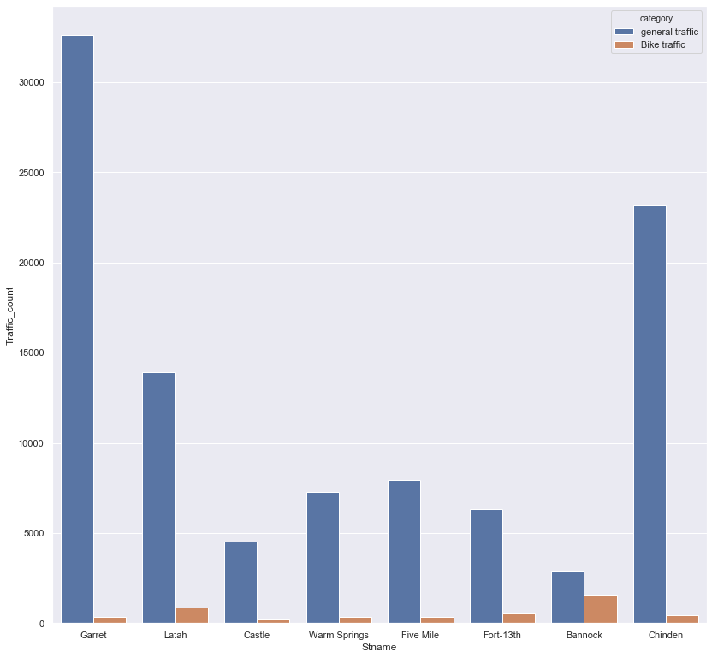
RQ2 : General traffic and Bike volume correlation
Typical Expectation :
Bike Traffic is inversely proportional to General traffic
True for Bannock St
However Latah and Fort st don’t follow this pattern
We will look for additional factors impacting bike Traffic

Slide 20
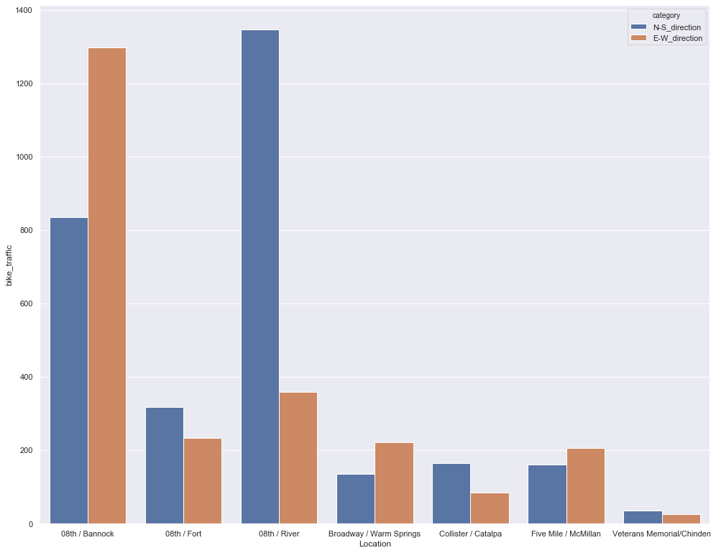
Directions
Intersection bike traffic can be
Equal distributed between both streets
Skewed towards one street
Skewed bike traffic pattern indicates that street rather than intersection is reason for higher traffic

Slide 21
Challenge : Intersection Speed Limit
Assumptions:
Longer Roads => Higher Automobile Traffic
Higher Posted Speed => Higher Automobile Traffic
W₁ = (S₁ * L₁ )/L_{t}
W₂ = (S₂ * L₂)/L_{t}
W_{i} =Weighted Average of Street i
L_{i} = Length of Street i
S_{i} = Posted Speed of Street i
L_{t} = Total Length of both roads
S₁ * L₁
Weighted Average Intersection Speed = (W₁ + W₂)/2
S₂* L₂

Slide 22
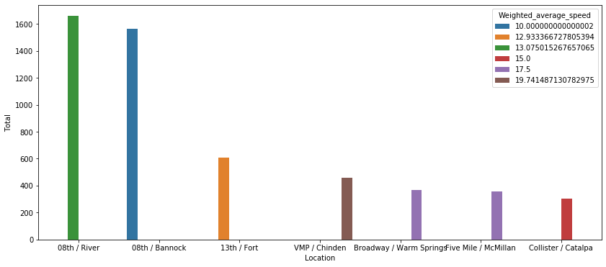
Challenge : Intersection Speed Limit
Lower Speed => Higher Bike Traffic
Bike Traffic
Higher Weighted Average Speed
Higher Speed => Lower Bike Traffic

Slide 23
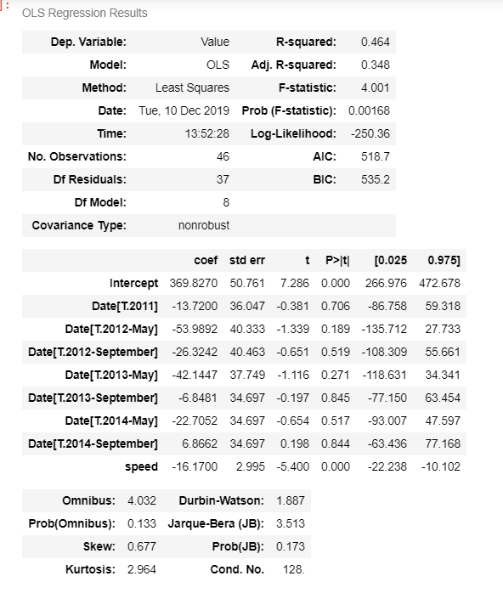
OLS Regression Results
Weighted Average Speed can be a good predictor variable for bike traffic.

Slide 24
Conclusion
Intersections with enough data were selected and analyzed for this project
It looks like streets with bike lanes see more bike traffic than streets without *
General traffic is an important but not the only factor affecting bike traffic
Weighted Average speed correlated well with bike traffic
Notes:
* More bike lanes towards downtown, university - further study is required

Slide 25
Future Direction and Recommendation
An expanded dataset with linking identifier would allow for more thorough analysis and generate more accurate predictions.
Possible sources include ITD Open Data, Google Map, Local bikers etc.
Notes:
Weather
School in session
Areas close to the university
Times: Weekdays 7 to 9 ad 4 to 6
Avoid school holidays

Slide 26
Thank You!

