Slide 1



Accelerator Architecture in Computational Biology and Bioinformatics, February 24th, 2018, Vienna, Austria
Exploring Speed/Accuracy Trade-offs in Hardware Accelerated Pre-Alignment in Genome Analysis
Mohammed Alser, Hasan Hassan, Akash Kumar, Onur Mutlu, and Can Alkan
Bilkent University, TU Dresden, ETH Zürich

Slide 2
Executive Summary
Problem: There is a significant performance gap between high-throughput DNA sequencers and read mapper.
Observations: Inaccuracy of state-of-the-art pre-alignment filters leads to high computational burden.
Goal: Identify and mitigate the sources of inaccuracy in state-of-the-art filters.
Key Results:
A pre-alignment filter is beneficial if the filter:
Is at least 2x faster than the alignment.
Can reject at least 80% of incorrect mappings.

Slide 3
What makes Read Mapper SLOW?
Notes:
As Prof. Onur explained that there exist a performance bottleneck between the sequencer and the read mapper. And bridging this gap requires understanding what makes read mapper SLOW!

Slide 4
What makes Read Mapper SLOW?
Key Observation # 1
90%
of the read mapper’s execution time is spent in read alignment.
Alser et al, Bioinformatics (2017)
Notes:
If we analyze the execution time of current read mappers that have alignment step, we will observe that 90% of the time is spent in read alignment step.

Slide 5



What makes Read Mapper SLOW? (cont’d)
Key Observation # 2
98%
of candidate locations have high dissimilarity with a given read.
Cheng et al, BMC bioinformatics (2015)
Xin et al, BMC genomics (2013)
Notes:
We also observe that an overwhelming majority of the candidate locations have high dissimilarity with a given read, which leads to waste the time verifying these locations.
H. Cheng, et al., "BitMapper: an efficient all-mapper based on bit-vector computing," BMC bioinformatics, vol. 16, p. 1, 2015.
H. Xin, et al., "Accelerating read mapping with FastHASH," BMC genomics, vol. 14, p. S13, 2013.

Slide 6
What makes Read Mapper SLOW? (cont’d)
Key Observation # 3
Quadratic-time dynamic-programming algorithms.
etc
etc
Data dependencies limits the computation parallelism.
etc
Computing the entire matrix all the time for all mappings.
Notes:
1- Read alignment follows the basic dynamic-programming doctrine which runs in a quadratic time.
2- Data dependencies between the entries limits the parallelism. Each cell depends or three pre-computed cells (immediate left, upper, and upper-left cells). Thus, we can compute the vectors one after another but not in parallel. Left-to-right, or top-to-bottom, anti-diagonal.
3- We can solve a significant amount of time, If we can find a way to detect the incorrect mappings with cheap heuristics, much cheaper than computing the alignment.

Slide 7
Can we do better?
Notes:
So, can we do better?

Slide 8
Proposed Strategy
Compute the alignment for only similar sequences
Highly parallel matrix computation
Highly accurate filtering algorithm
Notes:
1- Our first proposed strategy is to differentiate between correct mappings and incorrect ones. Remove the incorrect ones and align only similar sequences.
2- parallelizing the matrix computation.
3- Design an accurate filter to remove most of the incorrect mappings.

Slide 9
1- Align Only Similar Sequences
Notes:
The main aim of the pre-alignment filtering is to remove dissimilar sequences and allow only similar ones to be further processed.

Slide 10

The Effect of Pre-Alignment
Filter+
Alignment
assuming alignment processes 100 Mappings/sec
Pre-alignment saves more than
40% to 80%
of the total processing time
Target
Notes:
What effect pre-alignment has on overall execution time? Well, that depends on how much and how fast it can remove incorrect mappings

Slide 11
2- Highly Parallel Matrix Computation
8 matches 0 mismatches
I
S
T
A
N
B
U
L
I
S
T
A
N
B
U
L
Notes:
Our second proposed method to accelerate read mappers is to parallelize the matrix computation.
To explain our new matrix, here is an example of exact match sequences. Now imagine there is a base deletion for any reason.

Slide 12

2- Highly Parallel Matrix Computation (cont’d)
8 matches 0 mismatches
I
S
T
A
N
B
U
L
I
S
T
A
N
B
U
L
Notes:
Let it be the character “A”. What effect the deletion has on the overall alignment?

Slide 13
2- Highly Parallel Matrix Computation (cont’d)
3 matches 5 mismatches
I
S
T
A
N
B
U
L
I
S
T
N
B
U
L
To cancel the effect of deletion, we need to shift to right direction
Notes:
After deletion, the trailing bases will be shifted to left to form a single sequence.
But when we align it back, we get too many mismatches though the number of edits is only ONE.
To cancel the effect of deletion and correctly align the sequences, we have to shift the sequence to right and align again.

Slide 14
2- Highly Parallel Matrix Computation (cont’d)
7 matches 1 mismatches
I
S
T
A
N
B
U
L
I
S
T
N
B
U
L
I
S
T
N
B
U
L
Notes:
With the help of another right-shifted copy of the original sequence, we can have more similarities between the two sequences. Think about other scenarios where you have an insertion? Or a combination of deletion and insertion?

Slide 15
2- Highly Parallel Matrix Computation (cont’d)
Reference
2 Deletion masks
We need to compute 2E+1 vectors, E=edit distance threshold
dp[i][j]= 0 if X[i]=Y[j]
1 if X[i]≠Y[j]
Query
No data dependencies!
2 Insertion masks
Notes:
So this is how we compute the filter matrix. We pairwise compare each character from a sequence to its corresponding character from the other sequence. Match =0, Mismatch=1
The yellow diagonal vector represents XOR between the two sequences. The pink diagonal vectors represent right-shifted copies of the query sequence then compared to the reference. The blue vectors represent left-shifted copies of the query. By this we can guarantee that we can correctly examine any two sequences regardless the type of edits they have. AND NO DATA DEPENDENCIES between the cells.

Slide 16
3- Highly accurate filtering algorithm
Pigeonhole principle:
if E items are put into E+1 boxes, then one or more boxes would be empty.
I
S
T
A
N
B
U
L
Our aim is to find these E+1 segments quickly.
I
S
T
N
B
U
L
I
S
T
N
B
U
L
Notes:
Our third proposed method is design a highly accurate filtering algorithm.

Slide 17


3- Highly accurate filtering algorithm (cont’d)
MAGNET
Check for substitutions.
The longest identical subsequence ≥$\left\lceil (m−E)/(E+1)\right\rceil .$
Extraction & Encapsulation (divide-and-Conquer fashion).
Not much of matches in the first mask
38 ≥ $\left\lceil 75/4\right\rceil$
Notes:
1- we check for exact matching, If not enough matches in the first vector, then we continue.
2- Each mask nominate the longest segment of consecutive zeros. Then we pick the longest out of all nominated segments. We evaluate its length by the lower bound equality $\left\lceil (m−E)/(E+1)\right\rceil$, which occurs when all edits are equispaced and all E+1 subsequences are of the same length. If it satisfies then move to step 3.

Slide 18
3- Highly accurate filtering algorithm (cont’d)
MAGNET
Check for substitutions.
The longest identical subsequence ≥$\left\lceil (m−E)/(E+1)\right\rceil .$
Extraction & Encapsulation (divide-and-Conquer fashion).
Now divide the problem into two subproblems and repeat
Notes:
Step 3: Replace the longest match and all its corresponding positions in the other masks by ‘1’s. We also encapsulate the longest matches by one from right and left. This encapsulation represents the edits that divide a single long match into smaller matches. Then we can apply the third step recursively over the right side and left side separately (divide-and-conquer approach).

Slide 19
3- Highly accurate filtering algorithm (cont’d)
MAGNET
Check for substitutions.
The longest identical subsequence ≥$\left\lceil (m−E)/(E+1)\right\rceil .$
Extraction & Encapsulation (divide-and-Conquer fashion).
Counting the encapsulation bits reveals the number if edits
Notes:
When the algorithm is terminated, then the number of edits equals to the number of encapsulation bits = 5 edits

Slide 20
MAGNET Accelerator
Notes:
We implement our algorithm in Verilog and design a hardware accelerator for it. Each processing core is able to examine a single mapping. We integrate many hardware processing cores in the architecture of MAGNET for examining many mappings in a parallel fashion.

Slide 21
VC709 Resource Utilization
Edit Distance Threshold | MAGNET 1 core |  | GateKeeper 1 core
 | Slice LUT | Slice Register | Slice LUT | Slice Register
2 | 10.5% | 0.86% | 0.39% | 0.01%
5 | 37.8% | 2.3% | 0.71% | 0.01%
Edit Distance Threshold | MAGNET 8 cores, 2 cores |  | GateKeeper 16 cores
 | Slice LUT | Slice Register | Slice LUT | Slice Register
2 | 85% | 7% | 32% | 2%
5 | 83% | 6% | 45% | 2%
Notes:
GateKeeper occupies at least 10x less resources than MAGNET. This helps to integrate more processing cores than MAGNET.

Slide 22
False Accept Rate
MAGNET is 7x - 105x less false accept rate
Notes:
However, MAGNET is 7x - 105x less false accept rate

Slide 23
True Reject Rate
MAGNET rejects 87% - 99% incorrect mappings
Notes:
MAGNET also rejects 87% - 99% incorrect mappings

Slide 24
Alignment vs Pre-Alignment Speedup
Work | Platform | Mappings #/ 1 sec
MAGNET | FPGA (Virtex7) | 37,500,000
GateKeeper [17] | FPGA (Virtex7) | 1,665,811,051
SHD [4] | Intel SSE | 18,820,572
Myers’s algorithm [12] | Intel SSE [13] | 2,146,266
Smith-Waterman [4] | Intel SSE | 201,783
Smith-Waterman [16] | FPGA (Virtex4) | (128 bp) 689,543
Smith-Waterman [16] | GPU | (128 bp) 86,192
Smith-Waterman [15] | GPU | 4,000
MAGNET requires 2x less time than SHD and 44x more time than GateKeeper.
MAGNET is 17x faster than the accelerated implementation [13] of Myers’s algorithm [12]).

Slide 25
Speed/Accuracy Trade-offs (end-to-end)
Filter+
Alignment
assuming alignment processes 100 Mappings/sec
GateKeeper
MAGNET
Target
Notes:
So we have MAGNET that is accurate but slow
And GateKeeper that is fast but inaccurate.
What is better, SPEED or ACCURACY?

Slide 26
Conclusion
We introduce, MAGNET, fast and accurate FPGA pre-alignment filter.
Adding pre-alignment filter to genome analysis is beneficial if the filter is at least 2x faster than the alignment and able to reject at least 80% of incorrect mappings.
FPGAs will likely continue to be the best acceleration platform for computational genomics Aluru et al., IEEE Design & Test, (2014).
Integrating the FPGA accelerators with the sequencer can help to hide the complexity and details of the underlying hardware.

Slide 27
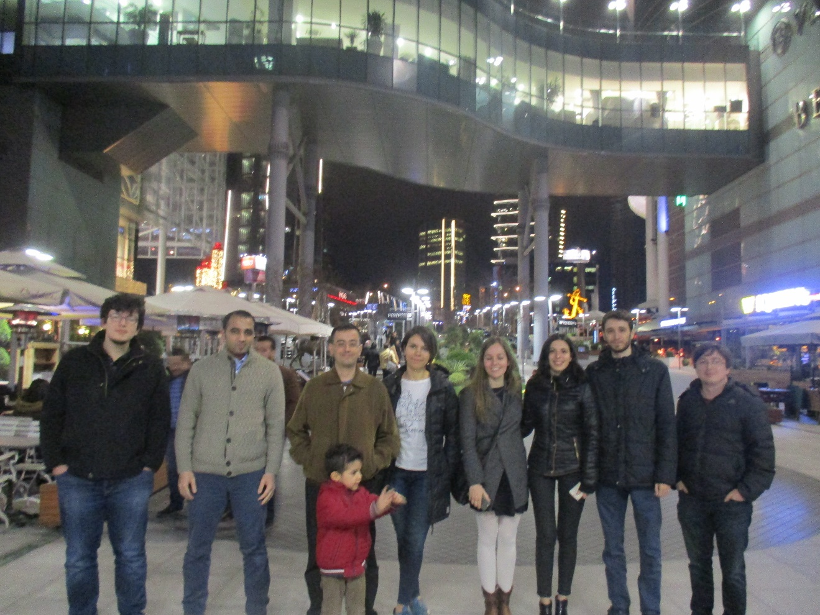




Acknowledgements
ALKAN Lab
Can Alkan
Mohamme Alser
SAFARI Lab
Onur Mutlu
Hasan Hassan
CfAED center
Akash Kumar

Slide 28
Accelerator Architecture in Computational Biology and Bioinformatics, February 24th, 2018, Vienna, Austria
Exploring Speed/Accuracy Trade-offs in Hardware Accelerated Pre-Alignment in Genome Analysis
Mohammed Alser, Hasan Hassan, Akash Kumar, Onur Mutlu, and Can Alkan
Bilkent University, TU Dresden, ETH Zürich

