Slide 1


IMPACT: Interval-based Multipass Proteomic Alignment with Constant Traceback
Sahand Kashani, Stuart Byma, James Larus
2019/02/16
Notes:
Recent algorithmic work

Slide 2
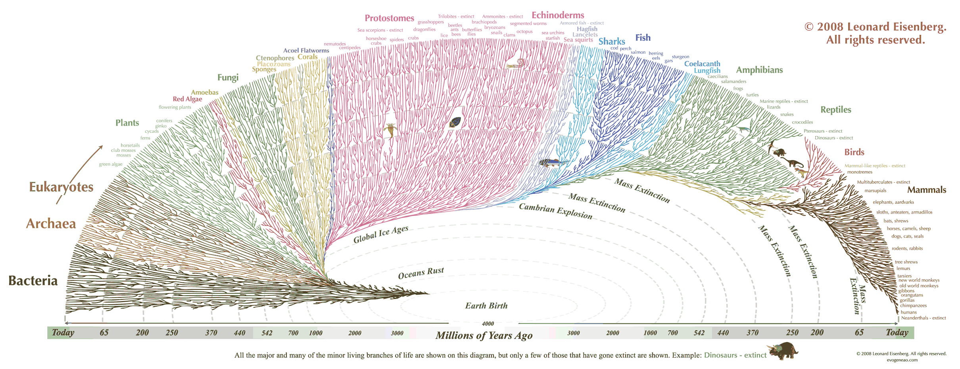
Phylogenetics – The study of evolutionary history between species
Image credit: http://www.oceanographerschoice.com/2009/06/wicked-cool-phylogenetic-tree/

Slide 3
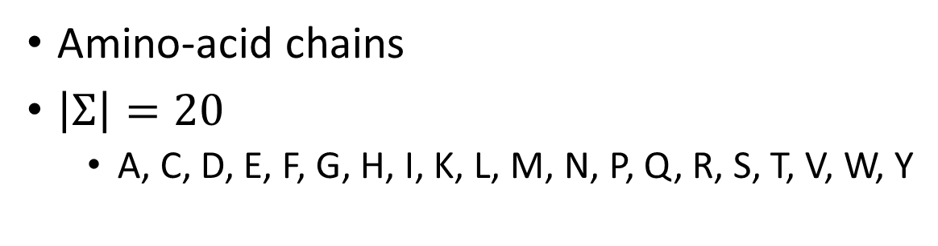
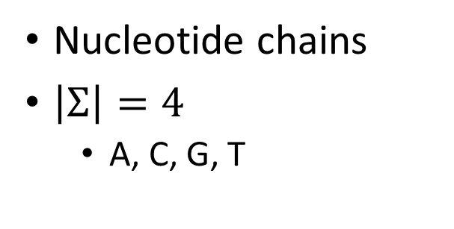
Evolutionary biology through protein analysis
Find relationships between species’ proteins
Cluster “similar” proteins together
Similarity determined through sequence alignment
DNA
Proteins
Nucleotide chains
$\left|Σ\right|=4$
A, C, G, T
Amino-acid chains
$\left|Σ\right|=20$
A, C, D, E, F, G, H, I, K, L, M, N, P, Q, R, S, T, V, W, Y

Slide 4
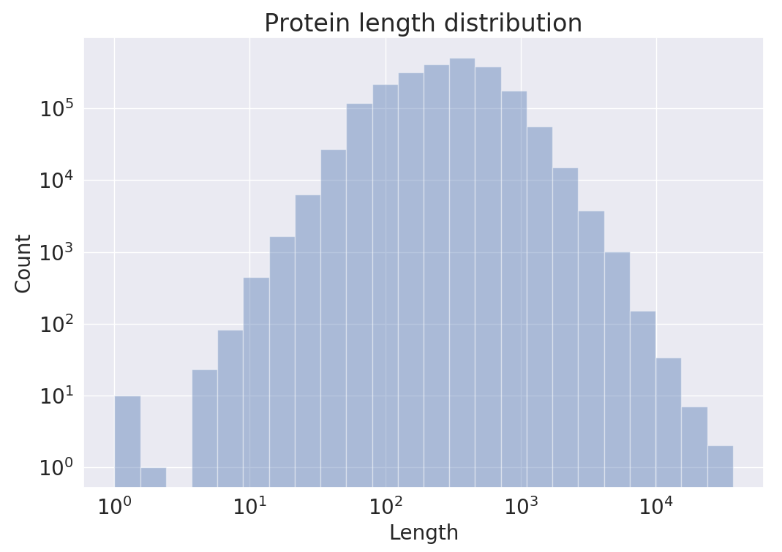
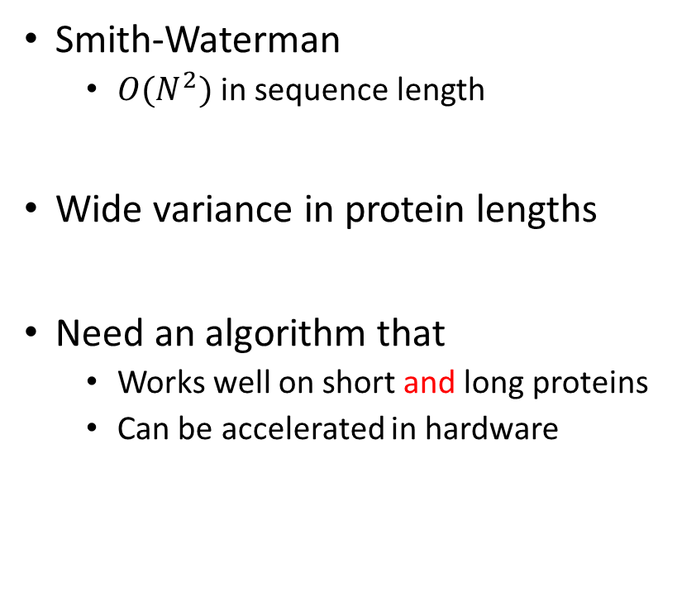
Alignment runtime extremes
Smith-Waterman
$O(N^{2})$ in sequence length
Wide variance in protein lengths
Need an algorithm that
Works well on short and long proteins
Can be accelerated in hardware
4 orders of magnitude
Notes:
Not the same fixed-length reads that you get out of your sequencing machine

Slide 5
Outline
Background (optimal vs. heuristic sequence alignment)
Hardware-friendly heuristic alignment for DNA sequences [1]
Adapting hardware-friendly heuristic alignment to protein sequences
Challenges around protein characteristics
Algorithmic alignment improvements
Quality of results & discussion
Future work
[1] Darwin: A Genomics Co-processor Provides Up to 15,000x Acceleration on Long Read Assembly [Turakhia, Bejerano, Dally], ASPLOS’18

Slide 6
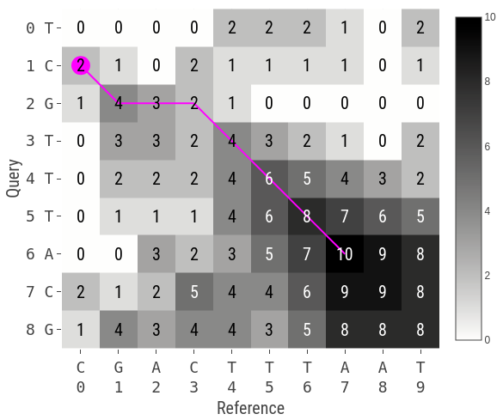
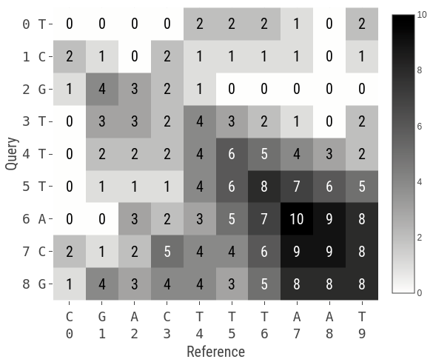
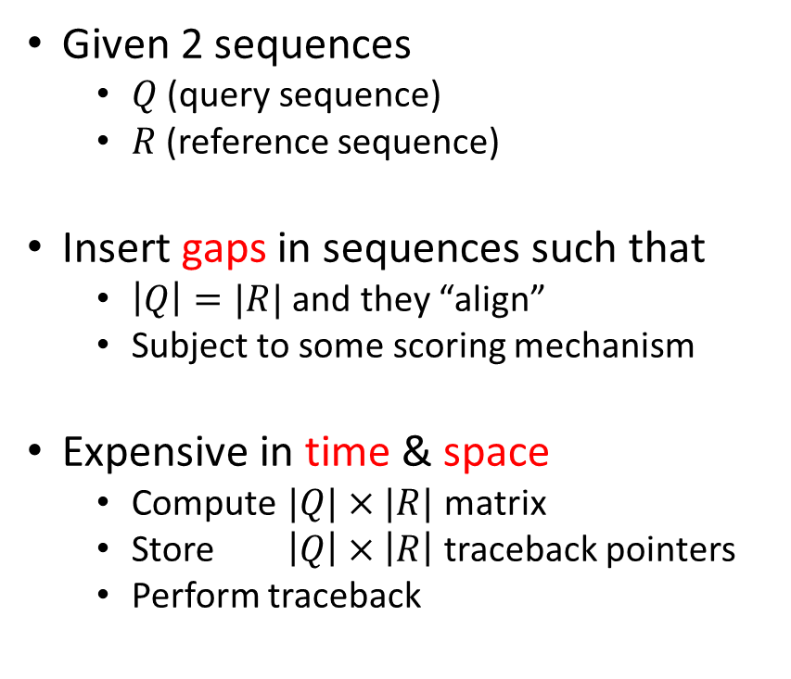
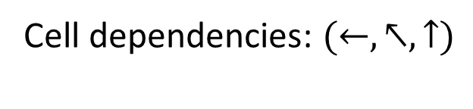
Optimal alignment
Cell dependencies: $(←,↖,↑)$
A | 2 | -1 | -1 | -1
C | -1 | 2 | -1 | -1
G | -1 | -1 | 2 | -1
T | -1 | -1 | -1 | 2
 | A | C | G | T
Given 2 sequences
$Q$ (query sequence)
$R$ (reference sequence)
Insert gaps in sequences such that
$\left|Q\right|=|R|$ and they “align”
Subject to some scoring mechanism
Expensive in time & space
Compute $|Q|×|R|$ matrix
Store $\left|Q\right|×\left|R\right|$ traceback pointers
Perform traceback
 | A | C | G | T
A | 2 | -1 | -1 | -1
C | -1 | 2 | -1 | -1
G | -1 | -1 | 2 | -1
T | -1 | -1 | -1 | 2
Notes:
For simplicity I’m illustrating alignment with DNA
Each cell remembers the neighbor it used to compute its value

Slide 7
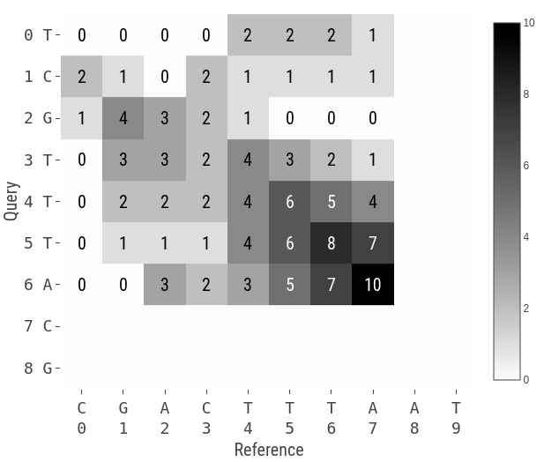
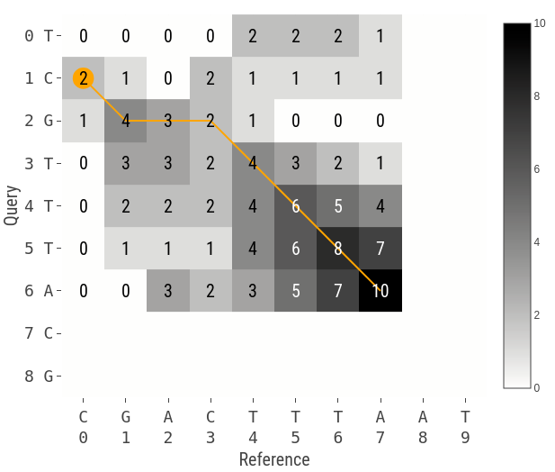
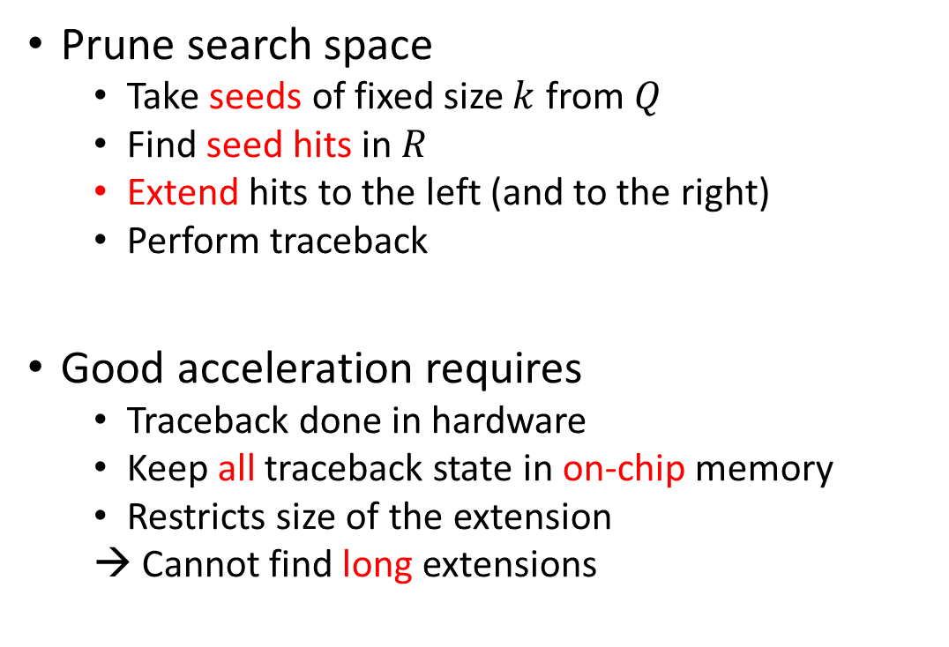
Heuristic alignment
Left extension
Prune search space
Take seeds of fixed size $k$ from $Q$
Find seed hits in $R$
Extend hits to the left (and to the right)
Perform traceback
Good acceleration requires
Traceback done in hardware
Keep all traceback state in on-chip memory
Restricts size of the extension
→ Cannot find long extensions
Notes:
Use seed hit location as an anchor to know where to end the alignment

Slide 8
Outline
Background (optimal vs. heuristic sequence alignment)
Hardware-friendly heuristic alignment for DNA sequences [1]
Adapting hardware-friendly heuristic alignment to protein sequences
Challenges around protein characteristics
Algorithmic alignment improvements
Quality of results & discussion
Future work
[1] Darwin: A Genomics Co-processor Provides Up to 15,000x Acceleration on Long Read Assembly [Turakhia, Bejerano, Dally], ASPLOS’18

Slide 9
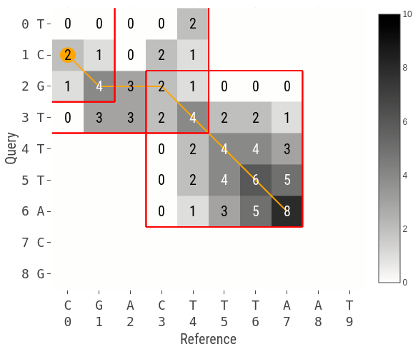
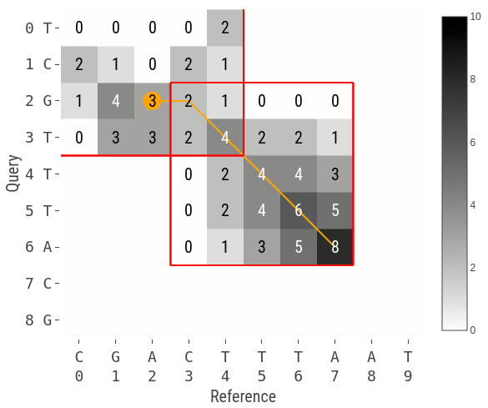

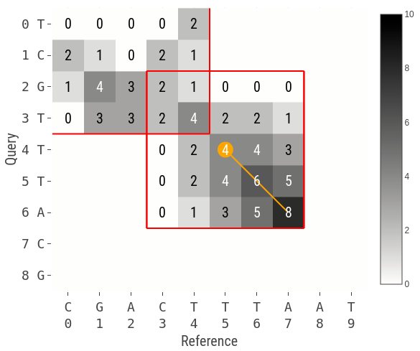
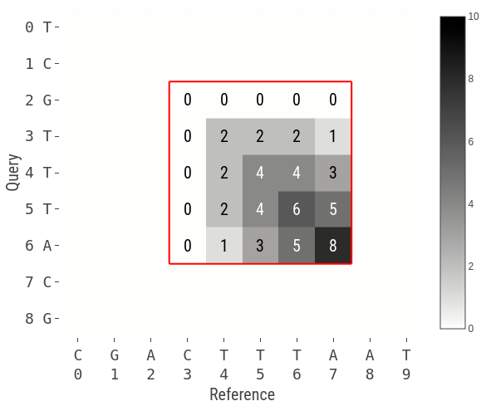
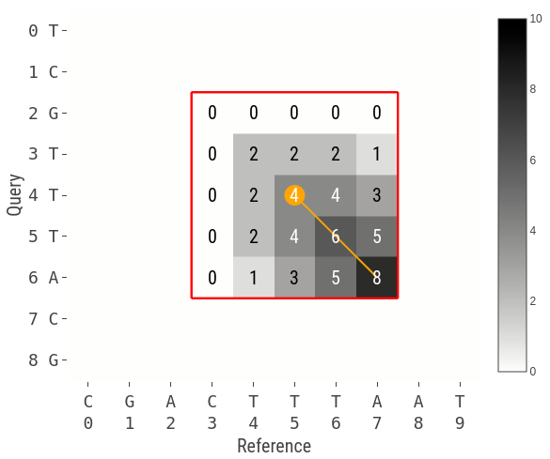
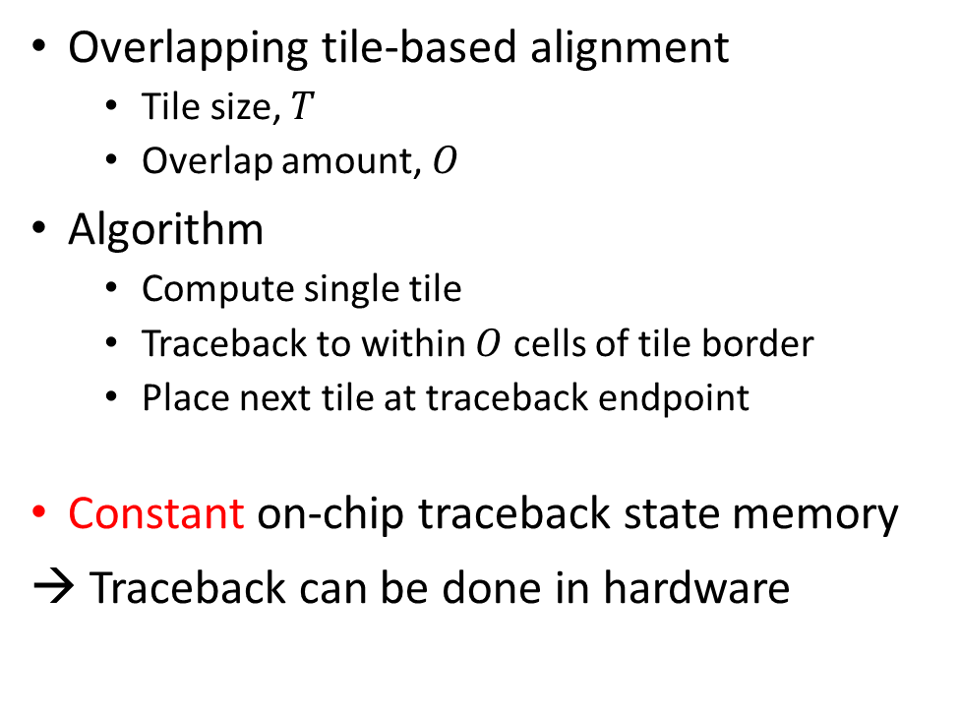

Heuristic hardware-friendly alignment GACT algorithm [1]
$$\left(T,O\right)=(5, 2)$$
Overlapping tile-based alignment
Tile size, $T$
Overlap amount, $O$
Algorithm
Compute single tile
Traceback to within $O$ cells of tile border
Place next tile at traceback endpoint
Constant on-chip traceback state memory
→ Traceback can be done in hardware
[1] Darwin: A Genomics Co-processor Provides Up to 15,000x Acceleration on Long Read Assembly [Turakhia, Bejerano, Dally], ASPLOS’18

Slide 10
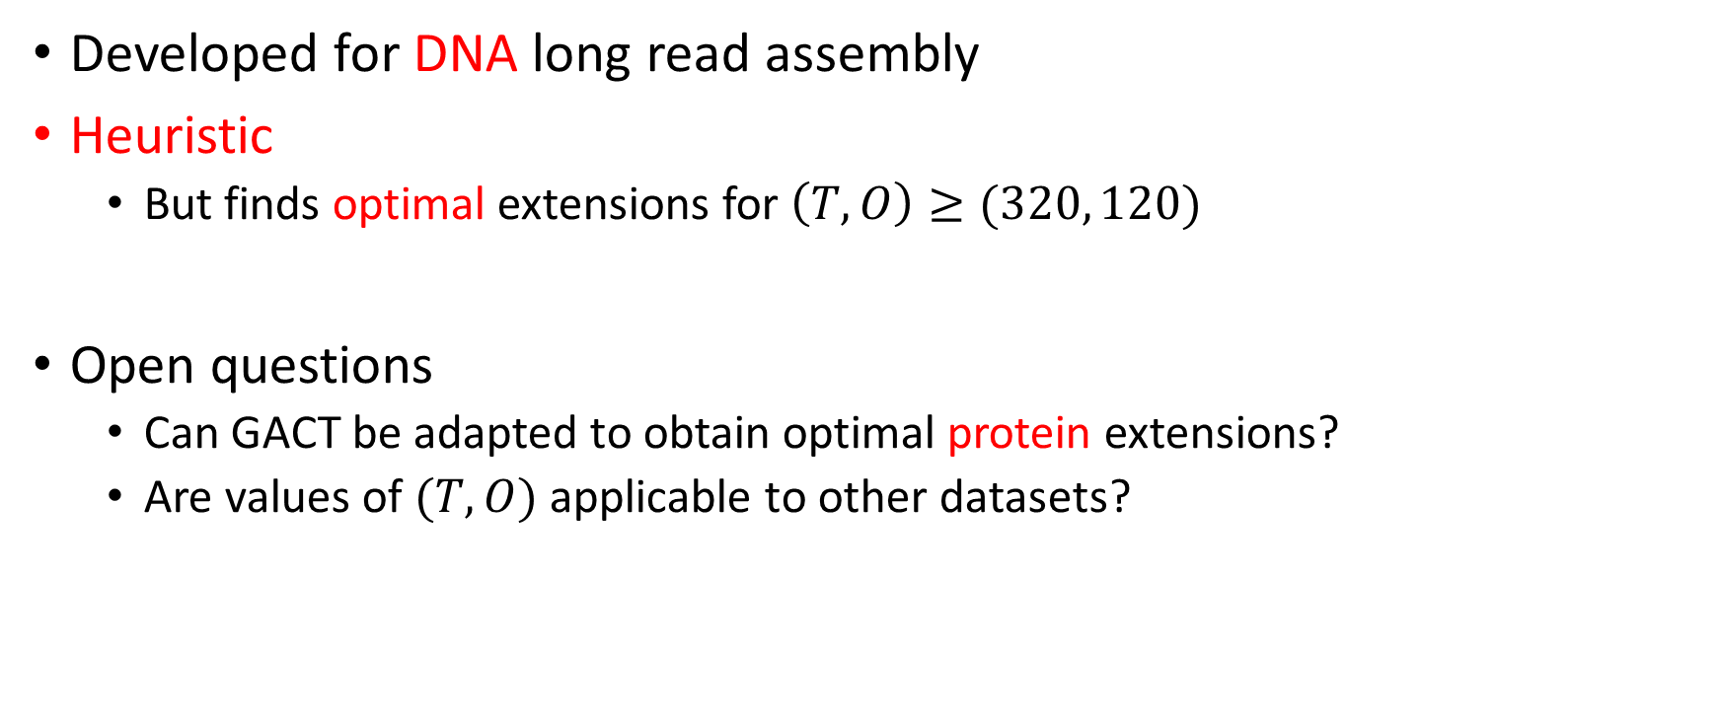
GACT performance
Developed for DNA long read assembly
Heuristic
But finds optimal extensions for $\left(T,O\right)≥(320, 120)$
Open questions
Can GACT be adapted to obtain optimal protein extensions?
Are values of $(T,O)$ applicable to other datasets?

Slide 11
Outline
Background (optimal vs. heuristic sequence alignment)
Hardware-friendly heuristic alignment for DNA sequences [1]
Adapting hardware-friendly heuristic alignment to protein sequences
Challenges around protein characteristics
Algorithmic alignment improvements
Quality of results & discussion
Future work
[1] Darwin: A Genomics Co-processor Provides Up to 15,000x Acceleration on Long Read Assembly [Turakhia, Bejerano, Dally], ASPLOS’18

Slide 12
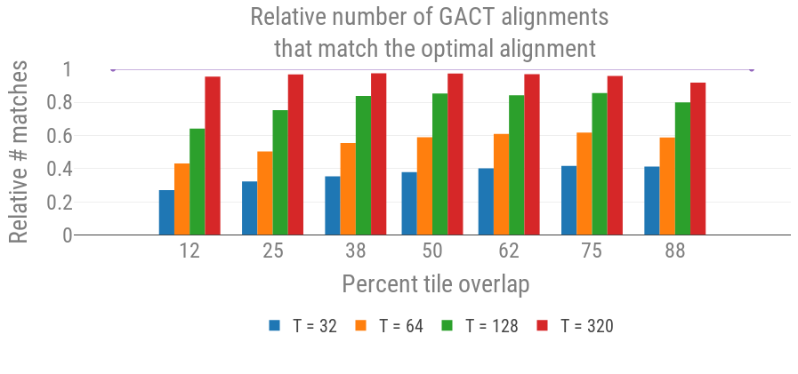
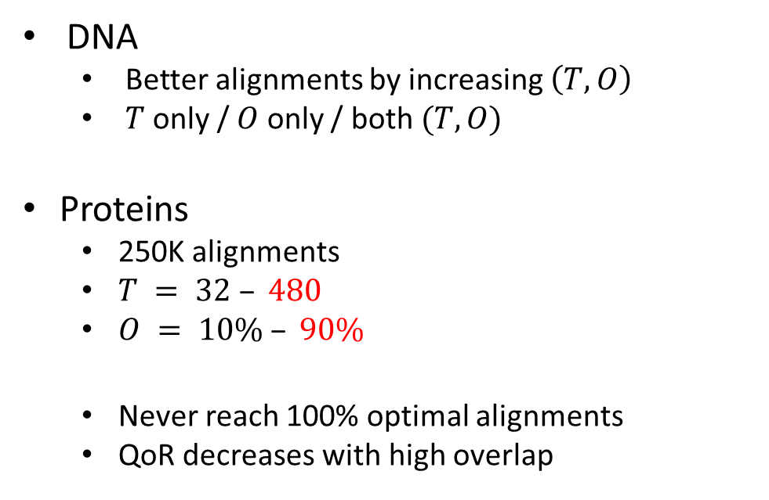
Design space exploration
DNA
Better alignments by increasing $\left(T,O\right)$
$T$ only / $O$ only / both $(T, O)$
Proteins
250K alignments
$T = 32 – 480$
$O = 10\% – 90\%$
Never reach 100% optimal alignments
QoR decreases with high overlap
Notes:
Only showing a subset of the results here for legibility and so we can see the data trends

Slide 13
Classifying GACT behavior
Obtains optimal alignment
Premature traceback termination
Sensitivity to GACT’s placement of current tile
Traceback divergence
Traceback in previous tile drives placement of current tile
Erroneous traceback in previous tile → current tile will be misplaced
Notes:
1) Traceback always matches the optimal traceback, but just termintes too early

Slide 14
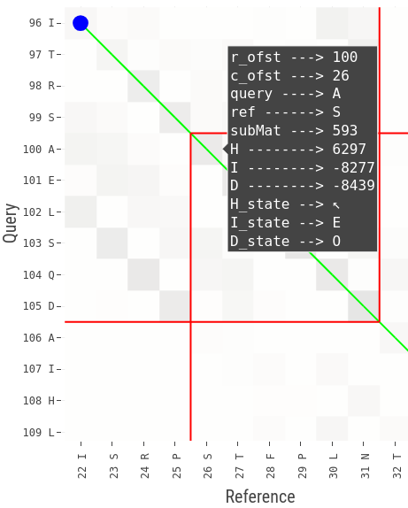
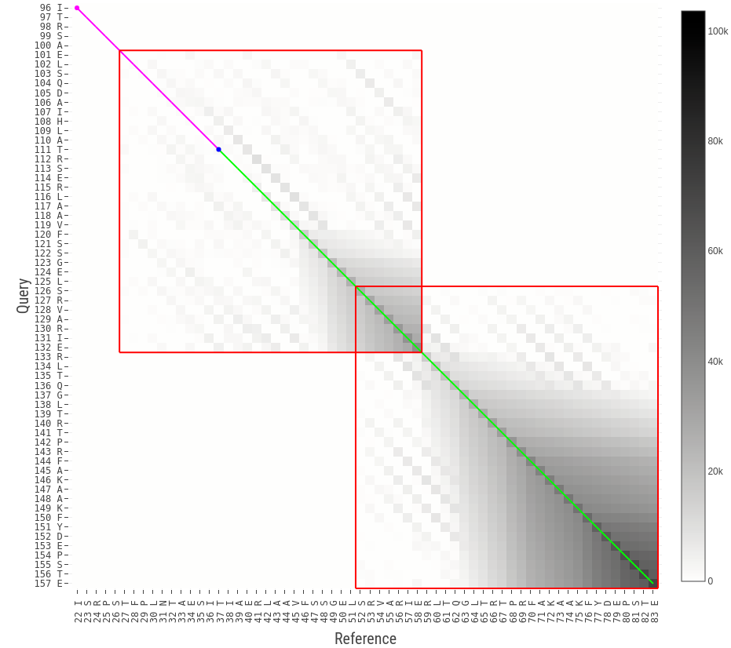
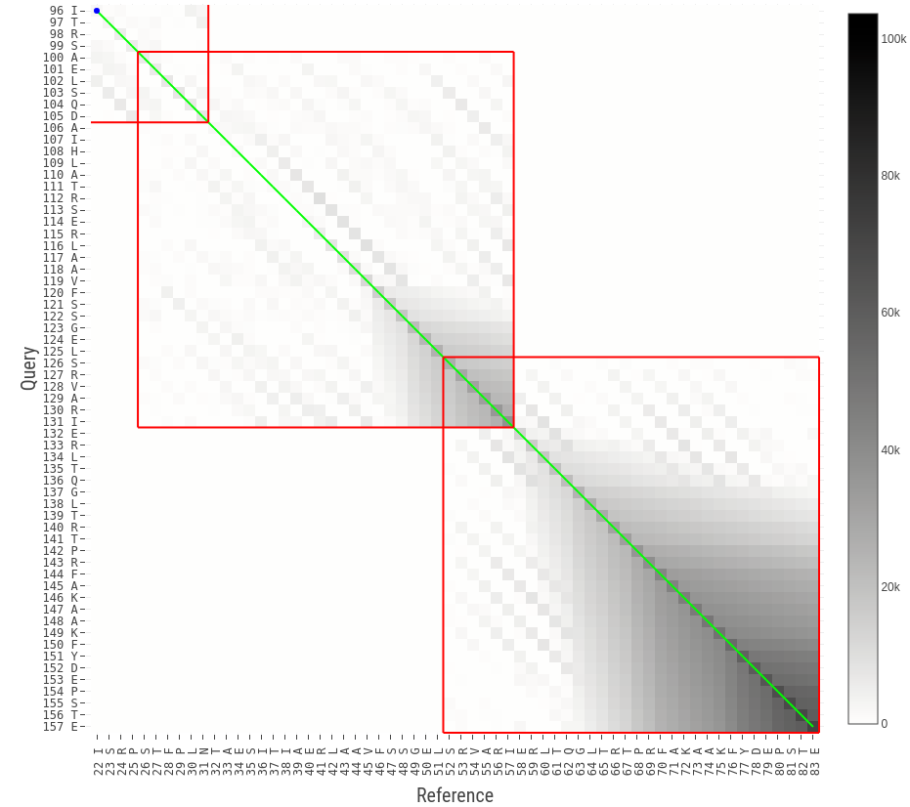



Premature traceback termination
$$(T,O)=(32, 7)$$
$$(T,O)=(32, 6)$$
Proteins are sensitive to tile placement
More tile overlap $≠$ better alignment
Occasionally results in worse alignments

Slide 15
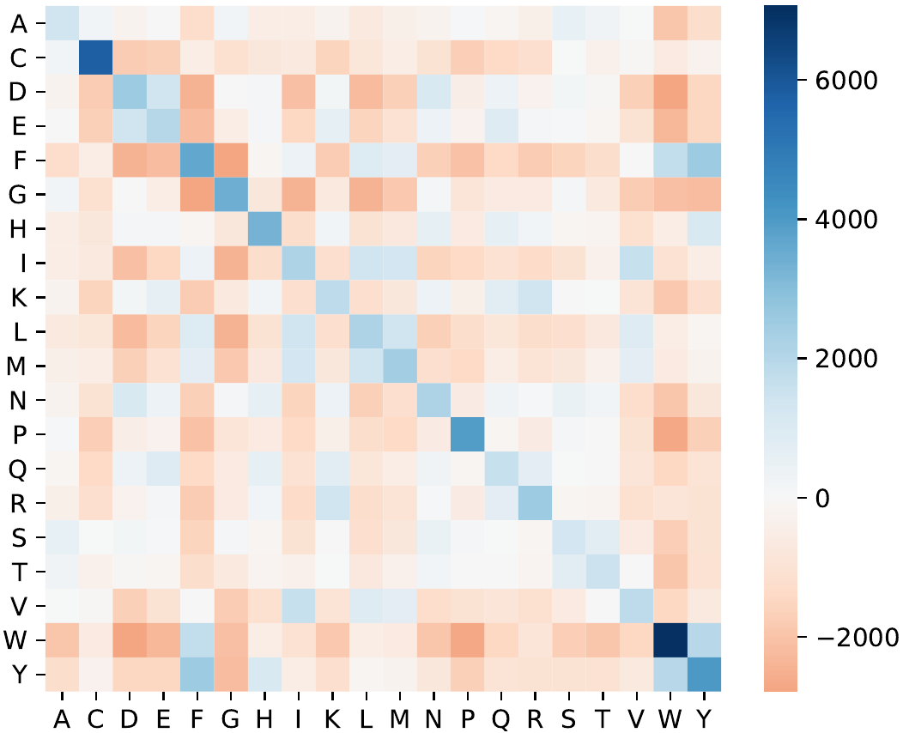
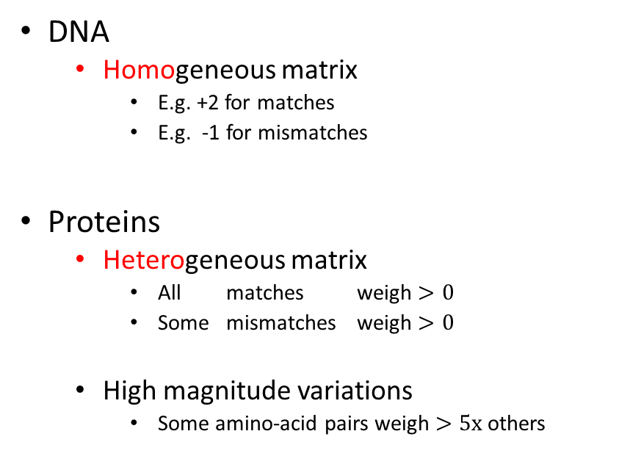
DNA vs. protein substitution matrices
A | 2 | -1 | -1 | -1
C | -1 | 2 | -1 | -1
G | -1 | -1 | 2 | -1
T | -1 | -1 | -1 | 2
 | A | C | G | T
DNA
Homogeneous matrix
E.g. +2 for matches
E.g. -1 for mismatches
Proteins
Heterogeneous matrix
All matches weigh $>0$
Some mismatches weigh $>0$
High magnitude variations
Some amino-acid pairs weigh $>5x$ others

Slide 16
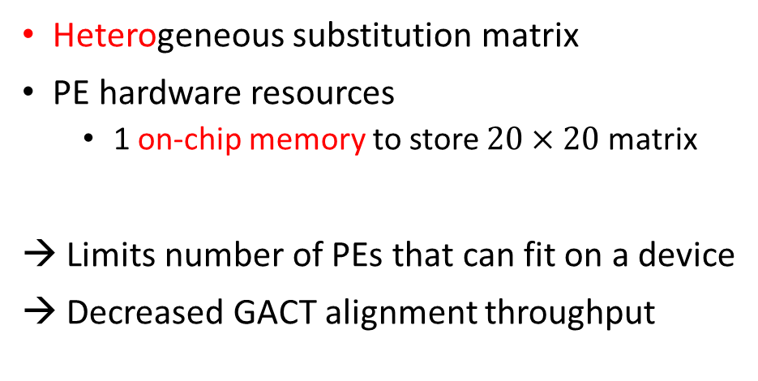
GACT hardware resource requirements
GACT can be efficiently implemented as a systolic array of Processing Elements (PE)
Each PE handles 1 cell in scoring matrix
DNA
Proteins
Homogeneous substitution matrix
PE hardware resources
1 comparator, 2 registers, 1 multiplexor
Large number of PEs can fit on a device
Increased GACT alignment throughput
Heterogeneous substitution matrix
PE hardware resources
1 on-chip memory to store $20×20$matrix
Limits number of PEs that can fit on a device
Decreased GACT alignment throughput
Notes:
There is not just 1 substitution matrix, so we can’t hard-code the matrix in our hardware design

Slide 17
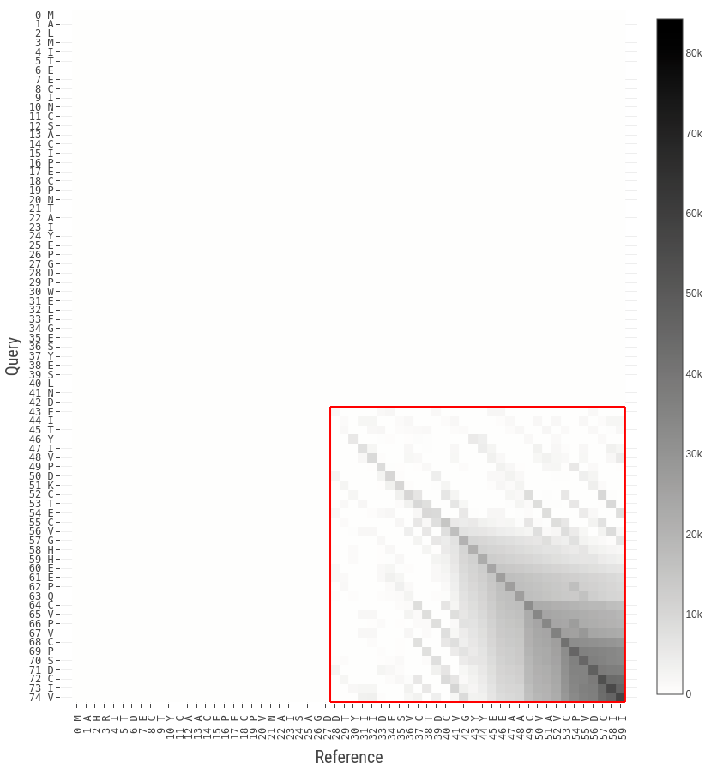
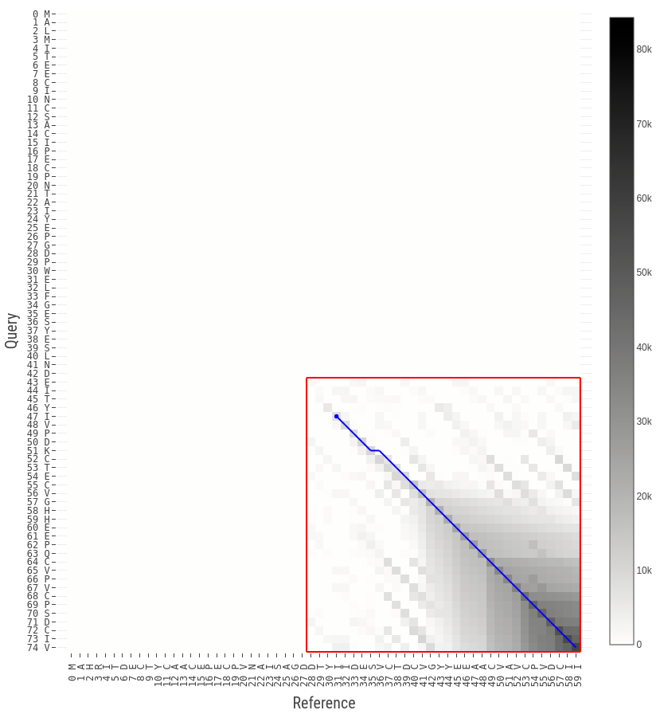
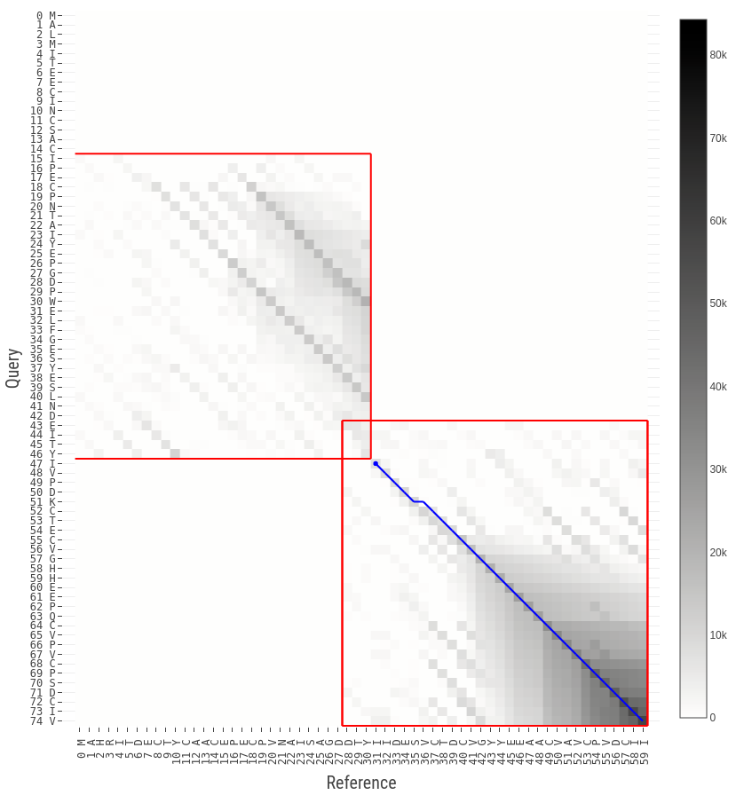
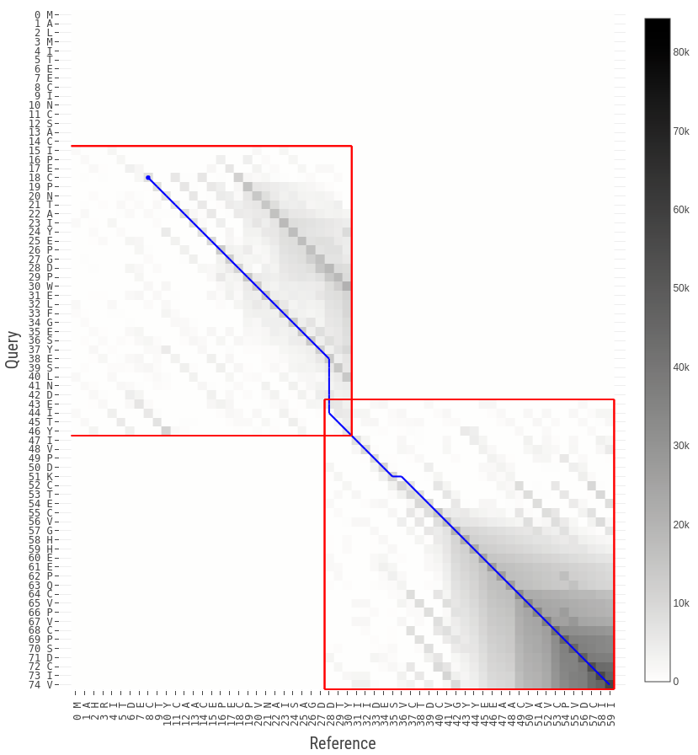
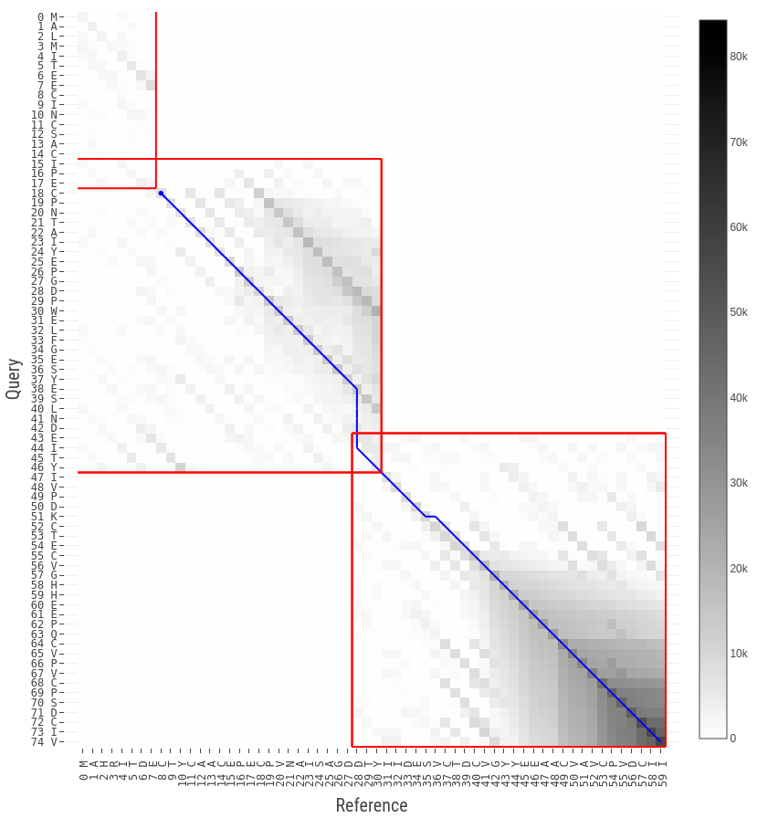

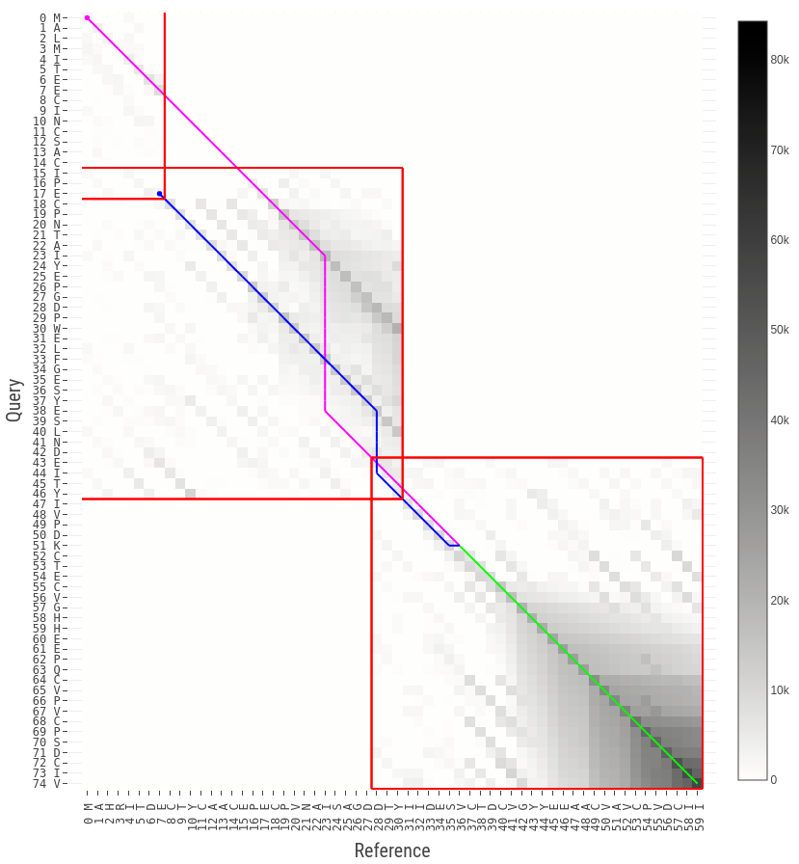

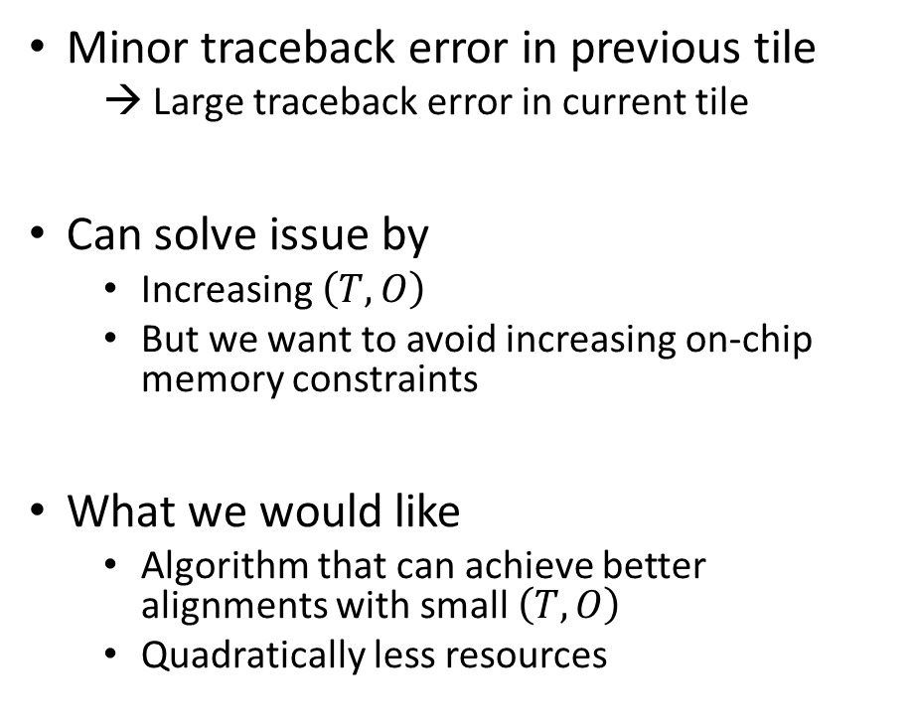
Traceback divergence
$$(T,O)=(32, 3)$$
Minor traceback error in previous tile
→ Large traceback error in current tile
Can solve issue by
Increasing $\left(T,O\right)$
But we want to avoid increasing on-chip memory constraints
What we would like
Algorithm that can achieve better alignments with small $\left(T,O\right)$
Quadratically less resources
Tile misplaced

Slide 18

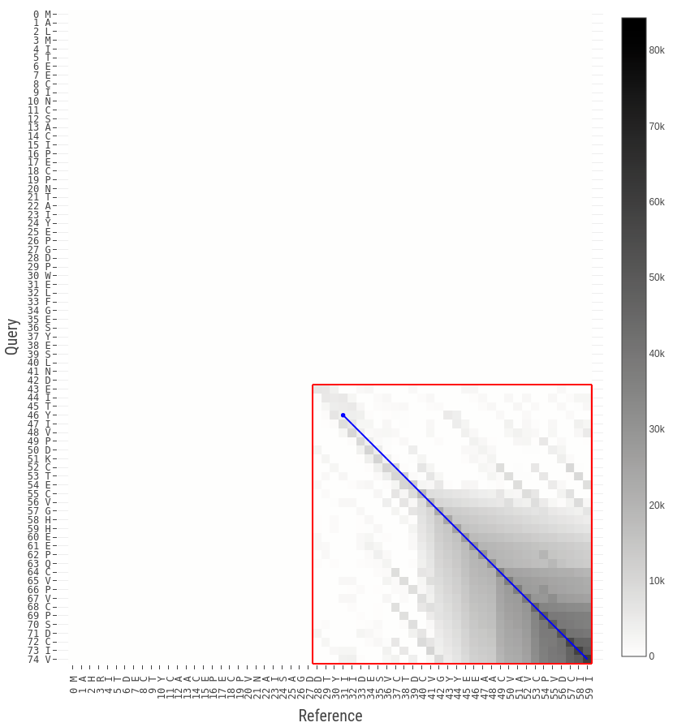

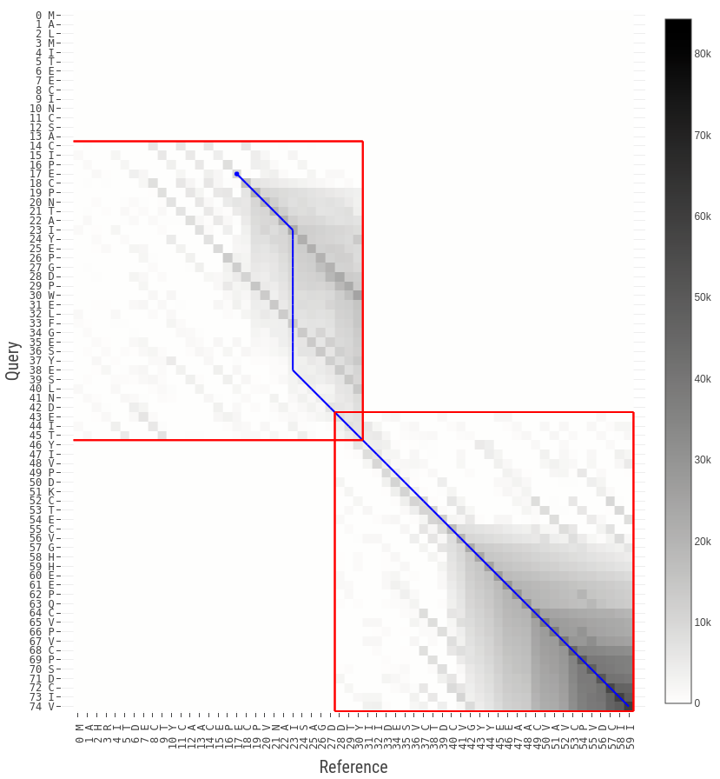
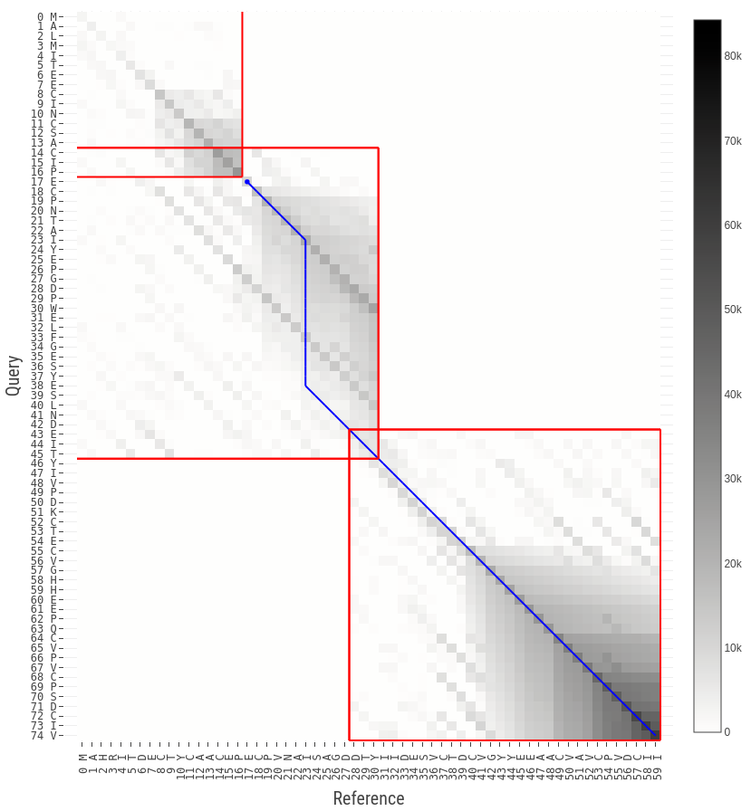
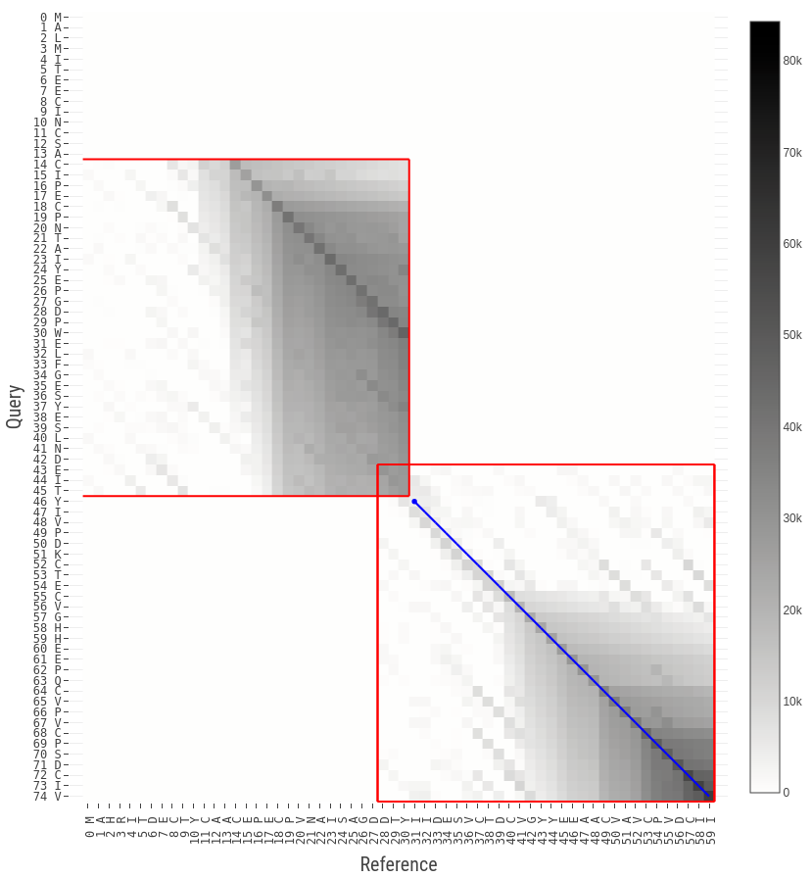
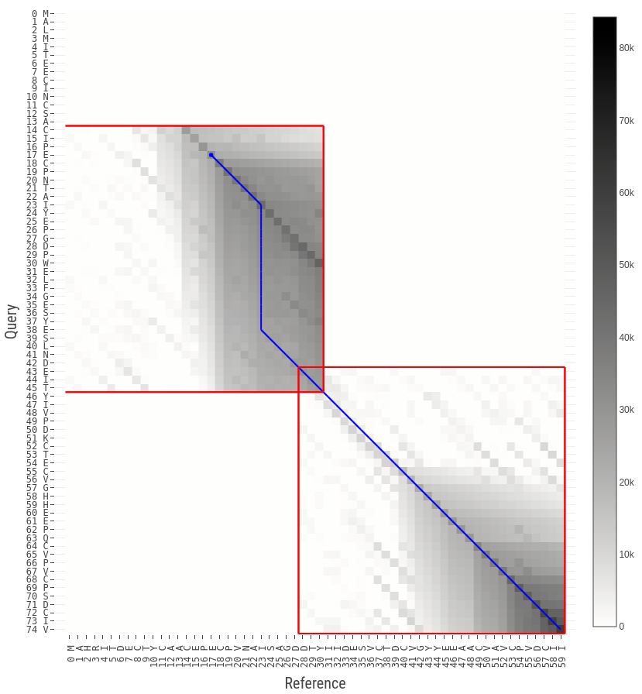
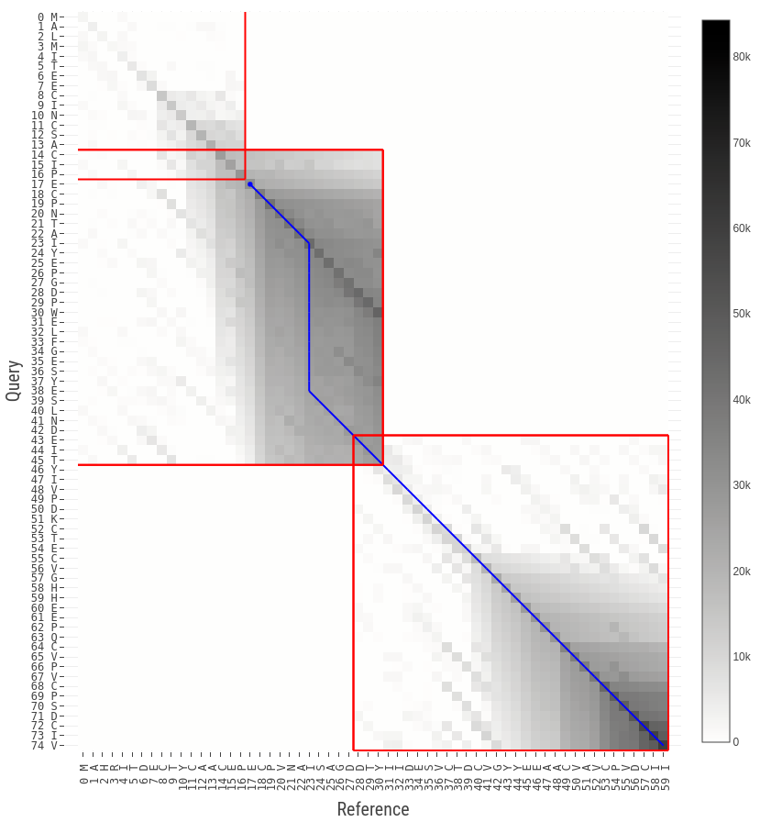
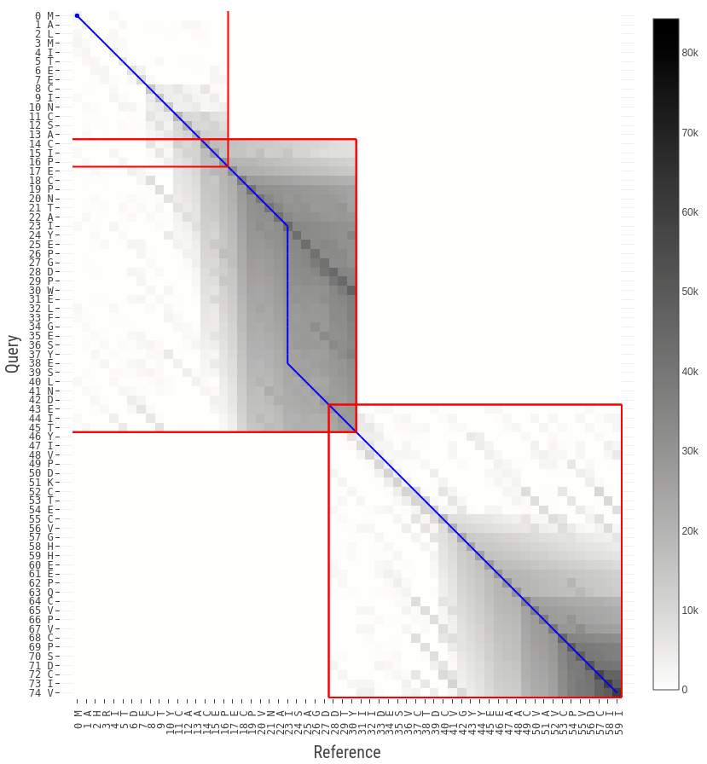
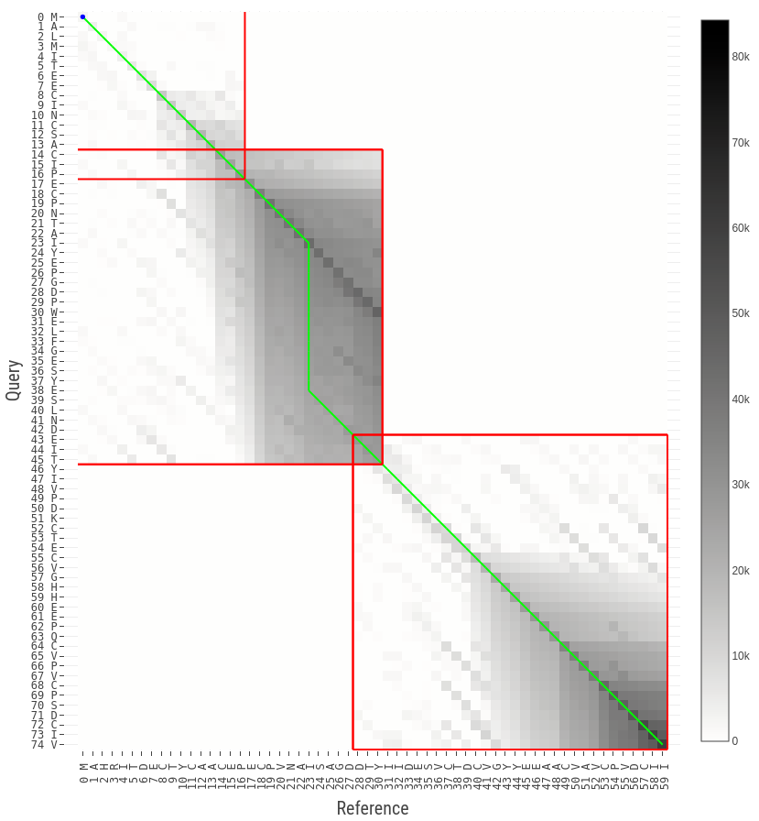
Improving the heuristic – Multi-pass GACT
Idea
Traceback drives placement of tiles
Increase confidence in previous tile’s traceback
Reduce probability of divergence in current tile
Multiple passes over 2 consecutive tiles
Compute tile 1
Traceback until border
Compute tentative tile 2
Recompute tile 1 (using elevated overlap region)
Final traceback of tile 1

Slide 19
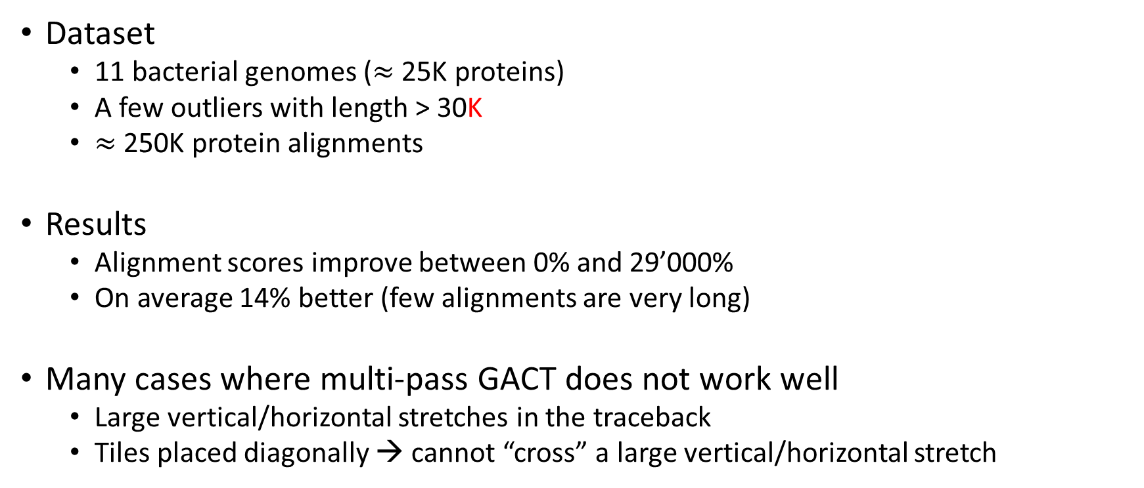
Quality of results & discussion
Dataset
11 bacterial genomes ($≈$ 25K proteins)
A few outliers with length > 30K
$≈$250K protein alignments
Results
Alignment scores improve between 0% and 29’000%
On average 14% better (few alignments are very long)
Many cases where multi-pass GACT does not work well
Large vertical/horizontal stretches in the traceback
Tiles placed diagonally → cannot “cross” a large vertical/horizontal stretch

Slide 20
Outline
Background (optimal vs. heuristic sequence alignment)
Hardware-friendly heuristic alignment for DNA sequences [1]
Adapting hardware-friendly heuristic alignment to protein sequences
Challenges around protein characteristics
Algorithmic alignment improvements
Quality of results & discussion
Future work
[1] Darwin: A Genomics Co-processor Provides Up to 15,000x Acceleration on Long Read Assembly [Turakhia, Bejerano, Dally], ASPLOS’18

Slide 21
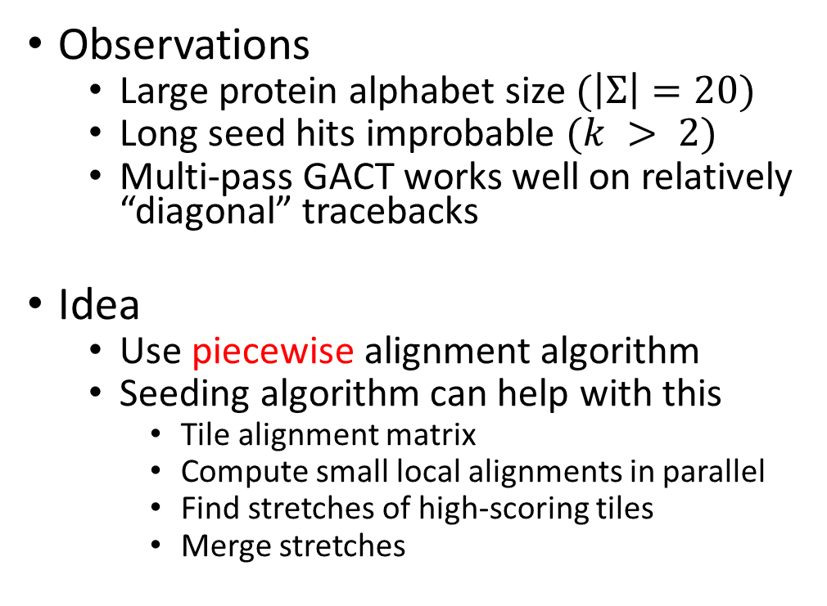
Seeding a protein-based heuristic aligner
Observations
Large protein alphabet size $(\left|Σ\right|=20)$
Long seed hits improbable $(k > 2)$
Multi-pass GACT works well on relatively “diagonal” tracebacks
Idea
Use piecewise alignment algorithm
Seeding algorithm can help with this
Tile alignment matrix
Compute small local alignments in parallel
Find stretches of high-scoring tiles
Merge stretches

Slide 22
Conclusion
Protein alignment is compute-intensive → hardware-acceleration
Long alignments (lengths span 4 orders of magnitude)
High on-chip memory resource requirements (large alphabet)
Skewed substitution matrices → existing heuristic aligners miss alignments
Proposed algorithmic improvements for a hardware-friendly aligner
Trades linearly more work for quadratically less resources
Increases protein sequence alignment scores
Avg. 14%
Max. 29000% (long proteins)

