Slide 1
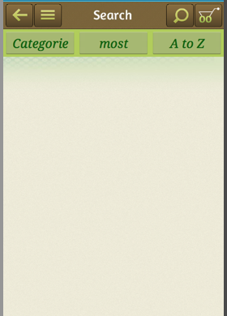
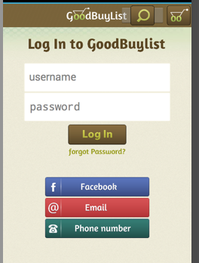
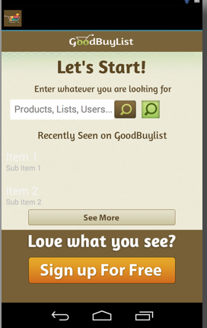
Search activity
activity_search.xml
Sign in activity
activity_sign_in.xml
Main activity
activity_main.xml
In activity_main.xml:
imageButton1 (see more) is to activity_sign_in.xml
imageButton2 (brown search button) is to activity_search.xml.
imageButton3(green search button) is to capture.xml (For barcode scaning)
imageButton4 (sign up for free) is to activity_sign_in.xml

Slide 2
Search activity
activity_search.xml
In activity_search.xml:
If the product exists, show the product.
Otherwise show products in three ways:
“Categories”, “most followed”, “A to Z”

Slide 3
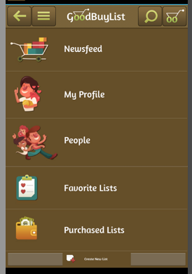
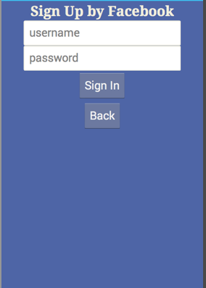
Sign in activity
activity_sign_in.xml
Sign in Done activity
activity_sign_in_done.xml
In activity_sign_in.xml:
If sign in success, go to activity_sign_in_done.xml.
Otherwise, stay in activity_sign_in.xml and show an error message.
Botton “Facebook” goes to activity_sign_facebook.xml
Facebook activity
activity_sign_facebook.xml

Slide 4
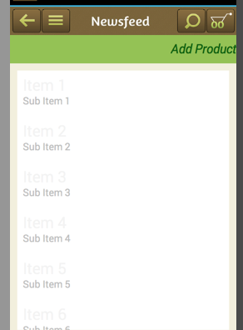
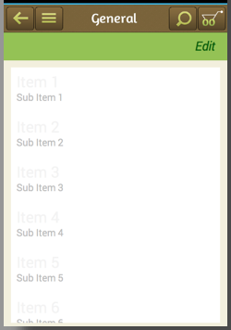
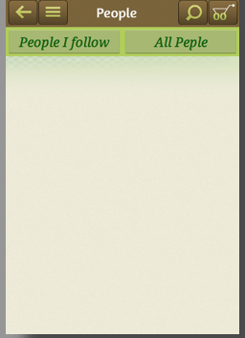
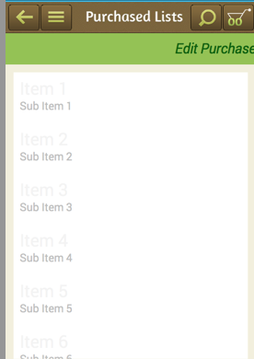
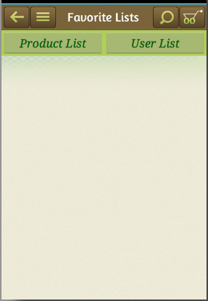
Newsfeed activity
Signin Done activity
User activity
Purchase activity
Favorite activity
People activity

