Slide 1
Latent Dirichlet Allocation (LDA) on ADS Summer Project
Tarun Ruchandani
Dr. Michael Kurtz
August 2016

Slide 2
Overview
Motivation
Data pipeline
What’s LDA?
Example
bag-of-words Assumption
L. D. A.
Document Similarity and Community Detection

Slide 3
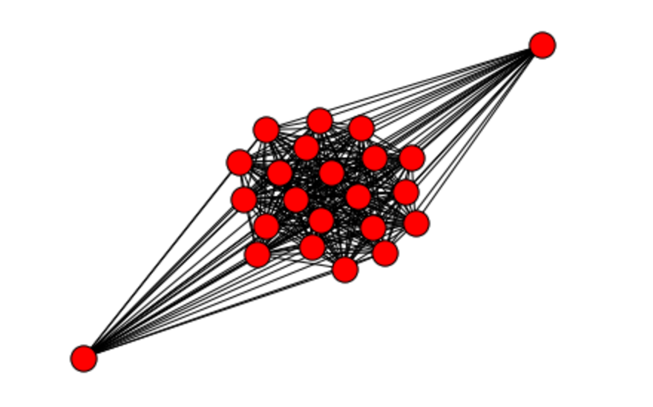
Motivation
Topic modeling
Understanding Ontology of Astrophysics

Slide 4
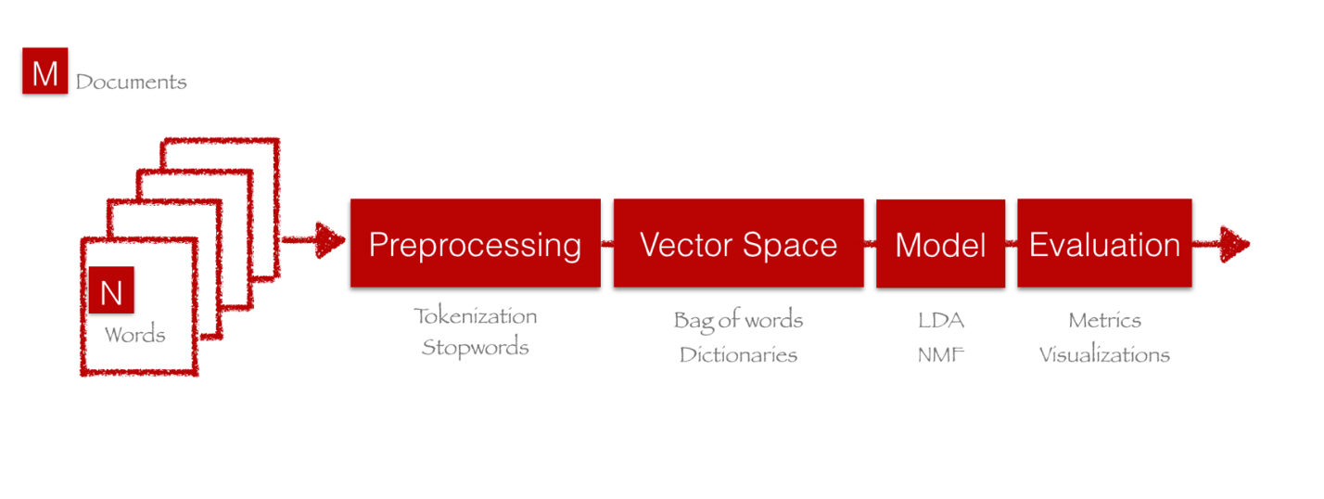
Data Pipeline
Perform preprocessing and vectorization in Spark

Slide 5
LDA
Line intensities measured on Mount Wilson coudé plates of 10 Lacertae provide data for an investigation of the atmosphere of this star by Unsold's method. From the Stark broadening of the hydrogen lines and the ionization equilibrium, the electron pressure, temperature, and surface gravity are estimated: log P~ = 2.80; effective temperature T = 29,600° K; and log g = 4.44. Within the large errors of the data, the relative abundances of helium, carbon, nitrogen, oxygen, neon, magnesium, and silicon turn out to be the same as in r Scorpii. The discrepancy in the computed neon to oxygen ratio between the planetary nebulae and the hot stars remains. Calculations of target areas for collisional excitation of for- bidden neon lines, on the one hand, and f-values for the permitted transitions observed in the stars, on the other, are necessary before this question can be clarified. In a discussion of the continuous spectrum it is shown that the need for a blanketing-effect correction of the type indicated by Unsold is almost eliminated if the mean value of the stellar absorption coefficient is computed in the manner suggested by Chandrasekhar

Slide 6
LDA
Decide on the number of words N the document will have (say, according to a Poisson distribution).
Choose a topic mixture for the document (according to a Dirichlet distribution over a fixed set of K topics). For example, assuming that we have the two topics: Physics and Chemistry above, you might choose the document to consist of 1/3 Physics and 2/3 Chemistry.
Generate each word w_i in the document by:
First picking a topic (according to the multinomial distribution that you sampled above; for example, you might pick the Physics with 1/3 probability and the Chemistry topic with 2/3 probability).
Using the topic to generate the word itself (according to the topic’s multinomial distribution). For example, if we selected the Physicstopic, we might generate the word “gravity” with 30% probability, “stars” with 15% probability, and so on.

Slide 7
Document Similarity
JS Divergence Matrix from LDA Document-Topic distribution
Given by:
JSD(P||Q) = 0.5*D(P||M) + 0.5*D(Q||M)
where M = 0.5*(P+Q),
and D(P||Q) is Kullback-Leibler Divergence given by:
D(P||Q) = sum over i [(P(i))*log(P(i)/Q(i))]
Similarity matrix constructed out of this divergence matrix by performing 1 – Dij (Dij being the JS Divergence measure between document i and j).
Build hash-table out of similarity matrix

Slide 8
Community Detection
1:1:1 0.0384615 "7" 6
1:1:2 0.0384615 "8" 7
1:1:3 0.0384615 "9" 8
- Each row begins with the multilevel module assignments of a node. The module assignments are colon separated from coarse to fine level, and all modules within each level are sorted by the total flow (PageRank) of the nodes they contain.
- Further, the integer after the last colon is the rank within the finest-level module, the decimal number is the amount of flow in that node, i.e. the steady state population of random walkers, the content within quotation marks is the node name, and finally, the last integer is the index of the node in the original network file.
Build hash-table out of similarity matrix

Slide 9
Thank you!

