Slide 1
Automated pet feeder
- Adam Cotter

Slide 2
Project Objectives
Automatically refilling pet feeder.
Graph food eaten.
Choose food amount.

Slide 3
Design
logWeight
controlMotor
bowlWeight
Refill
graphHabits
foodEaten

Slide 4
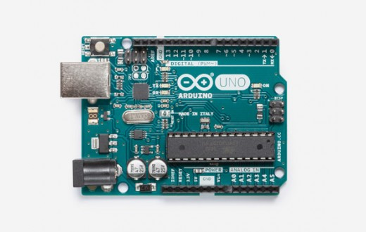

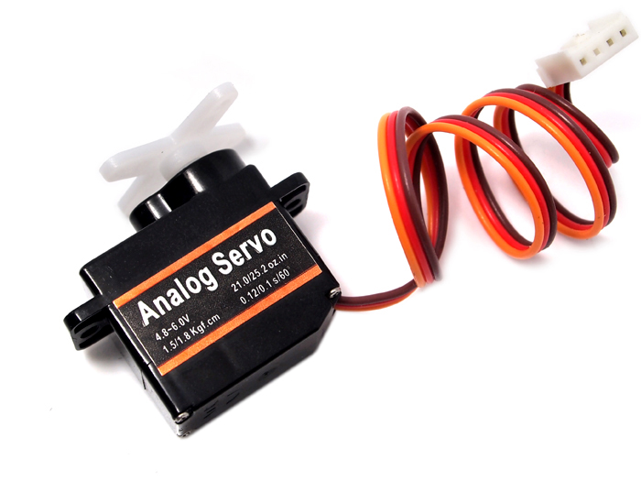
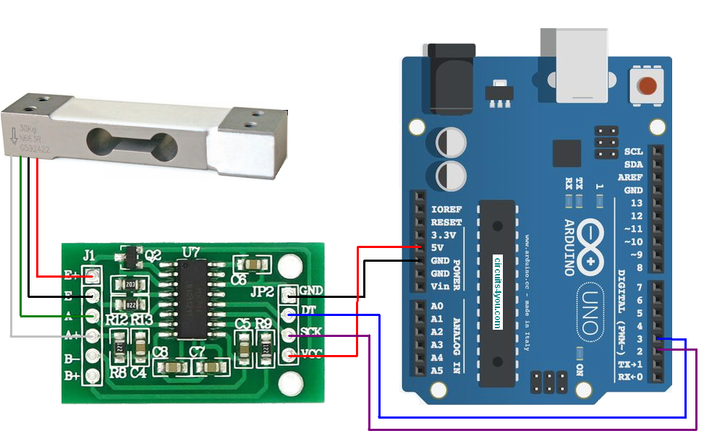
Technology
Arduino Uno
Arduino Programming Language
Servo Motor
Load Cell + HX711 Module

Slide 5
Problems
Inexperience with Arduino language
Dispenser design
Measuring weight

Slide 6
Things Learned
More familiar with Arduino/Microcontrollers
How to use Git and GitHub for source control
Project and time management

Slide 7

GitHub
https://github.com/aaccttrr/iotproject

