Slide 1



A CENTER FOR INTER-DISCIPLINARY RESEARCH
2018-19
TITLE
HOME AUTOMATION USING BOLT IOT
SUPERVISED BY
G.SNEHA REDDY
GOKARAJU RANGARAJU
INSTITUTE OF ENGINEERING AND TECHNOLOGY
AUTONOMOUS

Slide 2
Advanced Academic Center
( A Center for Inter-Disciplinary Research )
This is to certify that the project titled
“ ------------------------------------’’
is a bonafide work carried out by the following students in partial fulfilment of the requirements for Advanced Academic Center intern, submitted to the chair, AAC during the academic year _______________________.
HOME AUTOMATION USING BOLT
2019-20
NAME | ROLL NO. | BRANCH
A.SUMANTH | 18241A0564 | CSE B
K.VIGNESH | 18241A0581 | CSE B
P.RAJ KARAN | 18241A05A4 | CSE B
T.TEJA HARAVIND | 18241A05B5 | CSE B
This work was not submitted or published earlier for any study
Dr ./Ms./Mr.
G.Sneha Reddy
Dr.B.R.K.Reddy
Program Coordinator
Dr.Ramamurthy Suri
Associate Dean,AAC
Project Supervisor

Slide 3

ACKNOWLEDGEMENTS
We express our deep sense of gratitude to our respected Director , Gokaraju Rangaraju Institute of Engineering and Technology for permitting us to carry out this project and for the valuable guidance .
With immense pleasure, we express our deep sense of gratitude to our respected principal, for permitting us to carry out this project.
We are thankful to Associate Dean ,Advance Academic Centre for providing us appropriate ecosystem required to complete the project .
We are thankful to our project supervisor who spared valuable time and influenced novel ideas to guide us. We are indebted to all the above without whom we would not have completed the project.
We would like to thank our mentor/supervisor G.Sneha Reddy for sparing her valuable time with us, expert advice, encouragement and supportive guidance throughout this project.

Slide 4
• Authorization
TABLE OF CONTENTS
Authorisation
i
Acknowledgements
ii
Synopsis
iii
Abstract
iv
Summary
v
1.
Introduction
1
1.1 Nothing but a chip
1.2 Unbolting the Bolt Iot platform
1.3 A simple hotspot it is
1.4 Mobile applications in hours
1.5 Monitor and control from anywhere
1.6 So what is Bolt Iot?
1.7 Parameters
1
2
3
3
3
4
5
2.
Main text
6
2.1 Setting up the bolt Wi-Fi module
2.1.1 Things used in this project
2.2 Connections and Programs
2.2.1 Relay module
2.3 Sensors
2.4 Basic Working
2.4.1 Controlling Devices
2.5 Result
2.6 Advantages
6
6
7
7
8
9
10
11
12
3. Conclusion 13

Slide 5
SYNOPSIS
The main purpose of any IoT device is to connect with other IoT devices and applications (cloud-based mostly) to relay information using internet transfer protocols. The gap between the device sensors and the data network is filled by the IoT platform.
Bolt is an IoT platform to easily and quickly build products and services. Bolt comes with a Wi-Fi/GSM chip and a cloud platform which helps you connect your devices and sensors to the Internet. With Bolt Cloud you can control and monitor them over the internet, create personalised dashboards to visualise the data, monitor the device health, run machine learning algorithms and lot more.
Moreover Bolt Iot is cheaply available than Arduino and Raspberry Pi 3.
Arduino is available at a price of Rs 2500 (Mega variant), while Raspberry Pi 3 is available at a price point of Rs 2900 in India and Bolt IoT platform is available for the price of Rs 1750 in the developer’s package.

Slide 6
ABSTRACT
Bolt Iot is much better than Arduino and Raspberry Pi 3. This can be proved by comparing the three platforms with the following project:
“Detection of various gases in a chemical laboratory and recording the data in a highly precise manner along with the time stamp.”
Firstly, doing this project by using Arduino it results in a lot of voltage fluctuations, resulting to malfunctioning of the sensors because Arduino was unable to supply constant current to all the 3–5 sensors attached to it and moreover there is no onboard storage to store the data.
This time by using Raspberry Pi 3, there is no problem with the supply of voltage but the data stored in it must be collected after 3-4 days .This results in the loss of data for the time when the device was shutdown and also the data needed to be visualised in real-time and store that for the further analysis and development of the algorithm.
Finally using the Bolt IoT platform, things would have been very easy from the start, from storing the data to making it connect to the internet for real-time data collection to the data visualisation & AI predictions, Bolt offers a complete platform ready to be deployed.

Slide 7
SUMMARY
The main purpose of this project is to save electricity by using the Bolt Iot platform.
Using Bolt Iot there are so many projects to be done from these we have opted “Home Automation” which can be implemented in homes to save electricity by using a proximity sensor(movement detector).By using this sensor we can detect the movements of a person entering into the room and hence lights and fans are switched on automatically, also we can control this by using our smart phones connected to the same Wi-Fi which is connected to the Bolt chip.
Also there are two additional projects using Bolt those are “Light monitoring for plants” and “Temperature monitoring”.

Slide 8
INTRODUCTION
Over the past few years, the Internet of Things (IoT) has been an evolving trend for most startups. Also, many large and medium enterprises rely on IoT products for a coherent solution. But the fact is, the IoT is complex and there are endless problems while building an IoT product. According to Verizon’s report ‘State of Market: Internet of Things 2016,’ “Creating, implementing and managing IoT applications is a complex process involving sensors, mobile devices, secure network connectivity, storage, Big Data analytics, ability to scale new services, and on-going integration and fine-tuning. Most enterprises, regardless of size, do not have all of these capabilities and skills in-house to make the IoT a reality.” This proves to be a major drawback of IoT applications, which is why the IoT is still out of reach for many enterprises.
Nothing but a chip
To bridge the gap between the IoT and enterprises, Pranav Pai Vernekar and his team came up with Bolt IoT platform that provides hardware as well as the Cloud. Bolt enables enterprises and makers to build scalable IoT prototypes in a day’s time. Bolt’s small yet highly-functional prototyping board and its intuitive product-building experience help build prototypes at minimum cost and man hours.
Bolt takes care of analytics, visualisation, network connectivity, storage and scalability so that you, as a developer, can focus on the end application. Basically, it is a small chip that comes with a Wi-Fi module that lets you connect sensors and a Cloud platform to store and analyze data. Bolt’s Cloud platform helps you control and monitor your products over the Internet, create personalized dashboards to visualize data, monitor device health, send text messages and more.

Slide 9
Unbolting the Bolt IoT platform
Bolt offers a completely integrated approach. Hardware of Bolt consists of an ESP8266 chip, which is utilised for Wi-Fi communication and general-purpose input/output (GPIO) control, an SD card for local data storage and five-volt micro-USB charger connector for powering up the hardware unit.
It also has a power LED, a status LED to indicate hardware operation status and a Wi-Fi LED to indicate if the hardware is connected to Wi-Fi or not.
The Cloud is built using a Python based flask server and a message queuing telemetry transport (MQTT) backend to manage devices connected to the Cloud. The developed Cloud stack provides you with a dynamic dashboard using which you can control and monitor your devices over the Internet.
Unlike most other platforms, Bolt offers a hardware chip, Cloud, storage, analytics and visualisation in one integrated package. It also has an excellent partner developer network that provides you with full end-to-end IoT product or service development, which is often preferred by bigger companies.

Slide 10
A simple hotspot it is
The hardware unit starts a Wi-Fi hotspot when it is powered on, which is indicated by the blinking of a blue LED. You can connect to this hotspot using your mobile phone by entering the Wi-Fi credentials for the hardware unit you want to connect to. The device restarts and attempts to connect to the specific Wi-Fi network and, if successful, the blue LED light becomes stable. If not connected, the hardware continues to give out its own Wi-Fi hotspot for setup.
You can register the device to your account using the mobile phone app, after which the device is displayed on your Bolt Cloud dashboard. This gives you access to Control Panel, from where you can setup the device, Control/
Visualise page and the device icon, and so on. You can then proceed to the dashboard and click on the device icon and Control/Visualise it based on the type of the linked page.
Mobile applications in hours
Bolt enables you to develop mobile applications for multiple platforms within a few hours. It helps you build a customized user interface with simple scripting languages such as Hyper Text Markup Language/Cascading Style Sheets (HTML/CSS) and interface the GPIO pins using Bolt API. With Bolt’s patent-pending libdiscovery protocol, multiple Bolts can be controlled using a single application.
Monitor and control from anywhere
Bolt’s Cloud platform enables you to monitor and control devices from anywhere in the world. With user access management system built into Bolt’s secure Cloud platform, sharing dashboard is very easy. Cloud Control Panel provides you with features like receiving last alive time stamps, current state of the device, push over-the-air updates and more.
Pre-connected to Cloud. The real power of Bolt comes from its Cloud. Bolt hardware chip is pre-connected to Bolt Cloud, which lets you quickly deploy data visualisation and analytics. Bolt has an excellent data visualisation and analytics system because of its pre-built data visualisation service that converts data into useful intelligence and gives you actionable insights from your data. Bolt has simplified APIs that let you set up and manage devices with minimal effort.

Slide 11
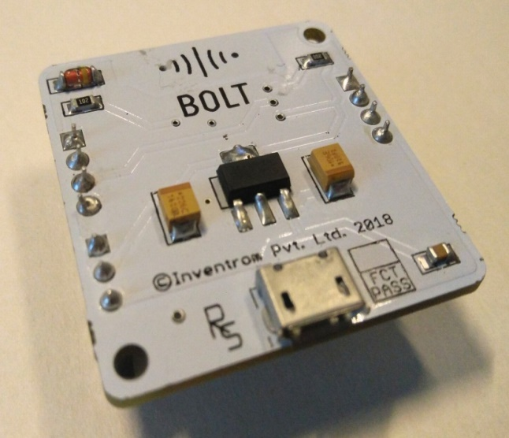
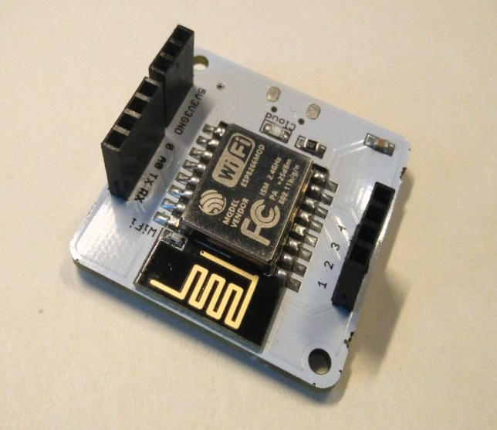
So what is Bolt IoT?
The Internet of Things (IoT) is nothing new, it has been with us for over a decade, but in this time we have seen the price of devices fall from hundreds of dollars to less than $10! The ESP8266 (and the newer ESP32) have really shaken the world of IoT from being pretty much a novelty industry (we all remember fridges that tweet and ovens that force us to accept an end user license agreement) into a citizen science revolution where sensors across the world are monitoring climate change, animal migration patterns and much more.
However, all of these good ideas need a power source and the ESP8266 has become the go-to board largely down to price, and not for its ease of use. But there are boards out there, based on the ESP8266, that offer an easy to use interface that we can use to program the board to do what we want!

Slide 12
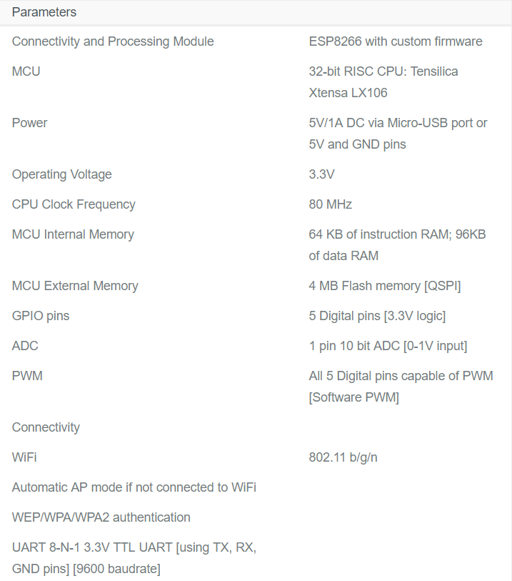

Slide 13
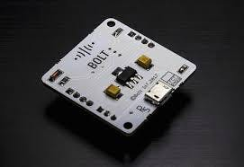
MAIN TEXT
Setting Up the Bolt Wi-Fi Module
Things used in this project
1.Bolt IoT Bolt Wi-Fi Module
2.Micro-USB to USB Cable (Generic) 3.Bolt IoT Bolt Cloud
4.Bolt IoT Android App
Firstly , to do any projects with bolt you need to create an account by signing up with your Gmail account.
To create a bolt iot account go to the website : https://cloud.boltiot.com/register/ and create your account.
Later go to docs and follow the procedure given under Setting up the Bolt Wi-Fi module heading.
After this step, you have to create the product and configure it(procedure under creating a new product) by giving an appropriate name.

Slide 14
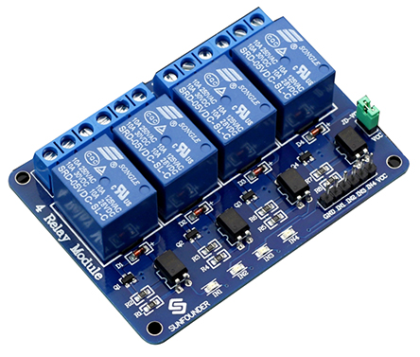
Connections and Program
Various I/O pins of Bolt Iot are connected to various devices.
The BOLT is programmed in a way to monitor and control the devices at the click of a button.
Make sure you have not powered on your Bolt Module while connecting the circuit. This will ensure that in case we make any mistake, it will not short circuit your device. Switch off the power if it is connected.
Connect the GND,VCC and INPUT pins of the Bolt to the respective pins of Proximity sensor with the help of jumper wires.
After linking it with the Bolt you can control the led with the help of your smart phone.
If you are interested to do the project by using motor or any output devices like bulb, you can do it by using relay module.
Relay module
A relay is an electrically operated switch. Many relays use an electromagnet to mechanically operate a switch, but other operating principles are also used, such as solid-state relays. A type of relay that can handle the high power required to directly control an electric motor or other loads is called a contactor.
Not only Home automation you can do various projects using Bolt like
Light Monitoring for Plants
Temperature Monitoring System

Slide 15
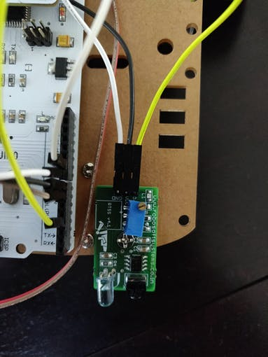
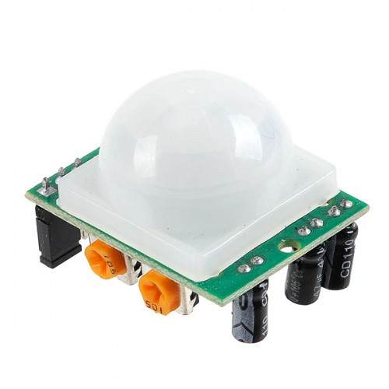
PROXIMITY SENSOR
A proximity sensor is a sensor able to detect the presence of nearby objects without any physical contact
Proximity sensor will sense the movement and it will send input to the Bolt Iot, and Bolt Iot send the output to LED or any other output devices.
PIR SENSOR
PIR Motion Detector Sensor Module. The Passive Infrared Sensor (PIR) sensor module is used for motion detection. It is often referred to used "PIR", "Pyro electric", "Passive Infrared" and "IR Motion" sensor. The module has an on-board pyro electric sensor, conditioning circuitry and a dome shaped Fresnel lens. It is used to sense movement of people, animals, or other objects. They are commonly used in burglar alarms and automatically-activated lighting systems.

Slide 16
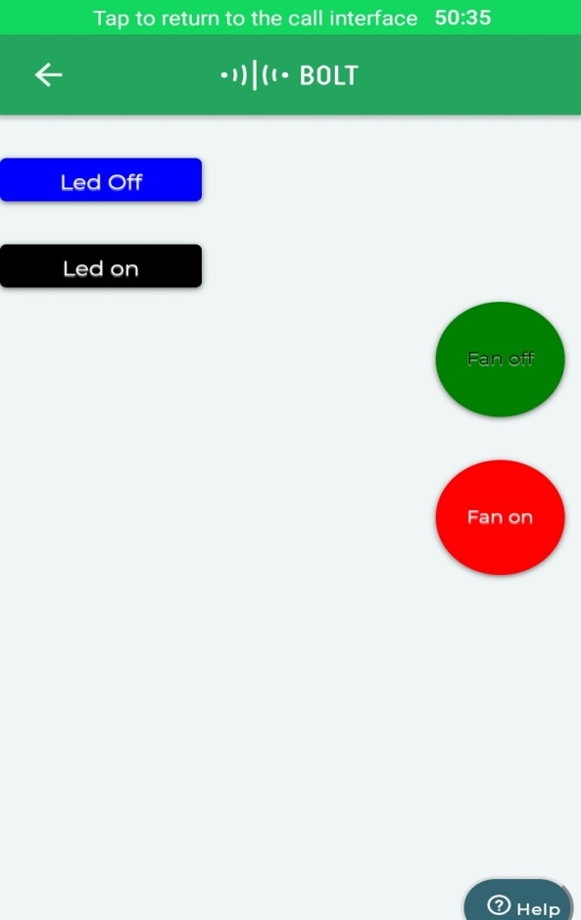
Basic Working
The proximity sensor is fitted near the door of the room. It senses any movement and displays a message if there is movement and switches on the room light. After a person leaves the room, the proximity sensor automatically switches off the room light.
Other devices like the TV, AC and Fan can be turned on or off by clicking the "ON" and "OFF" buttons displayed on the web page.

Slide 17
Controlling devices :
You can control your devices by just writing few lines of code :
var dual =dualButton("left");
dual.first_button({name:“BULB1 OFF", action:"digitalWrite",
pin:“1", value:"LOW", bgcolor:"blue",
shape:"rectangle", text_color:"white"})
dual.second_button({name:“BULB2 ON", action:"digitalWrite",
pin:“1", value:"HIGH", bgcolor:"black",
shape:"rectangle", text_color:"white"})
var dual2 =dualButton("right");
dual2.first_button({name:“BULB2 OFF", action:“digitalWrite",
pin:“2", value:“LOW", bgcolor:“Ornage",
shape:"circle", text_color:"black"})
dual2.second_button({name:“BULB2 ON", action:“digitalWrite",
pin:“2", value:“HIGH", bgcolor:“PURPLE",
shape:"circle", text_color:"White"})

Slide 18
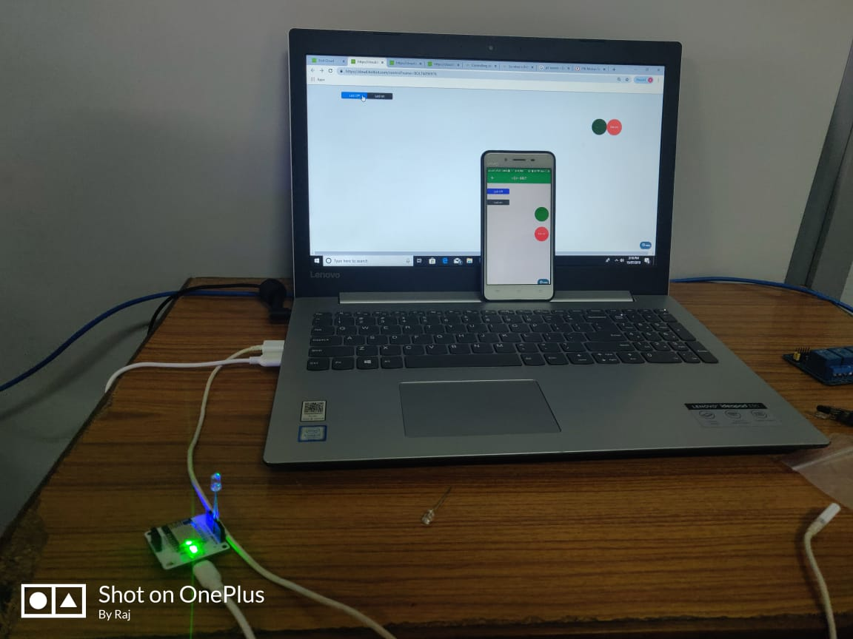
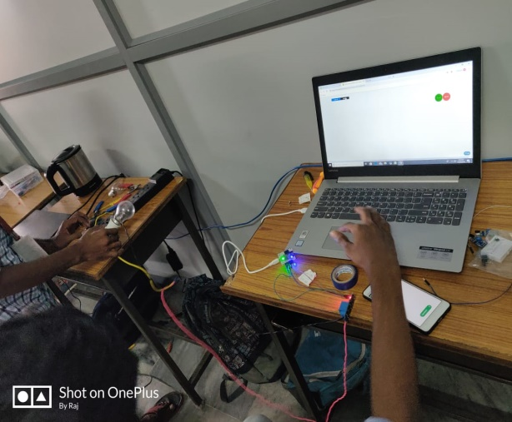
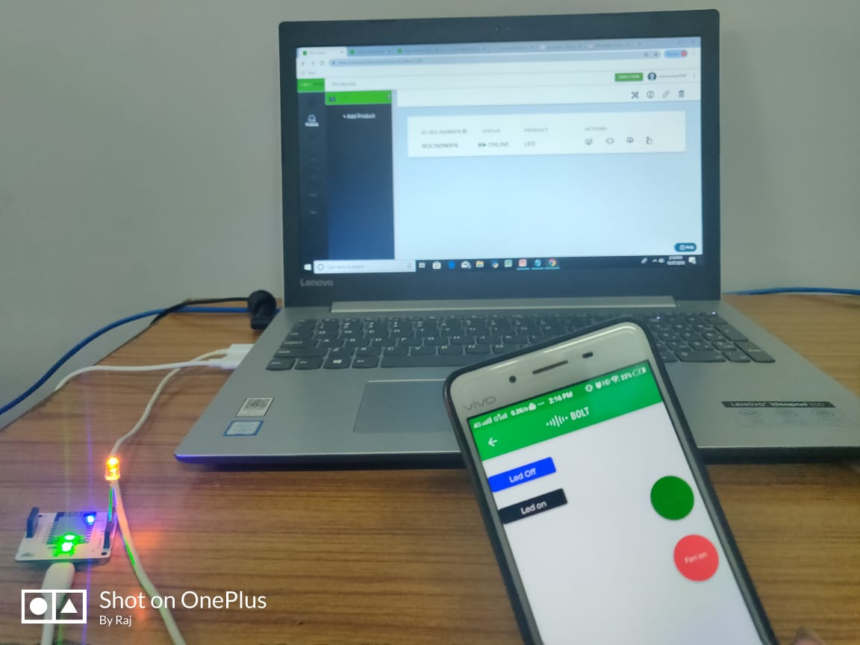
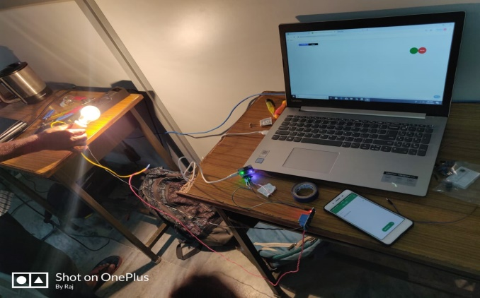
RESULT
Using Bolt App in mobile
Using Web Site

Slide 19
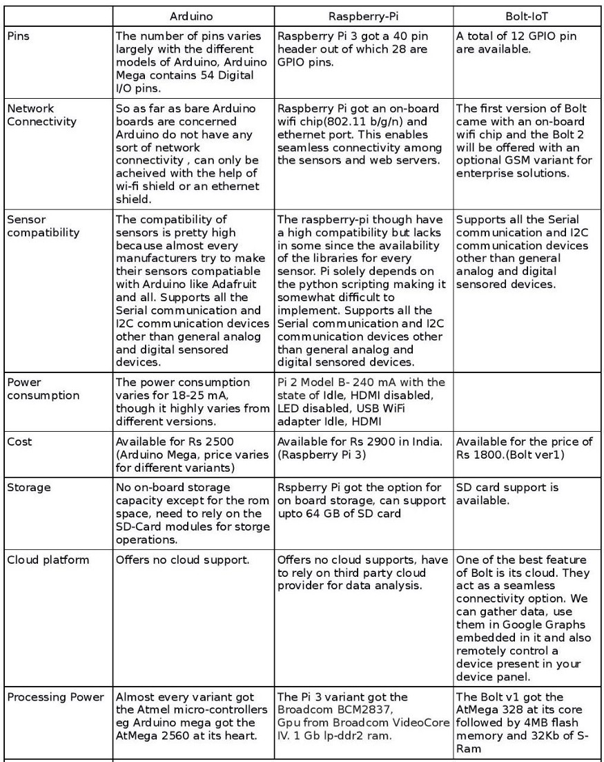
Advantages of Bolt Iot over Arduino and Raspberry Pi 3

Slide 20
CONCLUSION
Through this project we have concluded that we can control electrical application which are used in our home like fan, light, AC, remote etc. through Bolt interface.
There are so many ways to control this appliances. We have chose three among them :
Through the link(https://cloud.boltiot.com/remote/01ee6c14-e676-4e12-bb99-bc6226030791/digitalWrite?pin=0&state=HIGH&deviceName=BOLT6096976); i.e., Home Automation Using Bolt Iot.
Through Google assistant.
Proximity sensor.
At last we have concluded that in place of aurdino we can use Bolt Iot Platform which is available at low cost and also has better applications equal to aurdino and raspberry pi. It also have the on-board storage capacity with SD card support. One of the best feature of Bolt is its cloud.

