Slide 1
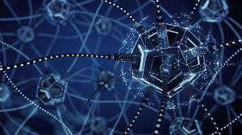
Image classification using python

Slide 2
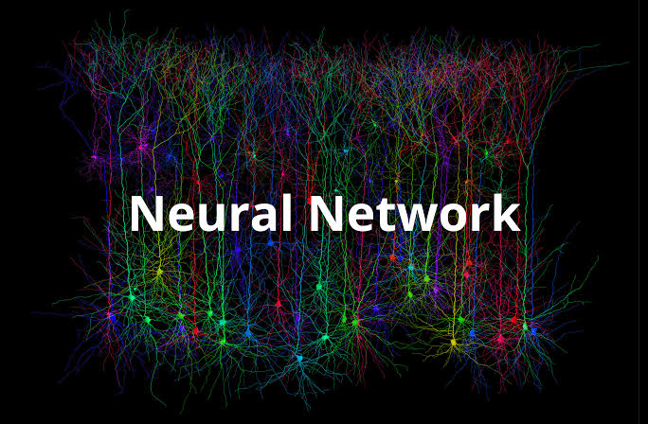
A NEURAL NETWORK IS A SERIES OF ALGORITHMS THAT ENDEAVORS TO
RECOGNIZE UNDERLYING RELATIONSHIPS IN A SET OF DATA THROUGH A
PROCESS THAT MIMICS THE WAY THE HUMAN BRAIN OPERATES.

Slide 3
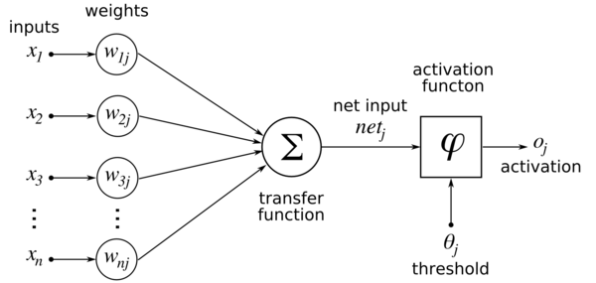
ARTIFICAL NEURAL NETWORK

Slide 4
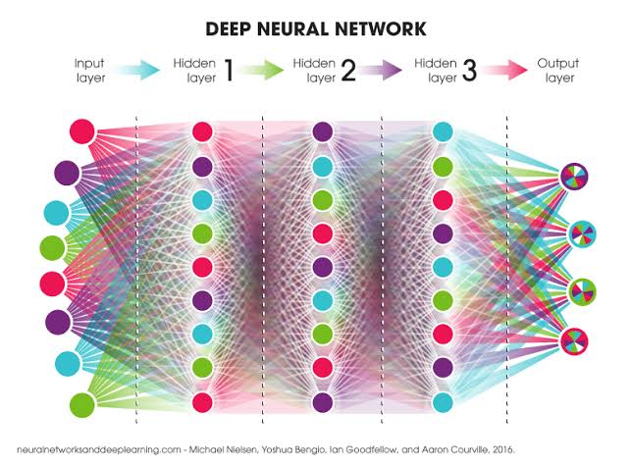

Slide 5
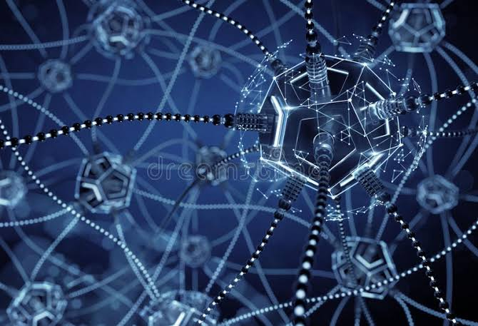
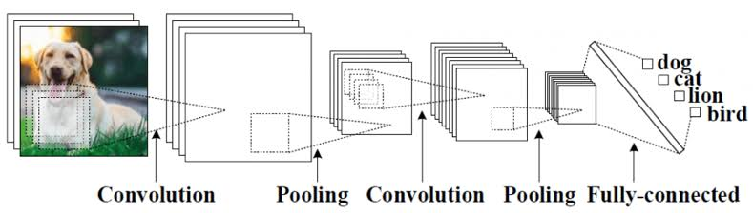
CONVOLUTION NEURAL NETWORK
In deep learning, a convolutional neural network (CNN, or ConvNet) is a
class of deep neural networks, most commonly applied to analyzing visual
imagery.
Layers in CNN:
Convolution
Pooling
Flattening
Fully-connected

Slide 6
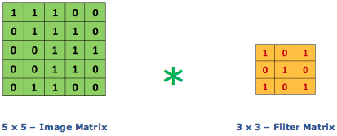
CONVOLUTION LAYER

Slide 7
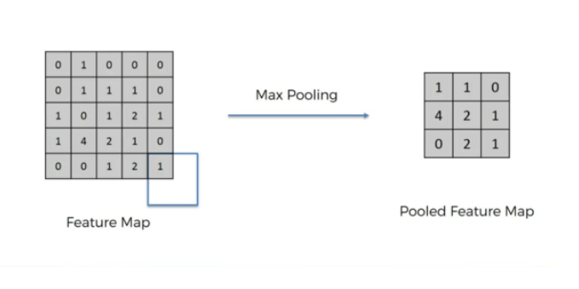
POOLING LAYER

Slide 8
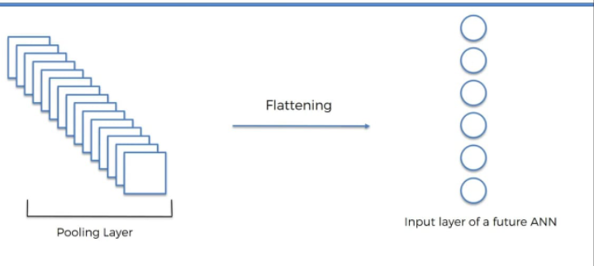
FLATTENING LAYER

Slide 9
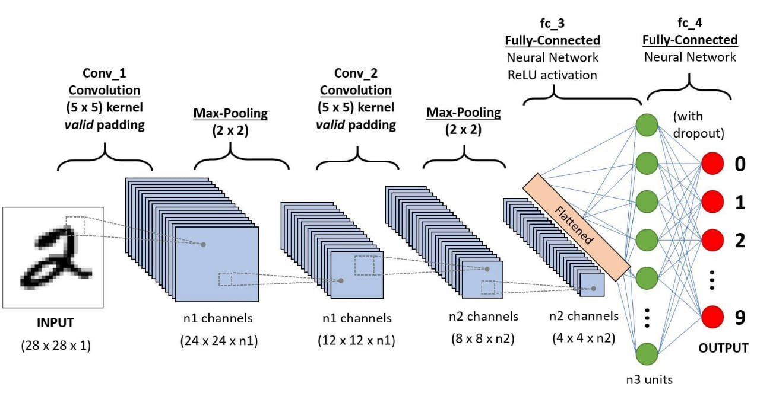
COMPLETE CNN ARCHITECTURE

Slide 10
APPLICATIONS
Computerized photography (e.g., Photoshop)
• Space image processing (e.g., Hubble space telescope images, interplanetary probe images)
• Medical/Biological image processing (e.g., interpretation of X-ray images, blood/cellular microscope images)
• Automatic character recognition (zip code, license plate recognition)
• Google lens.
• Remote sensing: aerial and satellite image interpretations

Slide 11
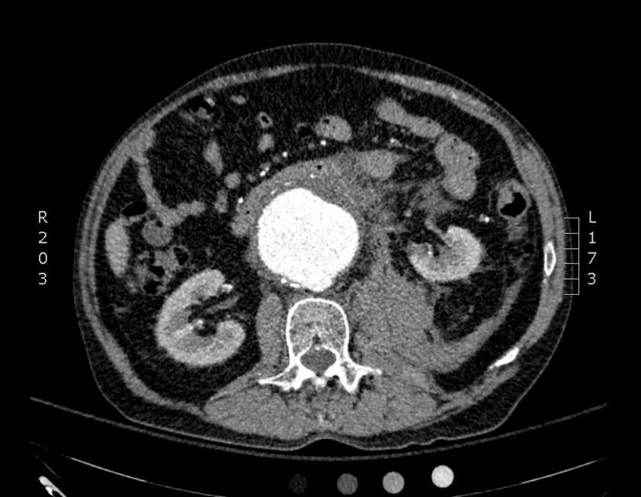

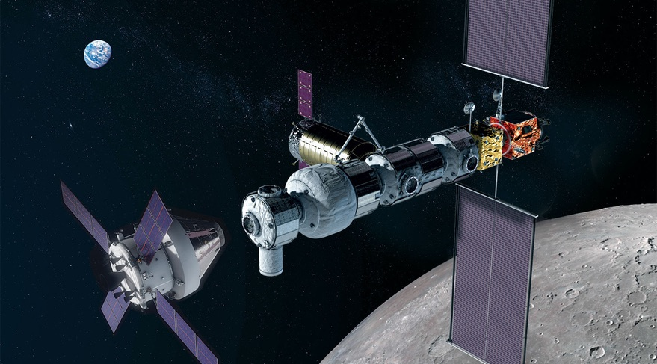

Slide 12


